Slide 1
Principles of
Operating Systems
Lecture 5 - CPU Scheduling
Prof. Erick Fredj
erick.fredj@gmail.com

Slide 2
Outline
Scheduling Objectives
Levels of Scheduling
Scheduling Criteria
Scheduling Algorithms
    FCFS, Shortest Job First, Priority, Round Robin, Multilevel
Multiple Processor Scheduling
Real-time Scheduling
Algorithm Evaluation

Slide 3
Scheduling Objectives
Enforcement of fairness
      in allocating resources to processes
Enforcement of priorities
Make best use of available system resources
Give preference to processes holding key resources.
Give preference to processes exhibiting good behavior.
Degrade gracefully under heavy loads.

Slide 4
Program Behavior Issues
I/O boundedness
    short burst of CPU before blocking for I/O
CPU boundedness
    extensive use of CPU before blocking for I/O
Urgency and Priorities
Frequency of preemption
Process execution time
Time sharing
    amount of execution time process has already received.

Slide 5
Basic Concepts
Maximum CPU utilization obtained with multiprogramming.
CPU-I/O Burst Cycle
    Process execution consists of a cycle of CPU execution and I/O wait.

Slide 6
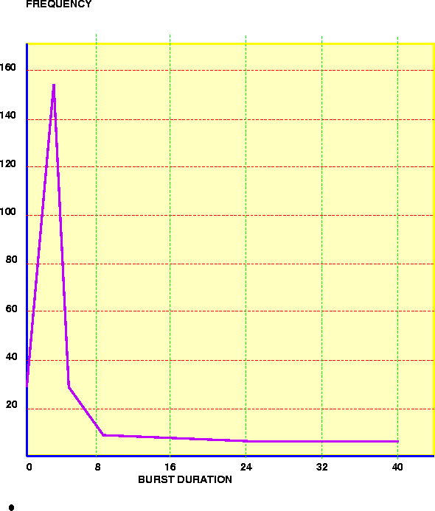
CPU Burst Distribution

Slide 7
Levels of Scheduling
High Level Scheduling or Job Scheduling
    Selects jobs allowed to compete for CPU and other system resources.
Intermediate Level Scheduling or Medium Term Scheduling
    Selects which jobs to temporarily suspend/resume to smooth fluctuations in system load.
Low Level (CPU) Scheduling or Dispatching
    Selects the ready process that will be assigned the CPU.
    Ready Queue contains PCBs of processes.

Slide 8
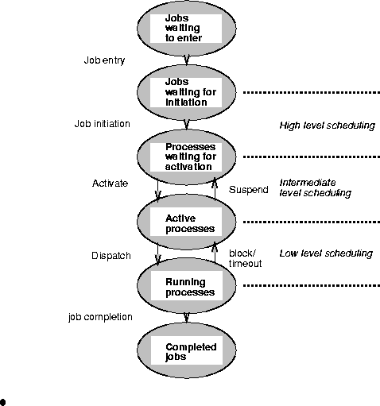
Levels of Scheduling(cont.)

Slide 9
CPU Scheduler
Selects from among the processes in memory that are ready to execute, and allocates the CPU to one of them.
  Non-preemptive Scheduling
    Once CPU has been allocated to a process, the process keeps the CPU until
      Process exits OR
      Process switches to waiting state
  Preemptive Scheduling
    Process can be interrupted and must release the CPU.
      Need to coordinate access to shared data

Slide 10
CPU Scheduling Decisions
CPU scheduling decisions may take place when a process:
      switches from running state to waiting state
      switches from running state to ready state
      switches from waiting to ready
      terminates
Scheduling under 1 and 4 is non-preemptive.
All other scheduling is preemptive.

Slide 11
CPU scheduling decisions
new
admitted
exit
terminated
interrupt
ready
running
I/O or
event
completion
Scheduler
dispatch
I/O or
event wait
waiting

Slide 12
Dispatcher
Dispatcher module gives control of the CPU to the process selected by the short-term scheduler. This involves:
      switching context
      switching to user mode
      jumping to the proper location in the user program to restart that program
Dispatch Latency:
    time it takes for the dispatcher to stop one process and start another running.
    Dispatcher must be fast.

Slide 13
Scheduling Criteria
CPU Utilization
    Keep the CPU and other resources as busy as possible
Throughput
    # of processes that complete their execution per time unit.
Turnaround time
    amount of time to execute a particular process from its entry time.

Slide 14
Scheduling Criteria (cont.)
Waiting time
    amount of time a process has been waiting in the ready queue.
Response Time (in a time-sharing environment)
    amount of time it takes from when a request was submitted until the first response is produced, NOT output.

Slide 15
Optimization Criteria
Max CPU Utilization
Max Throughput
Min Turnaround time
Min Waiting time
Min response time

Slide 16
First Come First Serve (FCFS) Scheduling
Policy: Process that requests the CPU FIRST is allocated the CPU FIRST.
  FCFS is a non-preemptive algorithm.
Implementation - using FIFO queues
      incoming process is added to the tail of the queue.
      Process selected for execution is taken from head of queue.

Slide 17
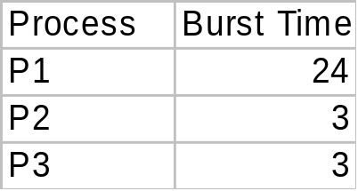
First-Come, First-Served(FCFS) Scheduling
Example
Suppose the arrival order for the processes is
    P1, P2, P3
Waiting time
    P1 = 0;
    P2 = 24;
    P3 = 27;
Average waiting time
    (0+24+27)/3 = 17
Gantt Chart for Schedule
P1
P2
P3
0
24
27
30

Slide 18
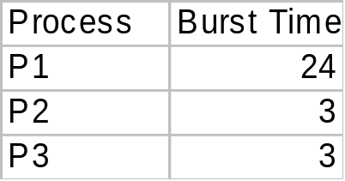
FCFS Scheduling (cont.)
Example
Suppose the arrival order for the processes is
    P2, P3, P1
Waiting time
    P1 = 6; P2 = 0; P3 = 3;
Average waiting time
    (6+0+3)/3 = 3 , better..
Convoy Effect:
      short process behind long process.
Gantt Chart for Schedule
P2
P3
P1
0
3
6
30

Slide 19
Shortest-Job-First(SJF) Scheduling
  Associate with each process the length of its next CPU burst. Use these lengths to schedule the process with the shortest time.
  Two Schemes:
    Scheme 1: Non-preemptive
      Once CPU is given to the process it cannot be preempted until it completes its CPU burst.
    Scheme 2: Preemptive
      If a new CPU process arrives with CPU burst length less than remaining time of current executing process, preempt. Also called Shortest-Remaining-Time-First (SRTF).
    SJF is optimal - gives minimum average waiting time for a given set of processes.

Slide 20
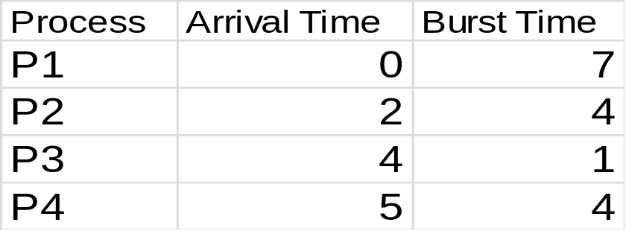
Non-Preemptive SJF Scheduling
Example
Gantt Chart for Schedule
P1
P3
P2
P4
0
7
8
12
16
Average waiting time =
(0+6+3+7)/4 = 4

Slide 21
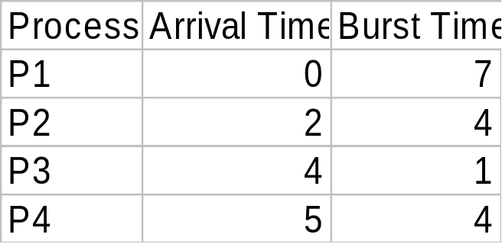
Preemptive SJF Scheduling(SRTF)
Example
Gantt Chart for Schedule
P1
P2
P3
P2
P4
P1
0
2
4
5
7
11
16
Average waiting time =
(9+1+0+2)/4 = 3

Slide 22
Determining Length of Next CPU Burst
One can only estimate the length of burst.
Use the length of previous CPU bursts and perform exponential averaging.
    tn = actual length of n-th burst
    τn+1 =predicted value for the next CPU burst
    α = 0, 0 ≤ α ≤ 1
    Define
      τn+1 = α tn + (1- α) τn

Slide 23
Exponential Averaging(cont.)
α = 0
    τn+1 = τn; Recent history does not count
α= 1
    τn+1 = tn; Only the actual last CPU burst counts.
Similarly, expanding the formula:
    τn+1 = αtn + (1-α) αtn-1 + …+ (1-α)^j αtn-j + … (1-α)^(n+1) τ0
      Each successive term has less weight than its predecessor.
j

Slide 24
Priority Scheduling
A priority value (integer) is associated with each process. Can be based on
      Cost to user
      Importance to user
      Aging
      %CPU time used in last X hours.
CPU is allocated to process with the highest priority.
    Preemptive
    Nonpreemptive

Slide 25
Priority Scheduling (cont.)
SJN is a priority scheme where the priority is the predicted next CPU burst time.
Problem
    Starvation!! - Low priority processes may never execute.
Solution
    Aging - as time progresses increase the priority of the process.

Slide 26
Round Robin (RR)
Each process gets a small unit of CPU time
      Time quantum usually 10-100 milliseconds.
      After this time has elapsed, the process is preempted and added to the end of the ready queue.
    n processes, time quantum = q
      Each process gets 1/n CPU time in chunks of at most q time units at a time.
      No process waits more than (n-1)q time units.
      Performance
        Time slice q too large - FIFO behavior
        Time slice q too small - Overhead of context switch is too expensive.
        Heuristic - 70-80% of jobs block within timeslice

Slide 27
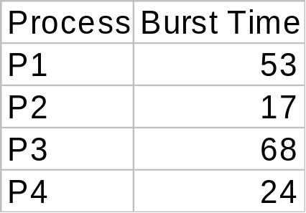
Round Robin Example
Time Quantum = 20
Gantt Chart for Schedule
P1
P2
P3
P4
P1
P3
P4
P1
P3
P3
0
20
37
57
77
97
117
121
134
154
162
Typically, higher average turnaround time than SRTF, but better response

Slide 28
Multilevel Queue
Ready Queue partitioned into separate queues
      Example: system processes, foreground (interactive), background (batch), student processes….
Each queue has its own scheduling algorithm
      Example: foreground (RR), background(FCFS)
Processes assigned to one queue permanently.
Scheduling must be done between the queues
      Fixed priority - serve all from foreground, then from background. Possibility of starvation.
      Time slice - Each queue gets some CPU time that it schedules - e.g. 80% foreground(RR), 20% background (FCFS)

Slide 29
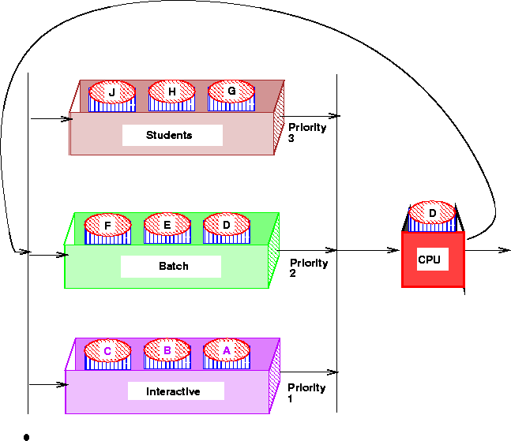
Multilevel Queues

Slide 30
Multilevel Feedback Queue
Multilevel Queue with priorities
A process can move between the queues.
      Aging can be implemented this way.
Parameters for a multilevel feedback queue scheduler:
      number of queues.
      scheduling algorithm for each queue.
      method used to determine when to upgrade a process.
      method used to determine when to demote a process.
      method used to determine which queue a process will enter when that process needs service.

Slide 31
Multilevel Feedback Queues
Example: Three Queues -
      Q0 - time quantum 8 milliseconds (RR)
      Q1 - time quantum 16 milliseconds (RR)
      Q2 - FCFS
Scheduling
      New job enters Q0 - When it gains CPU, it receives 8 milliseconds. If job does not finish, move it to Q1.
      At Q1, when job gains CPU, it receives 16 more milliseconds. If job does not complete, it is preempted and moved to queue Q2.

Slide 32
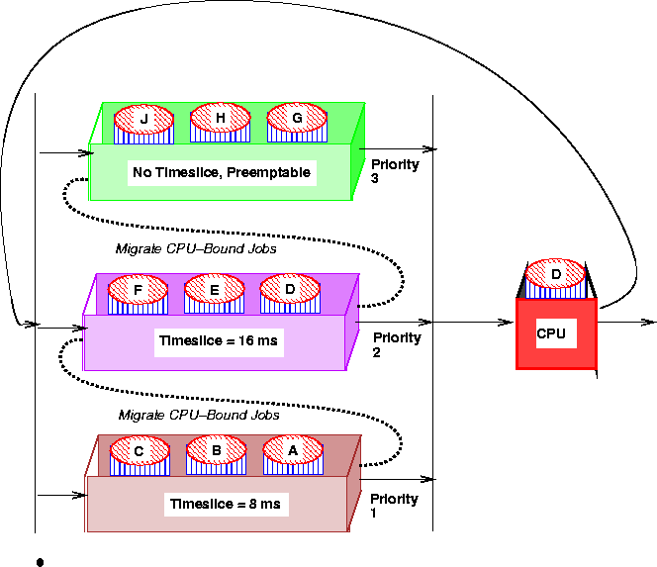
Multilevel Feedback Queues

Slide 33
Multiple-Processor Scheduling
CPU scheduling becomes more complex when multiple CPUs are available.
    Have one ready queue accessed by each CPU.
      Self scheduled - each CPU dispatches a job from ready Q
      Master-Slave - one CPU schedules the other CPUs
Homogeneous processors within multiprocessor.
      Permits Load Sharing
Asymmetric multiprocessing
      only 1 CPU runs kernel, others run user programs
      alleviates need for data sharing

Slide 34
Real-Time Scheduling???
Hard Real-time Computing -
      required to complete a critical task within a guaranteed amount of time.
Soft Real-time Computing -
      requires that critical processes receive priority over less fortunate ones.
Types of real-time Schedulers
      Periodic Schedulers - Fixed Arrival Rate
      Demand-Driven Schedulers - Variable Arrival Rate
      Deadline Schedulers - Priority determined by deadline
      …..

Slide 35
Issues in Real-time Scheduling???
Dispatch Latency
      Problem - Need to keep dispatch latency small, OS may enforce process to wait for system call or I/O to complete.
      Solution - Make system calls preemptible, determine safe criteria such that kernel can be interrupted.
Priority Inversion and Inheritance
      Problem: Priority Inversion
        Higher Priority Process needs kernel resource currently being used by another lower priority process..higher priority process must wait.
      Solution: Priority Inheritance
        Low priority process now inherits high priority until it has completed use of the resource in question.

Slide 36
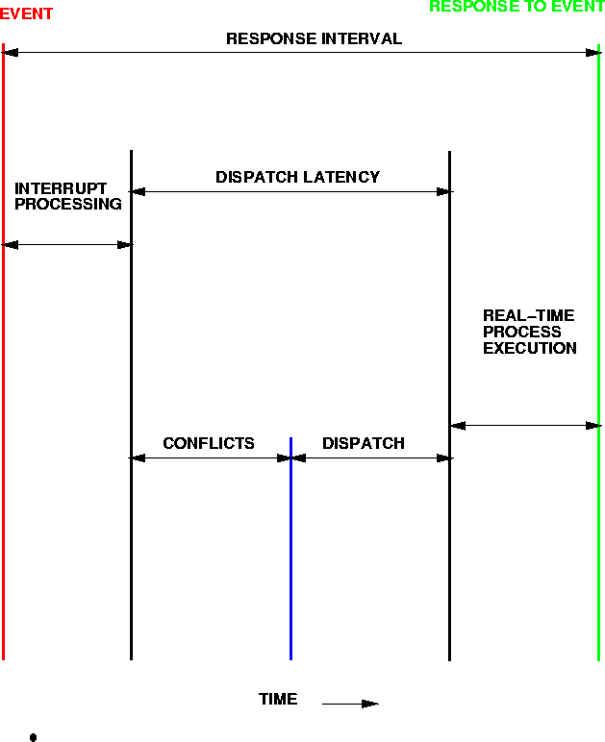
Real-time Scheduling - Dispatch Latency???

Slide 37
Algorithm Evaluation???
Deterministic Modeling
      Takes a particular predetermined workload and defines the performance of each algorithm for that workload. Too specific, requires exact knowledge to be useful.
Queuing Models and Queuing Theory
      Use distributions of CPU and I/O bursts. Knowing arrival and service rates - can compute utilization, average queue length, average wait time etc…
      Little’s formula - n = λ×W where n is the average queue length, λ is the avg. arrival rate and W is the avg. waiting time in queue.
Other techniques: Simulations, Implementation

