Slide 1
Principles of
Operating Systems
Lecture 6 and 7 - Process Synchronization

Slide 2
Outline
Cooperating Processes
The Bounded Buffer Producer-Consumer Problem
The Critical Section Problem
Synchronization Hardware
Semaphores
Classical Problems of Synchronization
Critical Regions
Monitors

Slide 3
Cooperating Processes
Concurrent Processes can be
      Independent processes
        cannot affect or be affected by the execution of another process.
      Cooperating processes
        can affect or be affected by the execution of another process.
Advantages of process cooperation:
        Information sharing
        Computation speedup
        Modularity
        Convenience(e.g. editing, printing, compiling)
Concurrent execution requires
        process communication and process synchronization

Slide 4
Producer-Consumer Problem
Paradigm for cooperating processes;
  producer process produces information that is consumed by a consumer process.
We need buffer of items that can be filled by producer and emptied by consumer.
      Unbounded-buffer places no practical limit on the size of the buffer. Consumer may wait, producer never waits.
      Bounded-buffer assumes that there is a fixed buffer size. Consumer waits for new item, producer waits if buffer is full.
  Producer and Consumer must synchronize.

Slide 5
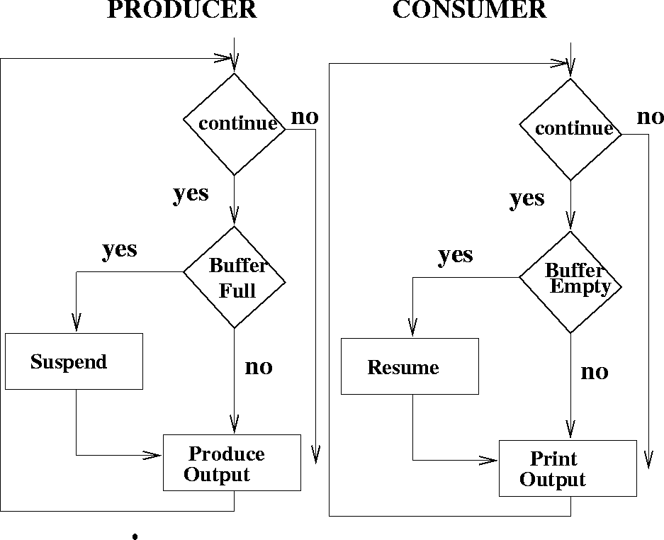
Producer-Consumer Problem

Slide 6
Bounded-buffer - Shared Memory Solution
Shared data
      var n;
      type item = ….;
      var buffer: array[0..n-1] of item;
      in, out: 0..n-1;
      in :=0; out:= 0; /* shared buffer = circular array */
      /* Buffer empty if in == out */
      /* Buffer full if (in+1) mod n == out */
      /* noop means ‘do nothing’ */

Slide 7
Bounded Buffer - Shared Memory Solution
Producer process - creates filled buffers
      repeat
      …
      produce an item in nextp
      …
      while in+1 mod n = out do noop;
      buffer[in] := nextp;
      in := in+1 mod n;
      until false;

Slide 8
Bounded Buffer - Shared Memory Solution
Consumer process - Empties filled buffers
      repeat
      while in = out do noop;
      nextc := buffer[out] ;
      out:= out+1 mod n;
      …
      consume the next item in nextc
      …
      until false

Slide 9
Background
Concurrent access to shared data may result in data inconsistency.
Maintaining data consistency requires mechanisms to ensure the orderly execution of cooperating processes.
Shared memory solution to the bounded-buffer problem allows at most (n-1) items in the buffer at the same time.

Slide 10
Bounded Buffer
A solution that uses all N buffers is not that simple.
    Modify producer-consumer code by adding a variable counter, initialized to 0, incremented each time a new item is added to the buffer
Shared data
      type item = ….;
      var buffer: array[0..n-1] of item;
      in, out: 0..n-1;
      counter: 0..n;
      in, out, counter := 0; //אתחול

Slide 11
Bounded Buffer
Producer process - creates filled buffers
      repeat
      …
      produce an item in nextp
      …
      while counter = n do noop;
      buffer[in] := nextp;
      in := in+1 mod n;
      counter := counter+1;
      until false;

Slide 12
Bounded Buffer
Consumer process - Empties filled buffers
      repeat
      while counter = 0 do noop;
      nextc := buffer[out] ;
      out:= out+1 mod n;
      counter := counter - 1;
      …
      consume the next item in nextc
      …
      until false;
The statements
      counter := counter + 1;
      counter := counter - 1;
must be executed atomically.

Slide 13
The Critical-Section Problem
N processes all competing to use shared data.
      Structure of process Pi ---- Each process has a code segment, called the critical section, in which the shared data is accessed.
    repeat
    entry section /* enter critical section */
    critical section /* access shared variables */
    exit section /* leave critical section */
    remainder section /* do other work */
    until false
Problem
      Ensure that when one process is executing in its critical section, no other process is allowed to execute in its critical section.

Slide 14
Solution: Critical Section Problem - Requirements
  Mutual Exclusion
      If process Pi is executing in its critical section, then no other processes can be executing in their critical sections.
  Progress
      If no process is executing in its critical section and there exists some processes that wish to enter their critical section, then the selection of the processes that will enter the critical section next cannot be postponed indefinitely.
  Bounded Waiting
      A bound must exist on the number of times that other processes are allowed to enter their critical sections after a process has made a request to enter its critical section and before that request is granted.

Slide 15
Solution: Critical Section Problem - Requirements
Assume that each process executes at a nonzero speed.
No assumption concerning relative speed of the n processes.

Slide 16
Solution: Critical Section Problem -- Initial Attempt
Only 2 processes, P0 and P1
General structure of process Pi (Pj)
    repeat
    entry section
    critical section
    exit section
    remainder section
    until false
Processes may share some common variables to synchronize their actions.

Slide 17
Algorithm 1
  Shared Variables:
    var turn: (0..1);
    initially turn = 0;
    turn = i ☑ Pi can enter its critical section
  Process Pi
    repeat
    while turn <> i do no-op;
    critical section
    turn := j;
    remainder section
    until false
    Satisfies mutual exclusion, but not progress.

Slide 18
Algorithm 2
  Shared Variables
    var flag: array (0..1) of boolean;
    initially flag[0] = flag[1] = false;
    flag[i] = true ☑ Pi ready to enter its critical section
  Process Pi
    repeat
    flag[i] := true;
    while flag[j] do no-op;
    critical section
    flag[i]:= false;
    remainder section
    until false
    Can block indefinitely…. Progress requirement not met.

Slide 19
Algorithm 3
  Shared Variables
    var flag: array (0..1) of boolean;
    initially flag[0] = flag[1] = false;
    flag[i] = true ☑ Pi ready to enter its critical section
  Process Pi
    repeat
    while flag[j] do no-op;
    flag[i] := true;
    critical section
    flag[i]:= false;
    remainder section
    until false
    Does not satisfy mutual exclusion requirement ….

Slide 20
Algorithm 4
  Combined Shared Variables of algorithms 1 and 2
  Process Pi
    repeat
    flag[i] := true;
    turn := j;
    while (flag[j] and turn=j) do no-op;
    critical section
    flag[i]:= false;
    remainder section
    until false
    YES!!! Meets all three requirements, solves the critical section problem for 2 processes.

Slide 21
Bakery Algorithm
Critical section for n processes
    Before entering its critical section, process receives a number. Holder of the smallest number enters critical section.
    If processes Pi and Pj receive the same number,
      if i <= j, then P is served first; else Pj is served first.
    The numbering scheme always generates numbers in increasing order of enumeration; i.e. 1,2,3,3,3,3,4,4,5,5

Slide 22
Bakery Algorithm (cont.)
Notation -
  Lexicographic order(ticket#, process id#)
    (a,b) < (c,d) if (a<c) or if ((a=c) and (b < d))
    max(a0,….an-1) is a number, k, such that k >=ai for i = 0,…,n-1
Shared Data
    var choosing: array[0..n-1] of boolean;(initialized to false)
    number: array[0..n-1] of integer; (initialized to 0)

Slide 23
Bakery Algorithm (cont.)
    repeat
    choosing[i] := true;
    number[i] := max(number[0], number[1],…,number[n-1]) +1;
    choosing[i] := false;
    for j := 0 to n-1
    do begin
    while choosing[j] do no-op;
    while number[j] <> 0
    and (number[j] ,j) < (number[i],i) do no-op;
    end;
    critical section
    number[i]:= 0;
    remainder section
    until false;

Slide 24
Hardware Solutions for Synchronization
Mutual exclusion solutions presented depend on memory hardware having read/write cycle.
      If multiple reads/writes could occur to the same memory location at the same time, this would not work.
      Processors with caches but no cache coherency cannot use the solutions
In general, it is impossible to build mutual exclusion without a primitive that provides some form of mutual exclusion.
    How can this be done in the hardware???

Slide 25
Synchronization Hardware
Test and modify the content of a word atomically - Test-and-set instruction
    function Test-and-Set (var target: boolean): boolean;
    begin
    Test-and-Set := target;
    target := true;
    end;
Similarly “SWAP” instruction

Slide 26
Mutual Exclusion with Test-and-Set
Shared data: var lock: boolean (initially false)
Process Pi
    repeat
    while Test-and-Set (lock) do no-op;
    critical section
    lock := false;
    remainder section
    until false;

Slide 27
Bounded Waiting Mutual Exclusion with Test-and-Set
    var j : 0..n-1;
    key : boolean;
    repeat
    waiting [i] := true; key := true;
    while waiting[i] and key do key := Test-and-Set(lock);
    waiting [i ] := false;
    critical section
    j := j + 1 mod n;
    while (j <> i) and (not waiting[j]) do j := j + 1 mod n;
    if j = i then lock := false;
    else waiting[j] := false;
    remainder section
    until false;

Slide 28
Semaphore
Semaphore S - integer variable
      used to represent number of abstract resources
Can only be accessed via two indivisible (atomic) operations
    (1) wait (S): while S <= 0 do no-op
    S := S-1;
    (2) signal (S): S := S+1;
      P or wait used to acquire a resource, decrements count
      V or signal releases a resource and increments count
      If P is performed on a count <= 0, process must wait for V or the release of a resource.

Slide 29
Example: Critical Section for n Processes
  Shared variables
      var mutex: semaphore
      initially mutex = 1
  Process Pi
    repeat
    wait(mutex);
    critical section
    signal (mutex);
    remainder section
    until false

Slide 30
Semaphore as a General Synchronization Tool
Execute B in Pj only after A execute in Pi
Use semaphore flag initialized to 0
Code:
  Pi Pj
  . .
  . .
  . .
  A wait(flag)
  signal(flag) B

Slide 31
Problem...
Busy Waiting, uses CPU that others could use. This type of semaphore is called a spinlock.
  OK for short times since it prevents a context switch.
For longer runtimes, need to modify P and V so that processes can block and resume.

Slide 32
Semaphore Implementation
Define a semaphore as a record
    type semaphore = record
    value: integer;
    L: list of processes;
    end;
Assume two simple operations
    block suspends the process that invokes it.
    wakeup(P) resumes the execution of a blocked process P.

Slide 33
Semaphore Implementation(cont.)
  Semaphore operations are now defined as
    wait (S): S.value := S.value -1;
    if S.value < 0
    then begin
    add this process to S.L;
    block;
    end;
    signal (S): S.value := S.value +1;
    if S.value <= 0
    then begin
    remove a process P from S.L;
    wakeup(P);
    end;

Slide 34
Block/Resume Semaphore Implementation
If process is blocked, enqueue PCB of process and call scheduler to run a different process.
Semaphores are executed atomically;
    no two processes execute wait and signal at the same time.
    Mutex can be used to make sure that two processes do not change count at the same time.
      If an interrupt occurs while mutex is held, it will result in a long delay.
      Solution: Turn off interrupts during critical section.

Slide 35
Deadlock and Starvation
  Deadlock - two or more processes are waiting indefinitely for an event that can be caused by only one of the waiting processes.
    Let S and Q be semaphores initialized to 1
  P0 P1
  wait(S); wait(Q);
  wait(Q); wait(S);
  . .
  . .
  . .
  signal (S) ; signal (Q);
  signal (Q); signal (S);
  Starvation- indefinite blocking. A process may never be removed from the semaphore queue in which it is suspended.

Slide 36
Two Types of Semaphores
Counting Semaphore - integer value can range over an unrestricted domain.
Binary Semaphore - integer value can range only between 0 and 1; simpler to implement.
Can implement a counting semaphore S as a binary semaphore.

Slide 37
Implementing S (counting sem.) as a Binary Semaphore
Data Structures
    var S1 : binary-semaphore;
    S2 : binary-semaphore;
    S3 : binary-semaphore;
    C: integer;
Initialization
    S1 = S3 =1;
    S2 = 0;
    C = initial value of semaphore S;

Slide 38
Implementing S
Wait operation
    wait(S3);
    wait(S1);
    C := C-1;
    if C < 0
    then begin
    signal (S1);
    wait(S2);
    end
    else signal (S1);
    signal (S3);
Signal operation
    wait(S1);
    C := C + 1;
    if C <= 0 then signal (S2);
    signal (S1);

Slide 39
Implementing S (counting sem.) as a Binary Semaphore
Data Structures
    var S1 : binary-semaphore;
    S2 : binary-semaphore;
    C: integer;
Initialization
    S1 = 1;
    S2 = 0;
    C = initial value of semaphore S;

Slide 40
Implementing S
Wait operation
    wait(S1);
    C := C-1;
    if C < 0
    then begin
    signal (S1);
    wait(S2);
    end
    signal (S1);
Signal operation
    wait(S1);
    C := C + 1;
    if C <= 0
    then signal (S2);
    else signal (S1);

Slide 41
Classical Problems of Synchronization
Bounded Buffer Problem
Readers and Writers Problem
Dining-Philosophers Problem

Slide 42
Bounded Buffer Problem
Shared data
      type item = ….;
      var buffer: array[0..n-1] of item;
      full, empty, mutex : semaphore;
      nextp, nextc :item;
      full := 0; empty := n; mutex := 1;

Slide 43
Bounded Buffer Problem
Producer process - creates filled buffers
      repeat
      …
      produce an item in nextp
      …
      wait (empty);
      wait (mutex);
      …
      add nextp to buffer
      …
      signal (mutex);
      signal (full);
      until false;

Slide 44
Bounded Buffer Problem
Consumer process - Empties filled buffers
      repeat
      wait (full );
      wait (mutex);
      …
      remove an item from buffer to nextc
      ...
      signal (mutex);
      signal (empty);
      …
      consume the next item in nextc
      …
      until false;

Slide 45
Readers-Writers Problem
Shared Data
      var mutex, wrt: semaphore (=1);
      readcount: integer (= 0);
Writer Process
      wait(wrt);
      …
      writing is performed
      ...
      signal(wrt);

Slide 46
Readers-Writers Problem
Reader process
      wait(mutex);
      readcount := readcount +1;
      if readcount = 1 then wait(wrt);
      signal(mutex);
      ...
      reading is performed
      ...
      wait(mutex);
      readcount := readcount - 1;
      if readcount = 0 then signal(wrt);
      signal(mutex);

Slide 47
Dining-Philosophers Problem
Shared Data
      var chopstick: array [0..4] of semaphore (=1 initially);

Slide 48
Dining Philosophers Problem
  Philosopher i :
      repeat
      wait (chopstick[i]);
      wait (chopstick[i+1 mod 5]);
      …
      eat
      ...
      signal (chopstick[i]);
      signal (chopstick[i+1 mod 5]);
      …
      think
      …
      until false;
פתרונות רעיוניים לבעיה

Slide 49
Higher Level Synchronization
Timing errors are still possible with semaphores
    Example 1
      signal (mutex);
      …
      critical region
      ...
      wait (mutex);
    Example 2
      wait(mutex);
      …
      critical region
      ...
      wait (mutex);
    Example 3
      wait(mutex);
      …
      critical region
      ...
      Forgot to signal

Slide 50
Conditional Critical Regions
High-level synchronization construct
A shared variable v of type T is declared as:
    var v: shared T
Variable v is accessed only inside statement
      region v when B do S
  where B is a boolean expression.
  While statement S is being executed, no other process can access variable v.

Slide 51
Critical Regions (cont.)
Regions referring to the same shared variable exclude each other in time.
When a process tries to execute the region statement, the Boolean expression B is evaluated.
    If B is true, statement S is executed.
    If it is false, the process is delayed until B becomes true and no other process is in the region associated with v.

Slide 52
Example - Bounded Buffer
  Shared variables
    var buffer: shared record
    pool:array[0..n-1] of item;
    count,in,out: integer;
    end;
  Producer Process inserts nextp into the shared buffer
    region buffer when count < n
    do begin
    pool[in] := nextp;
    in := in+1 mod n;
    count := count + 1;
    end;

Slide 53
Bounded Buffer Example
  Consumer Process removes an item from the shared buffer and puts it in nextc
    region buffer when count > 0
    do begin
    nextc := pool[out];
    out := out+1 mod n;
    count := count -1;
    end;

Slide 54
Implementing Regions
Region x when B do S
    var mutex, first-delay, second-delay: semaphore;
    first-count, second-count: integer;
Mutually exclusive access to the critical section is provided by mutex.
    If a process cannot enter the critical section because the Boolean expression B is false,
      it initially waits on the first-delay semaphore;
      moved to the second-delay semaphore before it is allowed to reevaluate B.

Slide 55
Implementation
Keep track of the number of processes waiting on first-delay and second-delay, with first-count and second-count respectively.
The algorithm assumes a FIFO ordering in the queueing of processes for a semaphore.
For an arbitrary queueing discipline, a more complicated implementation is required.

Slide 56
Implementing Regions
      wait(mutex);
      while not B
      do begin first-count := first-count +1;
      if second-count > 0
      then signal (second-delay);
      else signal (mutex);
      wait(first-delay);
      first-count := first-count -1;
      second-count := second-count + 1;
      if first-count > 0 then signal (first-delay)
      else signal (second-delay);
      wait(second-delay);
      second-count := second-count -1;
      end;
      S;
      if first-count > 0 then signal (first-delay);
      else if second-count > 0
      then signal (second-delay);
      else signal (mutex);

Slide 57
Monitors
High-level synchronization construct that allows the safe sharing of an abstract data type among concurrent processes.
      type monitor-name = monitor
      variable declarations
      procedure entry P1 (…);
      begin … end;
      procedure entry P2 (…);
      begin … end;
      .
      .
      .
      procedure entry Pn(…);
      begin … end;
      begin
      initialization code
      end.

Slide 58
Monitors
To allow a process to wait within the monitor, a condition variable must be declared, as:
      var x,y: condition
    Condition variable can only be used within the operations wait and signal. Queue is associated with condition variable.
      The operation
        x.wait;
      means that the process invoking this operation is suspended until another process invokes
        x.signal;
      The x.signal operation resumes exactly one suspended process. If no process is suspended, then the signal operation has no effect.

Slide 59
Dining Philosophers
      type dining-philosophers= monitor
      var state: array[0..4] of (thinking, hungry, eating);
      var self: array[0..4] of condition;
      // condition where philosopher I can delay himself when hungry but // is unable to obtain chopstick(s)
      procedure entry pickup (i :0..4);
      begin
      state[i] := hungry;
      test(i); //test that your left and right neighbors are not eating
      if state [i] <> eating then self [i].wait;
      end;
      procedure entry putdown (i:0..4);
      begin
      state[i] := thinking;
      test (i + 4 mod 5 ); // signal left neighbor
      test (i + 1 mod 5 ); // signal right neighbor
      end;

Slide 60
Dining Philosophers (cont.)
      procedure test (k :0..4);
      begin
      if state [k + 4 mod 5] <> eating
      and state [k ] = hungry
      and state [k + 1 mod 5] <> eating
      then
      begin
      state[k] := eating;
      self [k].signal;
      end;
      end;
      begin
      for i := 0 to 4
      do state[i] := thinking;
      end;

