Slide 1
Principles of
Operating Systems
Lectures 8 and 9 - Deadlocks

Slide 2
Outline
System Model
Deadlock Characterization
Methods for handling deadlocks
Deadlock Prevention
Deadlock Avoidance
Deadlock Detection
Recovery from Deadlock
Combined Approach to Deadlock Handling

Slide 3
The Deadlock Problem
A set of blocked processes each holding a resource and waiting to acquire a resource held by another process in the set.
  Example 1
      System has 2 tape drives. P1 and P2 each hold one tape drive and each needs the other one.
  Example 2
      Semaphores A and B each initialized to 1
  P0 P1
  wait(A) wait(B)
  wait(B) wait(A)

Slide 4
Definitions
A process is deadlocked if it is waiting for an event that will never occur.
    Typically, more than one process will be involved in a deadlock (the deadly embrace).
A process is indefinitely postponed if it is delayed repeatedly over a long period of time while the attention of the system is given to other processes,
    i.e. the process is ready to proceed but never gets the CPU.

Slide 5
Example - Bridge Crossing
  Assume traffic in one direction.
    Each section of the bridge is viewed as a resource.
  If a deadlock occurs, it can be resolved only if one car backs up (preempt resources and rollback).
    Several cars may have to be backed up if a deadlock occurs.
    Starvation is possible

Slide 6
Resources
Resource
    commodity required by a process to execute
Resources can be of several types
    Serially Reusable Resources
      CPU cycles, memory space, I/O devices, files
      acquire -> use -> release
    Consumable Resources
      Produced by a process, needed by a process - e.g. Messages, buffers of information, interrupts
      create ->acquire ->use
      Resource ceases to exist after it has been used

Slide 7
System Model
Resource types
  R1, R2,….Rm
Each resource type Ri has Wi instances
Assume serially reusable resources
    request -> use -> release

Slide 8
Conditions for Deadlock
  The following 4 conditions are necessary and sufficient for deadlock (must hold simultaneously)
    Mutual Exclusion:
      Only once process at a time can use the resource.
    Hold and Wait:
      Processes hold resources already allocated to them while waiting for other resources.
    No preemption:
      Resources are released by processes holding them only after that process has completed its task.
    Circular wait:
      A circular chain of processes exists in which each process waits for one or more resources held by the next process in the chain.

Slide 9
Resource Allocation Graph
A set of vertices V and a set of edges E
V is partitioned into 2 types
    P = {P1, P2,…,Pn} - the set of processes in the system
    R = {R1, R2,…,Rn} - the set of resource types in the system
Two kinds of edges
    Request edge - Directed edge Pi ---> Rj
    Assignment edge - Directed edge Rj ----> Pi

Slide 10
Resource Allocation Graph
Process
Resource type with 4 instances
Pi requests instance of Rj
Pi is holding an instance of Rj

Slide 11
Graph with no cycles
R1
R2
P1
P2
P3
R3
R4

Slide 12
Graph with cycles
R1
P2
P1
P3
R2
P4

Slide 13
Graph with cycles and deadlock
R1
R2
P1
P2
P3
R3
R4

Slide 14
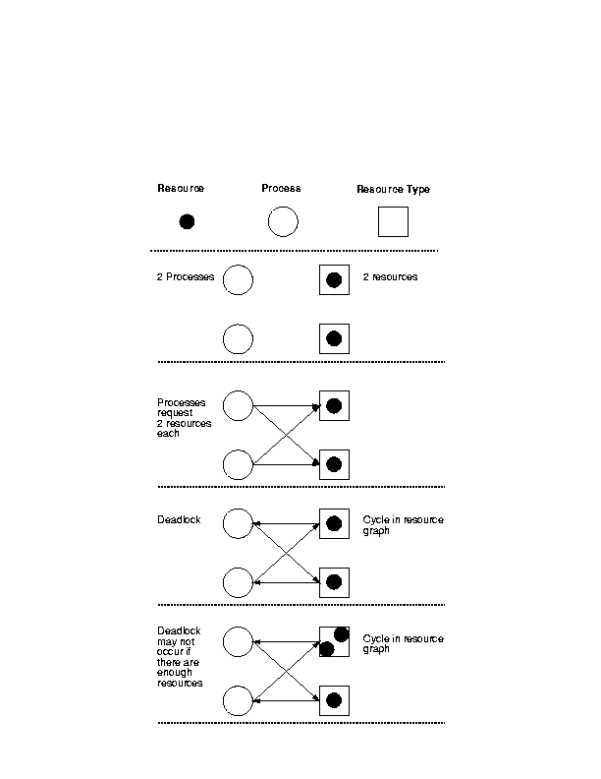

Slide 15
Basic facts
If graph contains no cycles
  NO DEADLOCK
If graph contains a cycle
  if only one instance per resource type, then deadlock
  if several instances per resource type, possibility of deadlock.

Slide 16
Methods for handling deadlocks
Ensure that the system will never enter a deadlock state.
Allow the system to potentially enter a deadlock state, detect it and then recover
Ignore the problem and pretend that deadlocks never occur in the system;
  Used by many operating systems, e.g. UNIX

Slide 17
Deadlock Management
  Prevention
      Design the system in such a way that deadlocks can never occur
  Avoidance
      Impose less stringent conditions than for prevention, allowing the possibility of deadlock but sidestepping (התחמקות)it as it occurs.
  Detection
      Allow possibility of deadlock, determine if deadlock has occurred and which processes and resources are involved.
  Recovery
      After detection, clear the problem, allow processes to complete and resources to be reused. May involve destroying and restarting processes.

Slide 18
Deadlock Prevention
  If any one of the conditions for deadlock (with reusable resources) is denied, deadlock is impossible.
  Restrain ways in which requests can be made
    Mutual Exclusion
      non-issue for sharable resources
      cannot deny this for non-sharable resources (important)
    Hold and Wait - guarantee that when a process requests a resource, it does not hold other resources.
      Force each process to acquire all the required resources at once. Process cannot proceed until all resources have been acquired.
      Low resource utilization, starvation possible

Slide 19
Deadlock Prevention (cont.)
    No Preemption
      If a process that is holding some resources requests another resource that cannot be immediately allocated to it, the process releases the resources currently being held.
      Preempted resources are added to the list of resources for which the process is waiting.
      Process will be restarted only when it can regain its old resources as well as the new ones that it is requesting.
    Circular Wait
      Impose a total ordering of all resource types.
      Require that processes request resources in increasing order of enumeration; if a resource of type N is held, process can only request resources of types > N.

Slide 20
Deadlock Avoidance
Set of resources, set of customers, banker
Rules
      Each customer tells banker maximum number of resources it needs.
      Customer borrows resources from banker.
      Customer returns resources to banker.
      Customer eventually pays back loan.
Banker only lends resources if the system will be in a safe state after the loan.

Slide 21
Deadlock Avoidance
Requires that the system has some additional apriori information available.
      Simplest and most useful model requires that each process declare the maximum number of resources of each type that it may need.
      The deadlock-avoidance algorithm dynamically examines the resource-allocation state to ensure that there can never be a circular-wait condition.
      Resource allocation state is defined by the number of available and allocated resources, and the maximum demands of the processes.

Slide 22
Safe state
    When a process requests an available resource, system must decide if immediate allocation leaves the system in a safe state.
    System is in safe state if there exists a safe sequence of all processes.
    Sequence <P1, P2, …Pn> is safe, if for each Pi, the resources that Pi can still request can be satisfied by currently available resources + resources held by Pj with j<i.
      If Pi resource needs are not available, Pi can wait until all Pj have finished.
      When Pj is finished, Pi can obtain needed resources, execute, return allocated resources, and terminate.
      When Pi terminates, Pi+1 can obtain its needed resources...

Slide 23
Basic Facts
If a system is in a safe state ⇒ no deadlocks.
If a system is in unsafe state ⇒ possibility of deadlock.
Avoidance ⇒ ensure that a system will never reach an unsafe state.

Slide 24
Resource Allocation Graph Algorithm
Used for deadlock avoidance when there is only one instance of each resource type.
      Claim edge: Pi → Rj indicates that process Pi may request resource Rj; represented by a dashed line.
      Claim edge converts to request edge when a process requests a resource.
      When a resource is released by a process, assignment edge reconverts to claim edge.
      Resources must be claimed a priori in the system.
    If request assignment does not result in the formation of a cycle in the resource allocation graph - safe state, else unsafe state.

Slide 25
Claim Graph
Process claims resource
Process requests resource
Process is assigned resource
Process releases resource

Slide 26
Claim Graph
1
2
Possible Deadlock!!
3
5
4

Slide 27
Banker’s Algorithm
Used for multiple instances of each resource type.
Each process must a priori claim maximum use of each resource type.
When a process requests a resource it may have to wait.
When a process gets all its resources it must return them in a finite amount of time.

Slide 28
Data Structures for the Banker’s Algorithm
Let n = number of processes and m = number of resource types.
      Available: Vector of length m. If Available[j] = k, there are k instances of resource type Rj available.
      Max: n × m matrix. If Max[i,j] = k, then process Pi may request at most k instances of resource type Rj.
      Allocation: n × m matrix. If Allocation[i,j] = k, then process Pi is currently allocated k instances of resource type Rj.
      Need: n × m matrix. If Need[i,j] = k, then process Pi may need k more instances of resource type Rj to complete its task.
      Need[i,j] = Max[i,j] - Allocation[i,j]

Slide 29
Safety Algorithm
    Let Work and Finish be vectors of length m and n, respectively. Initialize
      Work := Available
      Finish[i] := false for i = 1,2,…,n.
    Find an i (i.e. process Pi) such that both:
      Finish[i] = false
      Need_i <= Work
      If no such i exists, go to step 4.
    Work := Work + Allocation_i
      Finish[i] := true
      go to step 2
    If Finish[i] = true for all i, then the system is in a safe state.

Slide 30
Resource-Request Algorithm for Process Pi
    Request_i = request vector for process Pi. If Request_i[j] = k, then process Pi wants k instances of resource type Rj.
      STEP 1: If Request(i) ≤ Need(i), go to step 2. Otherwise, raise error condition, since process has exceeded its maximum claim.
      STEP 2: If Request(i) ≤ Available, go to step 3. Otherwise, Pi must wait since resources are not available.
      STEP 3: Pretend to allocate requested resources to Pi by modifying the state as follows:
      Available := Available - Request (i);
      Allocation (i) := Allocation (i) + Request (i);
      Need (i) := Need (i) - Request (i);
      If safe ⇒ resources are allocated to Pi.
      If unsafe ⇒ Pi must wait and the old resource-allocation state is restored.

Slide 31
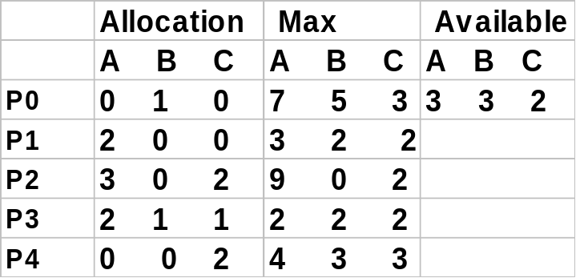
Example of Banker’s Algorithm
    5 processes
      P0 - P4;
    3 resource types
      A(10 instances), B (5 instances), C (7 instances)
    Snapshot at time T0

Slide 32
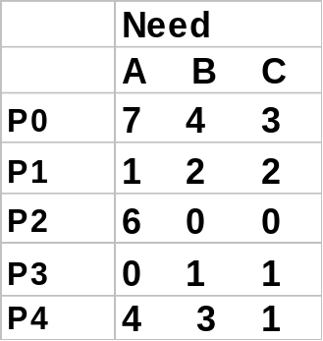
Example (cont.)
The content of the matrix Need is defined to be Max - Allocation.
The system is in a safe state since the sequence <P1,P3,P4,P2,P0> satisfies safety criteria.

Slide 33
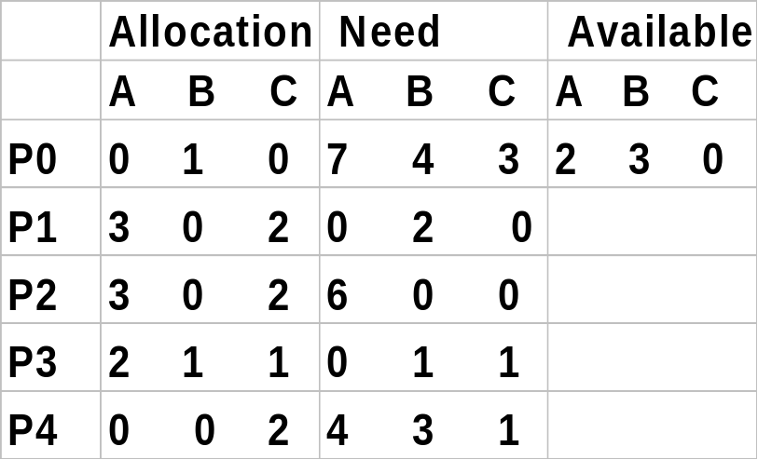
Example: P1 requests (1,0,2)
Check to see that Request ≤ Available
      ((1,0,2) ≤ (3,3,2)) ⇒ true.

Slide 34
Example (cont.)
Executing the safety algorithm shows that sequence <P1, P3, P4, P0, P2> satisfies safety requirement.
Can request for (3,3,0) by P4 be granted?
Can request for (0,2,0) by P0 be granted?

Slide 35
Deadlock Detection
Allow system to enter deadlock state
Detection Algorithm
Recovery Scheme

Slide 36
Single Instance of each resource type
Maintain wait-for graph
    Nodes are processes
    Pi → Pj if Pi is waiting for Pj.
Periodically invoke an algorithm that searches for a cycle in the graph.
An algorithm to detect a cycle in a graph requires an order of n^2 operations, where n is the number of vertices in the graph.

Slide 37
Several instances of a resource type
Data Structures
      Available: Vector of length m. If Available[j] = k, there are k instances of resource type Rj available.
      Allocation: n × m matrix. If Allocation[i,j] = k, then process Pi is currently allocated k instances of resource type Rj.
      Request : An n × m matrix indicates the current request of each process. If Request [i,j] = k, then process Pi is requesting k more instances of resource type Rj .

Slide 38
Deadlock Detection Algorithm
    Step 1: Let Work and Finish be vectors of length m and n, respectively. Initialize
      Work := Available
      For i = 1,2,…,n, if Allocation(i) ≠ 0, then Finish[i] := false, otherwise Finish[i] := true.
    Step 2: Find an index i such that both:
      Finish[i] = false
      Request (i) ≤ Work
      If no such i exists, go to step 4.

Slide 39
Deadlock Detection Algorithm
    Step 3: Work := Work + Allocation(i)
      Finish[i] := true
      go to step 2
    Step 4: If Finish[i] = false for some i, 1 ≤ i ≤ n, then the system is in a deadlock state. Moreover, if Finish[i] = false, then Pi is deadlocked.
  Algorithm requires an order of m × (n^2) operations to detect whether the system is in a deadlocked state.

Slide 40
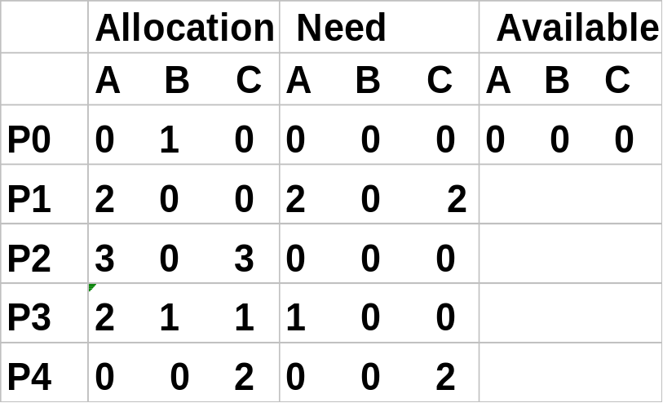
Example of Detection Algorithm
    5 processes - P0 - P4; 3 resource types - A(7 instances), B(2 instances), C(6 instances)
    Snapshot at time T 0: <P0,P2,P3,P1,P4> will result in Finish[i] = true for all i.

Slide 41
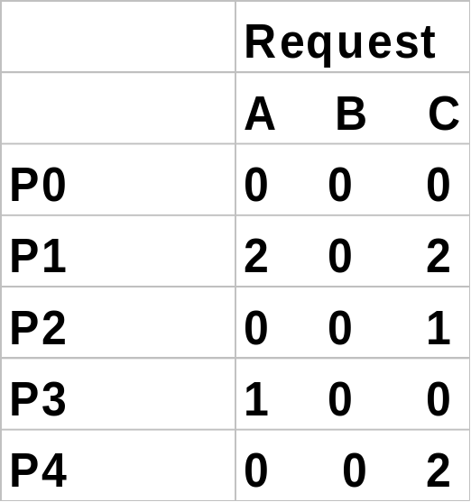
Example (cont.)
    P2 requests an additional instance of type C.
    State of system
      Can reclaim resources held by process P0, but insufficient resources to fulfill other processes’ requests.
      Deadlock exists, consisting of P 1,P 2,P 3 and P 4.

Slide 42
Detection-Algorithm Use
  When, and how often to invoke depends on:
    How often a deadlock is likely to occur?
    How many processes will need to be rolled back?
      One for each disjoint cycle
  How often --
    Every time a request for allocation cannot be granted immediately
      Allows us to detect set of deadlocked processes and process that “caused” deadlock. Extra overhead.
      Every hour or whenever CPU utilization drops.
    With arbitrary invocation there may be many cycles in the resource graph and we would not be able to tell which of the many deadlocked processes “caused” the deadlock.

Slide 43
Recovery from Deadlock: Process Termination
  Abort all deadlocked processes.
  Abort one process at a time until the deadlock cycle is eliminated.
  In which order should we choose to abort?
      Priority of the process
      How long the process has computed, and how much longer to completion.
      Resources the process has used.
      Resources process needs to complete.
      How many processes will need to be terminated.
      Is process interactive or batch?

Slide 44
Recovery from Deadlock: Resource Preemption
Selecting a victim - minimize cost.
Rollback
    return to some safe state, restart process from that state.
Starvation
    same process may always be picked as victim; include number of rollback in cost factor.

Slide 45
Combined approach to deadlock handling
Combine the three basic approaches
    Prevention
    Avoidance
    Detection
    allowing the use of the optimal approach for each class of resources in the system.
Partition resources into hierarchically ordered classes.
  Use most appropriate technique for handling deadlocks within each class.

