Slide 1
UPDATES to Mechanic 2 Frima Updated Wireframe
5/4/15

Slide 2
Mechanic 2 Updates
Previously “Give”

Slide 3
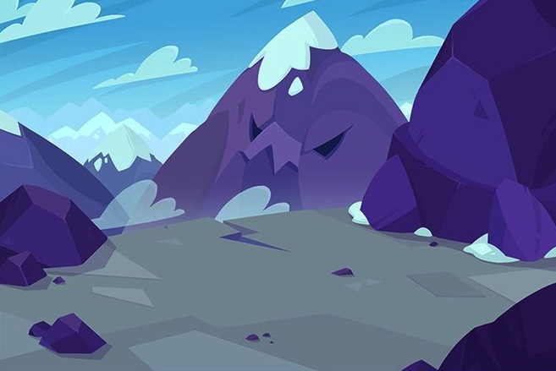
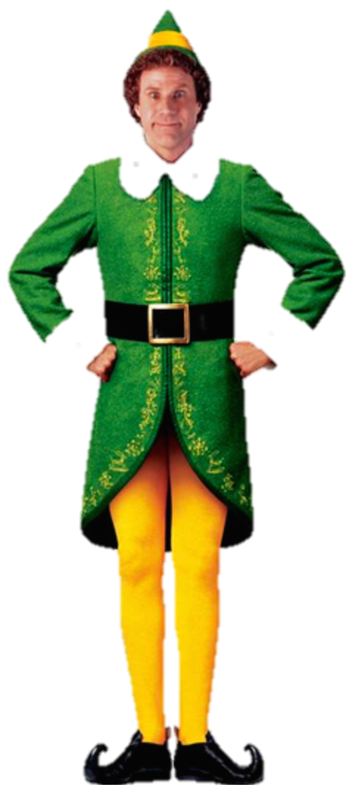

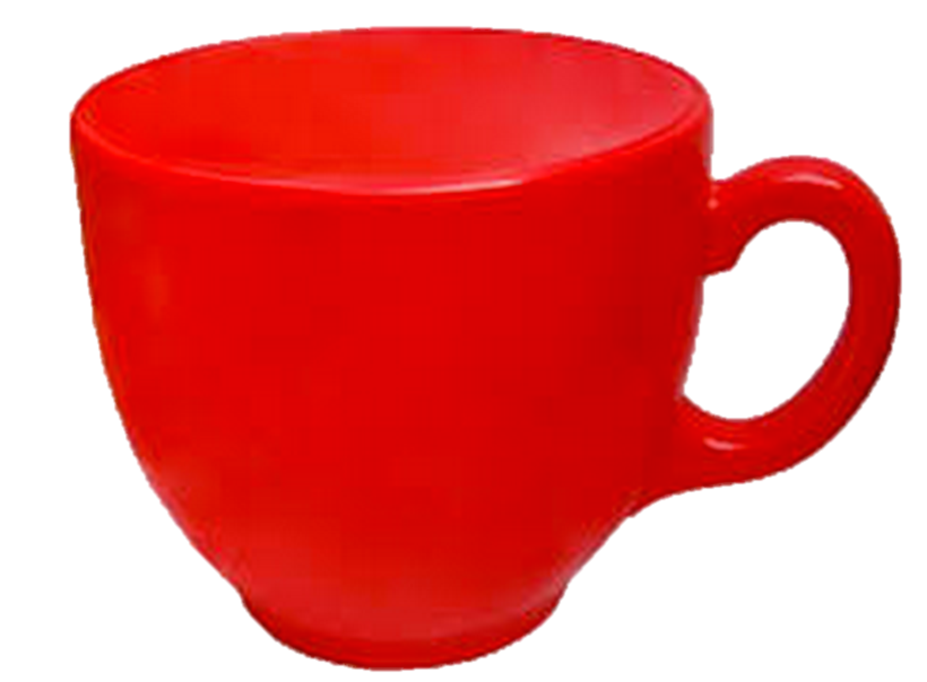
Help!
I need to ____ up this cup.
Letters
Word Chunks
Words
hill
felt
hall
spin
trap
damp
honk
Notes:
Word Selection & Separation
The player acknowledges the question and try to guess an answer.
He looks at the words provided for the challenge (set by the designer) and find out how to craft the available words into the answer.
For the sake of the wireframe, every character (NPC and Minis) are on the same screen.

Slide 4
Letters
Word Chunks
Filter 1
Words
hill
felt
hall
spin
trap
damp
honk
Notes:
Word Selection & Separation
The player think he has to create the word “FILL”.
He’ll need to craft the word by breaking “HILL”.

Slide 5
Letters
Word Chunks
Words
hill
felt
hall
spin
trap
damp
honk
Notes:
Word Selection & Separation
The player select “HILL” and give it to the Crafting Mini (blue one).
The orange one is the Scrambling Mini.

Slide 6
hill
Letters
Word Chunks
Words
hill
felt
hall
spin
trap
damp
honk
Notes:
Word Selection & Separation
The Mini spell the word given to him.

Slide 7
h
ill
Letters
Word Chunks
Words
hill
felt
hall
spin
trap
damp
honk
Notes:
Word Selection & Separation
Once spelled, the word breaks into parts.
It could have been “HI” & “LL”, or “H”, “I”, “L” & “L” or “HIL” & “L”
The player could have respent the word if it would not have been the parts he was looking for
The player can spend as many time the word as he wants.

Slide 8
h
ill
Letters
Word Chunks
Words
felt
hall
spin
trap
damp
honk
Notes:
Word Selection & Separation
The player decides weither he keeps the parts or not.
Kept parts are send to the Letters/Word Chunks tab.

Slide 9
Mechanic 2 Updates
Craft

Slide 10

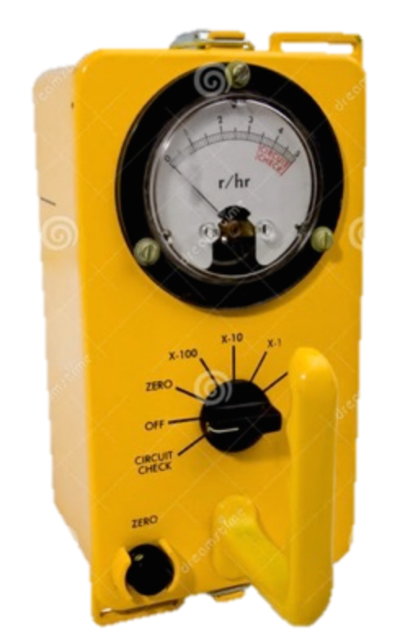
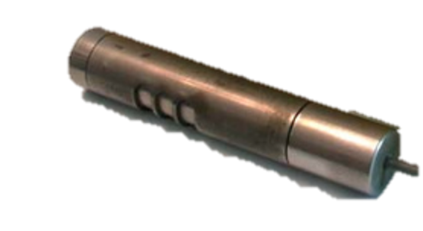
f
Letters
Word Chunks
Words
sp
bl
tw
tr
f
sw
sn
Notes:
Word Crafting
Player access his Letters and Word Chunks tabs and search for the correct parts
He places aligns them on the “crafting table”

Slide 11
f
ill
Letters
Word Chunks
Words
ill
bl
tw
tr
lt
sw
sn
Notes:
Word Crafting
When all components are correctly lined up, lever activates.

Slide 12
f
ill
Letters
Word Chunks
Words
sp
bl
tw
tr
fl
sw
sn
Notes:
Word Crafting
Player chooses lever for ‘Word fusion” as in Mechanic 1.

Slide 13
Help!
I need to ____ up this cup.
fill
Letters
Word Chunks
Words
sp
bl
tw
tr
fl
sw
sn
Notes:
Word Crafting
The different parts become one word ready to be validated.

Slide 14
Mechanic 2 Updates
Previously “Use”

Slide 15
Help!
I need to ____ up this cup.
fill
Letters
Word Chunks
Words
sp
bl
tw
tr
fl
sw
sn
Notes:
Word Crafting
The player take the newly crafted word and give it to the NPC.

Slide 16
Help!
I need to fill up this cup.
Letters
Word Chunks
Words
sp
bl
tw
tr
fl
sw
sn
Notes:
Word Crafting
The word is validated and the request is complete!

Slide 17
Mechanic 3
Previously “Say”

Slide 18
Letters
Word Chunks
Filter 1
Words
field
felt
hall
spin
trap
damp
honk
Notes:
Sentence Unscrambling
An advance player may decide to swap a word with another, in order to seek other words to craft.

Slide 19
Letters
Word Chunks
Words
field
felt
hall
spin
trap
damp
honk
Notes:
Sentence Unscrambling
The player only need to give one of his words to the Scrambling Mini

Slide 20
field
Letters
Word Chunks
Words
felt
hall
spin
trap
damp
honk
Notes:
Sentence Unscrambling
The Mini acknowledge the word, the spell a sentence with it.

Slide 21
Field hill on is the a.
?
Field
hill
on
is
the
a
Notes:
Sentence Unscrambling
The Scrambling Mini scrambles the sentence!
The player needs to unscramble it.

Slide 22
Field hill on is the a.
?
The
field
is
on
a
hill.
Notes:
Sentence Unscrambling
Once the sentence is correctly unscrambled, the lever activates an

Slide 23
The
field
is
on
a
hill.
Letters
Word Chunks
Words
hill
spin
felt
hall
trap
damp
honk
Notes:
Sentence Unscrambling
Once validated, the player can choose a word to switch with the one he previously had.

