Slide 1
Concept #2
15-04-07
© Curriculum Associates & Frima Studio 2015 | All rights reserved | Confidential

Slide 2
What is covered in this document?
All information related to the theme, gameplay and mechanic of Concept #2
What is Concept 2?
Overarching Story
Synopsis
Story progress over the years
Mechanics & Gameplay
Core Mechanics
Gameplay
Secondary Mechanics
Cross-Age Structure
Adaptation to Grade K Instruction
Questions to discuss
© Curriculum Associates & Frima Studio 2015 | All rights reserved | Confidential

Slide 3
What is Concept 2?
A creatures training game where the player needs to fulfill neighbors’ requests by providing them the words they are looking for.
With the help of his creatures, the player separates words into letters, syllables and components.
The player then recombines the separated elements into new words.
By understanding what the neighbors are looking for, the player can give them the correct words.
Filling requests provides coins that can be used at the shop, to upgrade the way words are separated and rebuilt.
© Curriculum Associates & Frima Studio 2015 | All rights reserved | Confidential

Slide 4
Overarching Story
Goal of Concept #2 Story
Let the player use words and Foundation Skills in meaningful way
Let the player care for his creatures
Let the player care for his house
Let the player care for his community
Themes of the Concept #2
Caring
Family
Expression
Community
Growth
Exchange
Helpfulness
Support
Narrative Constraints of Concept #2
Target boys and girls
Target 5 to 11 years old
Adapt itself to a repetitive and abstract gameplay
The story needs to be broken down into milestones based in the requests the player gets corresponding to each skill.
© Curriculum Associates & Frima Studio 2015 | All rights reserved | Confidential

Slide 5
Synopsis
The player starts his journey by finding a weird baby creature on his front doorstep.
The player would have previously heard the news that an alien spaceship has crashed nearby.
The creature, which is friendly, seems especially fond of TV, radios and sandwiches.
The player discovers that the creature can mimic the English language sounds that comes from the TV.
The two of them start to practice English together, by correctly pronouncing sounds for images and words.
As the creature learn sounds and eat sandwhiches, it starts growing and at some point, other creatures start appearing. Those newcomers are called Minis.
Those Minis start pronouncing sounds for letters themselves and are also craving different types of meals.
They seems also very interested in radios, where they try to reproduce the words they hear from it.
As the player cares for his creatures, other members of his village become intrigued by these word pronouncing creatures and start asking for their help.
The player then starts helping the different members of his town with the abilities of his pet creatures.
© Curriculum Associates & Frima Studio 2015 | All rights reserved | Confidential

Slide 6
Story progress over the years
Through the years, the player will have different goals to achieve in order to progress in the story. Below are examples of the kind of stories we could tell the player every year.
Those stories are not bound to the NPC requests or training level of his creature, but rather to his progress through real school years.
Thus, a newcoming 8-year-old student that has Skill Grade 1 will be playing the “Find the Mayor” story, while performing with the Skill Grade 1 lessons.
5-6-years-old – The player cares for the growth of its first creatures.
6-7-years-old – The player renovates its shabby house.
7-8-years-old – The player helps put the village back on the map.
8-9-years-old – The player and his creatures finds the mayor.
9-10-years-old – The player convinces the governor that the creatures are peaceful.
10-11-years-old – The player build a spaceship to send the creatures back into space.
© Curriculum Associates & Frima Studio 2015 | All rights reserved | Confidential

Slide 7
Mechanics
The game is divided into multiple core mechanics that are enhanced by different secondary mechanics.
Craft
System
See Word Component
Player
Merge Word Component
Train Minis
Invest Words
Craft Words
System
Project Word Component
Player
Choose Word
System
See Word
Player
Choose Word
Sort Words
Invest
Sort
Help Community
© Curriculum Associates & Frima Studio 2015 | All rights reserved | Confidential

Slide 8
Core Mechanic - Invest
The initial core mechanic requires the player to give the Minis a word to separate.
This word is very important, as it will directly influence what will the player gains from the following mechanics.
Before investing anything, the player needs to know what word he is looking for and how to get it.
What letters does the word require?
What syllables does the word require?
What word components does the word require?
Can the word be made from multiple crafted words?
Does the player have all the necessary letters/syllables/components to craft the word?
If not, how he can get the missing elements?
Then, he will “seed” the original word to the Minis. This seeding is done using the radio.
The radio is only used to propagate the seed words to the Minis, as a narrative element.
The seeded word directly influence what the Minis produce.
Depending on what the player has fed a Mini, the Mini changes color and provides different types of outcomes.
Ex.: A letter Mini that ate pizza becomes red and only provide vowels.
© Curriculum Associates & Frima Studio 2015 | All rights reserved | Confidential

Slide 9
Minis
Minis are small creatures that produces different outcomes (letters, syllables, components) required to craft words.
They can be influenced in many ways.
Radio
Food, which temporarily gives them a color
They also have a key attribute that never changes
The letter Mini will always be a Letter Mini
Attribute | Letter Mini | Syllable Mini | Component Mini
Default | Random | Random | Random
Type 1 | Vowel | Rhyme | Root
Type 2 | Consonant | 2-Letters Long | Suffix
Type 3 | High-Frequency | 3-Letters Long | Preffix
Type 4 | Low-Frequency | 4-Letters Long | Other Affix
© Curriculum Associates & Frima Studio 2015 | All rights reserved | Confidential

Slide 10
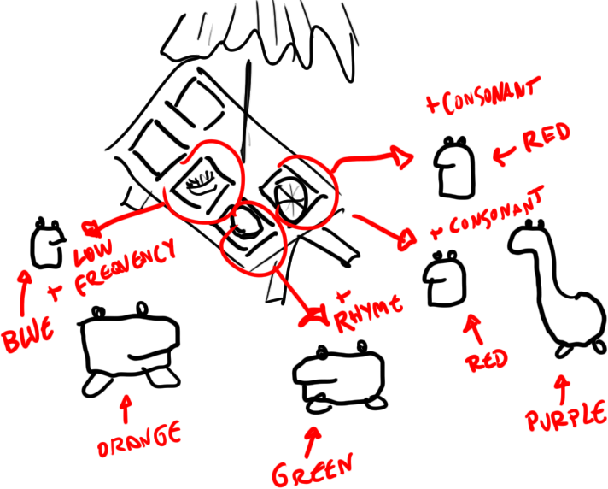
Based on what the player feeds the Minis, they will produce different sorts of outcomes.
A letter Mini could either produce a vowel, a consonant or a high/low frequency letter.
© Curriculum Associates & Frima Studio 2015 | All rights reserved | Confidential

Slide 11
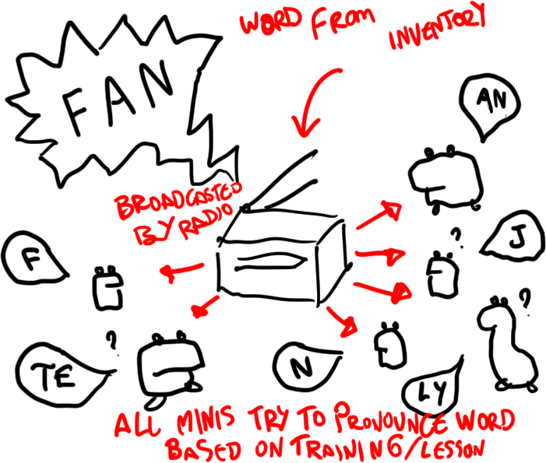
The player invests, from his own storage, the word FAN. It is the “seed word”.
He gives the word to the radio, which propagates it to the different Minis.
Minis then do their best to show the parts of the word—how well they do depends on experience points— how many skill-based words the player has built and “spent” on their training.
© Curriculum Associates & Frima Studio 2015 | All rights reserved | Confidential

Slide 12
Core Mechanic - Craft
The second core mechanic requires the player to craft words, from letters/syllables and components given by the Minis.
Minis of different shapes provide different outcomes.
Some Minis only give letters
Some Minis only give syllables
Some Minis only give word components
The Minis finally need a “seed word” to produce their outcome.
The player give the Minis the word FAN, hoping to get the letters A and N.
Once the Mini has everything he needs to produce an outcome, the player can interact with him to get the said outcome.
Once the player has all the outcomes he is looking for, he can merge them together and thus, craft words.
Ex.: Minis gave the letters LY, F, A and N. The could either craft FLY and AN, or the word FAN.
© Curriculum Associates & Frima Studio 2015 | All rights reserved | Confidential

Slide 13
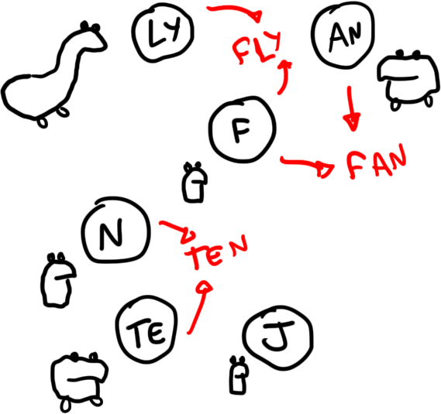
The Minis says different letters, syllables or word component.
From there, the player merge together the outcomes to create words.
© Curriculum Associates & Frima Studio 2015 | All rights reserved | Confidential

Slide 14
Core Mechanic - Sort
The third core mechanic requires the player to manage the words produced by the Mini.
The player has different options to put a word into use:
The player can store the word for later use.
The player can convert the word into experience points.
The player can simply discard the word.
Storing a word gives the player the ability to use it later in different actions:
Filling requests
Seeding the word to create new outcomes
Converting the word into experience points
The store has a limited capacity that can be upgraded from the shop.
Seeding a word to the Minis restarts the loop from the Invest mechanic.
Converting the word into experience points is necessary to have the Minis understand as many words as possible, based on the Foundation skills. In other words, making skill-based words and converting them to experience points brings the Minis up in their skill level.
A Mini insufficiently trained will not understand a word and may produce unrelated outcomes.
Ex. : An undertrained Mini encountering the word BIOLOGY may produce letters like E, A, J, N and such, as he’s too confused to spell it right.
© Curriculum Associates & Frima Studio 2015 | All rights reserved | Confidential

Slide 15
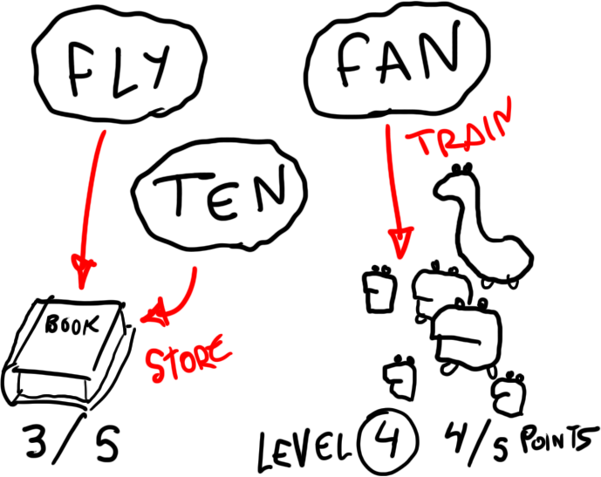
The player need to sort the crafted words by either storing them in the Book or giving them to the Minis
Giving them to the Minis increases their experience points, which helps them understand higher skill words.
© Curriculum Associates & Frima Studio 2015 | All rights reserved | Confidential

Slide 16
Gameplay
Through the core mechanics the player has different objectives:
Select the correct word for the radio
Select the correct food to influence the Minis
Craft the correct letters, syllables and word components by combining them together correctly into words
Sort the words in the correct category (Storage or to Minis)
Find the correct word(s) to fill the NPC request
Earn currencies to upgrade and customize
Different rewards are given by those objectives:
Correctly selecting the word and food speed up the process to find the words the player is looking for
Keeping the right words give more chance to find the correct word to fulfill the NPC request
Feeding the Minis enough trains them to be closer to the word the player is looking for
Correctly answering the NPC request provides currency
Earning currencies let the player purchase upgrades and customization
The elements create multiple behaviors.
Send the right word on the radio, for the Minis to produce the correct components.
Increase your chance of earning the correct components by giving them the appropriate meal.
Predict words through the available letters provided by the Minis
Decide what to do with each word
Determine the NPC request
Decide what to do with the currencies.
© Curriculum Associates & Frima Studio 2015 | All rights reserved | Confidential

Slide 17
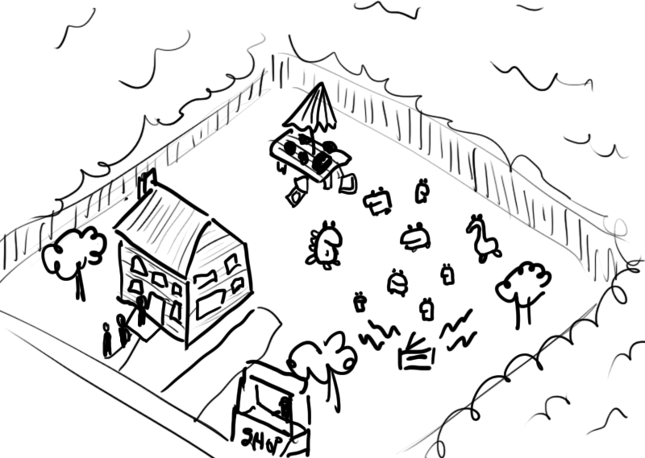
The player can access all mechanics from the screen showing his house and the backyard.
From there, the player can give food, set the radio, check the Minis, purchase at the shop and answer neighbors’ requests.
© Curriculum Associates & Frima Studio 2015 | All rights reserved | Confidential

Slide 18
Secondary Mechanics
Different secondary mechanics can be added to enhance the core mechanics.
NPC Requests
Following the lessons the player is at, different NPC comes and ask the player for different words. They reward him with coins for the shop.
Minis Training
By converting words into experience points, the player trains the Minis to understand better more complex words. This reduces the chance of getting unexpected words.
Prime Components/Words
Minis could produce “prime” outcomes that are worth more to NPC.
They are notified via a shiny golden state on the word.
Giving a prime word to an NPC increased the value of its reward. Ex.: The word CAT would give 10 coins. A prime CAT would give 15 coins instead.
Rotten Components/Words
As the prime components, some components could be “rotten”.
They are notified via a dark, bland state on the word.
These would worth less to NPC Requests; they would reduce the value of the reward.
Shopping
Using the coins the player earns from the NPCs, the player can purchase different items.
These includs food for the Minis, more radios to affect the Minis, customization for his house or other upgrades, both for gameplay and cosmetics.
House Decoration
The player can decorate his house with objects he gets from the shop.
More creatures
As the player needs to create more complex words, additional creatures could join the party (ex.: a rockband of alien creatures that makes lyrics from the player’s words, or a creature that improvises words from other words provided)
© Curriculum Associates & Frima Studio 2015 | All rights reserved | Confidential

Slide 19
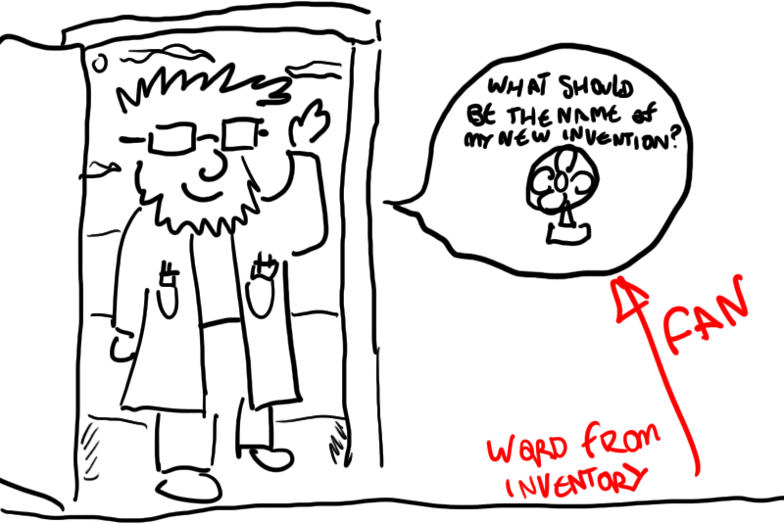
From the words he crafted, the player can fill requests by giving the neighbors the right word.
Fulfilling a request gives the player coins he can spend in the shop.
Non-picturable words can be showcased as blank spaces in an incomplete sentence provided by the character.
© Curriculum Associates & Frima Studio 2015 | All rights reserved | Confidential

Slide 20
Community Mechanics
In addition to the secondary mechanics, a community with more mechanics could be added.
The community is a group that promotes interaction between the players of a same school class.
Community Requests
Each player from the community can ask for requests to other players. The requests are taken from a list of supported words, each linked with a lesson. The requests are then automatically attributed to a player that is close to the lesson in term of progression. Proposing and completing the request awards community coins.
Community Marketplace
Players from any class, school or district can trade at the marketplace. They can sell their own words for store currency, or buy words they need.
Community Goals
All players of the community strive to reach the same goal, which requires them to accumulate a specific amount of community coins. Once a goal is reached, all players from the community receive additional objects to decorate their community and house.
Community Museum
Each player of the community also has a specific space in a museum where they can showcase a word they like or are proud of. The complexity of the word could award a certain amount of community coins or store currency on a frequent basis.
Community Decoration
From the goals they fulfill and the coins they amass, the players can decorate the community the way they like.
Community Arena
Players could compete with each other in an arena by trying to be the one that creates the hardest word (scrabble like score). They would need to feed their Minis and select the right components and words, as they do at their house.
© Curriculum Associates & Frima Studio 2015 | All rights reserved | Confidential

Slide 21
Cross-Age Structure
As outlined on Slide 6, the story should progress according to the player’s age. So should most of the secondary mechanics.
The secondary mechanics should be distributed among the years in the following manner:
5-6 years old – The student has no secondary mechanics and the core mechanic is simplified to include the Phonological Awareness Skills.
6-7 years old – The student has simple requests that provides no currency. He can decorate the house and has to train Minis.
7-8 years old – The student has advanced requests that reward currency. He also has access to the community requests , goals and decoration.
8-9 years old – The student has complex requests and Prime/Rotten components. He has access to the marketplace.
9-10 years old – The student has access to the museum.
10-11 years old – The student has access to the arena.
The NPC requests and training of the Minis should be bound to the player’s skill, as they are following closely the different lessons the player is learning.
Training the Minis is necessary to be on par with the requests that get progessively harder (following the Foundation Skills).
This gives us also the ability to speed up the learning for an older student with a lower skill, by reducing the number of requests per lesson, and the number of words required to train the Minis further.
© Curriculum Associates & Frima Studio 2015 | All rights reserved | Confidential

Slide 22
Adaptation to Phonemic Awareness Instruction
As Phonological Awareness students learn sounds before letters, we need to adapt this character-heavy system to this skill level.
Students who still have to complete Phonological Awareness Skills need to instruct a creature about sounds.
Having the creature say the sounds fits well in the narrative, but constrains the player —player has to learn the Phonological Awareness skills before beginning Phonics.
Instead of harvesting word components, the player will be provided phonemes, words, voice-over and images, and will need to select the right sounds for the creature.
This sequence will be much more controlled, giving the player fewer options.
This can be an issue with older players working at Grade K skill level.
The game reverts to normal as soon as the player starts his Phonics skills.
© Curriculum Associates & Frima Studio 2015 | All rights reserved | Confidential

Slide 23
Questions to discuss
Following the reading of the document (and the previous one), we need to ask ourselves a few questions, in order to correctly elaborate our next step:
What kind of narrative tone should we aim for?
The first concept was serious while being much more fantasy world.
The second concept is funny, while being set in a more realistic world.
How problematic is a repetitive gameplay?
The first concept had little to no repetition, as every action was aimed at a goal defined by the story.
The second concept requires the player to produce a large quantity of words to amass coins and a variety of words.
How important it is to embed our word-crafting mechanic into story, providing it a definite context, or can the user play a more abstract gameplay?
The first concept use words exactly for what they meant to be used at, as each word was part of a dialogue.
The second concept use words in a more abstract way, by putting focus on their structure rather than their usage.
How much should we put emphasis on community and other activities focused on the class?
The first concept had very few social features.
The second concept makes the players part of a village, where everybody needs to help each other.
How could we teach students the Foundation Skills without having them craft words?
The first two concepts used different kind of word-crafing mechanics.
How can we try something else next?
© Curriculum Associates & Frima Studio 2015 | All rights reserved | Confidential

