Slide 1
Lab Tracker preserves the reasoning around experiments.
The repo is a small research-context system: projects contain questions, sessions produce datasets, analyses support claims, and visualizations stay linked to the evidence that made them.
8
27
3
8
active projects
questions in example graph
datasets
tracked visualizations
Useful coworker framing: Lab Tracker is where a lab can see what a file or plot was for, what question it addressed, and which claims it supports.
Sources: README.md, retained-v1 surface, Lab Tracker MCP decision context.
01

Slide 2
SYSTEM
The repo is an API-backed research graph with app, CLI, and MCP entrypoints.
React app
/app dashboard, graph, capture, review
Service layer
File storage
Validation, permissions, graph projection, graph draft orchestration
Note and visualization assets
FastAPI routes
Projects, questions, notes, sessions, datasets, analyses, claims, visualizations, graph drafts
CLI / scripts
lab-tracker, lt client, setup helpers
Repository
Dolt mirror
SQLite by default; Postgres for shared multi-client runtime
Export-only versioned snapshot
MCP server
Read graph context before research-facing decisions
Sources: README.md, docs/internal-boundaries.md, docs/lab-tracker-mcp-skills.md.
02

Slide 3
DATA MODEL
The evidence model links why -> data -> analysis -> claim -> visualization.
Question
Dataset
Analysis
Claim
Visualization
What was this work trying to answer?
What data got committed or staged?
Which code/run touched it?
What conclusion is supported?
Which graph or figure shows it?
question parent links
26
Live example: PhD zebra finch song learning
27 questions, 3 datasets, 3 analyses, 8 supported claims, 8 visualization records. The graph keeps the reasoning chain inspectable instead of burying it in filenames and papers.
dataset-question links
18
analysis-dataset links
3
claim support links
8
visualization links
16
Source: local /projects/{id}/graph?view=evidence for PhD zebra finch song learning.
03

Slide 4
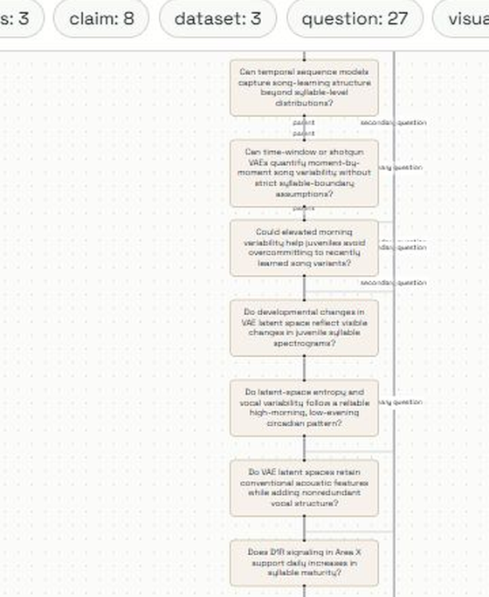
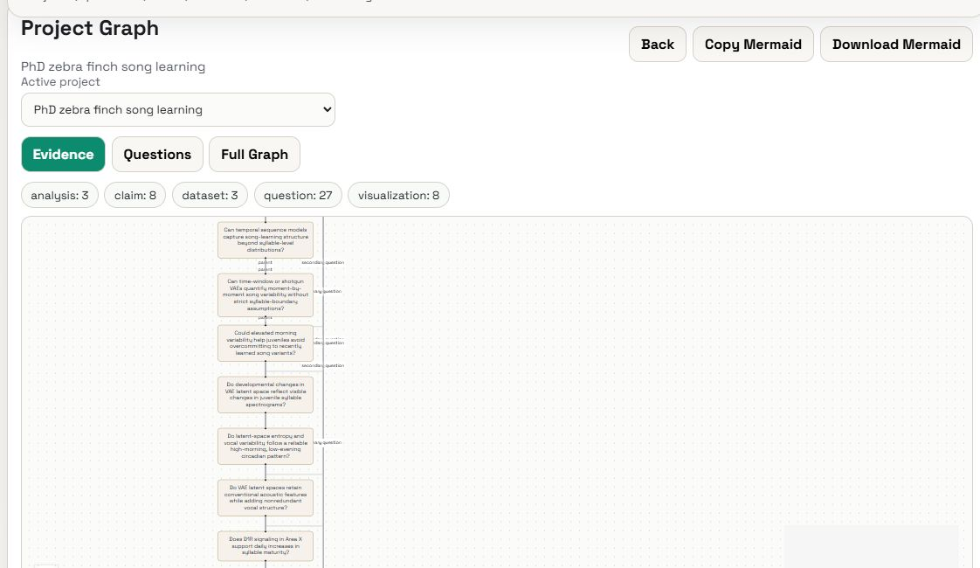
ACTUAL APP GRAPH
The app already renders the live evidence graph.
What this is
A screenshot from the local app route /app/graph, using the evidence view for the PhD zebra finch project.
The nodes come from the live API projection, not a hand-made diagram: questions, datasets, analyses, claims, and visualizations are all first-class records.
Left: readable crop of the live evidence graph. Above: the same graph in the app, with Evidence / Questions / Full Graph tabs and Mermaid export.
There is also a Mermaid export for sharing the same graph outside the app.
Source: screenshot from local Lab Tracker /app/graph evidence view.
04

Slide 5
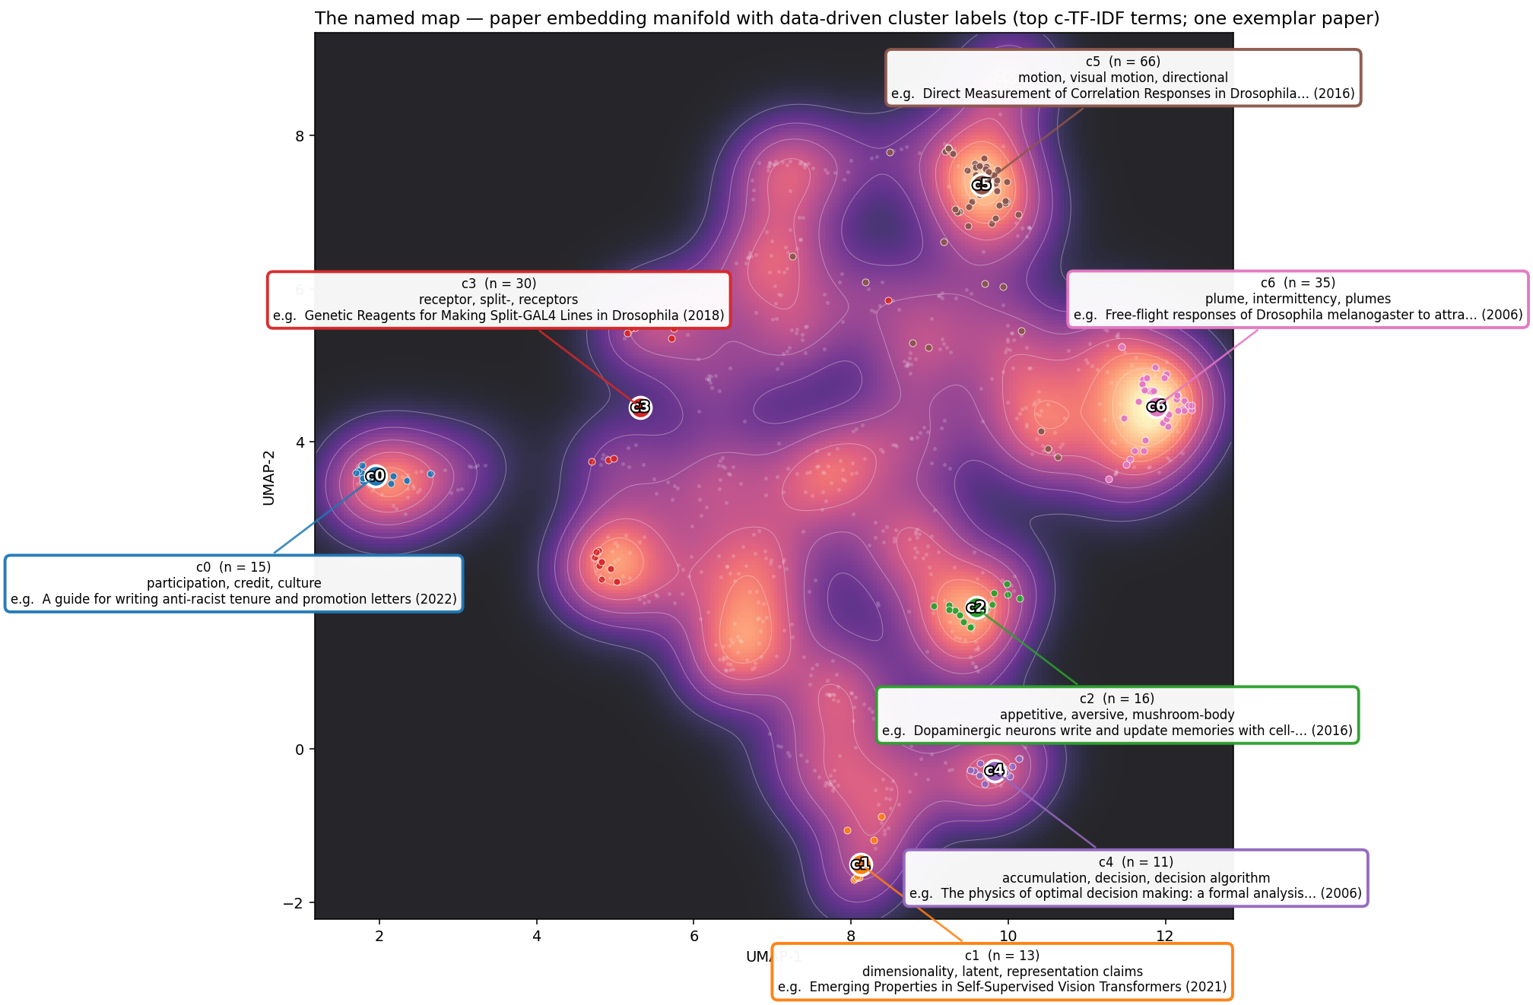
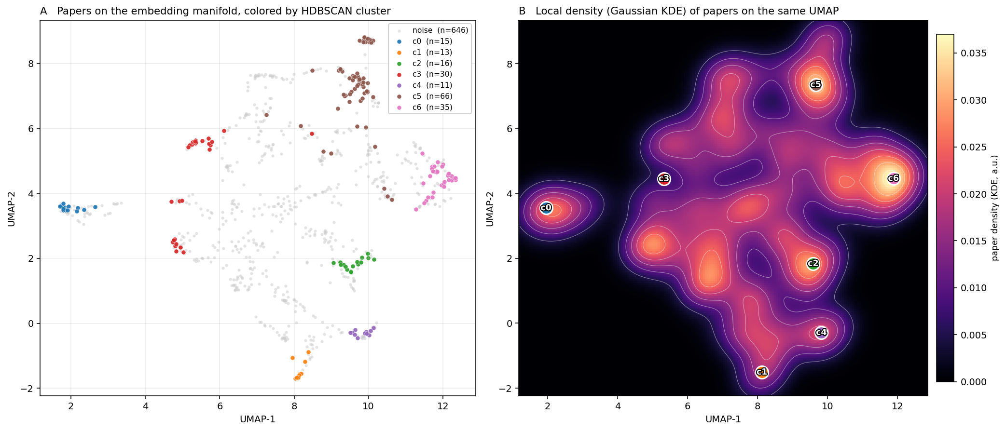
ACTUAL GRAPHS
The graph is tracking real analysis figures, not just metadata.
Example tracked output: a paper-embedding manifold over 832 papers and 9,937 chunks. HDBSCAN finds 7 dense clusters covering 22% of papers; the rest form the diffuse manifold.
Lab Tracker stores the question context and notes around these plots so a coworker can tell what the figures answer and where the next analysis branch lives.
Source PNGs: C:/Users/snb6/Documents/GitHub/LiteratureEmbeddings/plots.
05

Slide 6
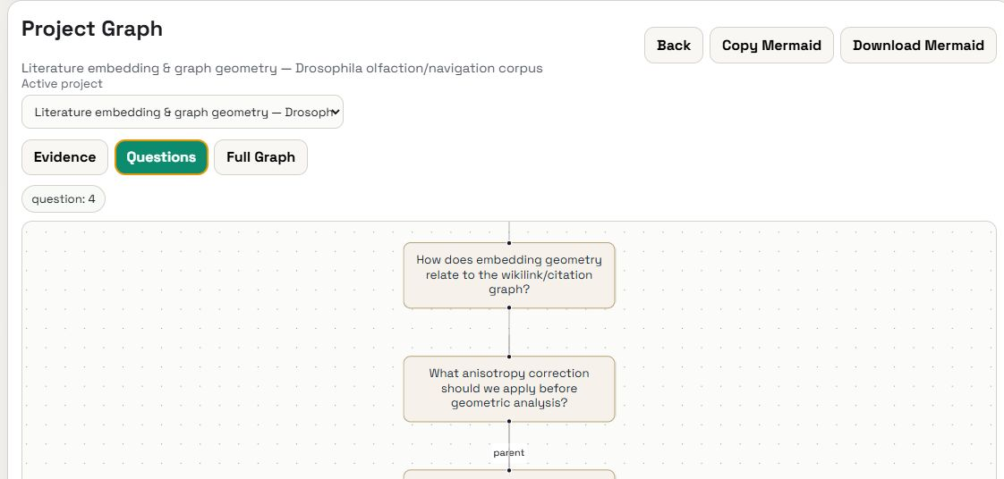
GRAPH-AWARE CAPTURE
AI suggestions are reviewable graph drafts, not automatic graph mutation.
Capture note
Build context
Draft ops
Human review
Photo, voice, photo+voice, text, or manual note.
Project, targets, recent notes, questions, datasets, claims, visualizations.
Model proposes structured graph operations with uncertainty.
Edit, accept, reject, submit, then commit through the API.
Why it matters
The model sees the existing graph before suggesting changes. That is the main product idea: use the lab record as context, then keep humans in charge of the commit.
This is also why the repo exposes an MCP decision-context tool for assistants.
Sources: docs/mobile-graph-aware-image-draft-review.md and docs/mcp-decision-context-tooling.md.
06

Slide 7
DEMO PATH
A quick coworker demo can stay under five minutes.
1. Open the app
2. Open Project Graph
3. Show plots
http://127.0.0.1:8000/app
Pick an active project and show the dashboard counts.
Use Evidence, Questions, and Full Graph tabs. Export Mermaid when you want a portable graph.
Use the literature project notes and plot outputs as the concrete example.
Useful commands
One-sentence explanation
uv run uvicorn lab_tracker.asgi:app --reload
uv run pytest -q
npm run test:frontend
bd ready --json
Lab Tracker is a lightweight graph-backed lab notebook that keeps the question, data, analysis, claim, and visualization chain inspectable.
The current scope is intentionally retained-v1: durable research records first, deferred automations later.
Source: README.md quickstart and retained-v1 surface.
07

