Slide 1
Lab Tracker: preserving experimental rationale
Questions → evidence → claims → figures
Source: docs/research-group-presentation.md
01

Slide 2
CORE PREMISE
A useful record includes why an experiment was done.
Source: docs/research-group-presentation.md
02

Slide 3
PROBLEM MAP
The argument has three linked problems.
Problem 1
record loses rationale
Problem 2
assistant lacks goals
Problem 3
manual maintenance fails
The experiment record loses the motivating question.
The assistant then lacks the same lab context.
Manual bookkeeping is too brittle to fix this reliably.
Source: docs/research-group-presentation.md
03

Slide 4
PROBLEM 1
Problem 1: the record loses the question an experiment answered.
Problem 1
record loses rationale
Problem 2
assistant lacks goals
Problem 3
manual maintenance fails
missing: answered
bench note (fly07)
divisive-norm fit
Does lateral inhibition
normalize PN output?
missing: answered
2025_12_10_Rig2_
session001.nwb
Fig 3b (draft)
Later readers see artifacts, but not the question each artifact was meant to resolve.
Source: docs/research-group-presentation.md
04

Slide 5
PROBLEM 2
Problem 2: assistants inherit the missing context.
Problem 1
record loses rationale
Problem 2
assistant lacks goals
Problem 3
manual maintenance fails
prompt + files
model
plausible output
not in the prompt
project goal
question hierarchy
prior claims
The failure is not reasoning capacity. It is absence of lab-specific context.
Source: docs/research-group-presentation.md
05

Slide 6
PROBLEM 3
Problem 3: complete context is not maintainable by manual bookkeeping.
Problem 1
record loses rationale
Problem 2
assistant lacks goals
Problem 3
manual maintenance fails
link note -> question
new note
link dataset -> question
current graph
new analysis
link claim -> evidence
If each edge depends on separate manual entry, the graph falls behind ordinary lab work.
Source: docs/research-group-presentation.md
06

Slide 7
RESOLUTION
A shared graph preserves rationale for later review.
Does lateral inhibition
normalize PN output?
later review:
the motivating question
question addressed
2025_12_10_Rig2_
session001.nwb
divisive-norm fit
Fig 3b
A figure stays traceable to the question its claim answers.
Source: docs/research-group-presentation.md
07

Slide 8
RESOLUTION
The same graph can supply an assistant context packet.
Does lateral inhibition
normalize PN output?
model
later review:
the motivating question
question addressed
2025_12_10_Rig2_
session001.nwb
divisive-norm fit
context packet
- lab goal
- question tree
- linked evidence
- prior claims
Fig 3b
Source: docs/research-group-presentation.md
08

Slide 9
RESOLUTION
Capture proposes graph updates for human review.
Does lateral inhibition
normalize PN output?
model
later review:
the motivating question
question addressed
2025_12_10_Rig2_
session001.nwb
divisive-norm fit
context packet
- lab goal
- question tree
- linked evidence
- prior claims
raw note
draft operations
link note -> question
attach evidence
Fig 3b
human review
Source: docs/research-group-presentation.md
09

Slide 10
WHAT IT IS
Lab Tracker records semantic edges among existing lab artifacts.
bench note (fly07)
Does lateral inhibition
normalize PN output?
divisive-norm fit
2025_12_10_Rig2_
session001.nwb
PN gain ×0.6 (n=18)
Fig 3b
control question:
presynaptic on ORNs?
The system stores references to artifacts and the scientific edges between them.
Source: docs/research-group-presentation.md
10

Slide 11
QUESTIONS FIRST
Begin with a motivating question.
motivating question
answerable question
dataset
analysis
supported claim + figure
Source: docs/research-group-presentation.md
11

Slide 12
QUESTIONS FIRST
Decompose it into answerable questions.
motivating question
answerable question
dataset
analysis
supported claim + figure
Source: docs/research-group-presentation.md
12

Slide 13
QUESTIONS FIRST
Link datasets and analyses to their questions.
motivating question
answerable question
dataset
analysis
supported claim + figure
Source: docs/research-group-presentation.md
13

Slide 14
QUESTIONS FIRST
Treat claims as supported only when evidence is attached.
motivating question
answerable question
dataset
analysis
supported claim + figure
Source: docs/research-group-presentation.md
14

Slide 15
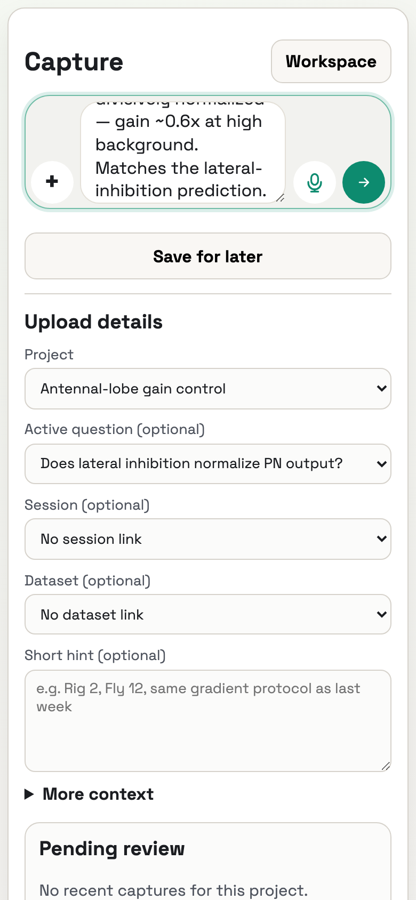
CAPTURE
Capture begins with the raw note.
Source: docs/research-group-presentation.md
15

Slide 16
CAPTURE
Graph context is added before model interpretation.
raw note
context packet
proposed operations
reviewer decision
Source: docs/research-group-presentation.md
16

Slide 17
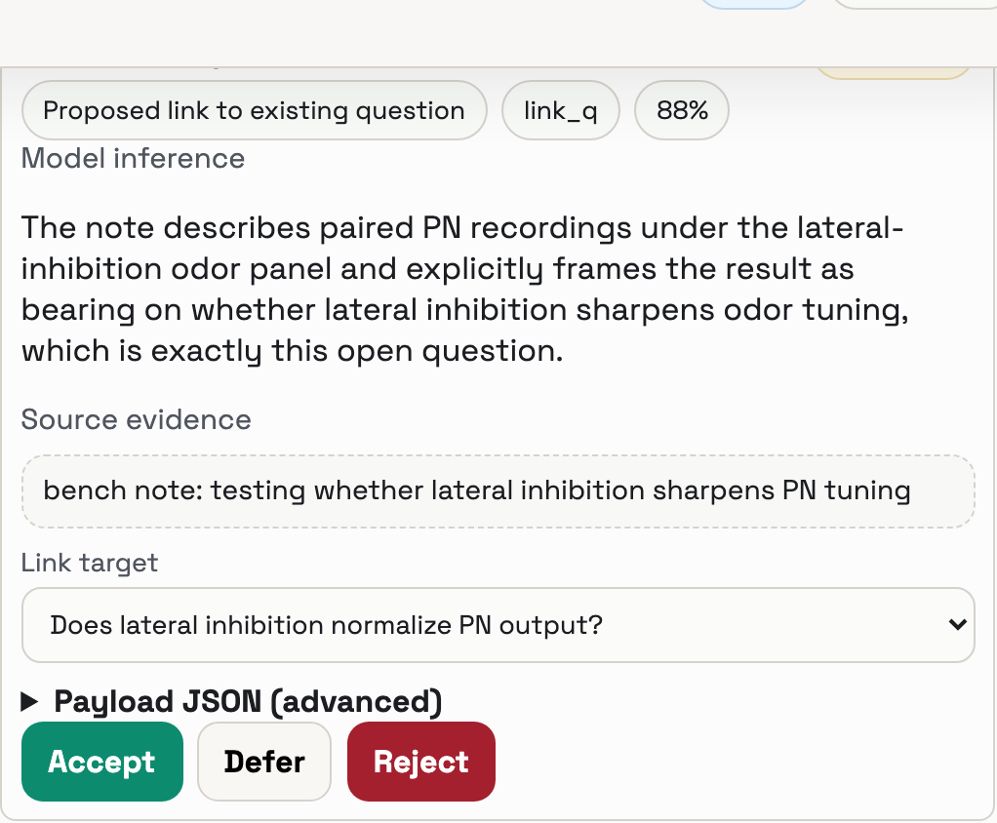
CAPTURE
The model returns proposed graph operations.
Source: docs/research-group-presentation.md
17

Slide 18
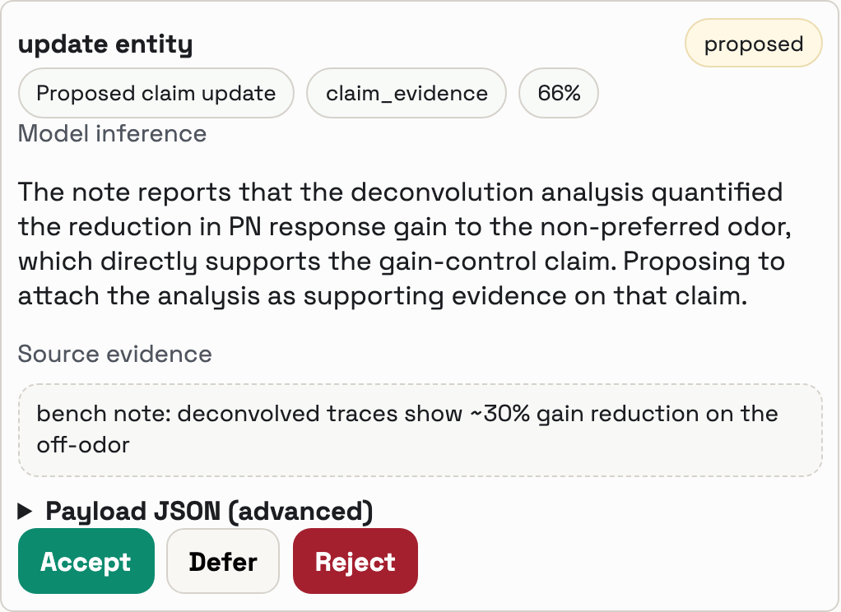
CAPTURE
The reviewer decides what enters the record.
Source: docs/research-group-presentation.md
18

Slide 19
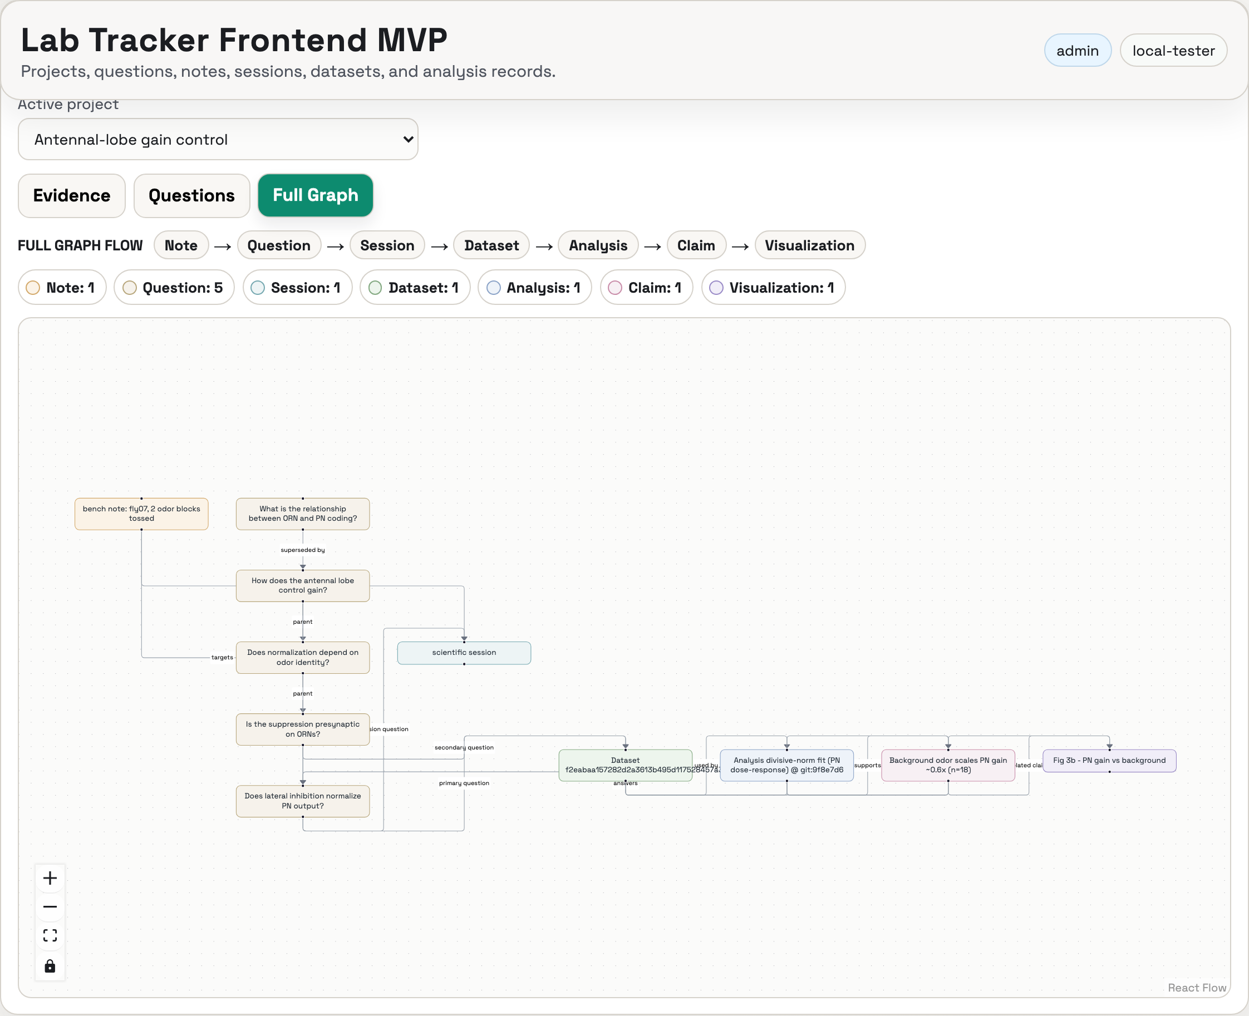
FIRST USE CASE
One project, its question hierarchy, and one result.
Source: docs/research-group-presentation.md
19

