Slide 1
Do hormonal contraceptives differ in their effect?
Study B — three methods, 93 people, genes and microbiome
Group B1–B5

Slide 2
What this deck is. One presentation answering the three Study B questions — do the three methods differ in community composition, does the ring differ from the two systemic methods in host gene expression, and does community type explain the genes better than the method does. The full workings live in the workshop documents — 01-qc.html (QC), 02-ring-vs-systemic.html and 03-three-arms-review.html (Question 2), 05-q1-three-arms-composition.html (Question 1) and 06-q3-community-vs-method.html (Question 3); this deck recomputes the headline numbers from the data so every slide can be traced. Because PowerPoint wants small numbers of things, each slide carries only the headline figure plus the sample sizes it is based on.

Slide 3
Study B in one slide

Slide 4
Who, what, how many
Method | Samples
Pill | 28
Injectable | 39
Vaginal ring | 26
93 participants, one vaginal swab each, one visit — no time course.
Each person used one of three hormonal contraceptives they chose themselves (this is not a randomised trial):

Slide 5
Two sequencing tables for the same 93 samples, features in rows: species (220 species × 93 samples) and host genes (14,226 genes × 93 samples), plus 15 cytokines.
Question for the week: do the methods differ in their effect? We answer it three ways — on the microbiome, on the genes, and by asking whether “community type” explains the genes better than the method does.

Slide 6
Before any result: what the arms might differ in besides the method
Baseline variable | Different across arms?
Bacterial vaginosis | no (Fisher p = 0.63)
Any STI | no
Nugent score | no (p = 0.65)
Sequencing batch | no — every arm in both batches
Vaginal pH | yes (Kruskal–Wallis p = 0.02)
No randomisation. People chose their method. So any difference between arms could be the method, or something else that tracks the choice.
We checked the baseline variables (01-qc.html):

Slide 7
The one real imbalance: vaginal pH. Median 4.55 in the pill arm vs 5.0 in ring and injectable; the ring arm has no sample below pH 4.4.
pH tracks both hormones and the vaginal microbiome, so it may be a confounder (distorting a method comparison) or on the causal path (part of the method’s effect). We show the unadjusted answer and note where pH changes it (Question 3 of 03-three-arms-review.html).
Everything we present is an association in a self-chosen comparison, not a trial effect.

Slide 8
Power: who is compared with whom
Comparison | n | Note
All three arms | 93 | 28 pill / 39 injectable / 26 ring
ring vs pooled systemic | 26 vs 67 | the pooled control is 58 % injectable
ring vs pill | 26 vs 28 | most even ring comparison
ring vs injectable | 26 vs 39 | most powerful ring comparison
pill vs injectable | 28 vs 39 | the pooling check
community type (2 groups) | 93 | 48 lactobacillus / 45 anaerobe
Every comparison in this deck, with the samples it is built on:

Slide 9
The ring arm is the smallest, so ring comparisons have the least power; a bigger arm finds more “significant” genes for the same true effect.
With 26–39 per group, only large gene-expression differences reach FDR < 0.05; small shifts land in the “suggestive” pile.

Slide 10
Question 1 — do the three methods differ in community composition?

Slide 11
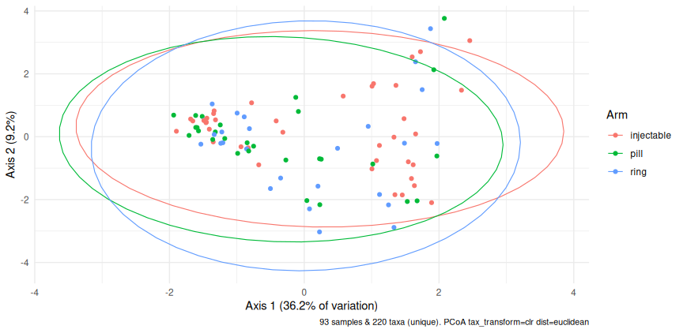
Q1: the microbiome map, three arms (n = 93)
Species-table PCoA (CLR + Euclidean) coloured by arm.

Slide 12
comparison | n | share of variation (%) | p (raw)
all three arms | 93 | 2.8 | 0.1748
PERMANOVA on species (CLR + Euclidean, adjusted for batch, 9,999 permutations)

Slide 13
Q1: the three methods do not carve the microbiome into three
comparison | n | share of variation (%) | p (raw) | p (adjusted, BH)
ring vs pill | 54 | 1.7 | 0.4579 | 0.4579
ring vs injectable | 65 | 1.7 | 0.3079 | 0.4579
pill vs injectable | 67 | 2.7 | 0.0834 | 0.2502
Pairwise PERMANOVA on species (9,999 permutations)

Slide 14
Answer: no clear three-way difference. The main test puts 2.8 % of the species-level variation on the method (p = 0.175, 93 samples) — not significant.
No pairwise comparison survives adjustment either. If the ring really reshaped the community differently from the systemic methods, we cannot see it here at this sample size.
What does structure this map is community type (lactobacillus vs anaerobe, axis 1 holds 36 % — 01-qc.html). That is the split Question 3 follows up.
No individual species stands out either: DESeq2 on raw species counts gives hit counts at chance level in every comparison (05-q1-three-arms-composition.html).
Sanity check: rerun q1-permanova with a different set.seed — the R² stays the same and the p-value should stay near 0.175.

Slide 15
Question 2 — the ring is local, the others are systemic: do the genes differ?

Slide 16
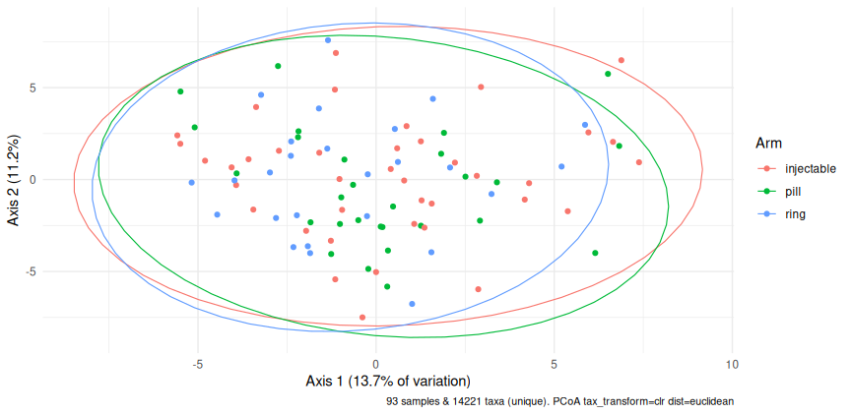
Q2: first ordinate the genes, all three arms (n = 93)
The arms overlap heavily on the map. The formal tests (9,999 permutations, 93 samples):
Gene-table PCoA (CLR + Euclidean, genes filtered at >=10 reads in >=10 samples) coloured by arm.

Slide 17
Test | Share of variation | p
arm (adjusted for batch) | 2.7 % | 0.101
ring vs pooled systemic | 1.7 % | 0.041
spread check (betadisper) | — | 0.66

Slide 18
The pooled test’s p sits on the 0.05 line (reruns with other seeds gave 0.03–0.055) — call it suggestive, not established.
The spread check says one arm is not just more scattered, which would fake a PERMANOVA difference.

Slide 19
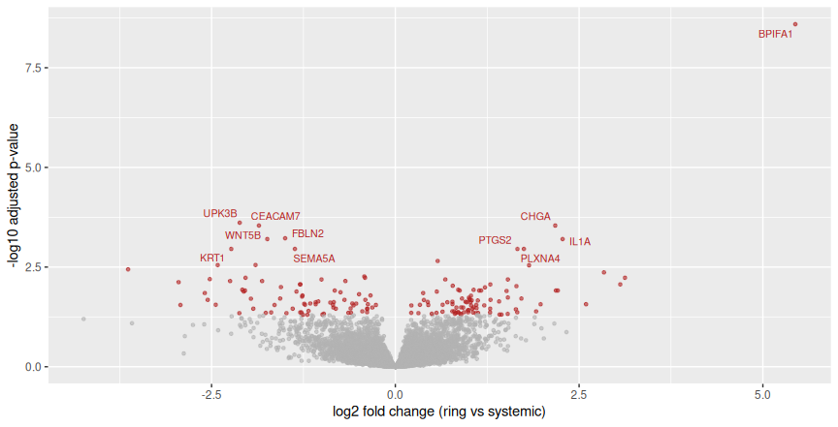
Q2: DESeq2 — ring vs pooled systemic (n = 26 vs 67)
165 genes at FDR < 0.05 (88 up in ring, 77 down) out of 14221 tested. Smallest FDR 2.6e-09.
Dropping the blood-contaminated sample B093 leaves 152 of 165 hits standing (92 %) — the list does not hinge on one sample (02-ring-vs-systemic.html).
Caveat from 03-three-arms-review.html: the raw-p hit lists are about twice what chance alone gives, and several top hits are keratins and mucus genes — the signal may partly be cell mix (how much surface tissue each swab caught), not the ring.
Volcano plot, ring vs systemic. Red: FDR < 0.05; labels: 10 smallest FDR.

Slide 20
Is pooling pill + injectable fair? (n = 28 vs 39)
evidence | result
pill vs injectable, DESeq2 genes at FDR < 0.05 | 11 (chance would give ~5–7)
pill vs injectable, raw p < 0.05 | 738 vs ~711 expected by chance
pill vs injectable, PERMANOVA (genes) | 1.4 %, p = 0.54
ring LFC vs pill vs ring LFC vs injectable (all genes) | r = 0.71, same direction
Evidence that the two systemic methods behave alike (from 03-three-arms-review.html)

Slide 21
Why it is fair: the two systemic arms are near-indistinguishable in the genes — 11 hits where chance predicts about 7, PERMANOVA p = 0.54, and the ring’s log2 fold changes point the same way against both (r = 0.71).
Two caveats: the pooled control is 58 % injectable, so “systemic” leans that way; and adjusting for the pH imbalance changes the ring-vs-pill list from 97 to 191 genes, so the pooled contrast is not the only defensible reading.
Alternative we did not choose: keep the three arms separate (03-three-arms-review.html does exactly that as a check).

Slide 22
Q2 verdict
The gene profile differs only subtly between ring and the systemic methods: PERMANOVA 1.7 % (p ≈ 0.04, borderline), three-arm test p = 0.10.
DESeq2 finds 165 genes at FDR < 0.05 (n = 26 vs 67) — mostly small shifts, possibly partly cell-mix rather than a true ring effect.
The effect, if real, is modest — no dramatic reprogramming of vaginal tissue. Follow-up: cytokines, cell-mix markers, and an independent cohort before calling it.

Slide 23
Question 3 — group by community type, then test the genes

Slide 24
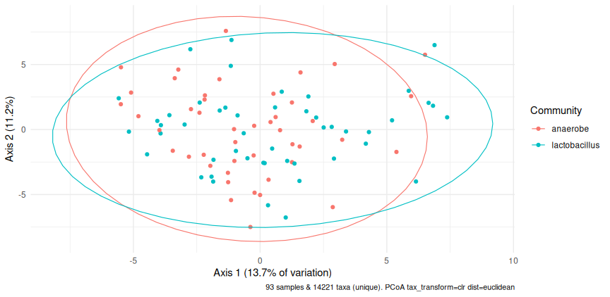
Q3: two community types, one map (n = 93)
Community type was assigned from the species table (Lactobacillus ≥ 50 % of species reads) and is tested on the gene table — the group is never defined from the table it is tested on.
Gene-table PCoA (same distances as Q2) coloured by community type.

Slide 25
Q3: does community type explain the genes better than the method?
term | n | share of variation (%) | p
community type | 93 | 1.4 | 0.1165
method (ring vs systemic) | 93 | 1.6 | 0.0532
PERMANOVA on genes: community vs method, each adjusted for the other (9,999 permutations)

Slide 26
grouping | PERMANOVA share (%) | p | DESeq2 genes at FDR < 0.05
community type (48 vs 45) | 1.4 | 0.1165 | 312
method, ring vs systemic (26 vs 67) | 1.7 | 0.0410 | 165
The two groupings head to head on the same gene table

Slide 27
Answer: about a tie on the overall map, community ahead gene by gene. On total variation the two groupings explain about the same small share (1.4 % vs 1.7 %), and neither marginal p-value is convincing. But gene by gene community type is the stronger signal: 312 genes at FDR < 0.05 vs 165 for ring vs systemic.
The two groupings are not the same thing in disguise: community composition is balanced across the arms (chi-squared p = 0.50), so this is a fair head-to-head, not a confounded one.
Why the mismatch between one map and many genes? A modest, consistent shift spread over many genes can pass the per-gene FDR while moving the overall profile only slightly.
Practical upshot for the group project: adjust for community type (or stratify by it) before interpreting gene differences between methods — and expect the method signal, if real, to be the smaller of the two.
One more reason to adjust: vaginal pH tracks community type far more strongly than it tracks the method (p ≈ 1e-07 vs 0.02, 06-q3-community-vs-method.html), and the two gene lists barely overlap (27 shared genes) — they are different signals, not one signal seen twice.
Full workings: 06-q3-community-vs-method.html.

Slide 28
Wrapping up

Slide 29
The three answers in three lines
Community composition: the three methods do not differ detectably (PERMANOVA 2.8 %, p = 0.175, n = 93). The strong structure is community type, not method.
Ring vs systemic genes: a small, suggestive difference — 1.7 % of variation (p = 0.041) and 165 genes at FDR < 0.05 (n = 26 vs 67), with cell-mix and pH caveats. Pooling the pill with the injectable is supported by the data (11 hits, p = 0.54, r = 0.71).
Community type vs method: about a tie on the overall gene map (1.4 % vs 1.7 % of variation, both weak p-values), but community type finds many more individual genes (312 vs 165). The groupings are independent (community is balanced across arms, p = 0.50) — report both, and adjust for community when reading method effects.
Standing caveat for all three: people chose their method, the arms differ in vaginal pH, and the ring arm is the smallest (n = 26) — treat every p-value here as a lead, not a verdict.

Slide 30
Choices made
Answered the workshop’s three questions in this order — composition, ring-vs-systemic, community-vs-method — one headline figure each; the alternative was to show every plot from the five analysis documents, which would bury the answers.
Community type defined from the species table and tested on the gene table (Lactobacillus ≥ 50 % of species reads, the notebook 02 rule); a stricter cut-off (60 %) or a third intermediate group is the alternative.
Species ordination/PERMANOVA on the unfiltered species table with CLR + Euclidean (half-min replacement), matching 01-qc.html; filtering rare species first is the alternative.
Gene ordination and DESeq2 on genes with ≥ 10 reads in ≥ 10 samples, matching 02-ring-vs-systemic.qmd; a stricter filter loses power, a laxer one wastes tests.
Raw counts into DESeq2 (it normalises itself); CPM or logged values would be wrong.
Reported both the three-arm and the pooled ring-vs-systemic PERMANOVA — the pooled one is the workshop’s question but sits on the p = 0.05 line; showing only it would overstate the evidence.
Quoted the pairwise DESeq2 and pH-sensitivity numbers from 03-three-arms-review.html rather than recomputing them here; rerunning every fit in the deck is the alternative.
Kept the deck as a summary layer over the five analysis documents (01 QC, 02+03 Question 2, 05 Question 1, 06 Question 3) rather than re-deriving every sensitivity check on a slide.
Used 9,999 permutations and by = "margin" for all PERMANOVA in this deck, following the review document’s correction of the sequential test.
Did not adjust the main results for pH (it may be on the causal path); where pH matters we say so explicitly — the fully adjusted model is the alternative.

