Slide 1
STUDY B · CONFERENCE PRESENTATION
Do hormonal contraceptives differ
in their effect?
Three methods, 93 people, microbiome and host genes
Group B1–B5 · Data Science for Biology workshop
Q1 Do the methods differ in community composition?
Q2 Does the ring differ from the systemic methods in genes?
Q3 Does community type explain the genes better than method?

Slide 2
THE WEEK IN ONE SLIDE
One dataset, three questions
Q1 — Community composition
Do pill, injectable and ring carve the vaginal microbiome into three?
Species table: 220 × 93
Test: PERMANOVA on CLR + Euclidean distances
Q2 — Ring vs systemic genes
The ring acts locally, the others systemically — do host genes differ?
Gene table: 14,226 × 93
Test: PERMANOVA + DESeq2 on raw counts
Q3 — Community vs method
Group by microbiome type, not method — which explains genes better?
Community: Lactobacillus ≥ 50 % of species reads
Rule: defined on species, tested on genes
Full workings: 01-qc.html (QC), 02 + 03 (Question 2), 05 (Question 1), 06 (Question 3) — every headline number in this deck can be traced to one of them.
Study B · Group B1–B5 · Data Science for Biology
2

Slide 3
SETUP
Who, what, how many
▪ 93 participants, one vaginal swab each, one visit — no time course
▪ Each person used one of three hormonal contraceptives they chose themselves — this is not a randomised trial
▪ Two sequencing tables for the same 93 samples, features in rows:
  – species — 220 species × 93 samples
  – host genes — 14,226 genes × 93 samples
▪ Plus 15 cytokines measured in the same samples
28
pill
39
injectable
26
vaginal ring
48 / 45
lactobacillus / anaerobe
community type
The question: do the methods differ in their effect? We answer it three ways — microbiome, genes, and community type vs method.
Study B · Group B1–B5 · Data Science for Biology
3

Slide 4
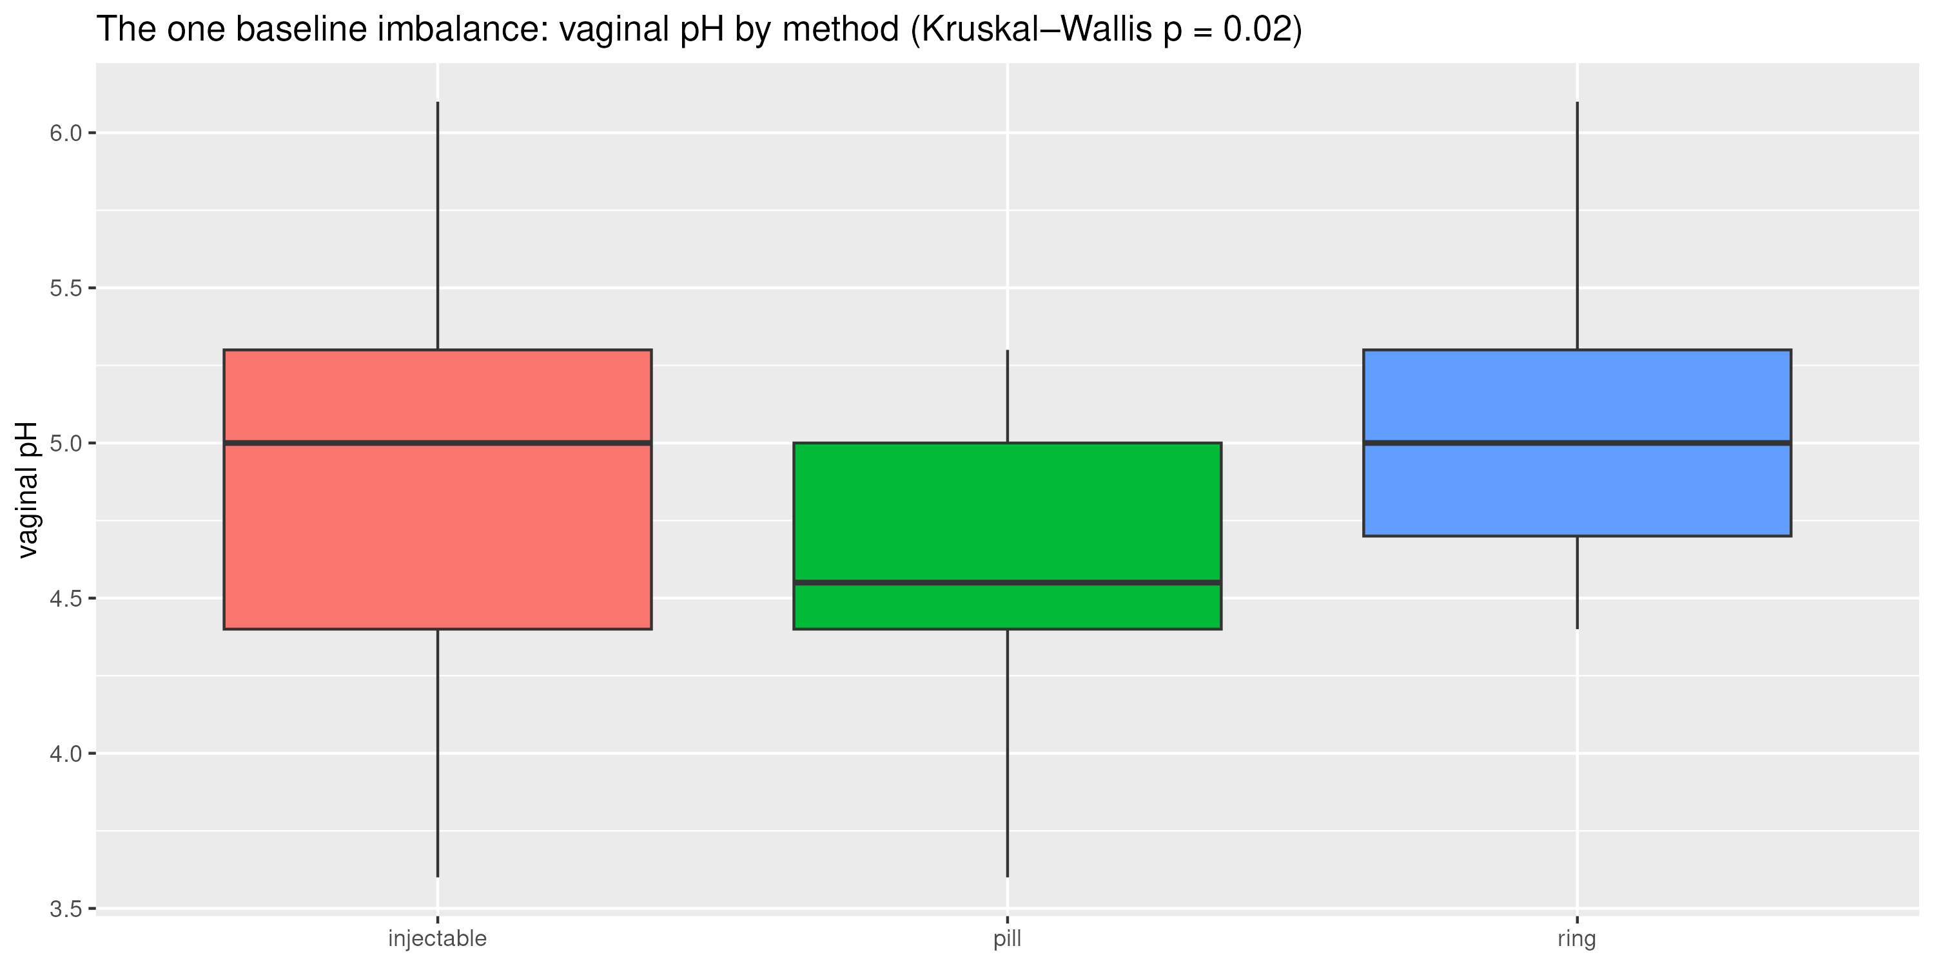
SETUP · CAVEATS FIRST
No randomisation — people chose their method
▪ Any arm difference could be the method or something that tracks the choice
▪ Checked every baseline variable:
  – Bacterial vaginosis — no (Fisher p = 0.63)
  – Nugent score — no (p = 0.65)
  – Sequencing batch — every arm in both batches
▪ Vaginal pH — yes, p = 0.02: median 4.55 in pill vs 5.0 in ring and injectable
▪ pH may be a confounder or on the causal path — we show the unadjusted answer and say where pH changes it
Vaginal pH by method — the one baseline imbalance
(Kruskal–Wallis p = 0.02)
Study B · Group B1–B5 · Data Science for Biology
4

Slide 5
SETUP · POWER
Who is compared with whom
Comparison | n | Note
All three arms | 93 | 28 pill / 39 injectable / 26 ring
ring vs pooled systemic | 26 vs 67 | pooled control is 58 % injectable
ring vs pill | 26 vs 28 | most even ring comparison
ring vs injectable | 26 vs 39 | most powerful ring comparison
pill vs injectable | 28 vs 39 | the pooling check
community type | 93 | 48 lactobacillus / 45 anaerobe
▪ The ring arm is the smallest — ring comparisons have the least power
▪ A bigger arm finds more “significant” genes for the same true effect
▪ With 26–39 per group, only large gene-expression differences reach FDR < 0.05
▪ Small shifts land in the “suggestive” pile — remember this when reading Q2
Study B · Group B1–B5 · Data Science for Biology
5

Slide 6
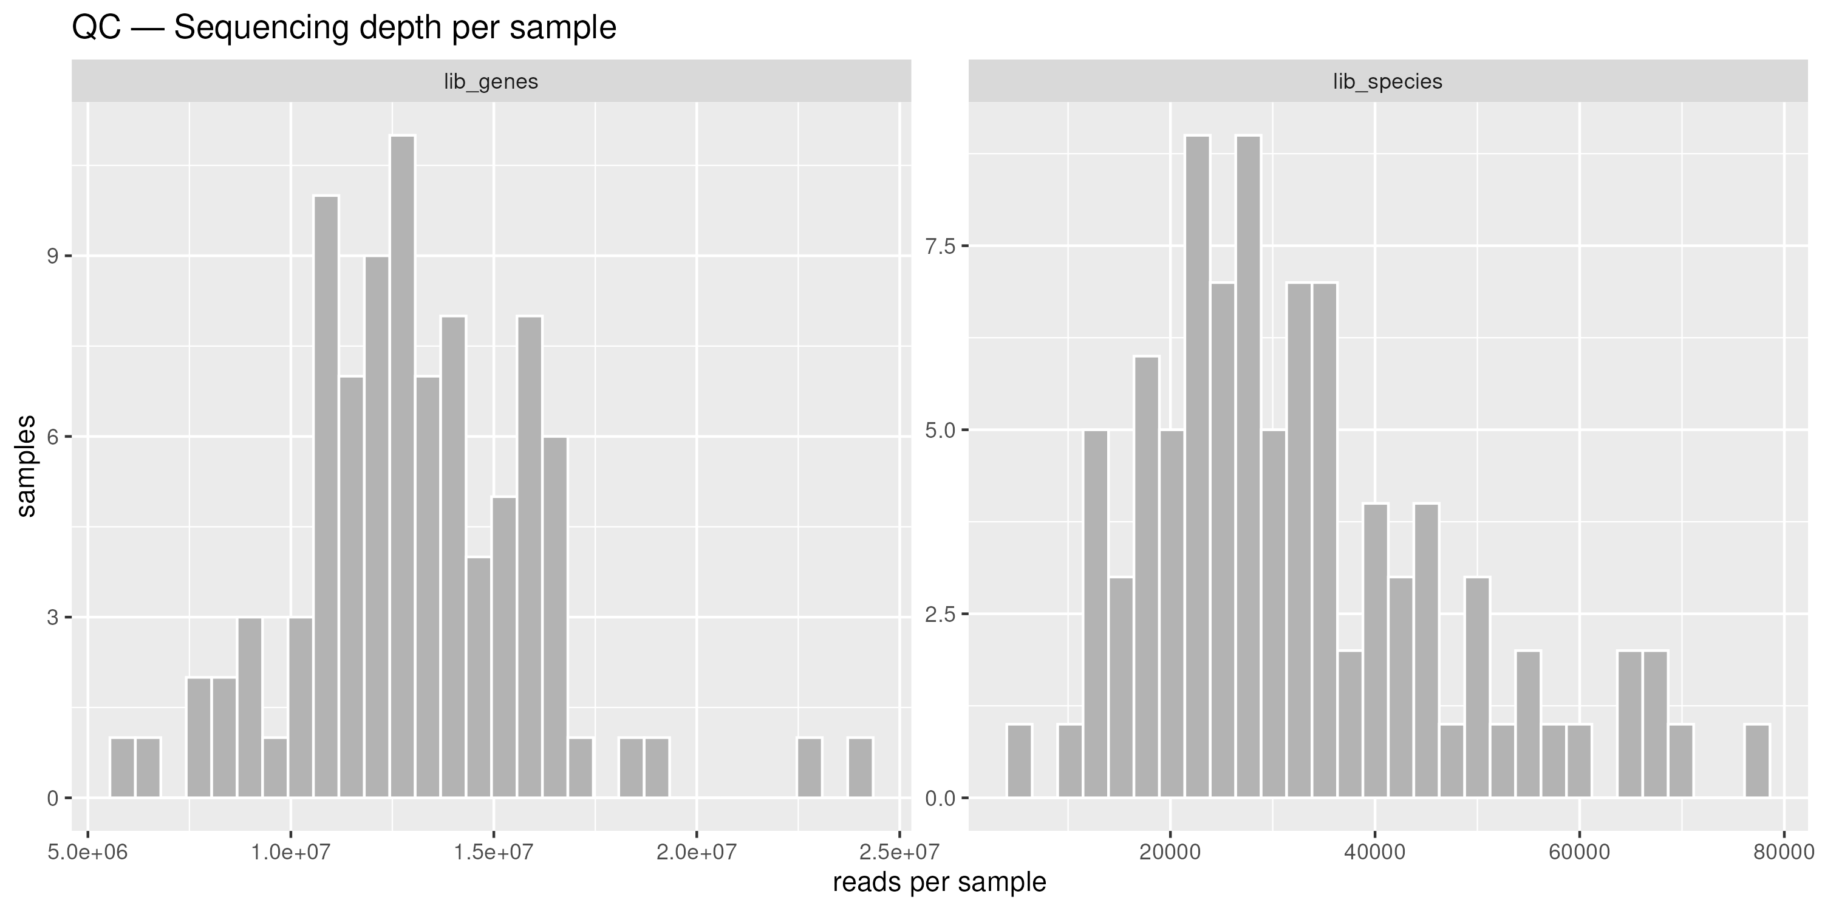
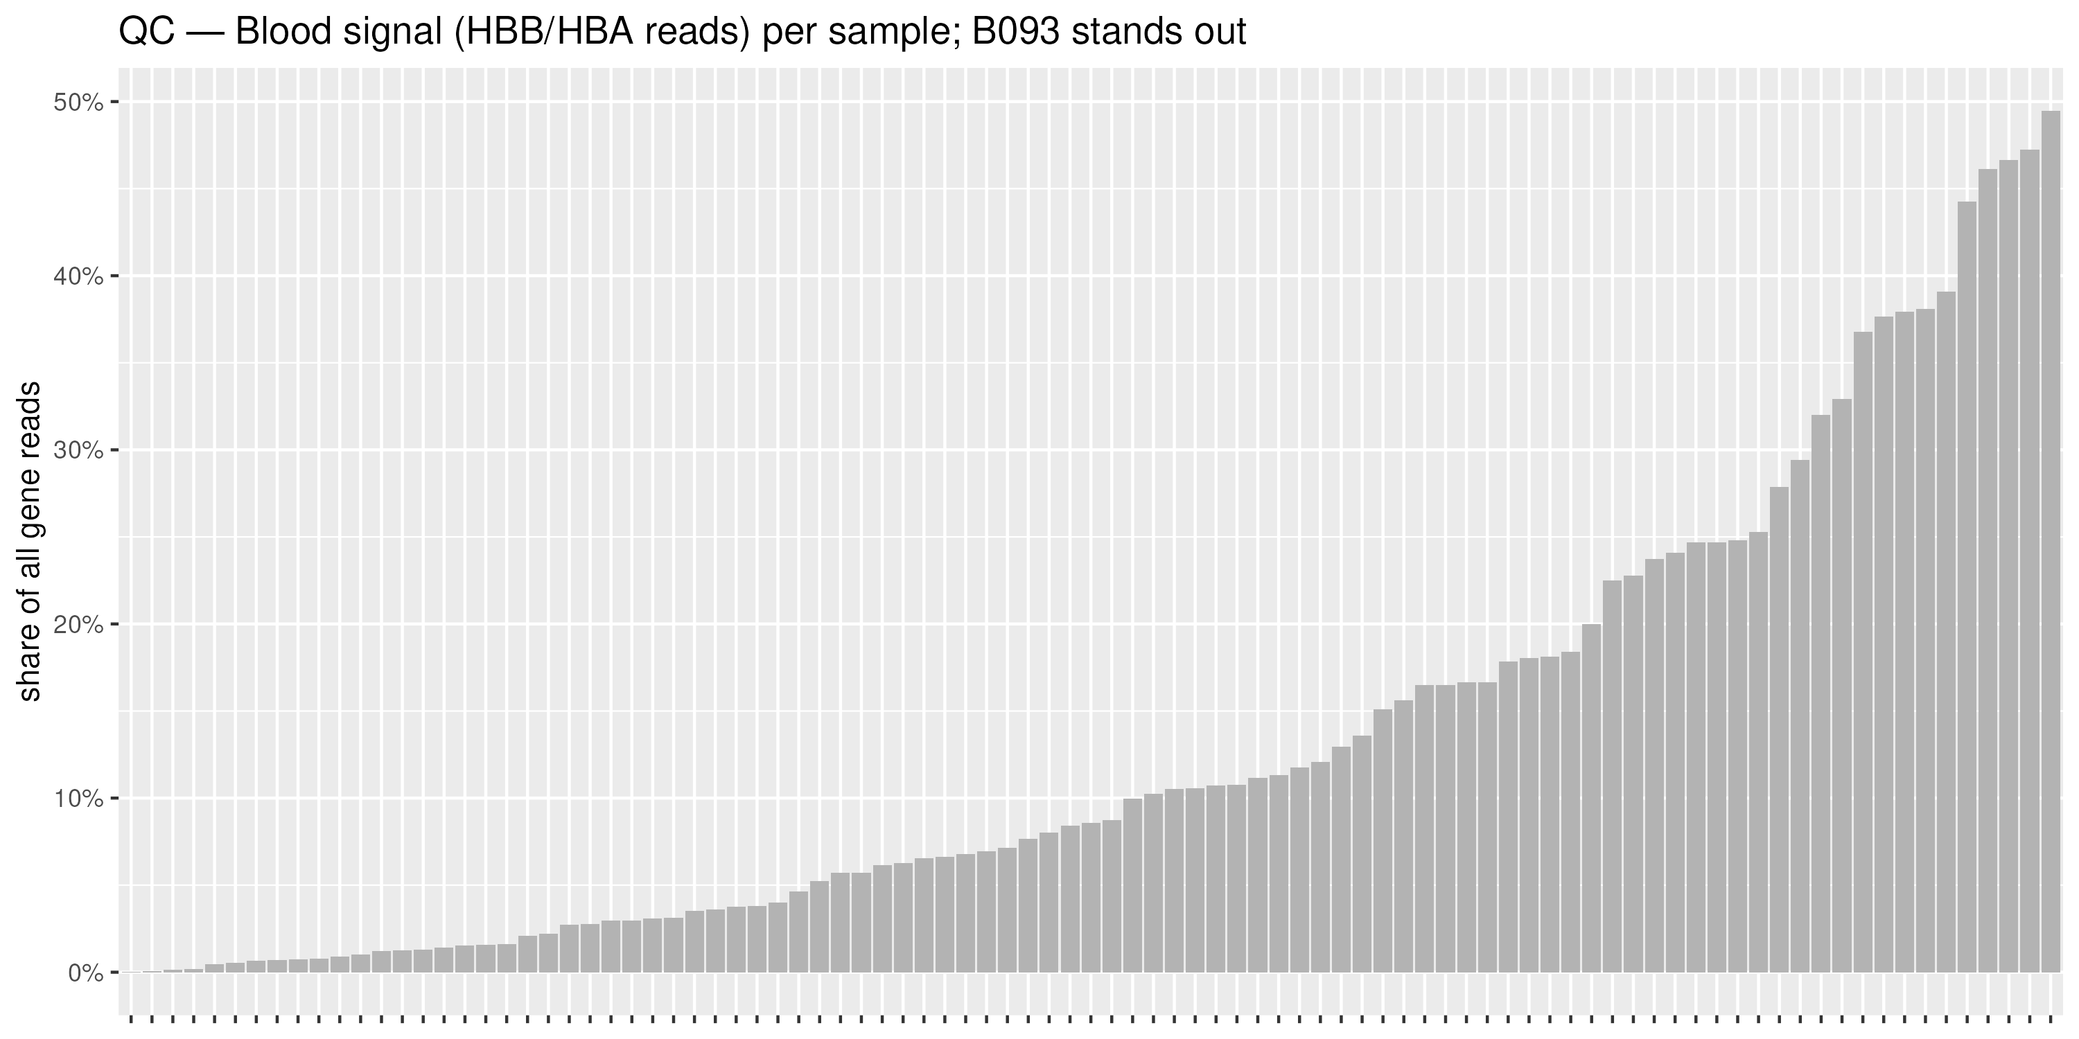
SETUP · QUALITY CONTROL
QC — the two things that mattered
Reads per sample, species vs RNA-seq — nine low-depth
microbiome samples flagged, none dropped
Blood (HBB/HBA) reads per sample — B093 carries about
one third blood reads; the 92 %-survival check covers it
Neither check changed the plan: nine low-depth samples kept (visible, not influential) and B093 not dropped — instead every hit list is retested without it.
Study B · Group B1–B5 · Data Science for Biology
6

Slide 7
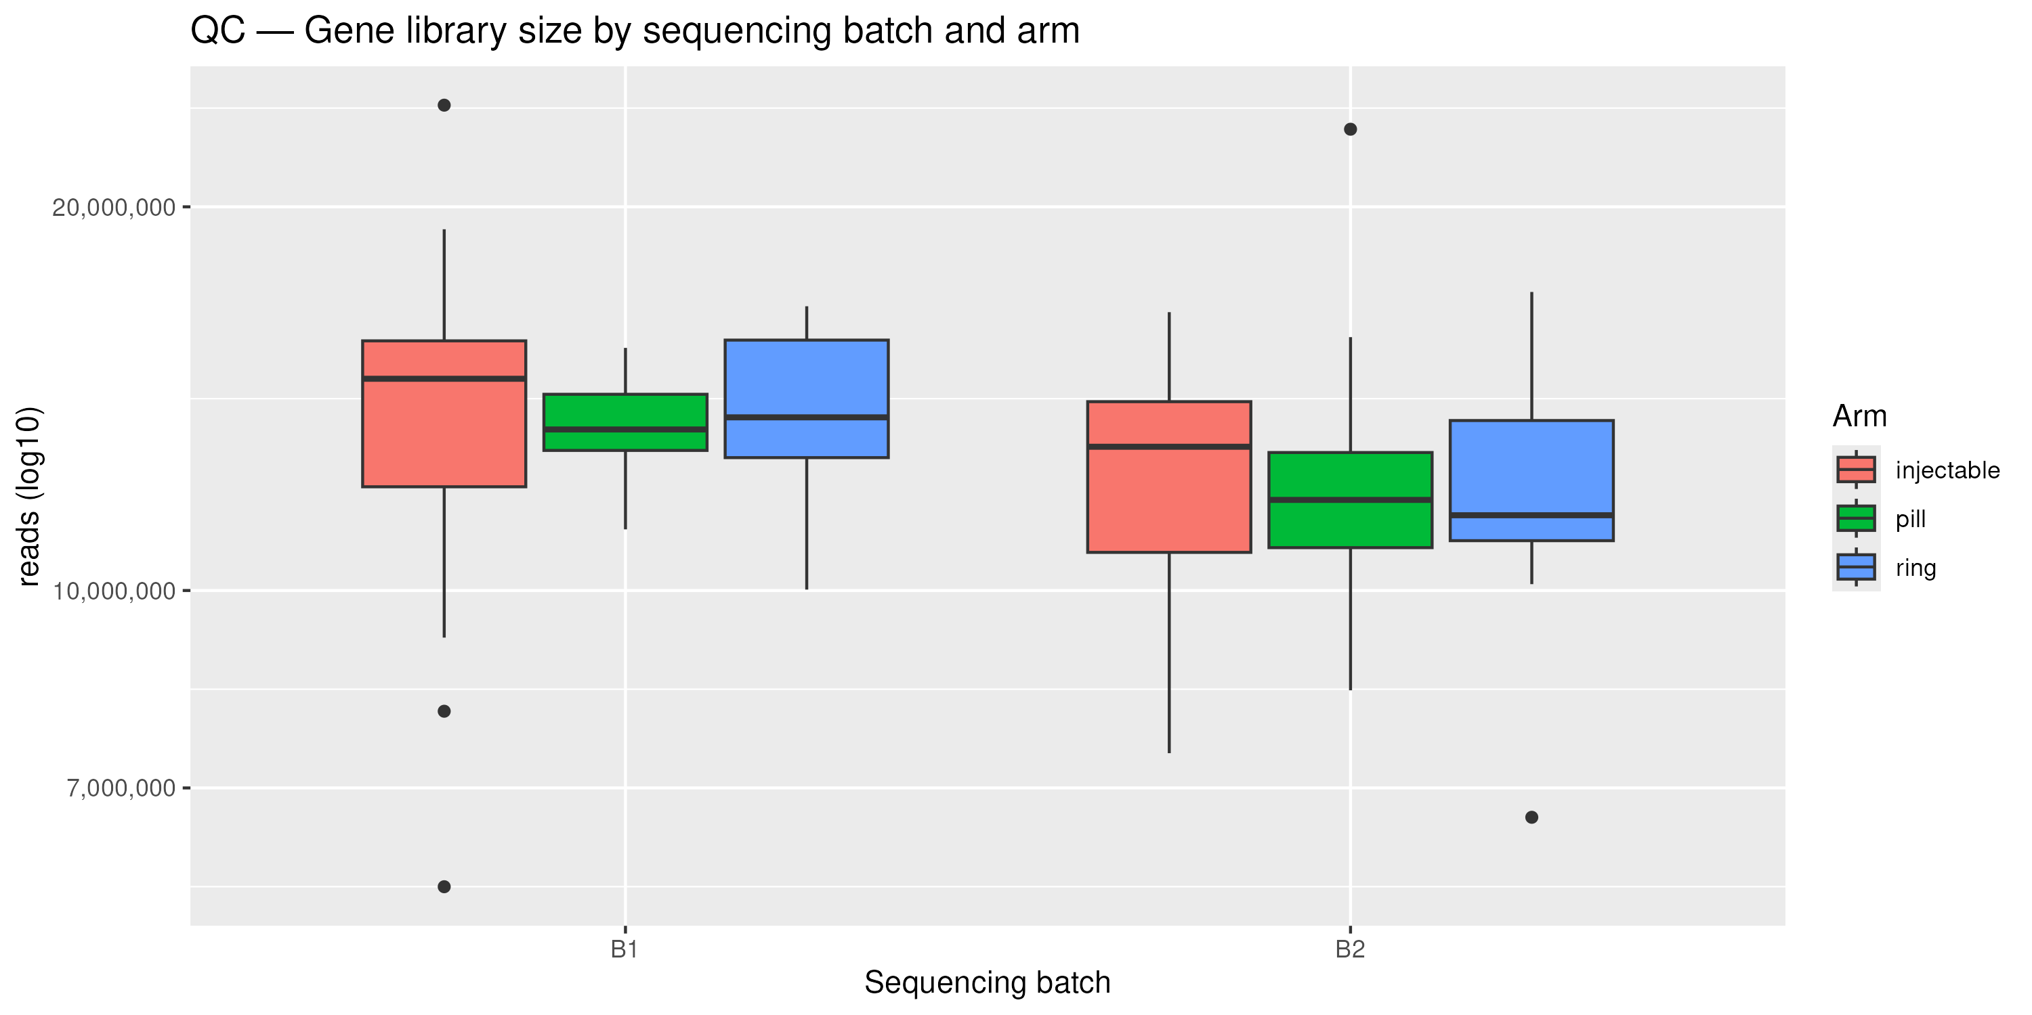
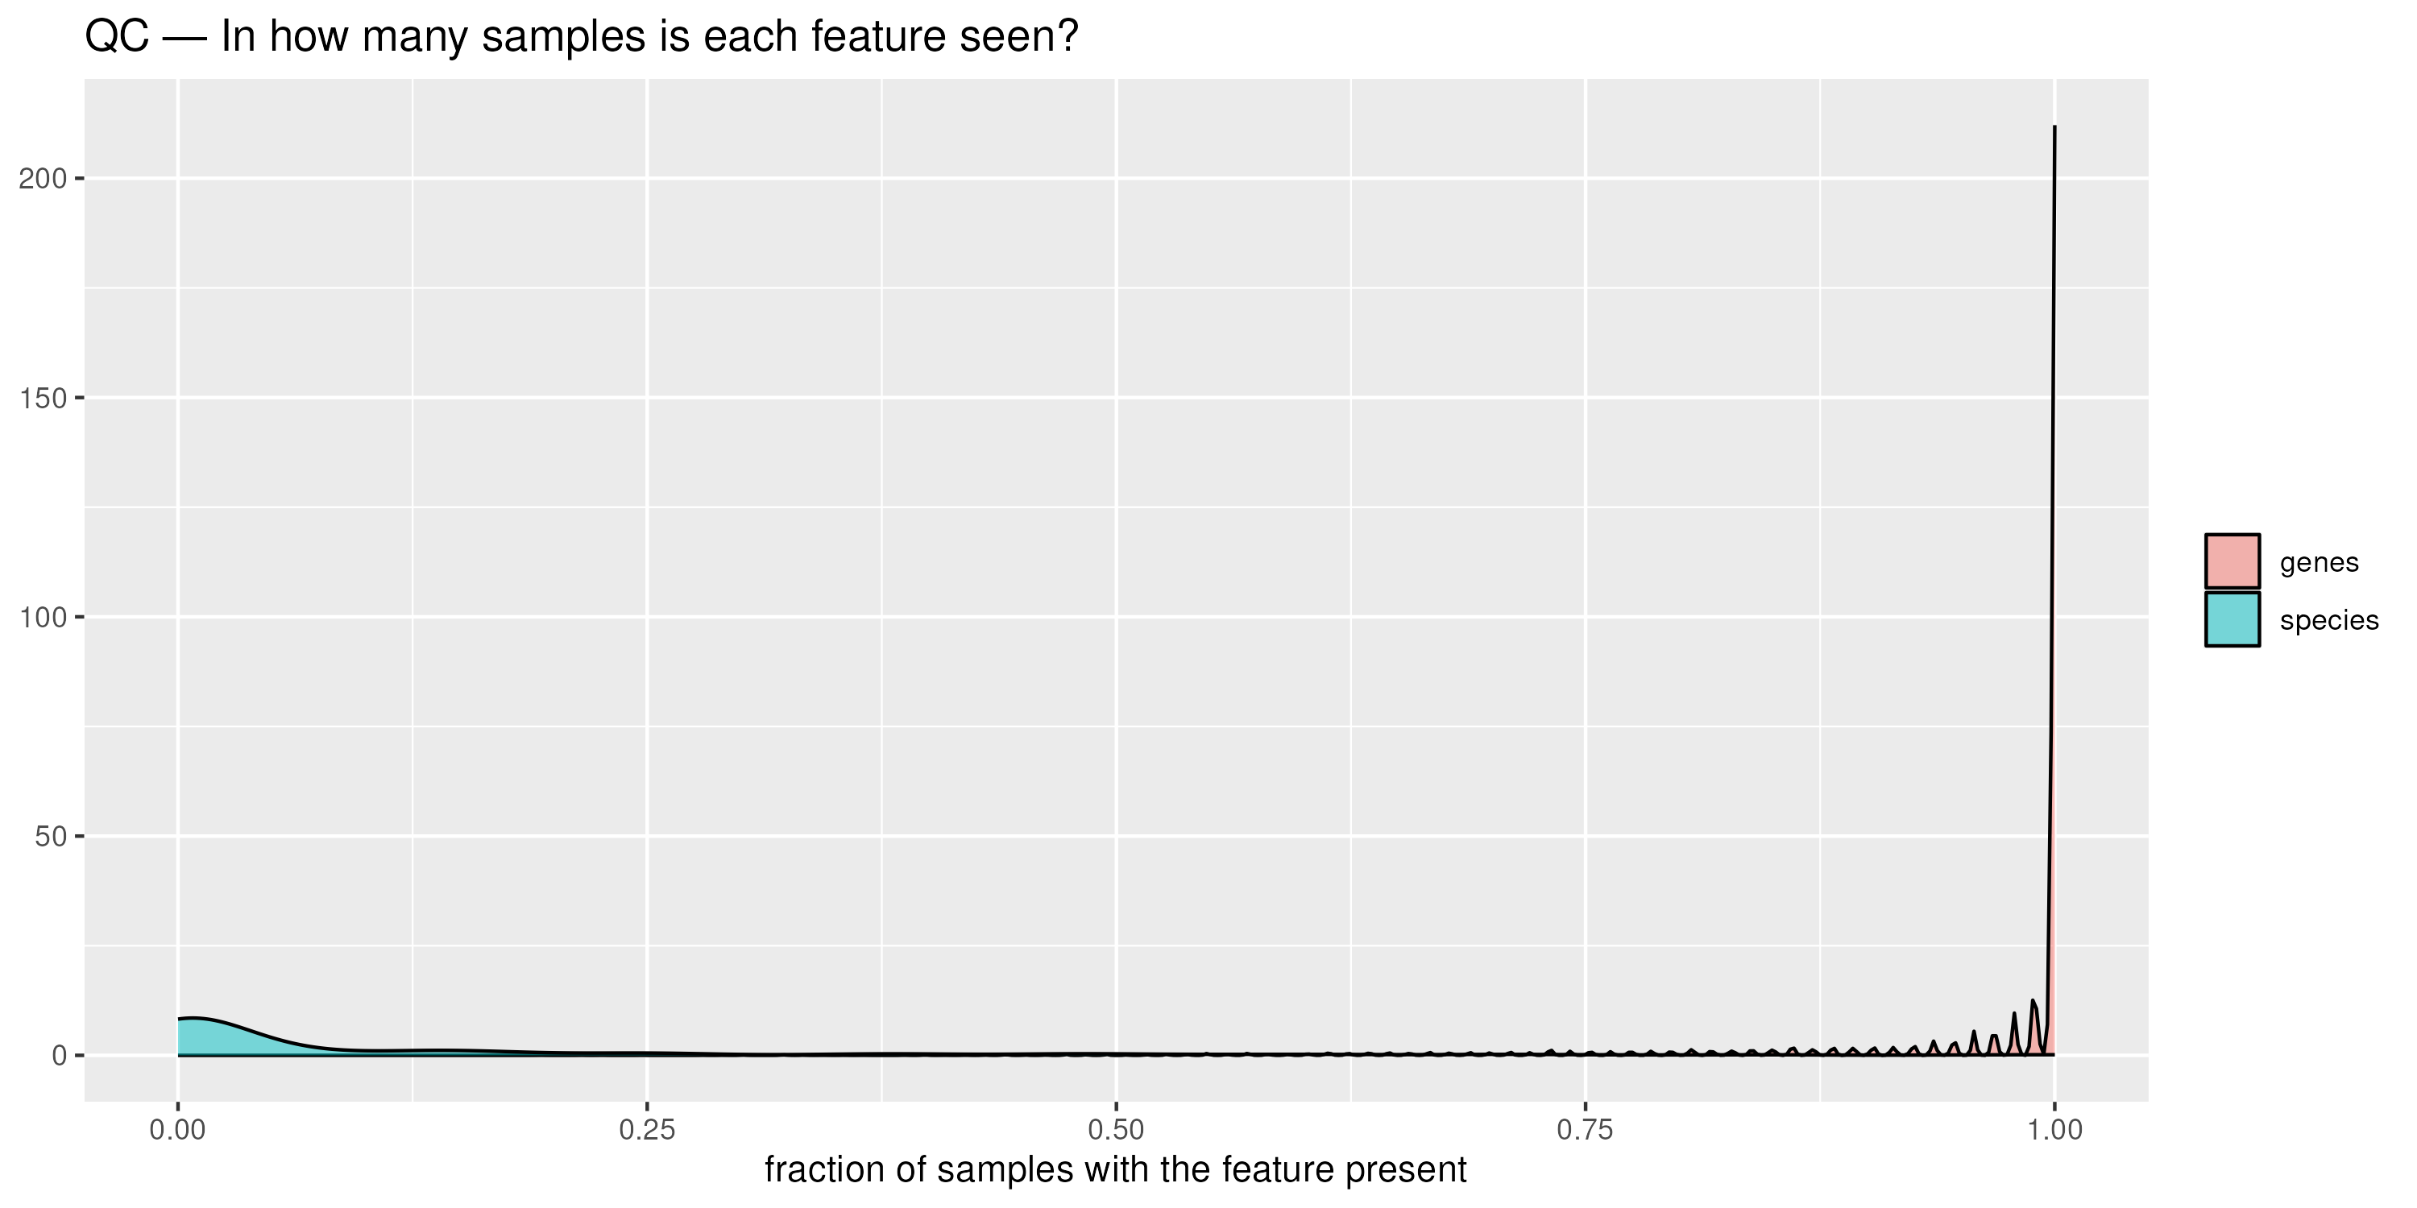
SETUP · QUALITY CONTROL
QC — batch and feature prevalence
Gene library size by sequencing batch and arm —
no batch-depth problem
Genes are dense, species are sparse — different filtering
rules for the two tables
Consequence: raw counts into DESeq2 (never CPM, never logged), genes filtered at ≥ 10 reads in ≥ 10 samples, species ordination on the unfiltered table.
Study B · Group B1–B5 · Data Science for Biology
7

Slide 8
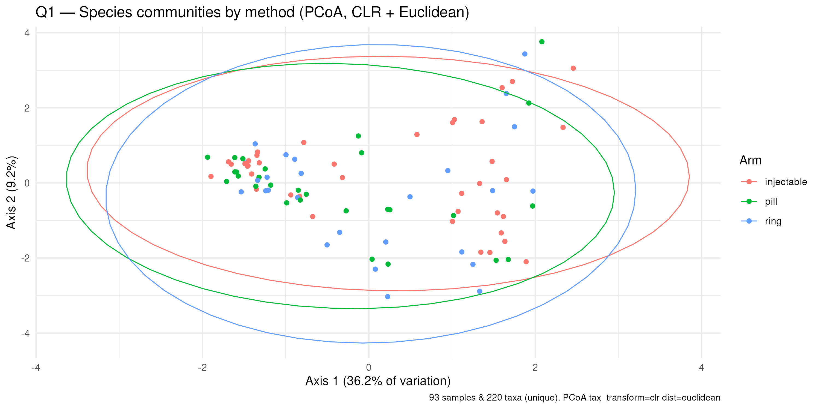
QUESTION 1 · COMMUNITY COMPOSITION
The three methods do not carve the microbiome into three
2.8 % · p = 0.172
PERMANOVA, all three arms (n = 93),
adjusted for batch, 9,999 permutations
▪ No clear three-way difference — not significant
▪ No pairwise comparison survives adjustment either (ring vs pill, ring vs injectable, pill vs injectable)
▪ No individual species stands out: DESeq2 hit counts at chance level in every comparison
▪ What does structure this map: community type (axis 1 holds 36 %) — that is Q3
Species PCoA (CLR + Euclidean), coloured by method — the arms overlap heavily
Study B · Group B1–B5 · Data Science for Biology
8

Slide 9
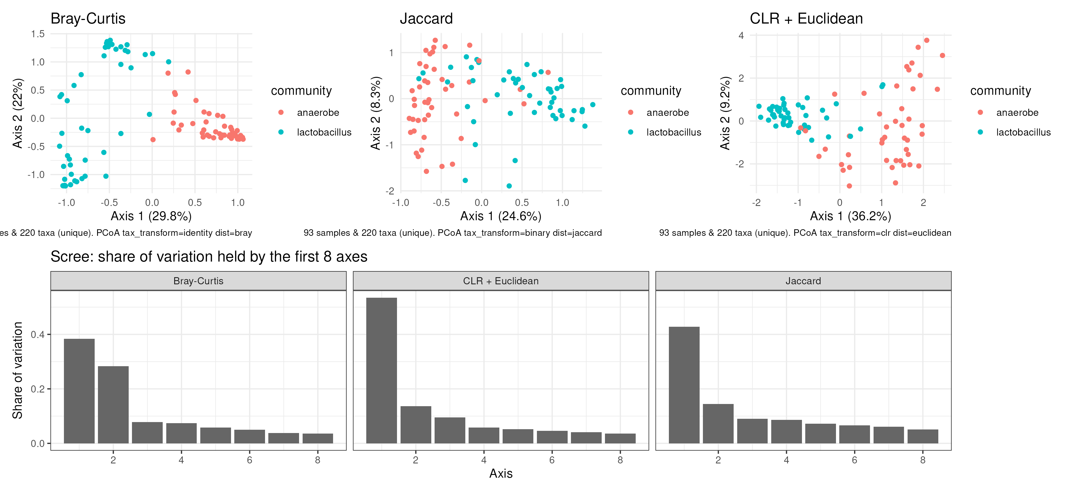
QUESTION 1 · ROBUSTNESS
The community split is real; the method split is not
▪ Same answer under all three distances
▪ The community-type separation appears every time
▪ The method separation never does
Species ordination under three distances (Bray–Curtis, Jaccard, CLR + Euclidean) with scree plots — same conclusion each time
Study B · Group B1–B5 · Data Science for Biology
9

Slide 10
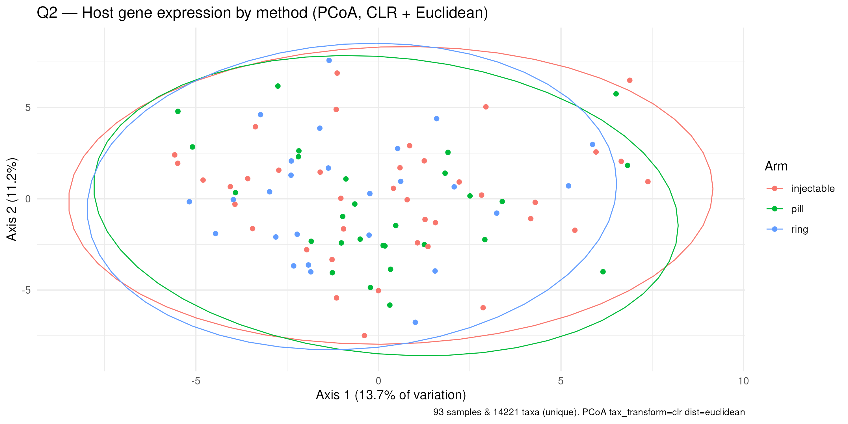
QUESTION 2 · RING vs SYSTEMIC GENES
The gene maps overlap; the formal tests sit on the 0.05 line
1.7 % · p = 0.041
ring vs pooled systemic (n = 26 vs 67),
borderline — reruns gave 0.03–0.055
▪ Three-arm test (adjusted for batch): 2.7 %, p = 0.101 — not significant
▪ Spread check (betadisper): one arm is not simply more scattered, which would fake a difference
▪ Verdict: suggestive at best — call it a lead, not a finding
Gene PCoA (CLR + Euclidean), coloured by method — heavy overlap
Study B · Group B1–B5 · Data Science for Biology
10

Slide 11
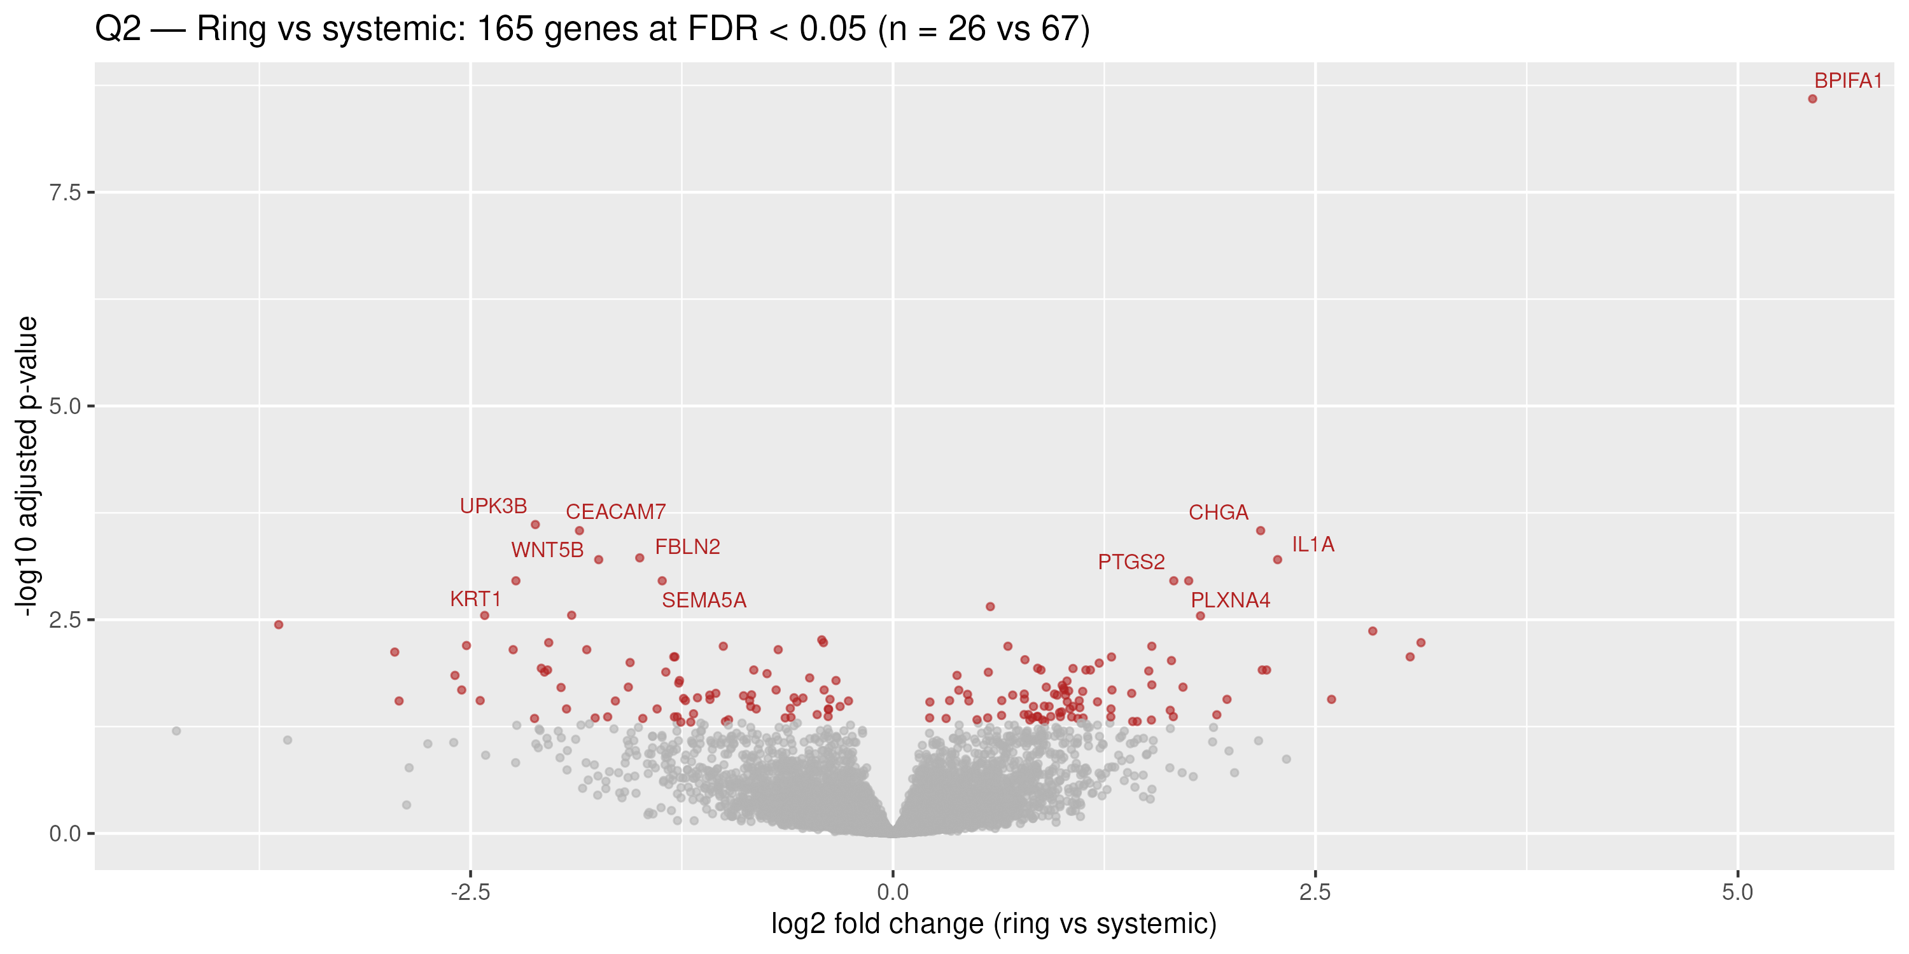
QUESTION 2 · RING vs SYSTEMIC GENES
DESeq2: 165 genes at FDR < 0.05 — mostly small shifts
165 / 14,226
genes at FDR < 0.05 (88 up in the ring),
n = 26 vs 67
▪ Dropping the blood-contaminated sample B093 leaves 152 of 165 hits standing (92 %) — the list does not hinge on one sample
▪ Caveat: raw-p hit lists are about twice what chance gives, and top hits are keratins and mucus genes — may partly be cell mix, not the ring
▪ If real, the effect is modest — no dramatic reprogramming of vaginal tissue
Ring vs pooled systemic. Red: FDR < 0.05; labels: the ten smallest FDR values
Study B · Group B1–B5 · Data Science for Biology
11

Slide 12
QUESTION 2 · A CHECK ON THE DESIGN
Is pooling pill + injectable into “systemic” fair?
Evidence (pill vs injectable) | Result
DESeq2 genes at FDR < 0.05 | 11 (chance would give ~5–7)
Raw p < 0.05 | 738 vs ~711 expected by chance
PERMANOVA (genes) | 1.4 %, p = 0.54
Ring LFC vs pill vs injectable (all genes) | r = 0.71 — same direction
▪ Why it is fair: the two systemic arms are near-indistinguishable in the genes, and the ring's log2 fold changes point the same way against both (r = 0.71)
▪ Caveat 1: the pooled control is 58 % injectable, so “systemic” leans that way
▪ Caveat 2: adjusting for the pH imbalance changes the ring-vs-pill list from 97 to 191 genes — the pooled contrast is not the only defensible reading
▪ Alternative not chosen: keep the three arms separate (document 03 does exactly that as a check)
Study B · Group B1–B5 · Data Science for Biology
12

Slide 13
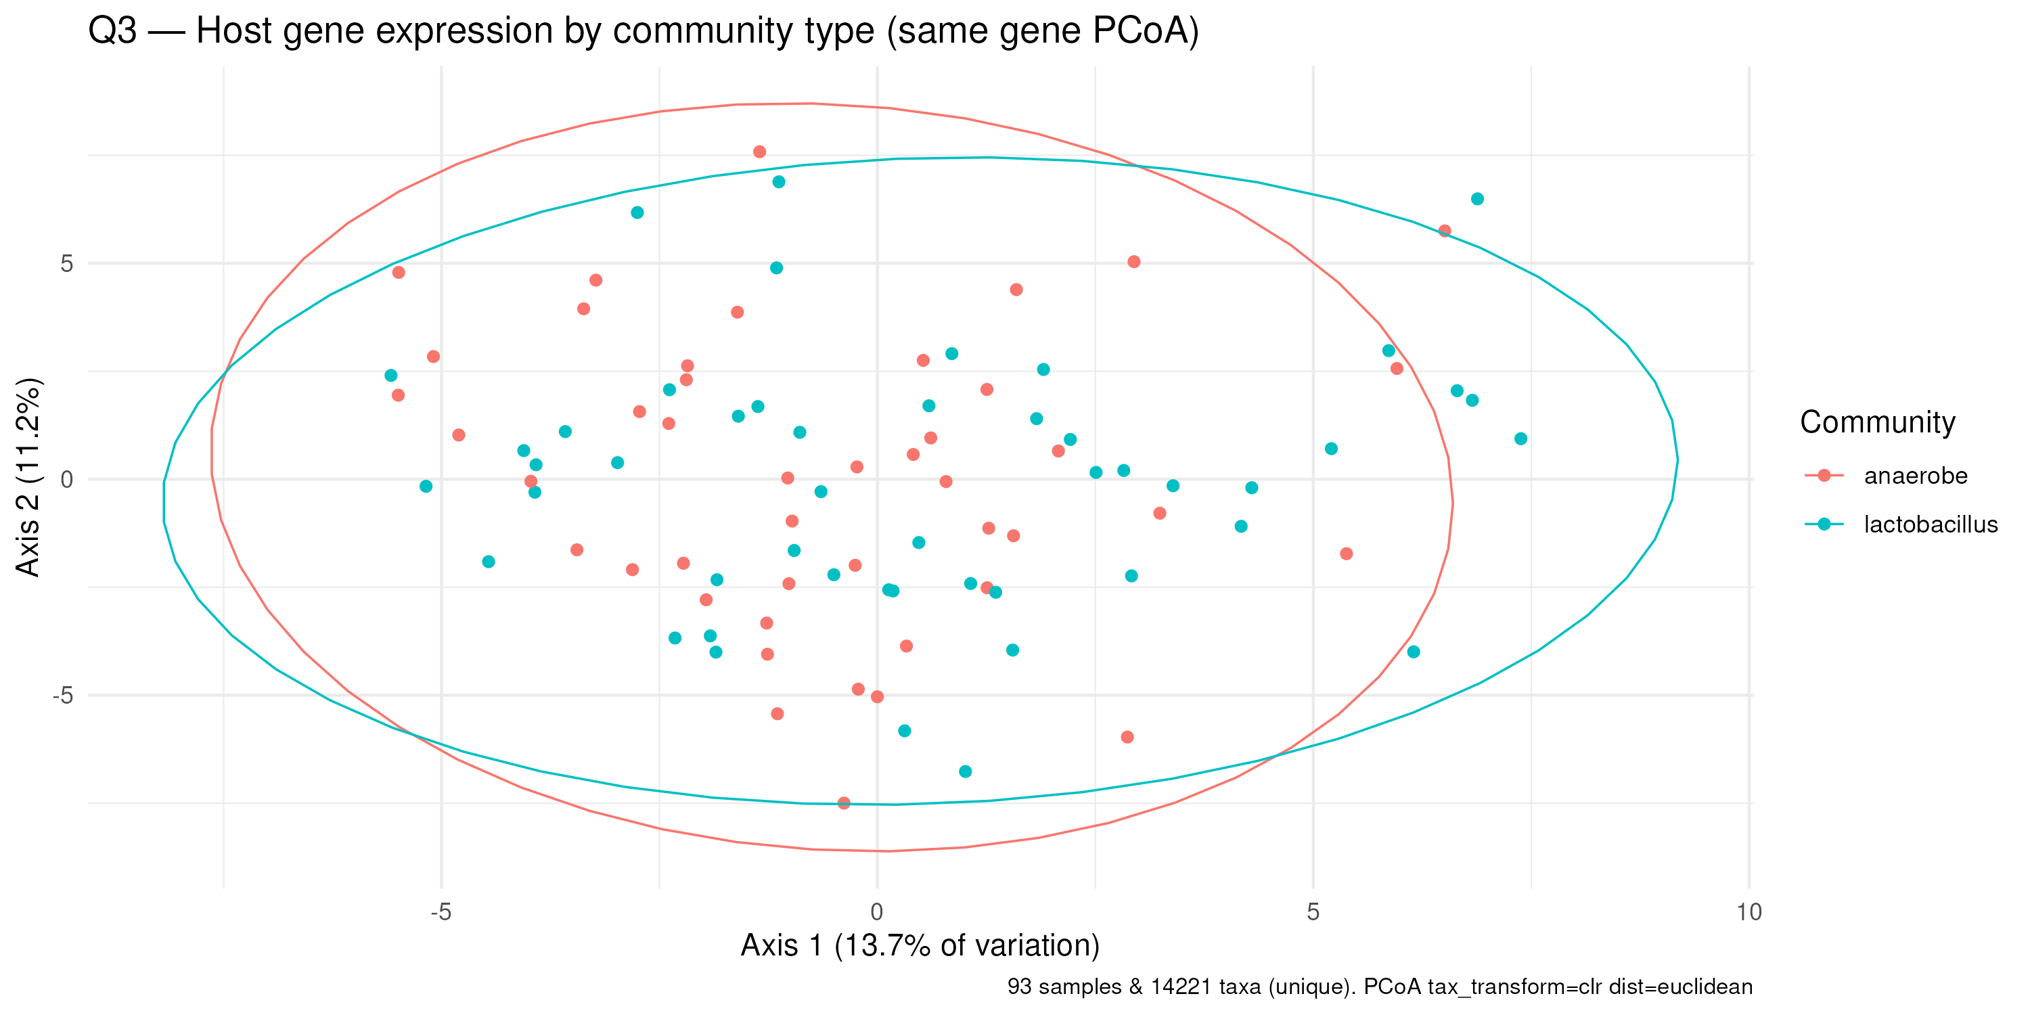
QUESTION 3 · COMMUNITY vs METHOD
Group by community type, then test the genes
Grouping | share % | p | genes at FDR<0.05
community type (48 vs 45) | 1.4 % | 0.117 | 312
ring vs systemic (26 vs 67) | 1.6 % | 0.053 | 165
▪ Tie on the map, community ahead gene by gene: 312 vs 165 genes at FDR < 0.05
▪ Groupings are independent — community is balanced across arms (χ² p = 0.50); gene lists barely overlap (27 shared)
▪ pH tracks community type far more strongly than method (p ≈ 1e-07 vs 0.02) — one more reason to adjust
▪ Upshot: adjust for community type before reading method effects
Same gene PCoA as Q2, coloured by community type — the split is clearer
Study B · Group B1–B5 · Data Science for Biology
13

Slide 14
WRAPPING UP
The three answers in three lines
Q1 — Community composition
The methods do not differ detectably — PERMANOVA 2.8 %, p = 0.172 (n = 93). The strong structure is community type, not method.
Q2 — Ring vs systemic genes
Small and suggestive — 1.7 % of variation (p = 0.041) and 165 genes at FDR < 0.05, with cell-mix and pH caveats. Pooling pill + injectable is supported (11 hits, p = 0.54, r = 0.71).
Q3 — Community type vs method
About a tie on the map (1.4 % vs 1.6 %), community ahead gene by gene (312 vs 165). The groupings are independent — report both, and adjust for community when reading method effects.
Standing caveat for all three: people chose their method, the arms differ in vaginal pH, and the ring arm is the smallest (n = 26) — treat every p-value here as a lead, not a verdict.
Study B · Group B1–B5 · Data Science for Biology
14

Slide 15
WRAPPING UP
Choices made (and the alternatives we did not choose)
▪ Community type from the species table, tested on the gene table (Lactobacillus ≥ 50 % of species reads) — a stricter 60 % cutoff is the alternative
▪ Species ordination on the unfiltered table, CLR + Euclidean with half-min replacement — filtering rare species first is the alternative
▪ Genes ≥ 10 reads in ≥ 10 samples — a stricter filter loses power, a laxer one wastes tests
▪ Raw counts into DESeq2 (it normalises itself) — CPM or logged values would be wrong
▪ Both PERMANOVA groupings reported (three-arm and pooled) — showing only the pooled one would overstate the evidence, as it sits on the p = 0.05 line
▪ 9,999 permutations, by = "margin" for every PERMANOVA — the sequential test is the (overstated) alternative
▪ Main results unadjusted for pH (it may be on the causal path); where pH matters we say so — full adjustment is the alternative
▪ Quoted sensitivity numbers from the review document rather than recomputing every fit on a slide
Study B · Group B1–B5 · Data Science for Biology
15

Slide 16
Three questions, three answers,
no verdicts — just leads.
Where every number lives:
01-qc.html — quality control · 02-ring-vs-systemic.html and 03-three-arms-review.html — Question 2
05-q1-three-arms-composition.html — Question 1 · 06-q3-community-vs-method.html — Question 3
make_slide_figures.R regenerates every figure in this deck from the data — the deck is fully reproducible
Thank you — questions? · Group B1–B5

