Slide 1

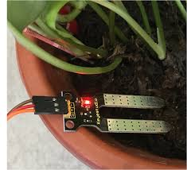

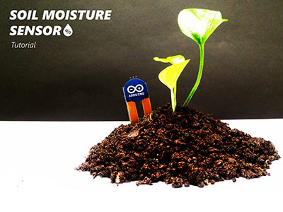

HL-69 SOIL MOISTURE SENSOR
Presented by:
Samuel Emon Halder-22101183
Pinky Akter-22101156
Presented To:
A.S. Zaforullah Momtaz
Assistant Professor
University of Asia Pacific

Slide 2

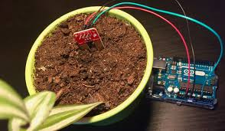


Introduction
Senor Introduction:
The HL-69 Soil Moisture Sensor is a widely used electronic device designed to measure the moisture content of soil. It is commonly used in agriculture, gardening, and automated irrigation systems to help monitor soil conditions and optimize water usage.

Slide 3
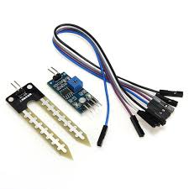

Key Features
Two Probes: Detect moisture levels by measuring conductivity.
Analog Output: Provides variable voltage readings based on moisture content.
Low Power Consumption: Suitable for battery-powered applications.
Digital Output: Can be used for threshold-based automation with a comparator circuit.
Easy Integration: Compatible with microcontrollers like Arduino and Raspberry Pi.
Working Principle
Less
Conductivity
Higher Resistance
Higher Sensor Value
DO=High(5V)
Dry soil
More
Conductivity
Lower Resistance
Lower Sensor Value
Wet soil
DO=Low(0V)

Slide 4
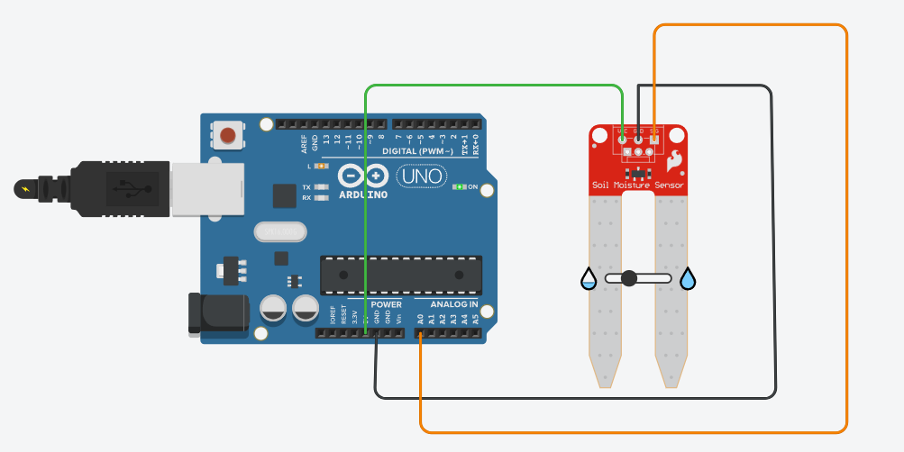

Connections
The sensor works on the principle of electrical resistance. When soil moisture increases, electrical conductivity improves, resulting in lower resistance and higher output voltage. Conversely, dry soil has lower conductivity, leading to higher resistance and a lower output signal.
Sensor
Arduino
VCC
5V
GND
GND
A0
A0

Slide 5
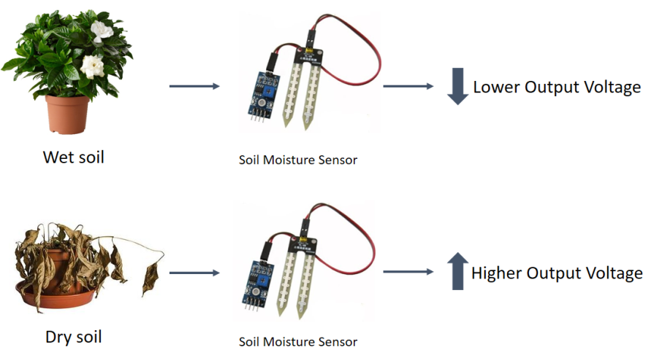
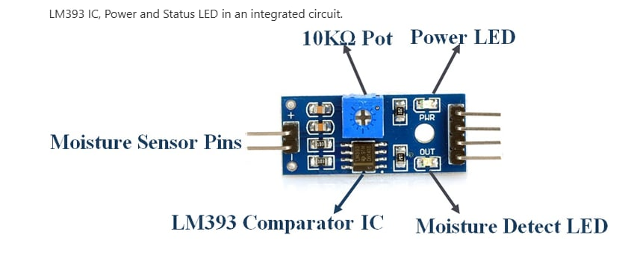
Mechanisms
The sensor has two probes that act as electrodes
Higher resistance between probes when moisture is low
Lower resistance when moisture is high
Sensor’s comparator circuit converts analog signal into binary output
Output remains Low for moisture signal above the threshold
Output goes high if the moisture drops below the threshold

Slide 6
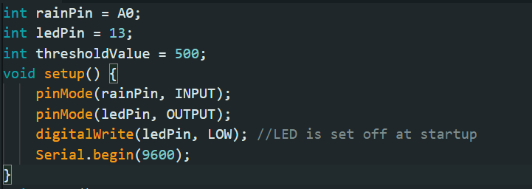
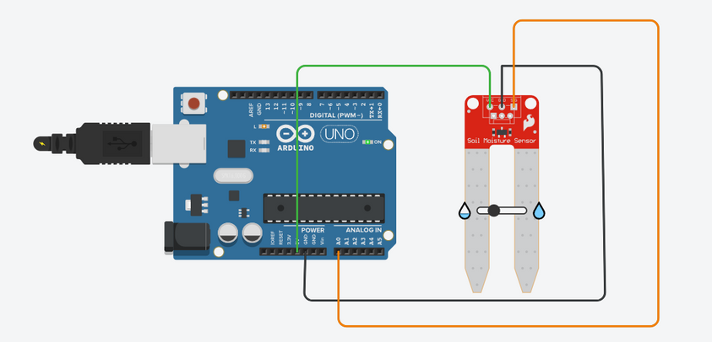
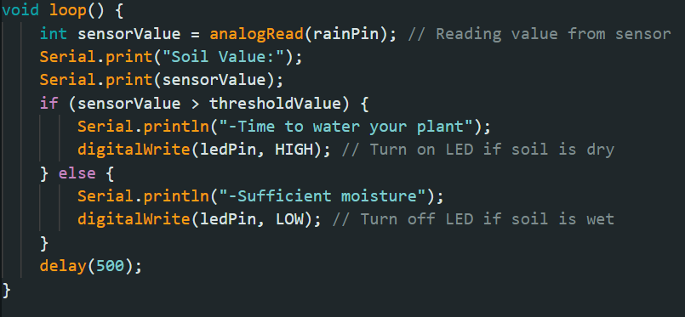
Soil Moisture Sensor Code

Slide 7
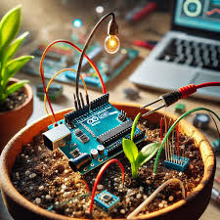


Applications
Used in smart irrigation systems: Can control water supply based on soil moisture levels automatically thus reducing water wastage and optimizing irrigation.
Precision agriculture: Helps farmers to monitor soil moisture levels and water crops adequately without overwatering.
Environmental Monitoring: Can be used in measuring soil moisture in forests and wetlands. Useful for climate research purposes.
Landslide Prediction System: Installed in hilly areas to detect high soil moisture that could cause landslides.

Slide 8

THANK YOU.

