Slide 1
Machine Learning to Segment a Corpus Callosum PDM
Samuel George
Comp 775, Fall 2018

Slide 2
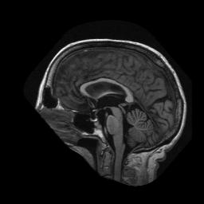
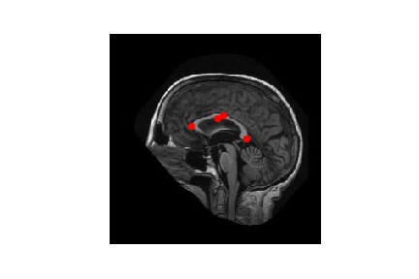
Project Goal
Simply put, the goal of my project was to predict a point distribution model (PDM) that would segment the Corpus Callosum using a neural network (NN) based object detection model (ODM). This PDM would be derived entirely from the image and require no additional tuning after the prediction was made. To simplify the problem at the start I only sought to learn four key landmarks on the Corpus Callosum. From here, if this performed well, I can expand to a full PDM.
Neural Network
Based Algorithm

Slide 3
Challenges
While NNs can be powerful tools for performing this kind of task, they present several challenges:
How do we get enough training data?
Usually training a NN takes at least thousands of examples, but I only started with the 32 images and corresponding PDMs provided for Assignment 2.
Can we use a pre-trained network to alleviate the need for large amounts of training data?
A network that has already been trained to recognize image structures may vastly improve performance with less training images. This may alleviate our need for the thousands of images usually required for an object detection task.
What Architecture and hyper-parameters should we use for our NN?
Both Convolutional Neural Networks (CNNs) and Dense Neural Networks (DNNs) have many design decisions to be considered.
How many of each layer should we have? What activation, loss function, and optimizer should we use for our network? All these present challenging parameters to tune.

Slide 4
Challenge 1: Training Data - Concept
As discussed, 32 images will not be enough to train a neural network. How will I get more training data?
My solution here was to generate 72 rotated versions of each of the given images and PDM. This gave me 2304 images from the 32 original images given.
I then split the data into a training and test set:
Dataset: 24 original images were selected and rotated to produce the 1728 images (75%) for training, while the remaining 8 original images are rotated to produce the 576 images (25%) for validation.

Slide 5
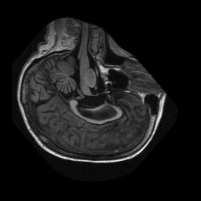
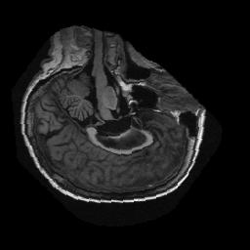
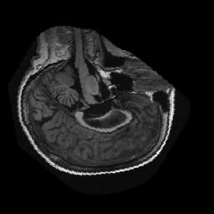
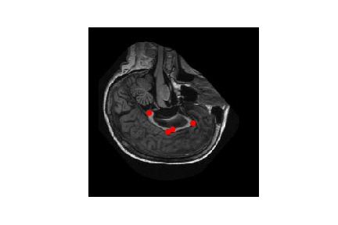
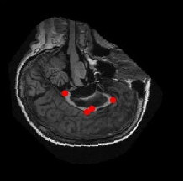
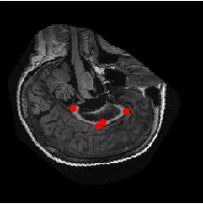
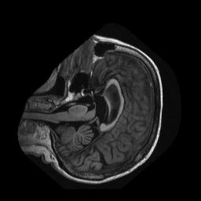
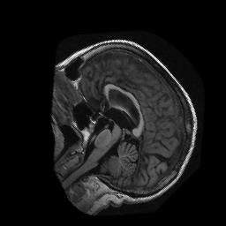
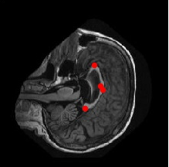
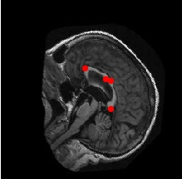
Challenge 1: Training Data - Example
Below is an example of the samples generated from the rotation of the image and its respective PDM:
Image Set
Matching PDM

Slide 6
Challenge 1: Training Data – Summary
Overall, this method gives me a way to produce the necessary number of training samples to even hope for machine learning to work well. Techniques such as this are often used to generate more samples and have been shown to be a low-cost way to get more samples compared to techniques such as Generative Adversarial Networks.
With the training data in place, I then started to consider what type of neural network would be best for estimating the PDM points.

Slide 7
Challenge 2: Pre-Training Network - Concept
One way to greatly improve performance on smaller datasets is to use a neural network that has been pre-trained on a similar task. If that original task had a much larger pool of training data, then the reused layers and weights should generalize better and combat many of the problems of overfitting that exists when using a smaller dataset.
Here I choose to re-use the convolutional layers and weights from a network that had already been trained on ImageNet.
ImageNet networks have been trained to recognize over 1000 different categories of image and have seen over 1 million images in training.
I choose to check performance using four different ImageNet trained networks:
Inception V4
ResNet V2 50
ResNet V2 152
PNASNet-5_Large_331

Slide 8
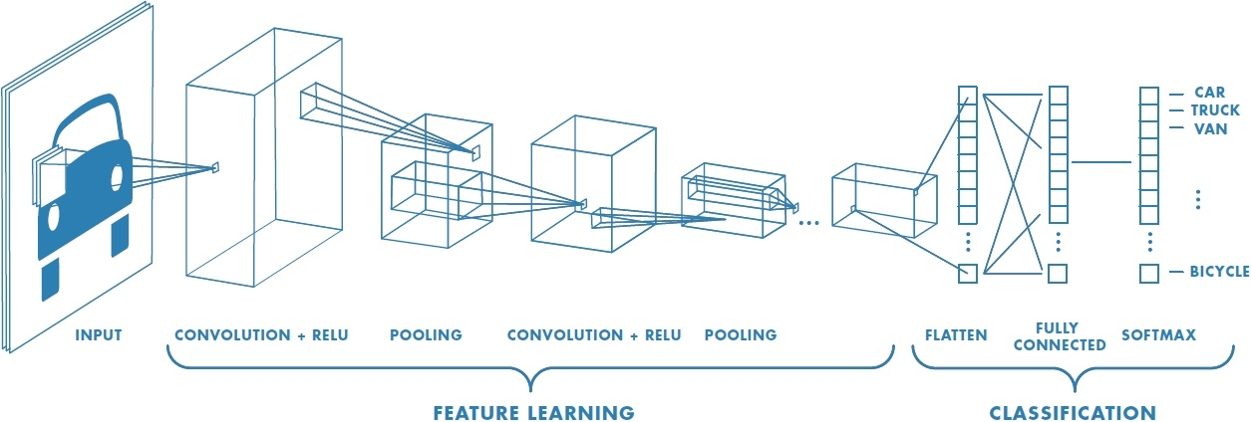
Challenge 2: Pre-Training Network - Premise
Neural Networks for doing image classification have a structure that is like the one shown below:
Overlayer:
The last layer before the fully connected layers is generally understood to be a coding of object features.
Feature Extraction Layers:
These layers recognize broad patterns in the image.
*https://www.mathworks.com/solutions/deep-learning/convolutional-neural-network.html

Slide 9
Challenge 2: Pre-Training Network - Adaptation
All the neural networks I selected have a structure such as this. I will Use a network design that implements pre-training as shown below.
These Layers are the CNN layers from the ImageNet trained network.
Our PDM recognition training layers.
Feature Layer
Input Image
Freeze Layer
Pre-Trained Convolution Layers
Task Specific DNN Layers
We will not allow CNN layers to train. This prevents overfitting.
The high-level features from our Image.

Slide 10
Challenge 2: Pre-Training Network– Summary
The use of a pre-trained network should help combat overfitting as well as help us get better results with our relatively small amount of training data.
With this we are now ready to design our full network that estimates our PDM.
I tried 4 different pre-trained networks and settled on the PNASNet-5_Large_331 as the best network. Statistics on these networks is given below:
Network | ImageNet Top-5 Accuracy | ImageNet Top-1 Accuracy
Inception V4 | 95.2% | 80.2%s
ResNet V2 50 | 92.8% | 75.6%
ResNet V2 152 | 94.1% | 77.8%
PNASNet-5_Large_331 | 96.2% | 82.7%

Slide 11
Challenge 3: Network Architecture - Concept
At this point, I built a neural network like a network designed to put a bounding box around a desired object. It estimates the eight values (4 points) in the PDM.
Input Image
Final Code Layer
L2-loss
Freeze
Layer
Dense Hidden Layers
(1000,500,100,50)
Pre-Trained PNASNet-5_Large_331 Convolution Layers
Final Image
PDM Points
(8 Points)
True PDM Points
(8 Points)
Backpropagation

Slide 12
Challenge 3: Network Architecture - Failure
However, after tuning all kinds of hyperparameters such as batch normalization, dropout rate, activation function, and number of layers at each step I was still unable to get a convincing PDM for the dataset.
It was at this point I decided to try and get a more accurate view of loss using the concept of Multi-Task Learning (MTL).
To implement MTL I freed the PDM points and had the network estimate the 4 points in the PDM separately.

Slide 13
Challenge 3: Network Architecture - MTL
Freeing all the points gives you a more accurate view of loss and allows the network to fit a much better PDM.
Input Image
P1
(50,2)
L2-loss
P1 True
Final Code Layer
P2
(50,2)
P2 True
Freeze
Layer
Pre-Trained PNASNet-5_Large_331 Convolution Layers
Dense Shared Hidden Layers
(1000,500,100)
P3
(50,2)
P3 True
P4
(50,2)
P4 True
Final Image
Backpropagation

Slide 14
Challenge 3: Network Architecture - Summary
Using MTL I was able to get good results for my dataset.
Below are some of the other architectural features that I tuned and what values ended up getting me the best PDM:
Item | Value
Convolutional Layers | PNASNet-5_Large_331
Dropout Rate | .01 (Basically None)
Batch Normalization | Yes (All but last layer)
Loss Function | L2-loss
Optimizer | Adam Optimizer (Learning Rate = 1)
Activation | Relu
Parameters Trained | 2.55 Million
Total Parameters | 91.77 Million

Slide 15
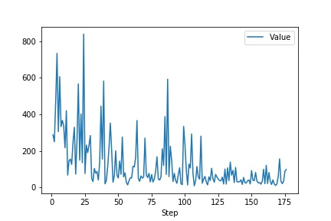
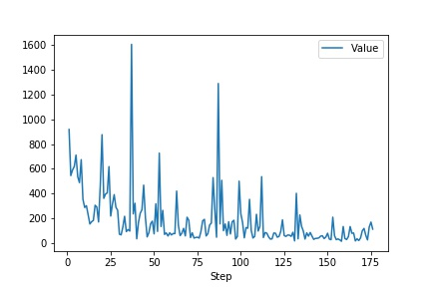
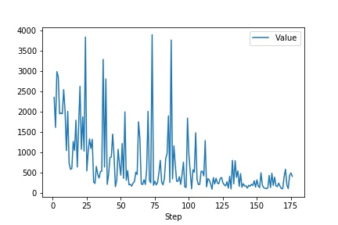
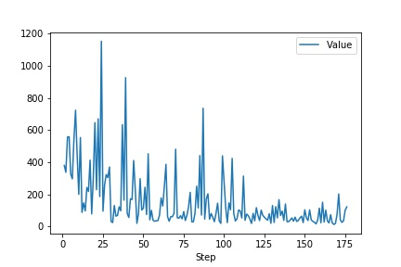
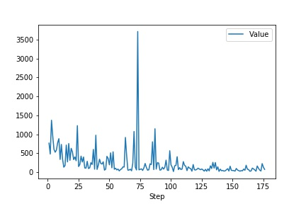
Results - Training
Looking at the graphs below we can see that each point, along with the total loss is learning where it belongs in the images. Note that these loss values come from the validation set, not the training data.
Point 1 Loss
Point 2 Loss
Total Loss
L2-loss
L2-loss
Point 3 Loss
Point 4 Loss
Epoch
Epoch

Slide 16
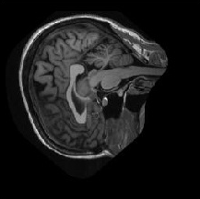
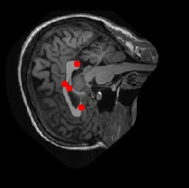

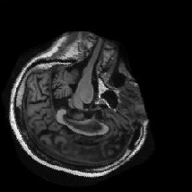
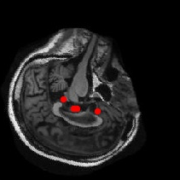
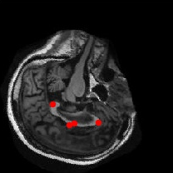
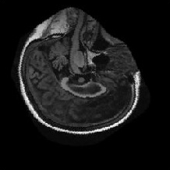
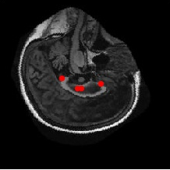
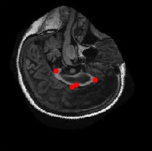
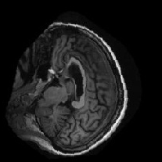
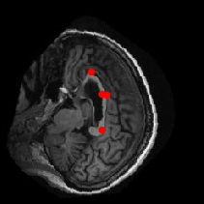
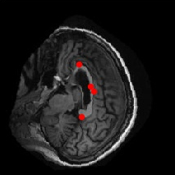
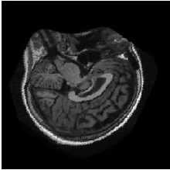
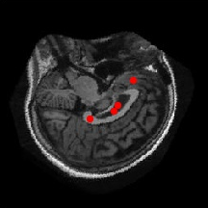

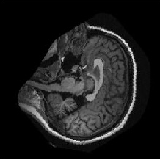
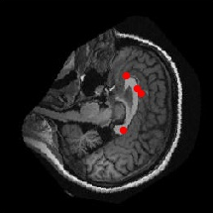
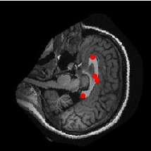
Results - Visual
Looking at a variety of fits from the test data, we see that some images worked better than others.
Test Image
Guess PDM
True PDM
Test Image
Guess PDM
True PDM

Slide 17
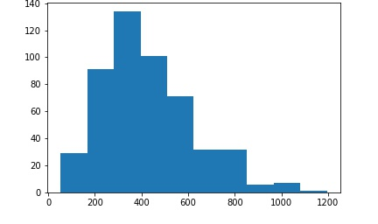
Results - Statistics
Looking at the statistics mean and median L2-loss of the data we see that in general we are fitting a pretty good PDM.
Statistic | Value
Test Set Average L2-loss | 427 (Each pixel is off by about 5 pixels)
Test Set Median L2-loss | 391 (Each Pixel is off by about 4 pixels)
The distribution of L2-loss for the images also shows us that a couple of images are just fitting very poorly, while most are fitting a PDM very well.
L2-loss Distribution
Number of Images
L2-loss

Slide 18
Conclusions
Overall, considering that I only had 32 unique images to begin with, I think the project was very successful in finding points on the Corpus Callosum.
Using pre-trained layers of an existing neural network as well as implementing a Multi-Task Learning model for my network proved effective in getting accurate results with very little training data.
As with most neural network projects, it is hard to tell if I reached an optimum solution. Given the amount of training data I had, it would make a lot of sense to use an architecture like this as a precursor to some of the other algorithms we studied. Using a neural network to find a good center of gravity for the PDM for example, would be a great starting point for many of the algorithms, such as ASM, that we have studied this semester.

Slide 19


