Slide 1
Agro USSD Project
USSD-based Agricultural Marketplace & Information System
Team Members:
Dasaolu Samuel Oluwafeyigbemiga
Ogor Paul Olatunji
Akinrinola Simeon
Taiwo Zacheaus
Date: 19th September, 2025

Slide 2
Problem Statement
Limited access to internet among rural farmers
Lack of platforms to connect farmers and buyers
Inconsistent and unavailable market prices
Difficulty in product visibility for smallholder farmers

Slide 3
The Opportunity
Nigeria has over 70% rural farmers
Millions of potential users without reliable internet
Huge agro-market worth billions of Naira
Gap: Accessible, offline agricultural marketplace

Slide 4
Proposed Solution
AgroUSSD provides a simple, affordable, and accessible platform
Works on any phone using USSD codes
No internet required
Farmers and buyers can interact seamlessly
A simple USSD code (*123#) accessible on any phone
Farmers register and list products
Real-time market price updates

Slide 5
System Objectives
Connect farmers with buyers directly
Provide real-time market price information
Enable farmers to create product and harvest listings
Ensure secure access through authentication

Slide 6
System Flow (User Journey)
Farmers:
Register
Create harvest records
List products
Buyers:
Search products
Check market prices
Connect with farmers

Slide 7
Technology Overview
USSD Gateway via Telcos
Backend server handles requests
Database stores farmers, buyers, products, prices
Secure session management

Slide 8
System Design Overview
Flowchart defines user experience for both farmers and buyers
Farmers create harvest records & listings
Buyers search products & view prices
Both connect via secure session handling

Slide 9
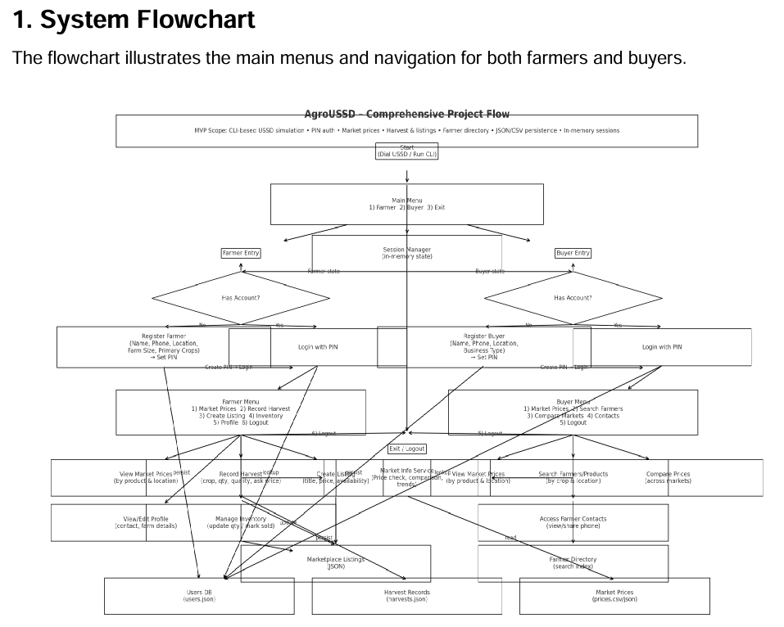
System Design Overview

Slide 10
Entity-Relationship Model
Entities:
Farmer
Buyer
Product
HarvestRecord
MarketPrice
Session
Relationships:
Farmers list products
Buyers search products
MarketPrice describes products

Slide 11
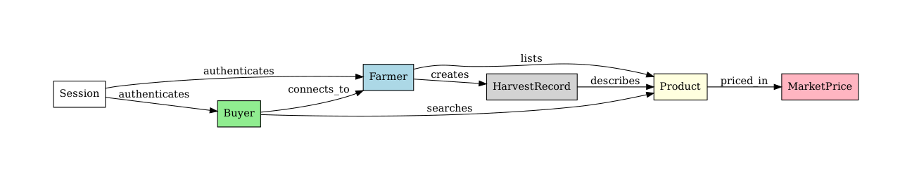
Entity-Relationship Diagram
The ER diagram outlines the data model and persistence layer structure, including farmers, buyers, products, harvests, and market prices.

Slide 12
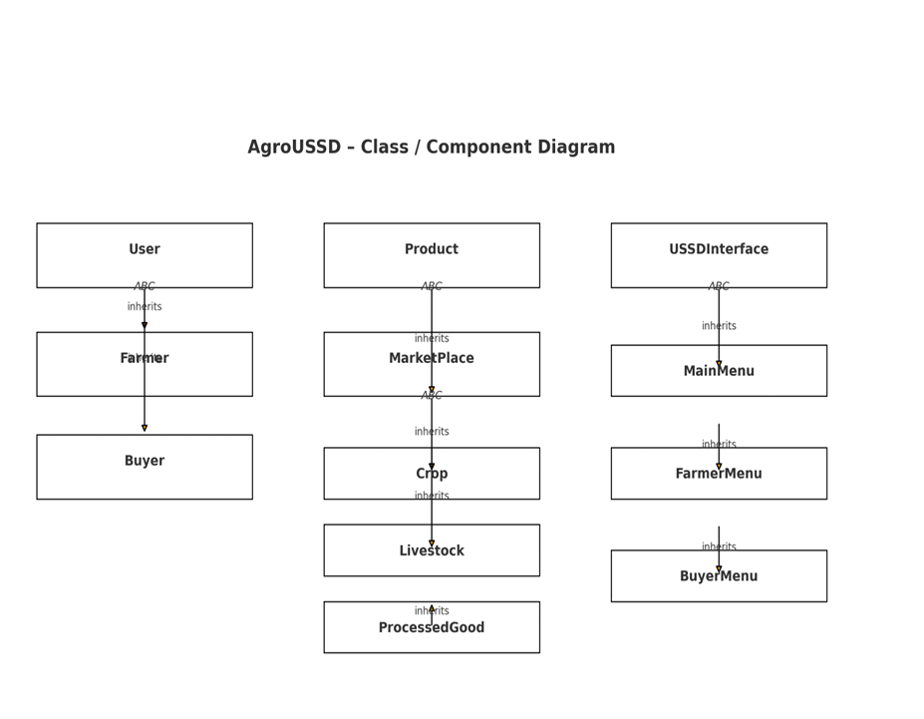
Component Diagram
This diagram shows the object-oriented design, including abstract base classes and inheritance.

Slide 13
Sequence Diagram (Critical Operations)
Examples:
1. Buyer searches for product → System retrieves listing → Connects to farmer
2. Farmer creates harvest record → Product becomes available in system

Slide 14
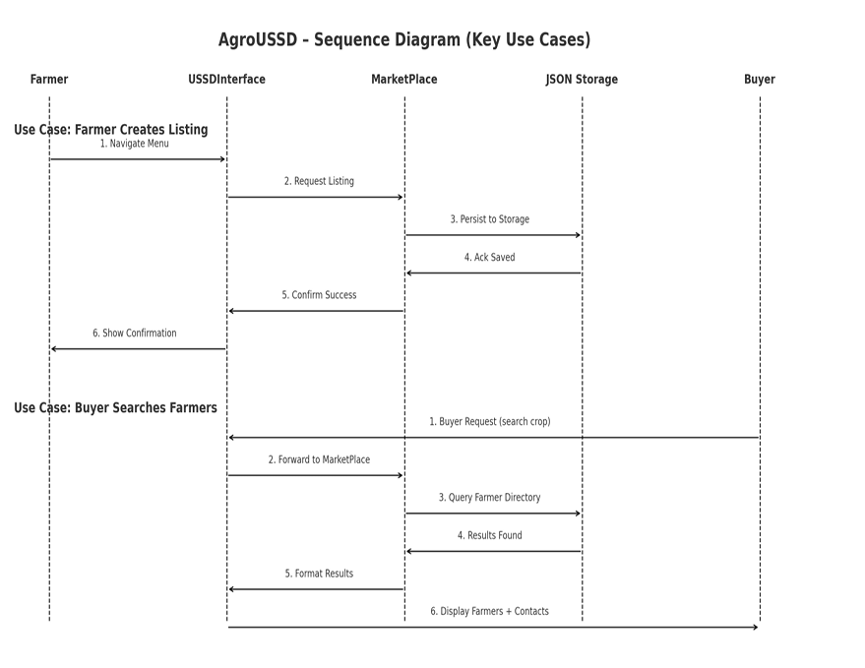
Sequence Diagram
The sequence diagram details interactions for critical journeys such as creating listings and searching farmers.

Slide 15
Implementation & Impact
Benefits:
Boosts farmer visibility
Provides fair pricing information
Connects rural communities to buyers
Scalable for other regions
Future Expansion:
Payment gateway integration
SMS alerts for updates
Partnerships with cooperatives & banks

Slide 16
Conclusion
AgroUSSD bridges the gap between farmers and buyers.
Provides accessible, real-time agricultural information.
Enhances transparency and connectivity in agriculture.

Slide 17
USSD Demo – Start
*123# → Welcome to AgroUSSD
1. Farmer 2. Buyer

Slide 18
USSD Demo – Farmer Menu
Farmer Menu:
1. Register 2. Create Harvest Record 3. List Products

Slide 19
USSD Demo – Buyer Menu
Buyer Menu:
1. Search Products 2. Check Market Prices 3. Connect to Farmer

Slide 20
USSD Demo – Market Prices
Market Prices:
Maize: ₦120/kg Rice: ₦200/kg
Cassava: ₦80/kg

