Slide 1


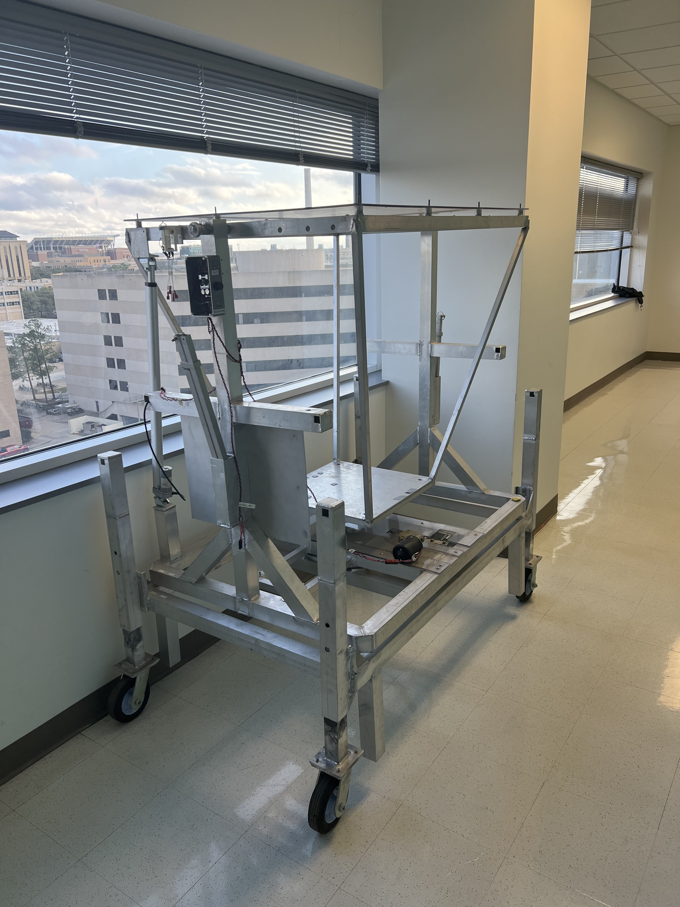
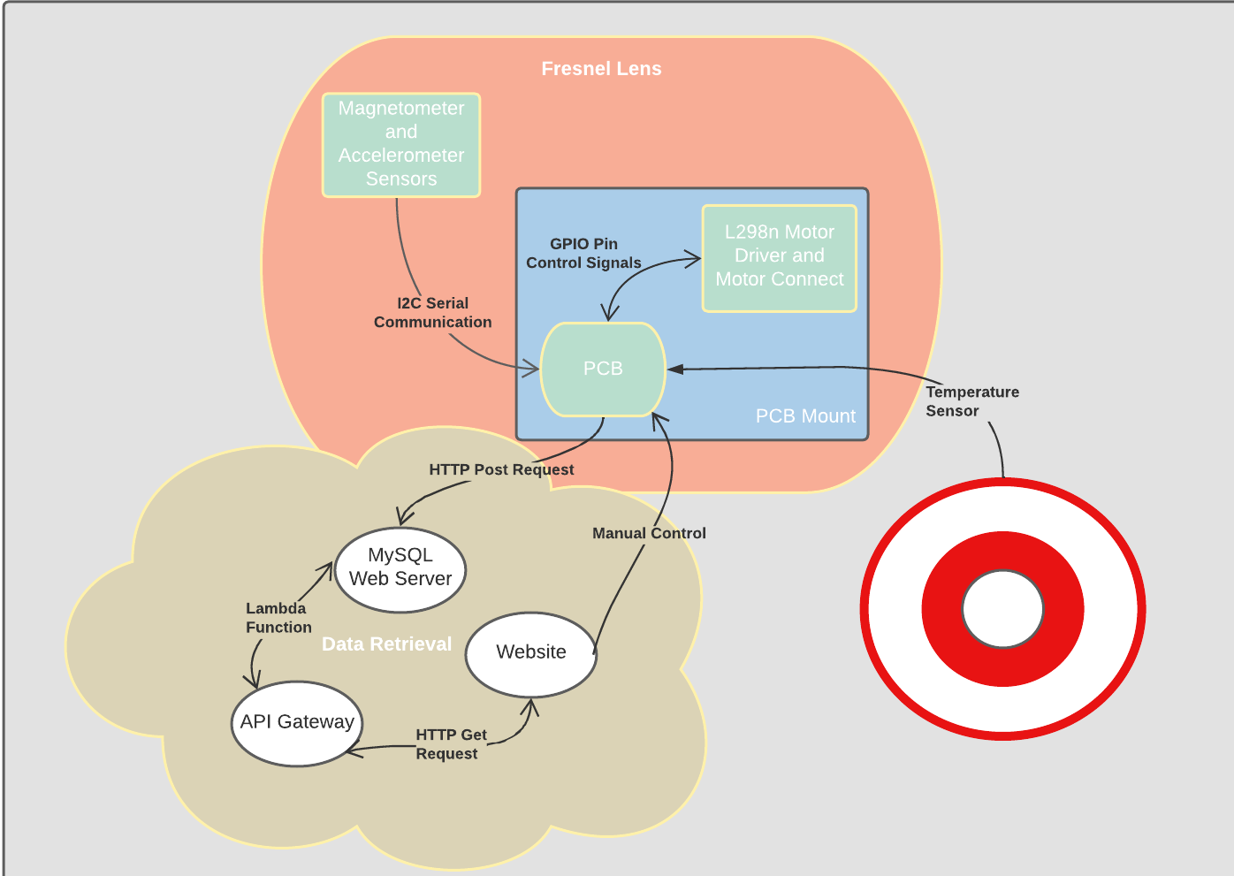
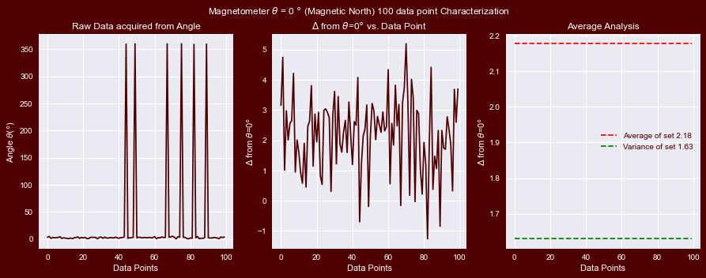
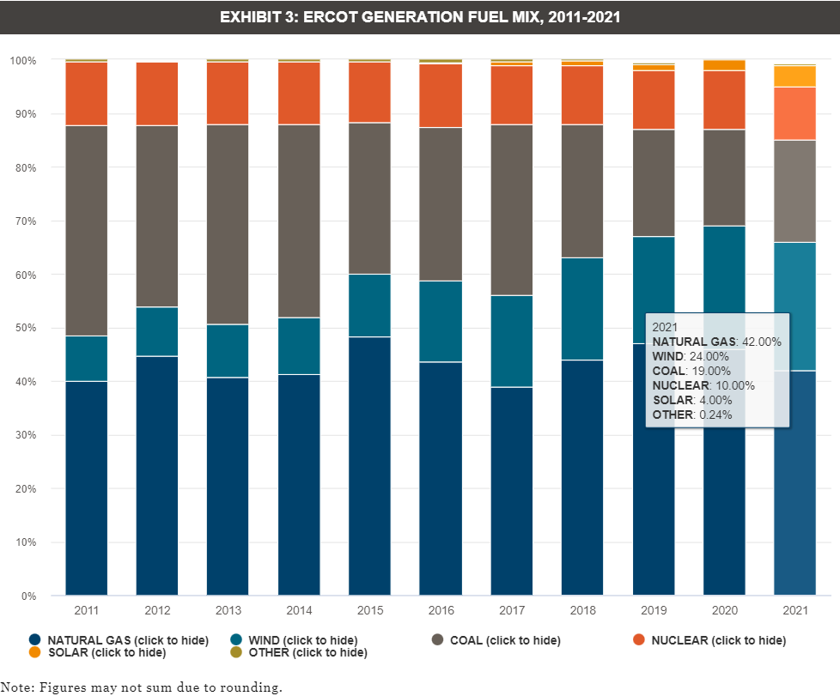
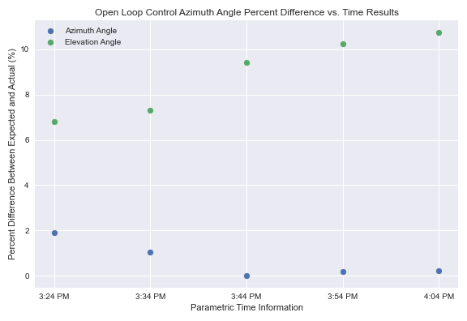

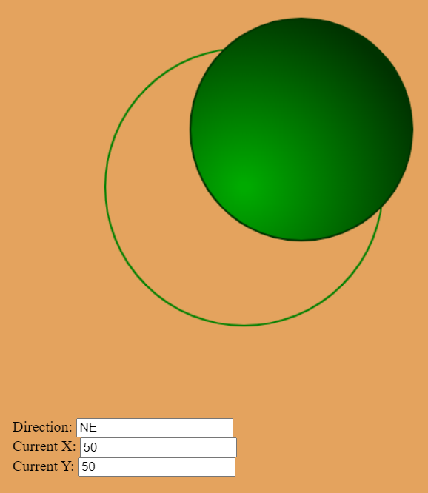
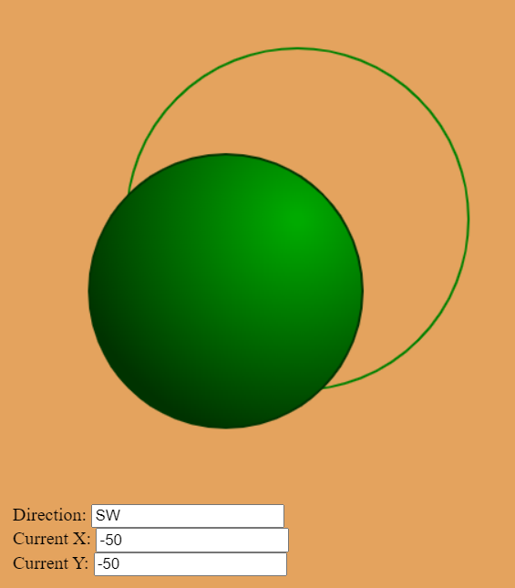
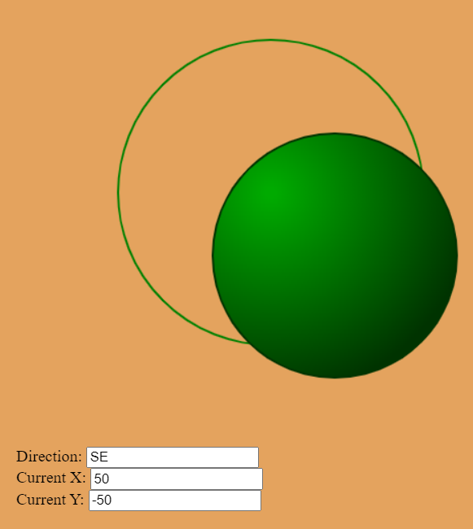
EPS Booth: 316
Fresnel Control Tracking
Jordan George, Samuel Dixon
Faculty Member: Dr. Christi Madsen
Problem Definition
Engineering Analysis
Short-length serial communication for system feedback
Control Results for Azimuth and Elevation Tracking on a ten-minute interval basis for five sample points
Joystick Pulse-Width-Modulation encoded signal for wireless variable speed adjustment of system
System Block Diagram
There is a growing necessity for rapid change of energy source partition from non-renewable to renewable energy sources. This need is prompted from the basis of conscious consumption and environmental need. While there is apparent growth being made show in Figure 1, there is still significant room for improvement.
Figure 4: System Block Diagram
Figure 2: Magnetometer reading results for magnetic north
Outcomes
Accomplishments
Provided PCB solution to actuate motor movement for manual and automatic control algorithms
Created open loop control algorithm to track sun motion with a maximum of 11 percent difference
Implemented IoT interaction with a website, I2C sensors, and ESP32 MCU to provide real-time system interaction with low latency over TAMU IoT Wi-Fi network
Developed and organized a Relational Database (MySQL) for data storage, website backend, and future analytics
Figure 5: Fresnel Lens System
Incorporate use of sensors or encoders to create a closed loop motor control system for more accurate results and positioning
Allow system to retrieve current time and date other than the use of Wi-Fi, so system is not dependent on network connectivity
Utilize dynamic information that can be inputted by the user, such as latitude and long
Integrate lens tracking onto target for thermal to chemical energy conversion
Impact
Renewable energy systems continue to accelerate in development across the world to reduce the carbon footprint of non-renewable energy consumption. This project will be utilized as one element in a mid-scale controls system to harness renewable energy into accessible charging point. The main impact will be on the future of the world. Through making steps to transitioning to renewable energy sources, future generations will have the same opportunities and beautiful earth the current population has access to today.
Figure 1: Ercot Energy Source Partition Bar Chart 2011-2021
Methodology
Hardware and Software
The system utilizes a custom-made PCB board with a Wi-Fi ESP32 MCU to obtain key parametric information for solar tracking and sensor data collection. The ESP32 queries the STNP servers (System Time Network Protocol) for the corresponding time zone in college station). With this data and the local latitude and longitude readings, two angles are computed to actuate the control system.
Azimuth angle: bearing to adjust the system from magnetic north. ( Accomplished by rotation motor )
Elevation angle: angle to adjust the system to the new angle made with the ground ( Accomplished by linear actuator motor )
Data is monitored on a web application for system analysis and a manual control joystick is provided for alignment
Figure 3: Control Results for Azimuth and Elevation Tracking
Future Project Goals
Incorporate use of sensors or encoders to create a closed loop motor control system for more accurate results and positioning
Allow system to retrieve current time and date other than the use of Wi-Fi, so system is not dependent on network connectivity
Utilize dynamic information that can be inputted by the user, such as latitude and long
Integrate lens tracking onto target for thermal to chemical energy conversion
References
Magnetometer Calibration: https://www.digikey.com/en/maker/projects/how-to-calibrate-a-magnetometer/50f6bc8f36454a03b664dca30cf33a8b
The Sun’s Position: https://www.pveducation.org/pvcdrom/properties-of-sunlight/the-suns-position
Programming the ESP32: https://docs.espressif.com/projects/esp-idf/en/latest/esp32/get-started/
Ercot Energy Partition: https://comptroller.texas.gov/economy/fiscal-notes/2022/sep/energy.php
Quadrant 1
Quadrant 2
Quadrant | Scaled X-Axis duty cycle modulating rotation motor speed (%) | Scaled Y-axis duty cycle modulating elevation motor speed (%) | Rotational Motor Direction And Quadrant | Linear Actuator Motor Direction And Quadrant
1 | 50 | 75 | CW | Upward
2 | 50 | 75 | CCW | Upward
3 | 50 | 75 | CCW | Downward
4 | 50 | 75 | CW | Downward
Acknowledgements
Dr. Christi Madsen, Mr. Robert Atkins – Sponsorship and Resources
Dr. Nowka , Dr. Stavros, and Dr. Lusher – Capstone guidance
Dalton Cyr – Teaching Assistant and feedback
Paul Stroffegen – Open source magnetometer calibration
Quadrant 3
Quadrant 4
Table 1: Conversion and Control Factors
Duty Cycle (%) | Average Voltage on Motor (V)
50 | 6
75 | 8
Figure 3: Control Results for Azimuth and Elevation Tracking
Table 2: Conversion and Control Factors

