Slide 1
CS598 SP23 Team 176
"Simple Attend and Diagnose”
Zhentao Xu, Samuel Doud
Date: May 8, 2023
Notes:
Hi …
In this presentation, we will present the paper “Attend and diagnose” and our reproduction result for this paper.

Slide 2
Introduction
The proposed deep learning architecture is called "Simply Attend and Diagnose (SAnD),"
The SAnD model
Limitation of RNN: memory constraints, optimization challenges, and difficulties in parallelization.
based on a masked self-attention mechanism, incorporates temporal order using positional encoding and dense interpolation strategies.
The authors also develop a multi-task variant of SAnD for inferring models with multiple diagnosis tasks.
The evaluation of the model is performed on the MIMIC-III benchmark datasets, demonstrating its superior performance compared to LSTM models and classical baselines with hand-engineered features
Notes:
The proposed deep learning architecture is called "Simply Attend and Diagnose (SAnD),"
The SAnD model
Limitation of RNN: memory constraints, optimization challenges, and difficulties in parallelization.
based on a masked self-attention mechanism, incorporates temporal order using positional encoding and dense interpolation strategies.
The authors also develop a multi-task variant of SAnD for inferring models with multiple diagnosis tasks.
The evaluation of the model is performed on the MIMIC-III benchmark datasets, demonstrating its superior performance compared to LSTM models and classical baselines with hand-engineered features

Slide 3
Scope of Reproducibility
We focus on the reproducibility of the Transformer model in clinical time series analysis.
We use the MIMIC-III benchmark datasets, specifically targeting the mortality prediction task.
Data Loading: The MIMIC-III Benchmark introduced by Harutyunyan et al. (2017) serves as the foundation for the dataset.
Model Structure: Transformer Model (self attention, positional encoding, dense imputation)
Notes:
The authors claim that their approach, called SAnD, outperforms existing models in tasks such as In Hospital Mortality prediction. To ensure reproducibility, the authors have shared a repository containing the model's structure definition, although it lacks specific clinical data. Our objective is to replicate the performance results, specifically in the mortality prediction task, using the dataset from the MIMIC-III Benchmark. We will compare our replicated results with the authors' claimed evaluation results to assess reproducibility.

Slide 4
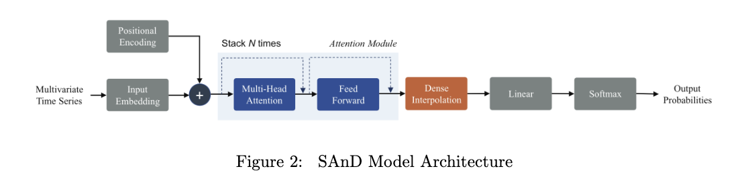
Methodology

Slide 5
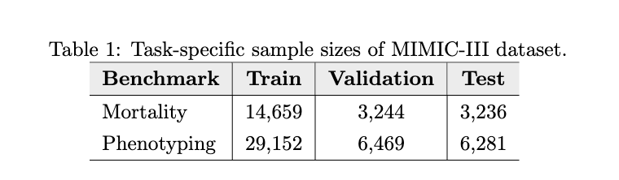
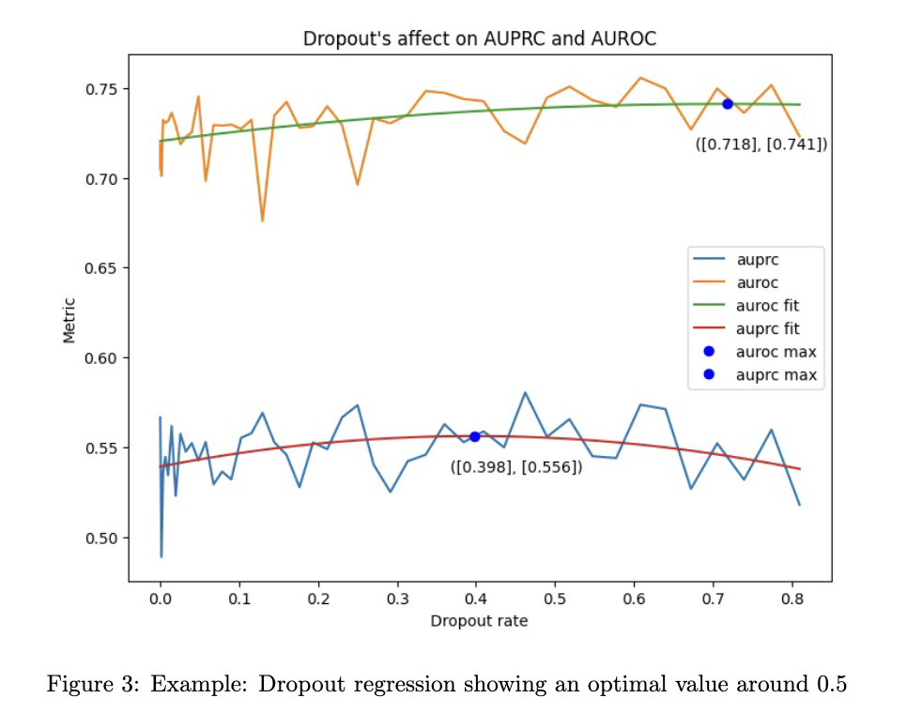
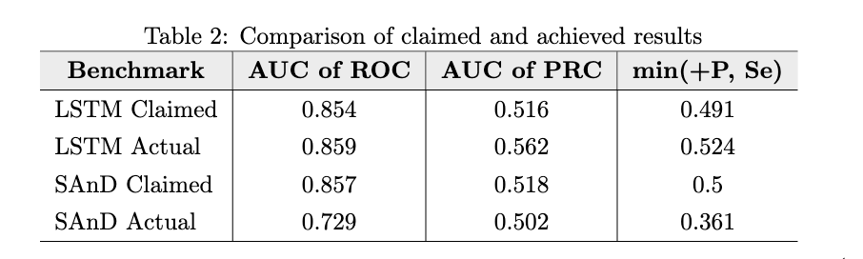
Experiment Result, Hyperparameter Tuning
Dataset
Experiment Result
Hyperparameter Tuning

Slide 6
Thank you

