Slide 1

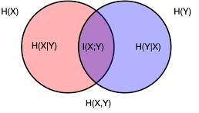
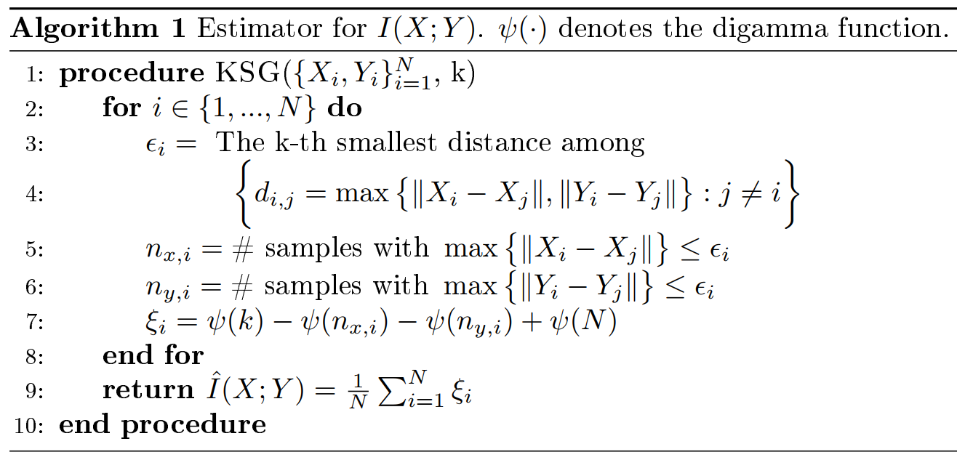
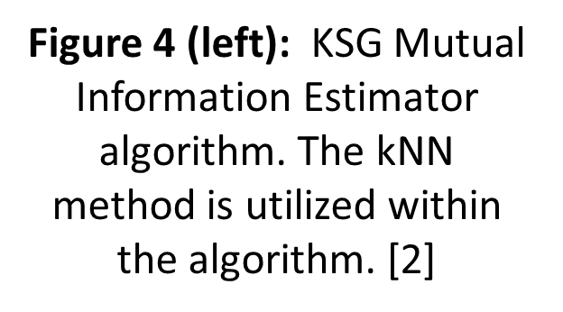
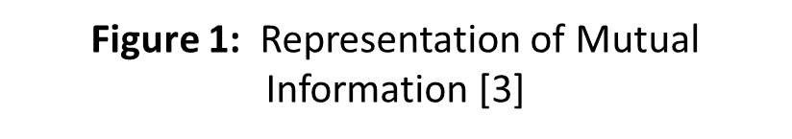
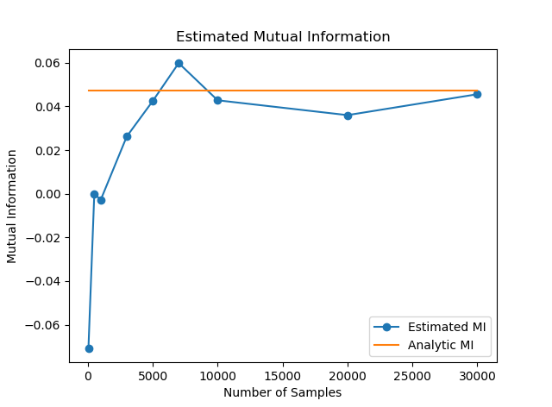
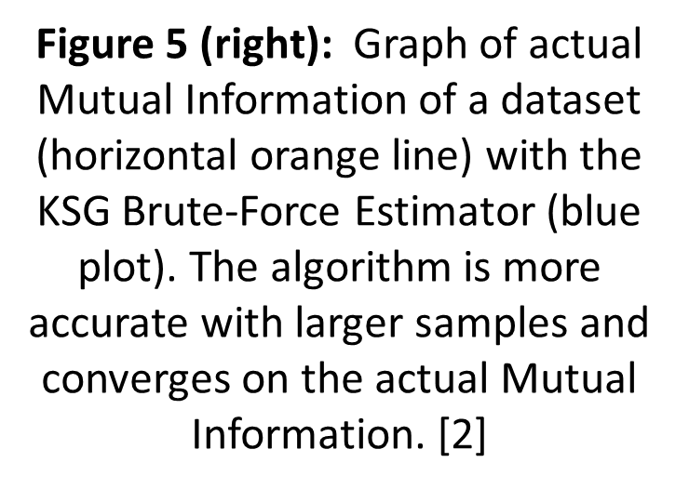
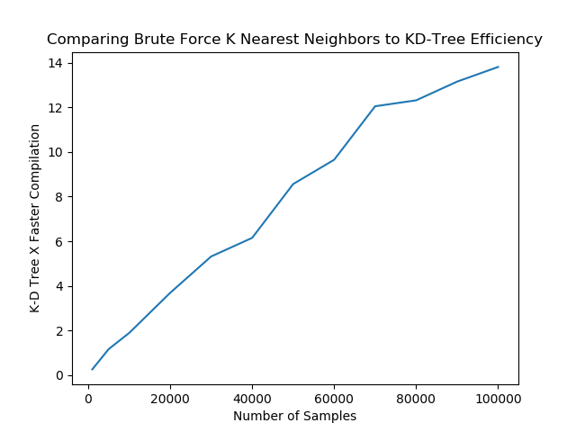
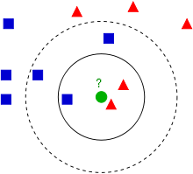
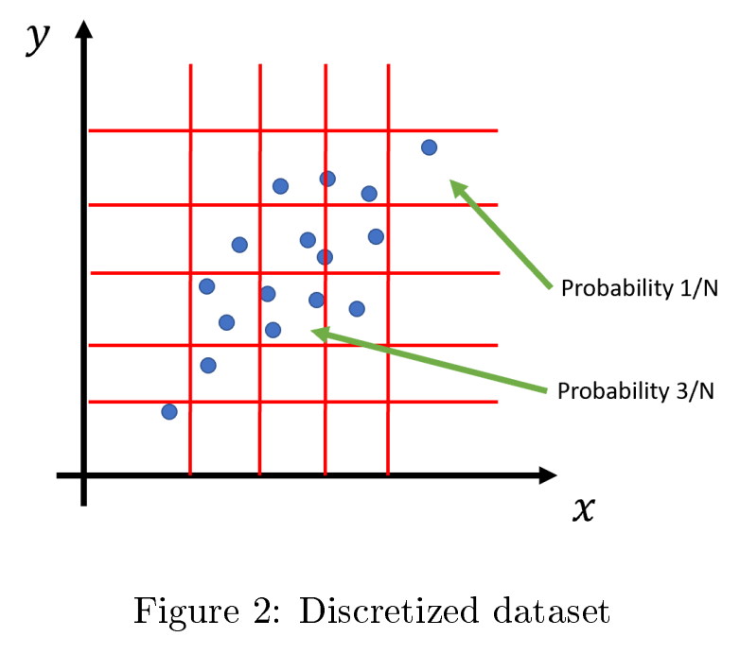
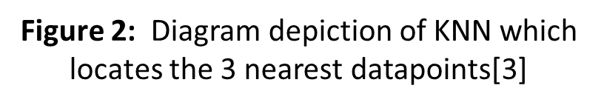
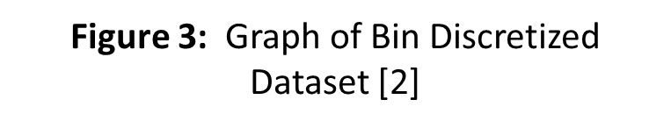
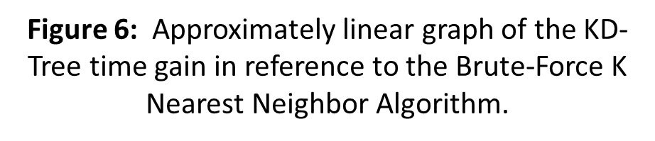
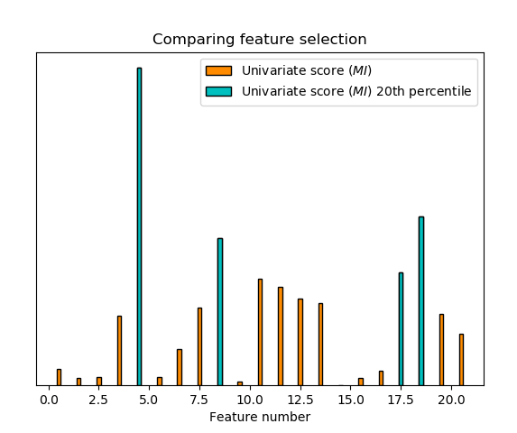
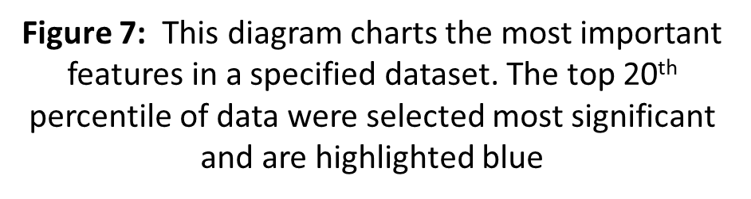
Mutual Information Estimation Utilizing K-Nearest Neighbors
Mentees: Samuel Dovgin and Sehe Tinfang
Mentor: Alan Yang
I. Introduction
IV. Implementation
Mutual information (MI) is a measure of the mutual dependence between two random variables based on their marginal and joint probability distributions. Intuitively, MI quantifies the information obtained about one variable through the other. It has applications in machine learning as a criterion for feature selection and in optimization of neural networks.
1st stage
II. Problem Statement
(Later talk about how this is either sacrificing space in the k-d tree or approximating with the monte carlo simulator.)
Computing MI in machine learning can be difficult because usually only datasets are available, not the relevant distributions of random variables. One way to estimate MI from a dataset is by discretizing the data, but finite sampling leads to many errors in estimation.
The KSG Nearest Neighbor Estimator attempts to fix this issue by discretizing based on the K Nearest Neighbors to a point in the dataset instead of a fixed box width. Computing the K Nearest Neighbors is a very computationally expensive part of the algorithm, so we investigated a few ways to do this more efficiently (such as KD-trees and Monte Carlo) than brute force methods and their implementations.
2nd stage
Using a KD-tree (k-dimensional tree) we were able to quickly parse the samples and find the KNN of each point. Comparing this to the Brute-Force version of the we saw significant magnitudes in conserved time. KD-trees do not greatly increase the space complexity of the dataset and as such we found this method to be efficient on multiple fronts
III. Objective & Methodology
3rd stage
[Main objective] Increase the speed of K Nearest Neighbors for Mutual Information Estimation through several methods including approximation and utilizing new data structures. We expect to retrain high accuracy while improving the speed of the implementation runtime.
Using a mutual info classifier we tested the ability of MI to predict the most important features in an example dataset from the UCI Machine Learning Repository. In this case, we tested a mushroom dataset with two classes, poisonous or edible. Through mutual info alone we were able to accomplish an essential machine learning task. This selection picks only the useful data, saving time.
We followed these stages to accomplish our objective:
[1st Stage] Learn the basics about the KSG brute force implementation and consider different solutions for optimizing its runtime.
[2nd Stage] Study the KD-tree data structure implementation and analyze its improvements on the algorithm
[3rd Stage] Finally test Monte Carlo random sampling simulators for approximation optimizations. Additionally test mutual information classifiers on data to see how they can be used. Understand the trade-offs of approximations on the accuracy of the function.
V. Conclusions
Acknowledgments
We were able to develop several strategies and compare different methods of more efficiently computing K Nearest Neighbors. This can be applied to our choice of the KSG Mutual Information Estimator however it can improve other algorithms as well. Future work would be to continue improving KNN efficiency or that of other algorithms.
We appreciate the support of our mentor for teaching us and guiding us to the necessary knowledge and skills required for this research. We are also thankful to the PURE committee for proving this opportunity to get introduced to research with grad students.
Throughout this project we have learned how to utilize new data structures such as KD-trees and implementing them to decrease runtime. Additionally we have learned how to parse large machine learning datasets and apply specific classifiers in PYTHON. Experience with python libraries Matplotlib and Numpy will be extremely useful.
References
[1] Estimating mutual information: Alexander Kraskov, Harald Stögbauer, and Peter Grassberger
[2] Mutual Information Write-Up: Alan Yang
[3] Mutual Information Website: www.scholarpedia.org

