Slide 1
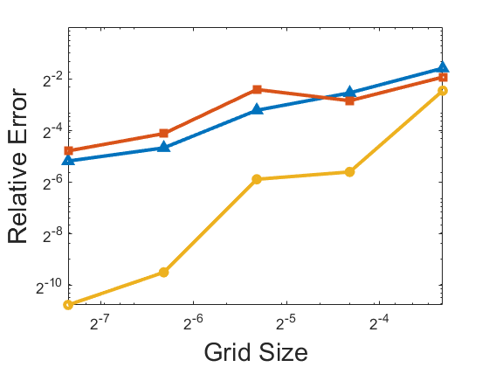
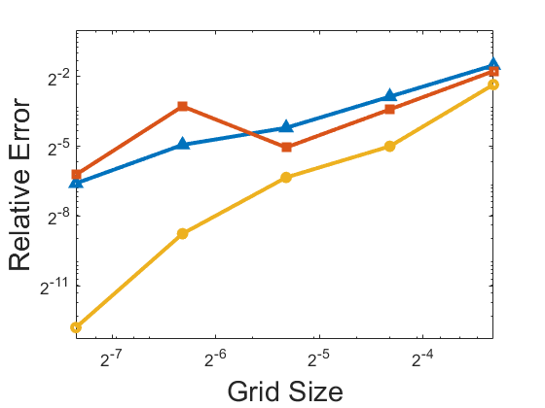
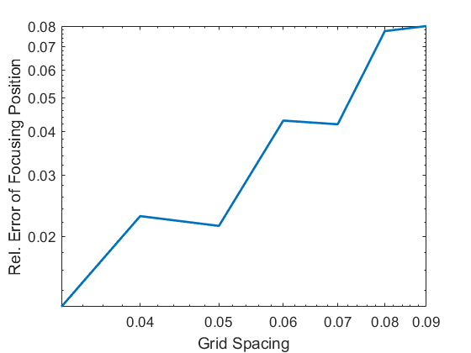
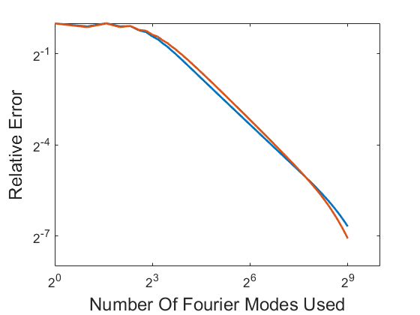
A
1
B
1
For A&B
1
1
Eqn. 7
Eqn. 10
Eqn. 8
2
2
1
1
C
D
For D
Re = 1
Re = 50
Rel. Error of Focusing Position
1
2
1
1
Grid Spacing

