Slide 1
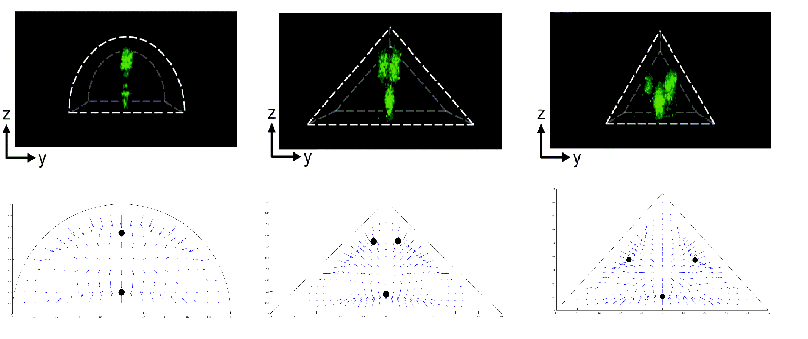
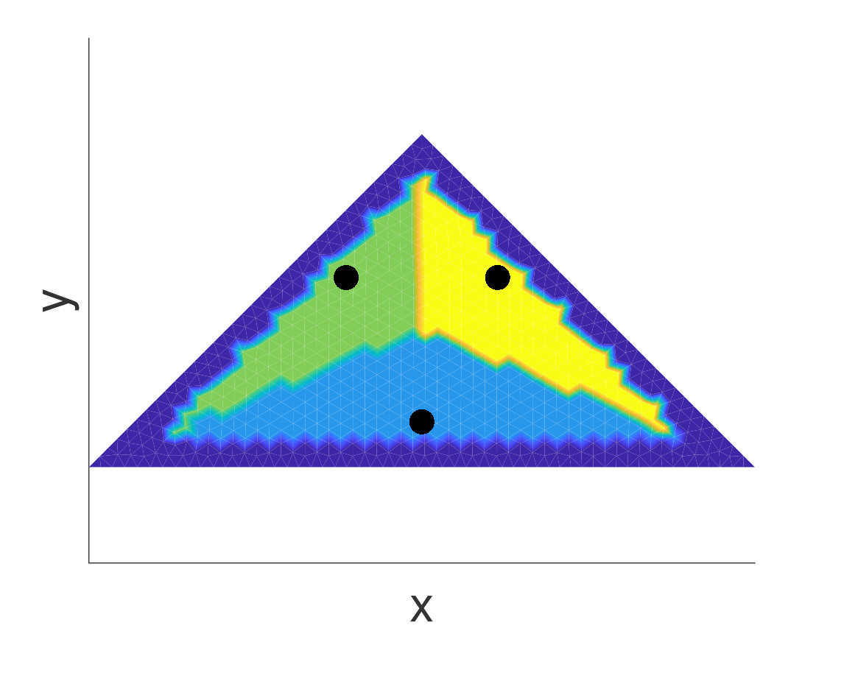
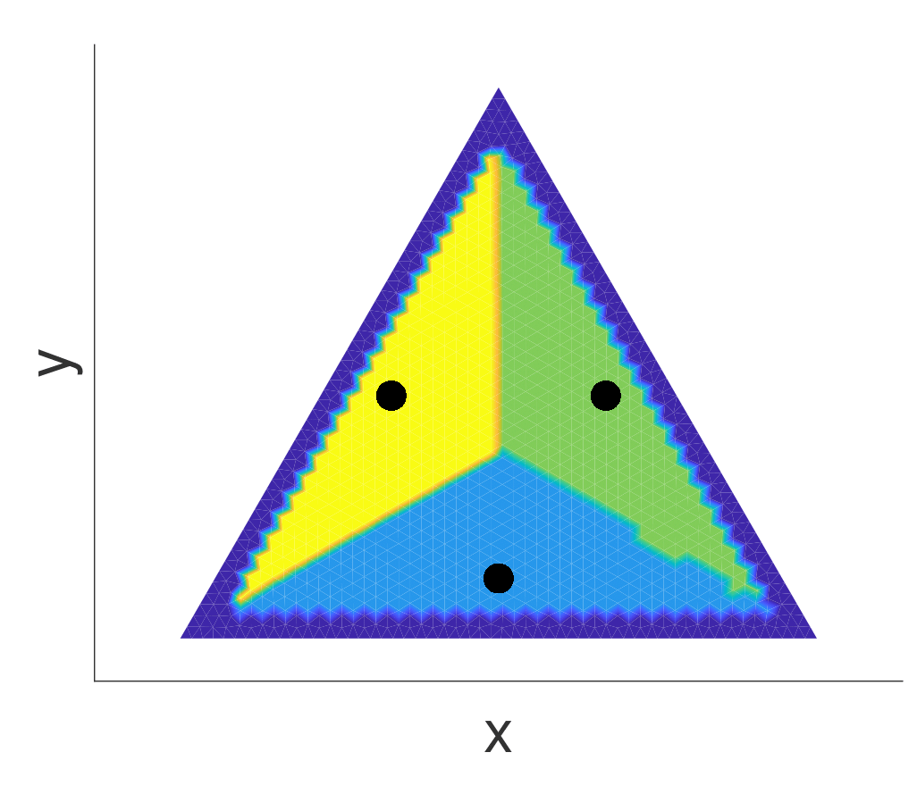
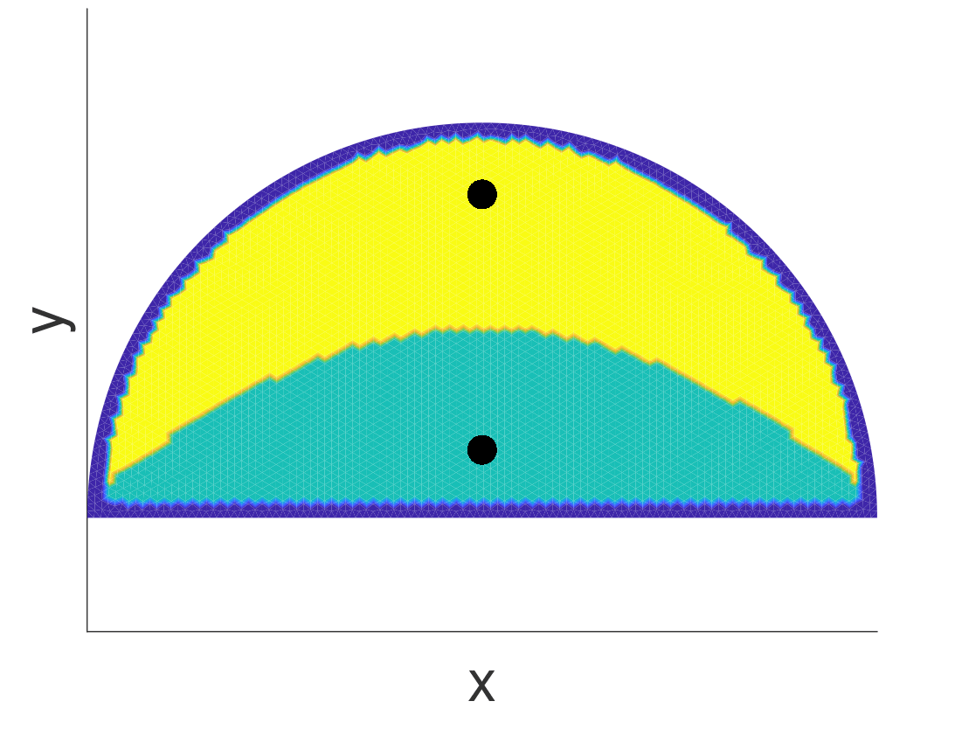
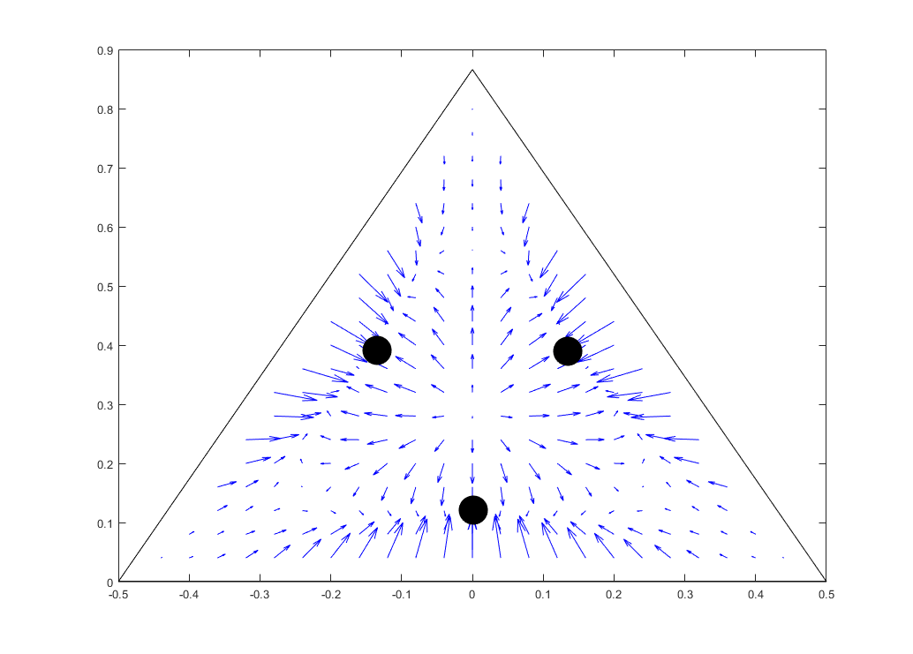
55μm, R_{p}=2.0
55μm , R_{p}=2.0
Experiments from J. Kim, et al.al.
90μm , R_{p}=2.0
Theoretical prediction
Predicted focusing position

