Slide 1
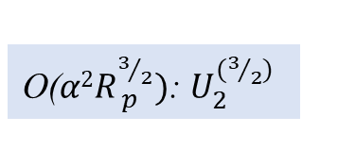










Inner Solution
$$R=R_{p}^{1/2}r$$
Outer Solution
O($α$):$u_{1}^{(0)}$
$$O\left(\frac{α}{r^{2}}\right)→O\left(\frac{αR_{p}}{R^{2}}\right)$$
O($α$Rp): $u_{1}^{(1)}$
O($α$Rp): $U_{1}^{(1)}$
$$O\left(αR_{p}\right)→O\left(αR_{p}\right)$$
$$O\left(α^{2}R_{p} r\right)→O\left(\frac{αR_{p}R}{R_{c}^{1/2}} \right)$$
Not used in calculation
O($α2$): $u_{2}^{(0)}$
O($α2$Rp): $u_{2}^{(1)}$
$$O\left(\frac{α^{2}}{r^{3}} \right)→O\left(\frac{α^{2}R_{ p}^{3/2}}{R^{3}}\right)$$
O($α2R_{ p}^{3/2})$: $U_{2}^{(3/2)}$

