Slide 1
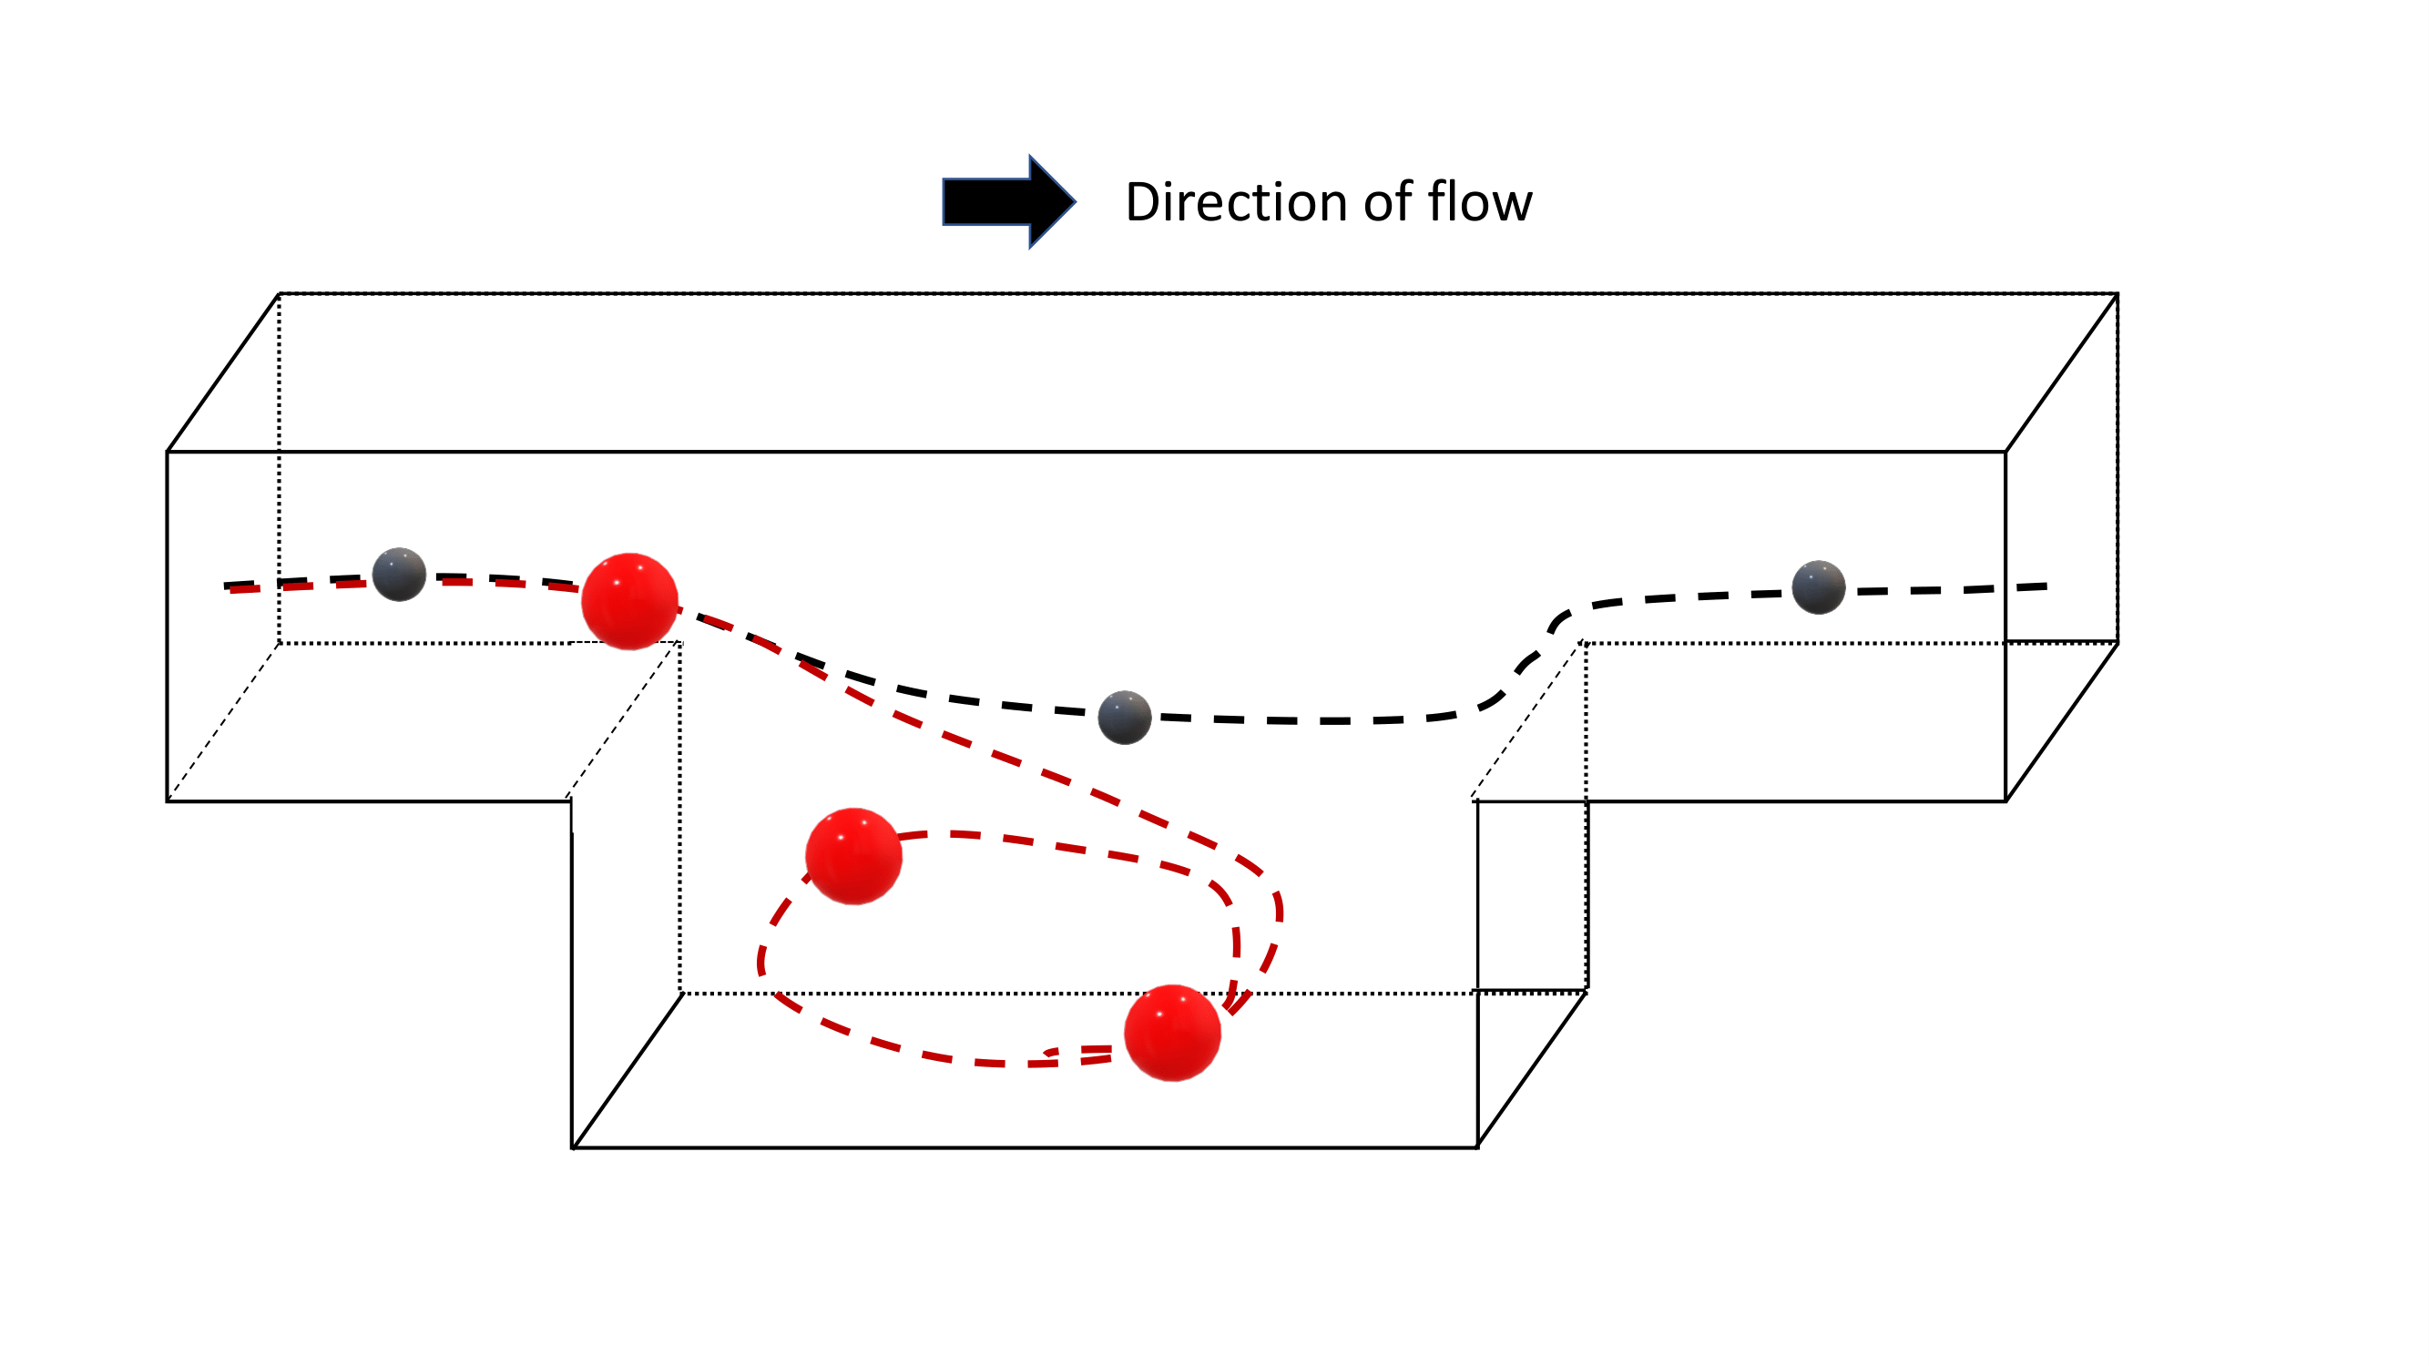
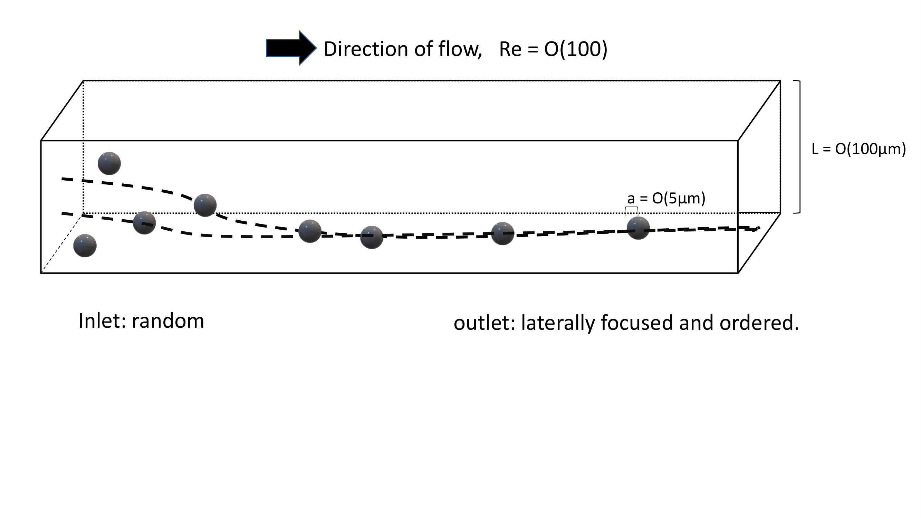
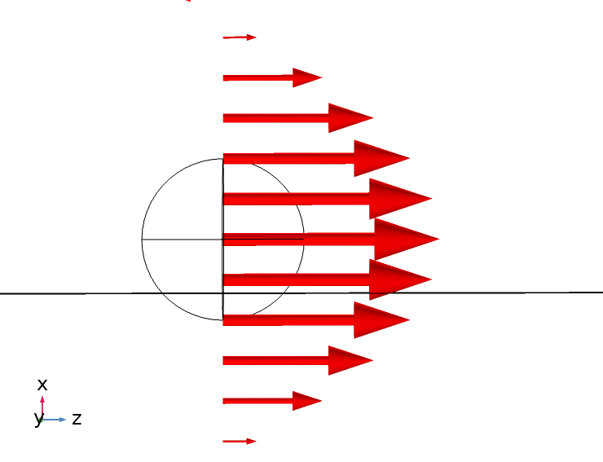
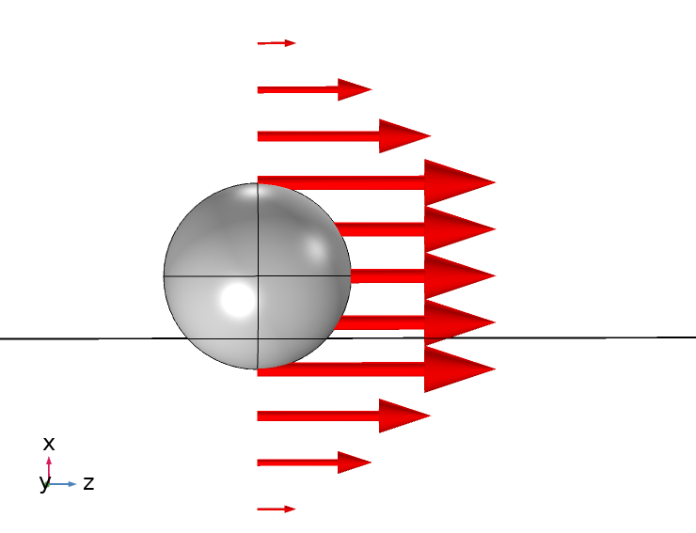
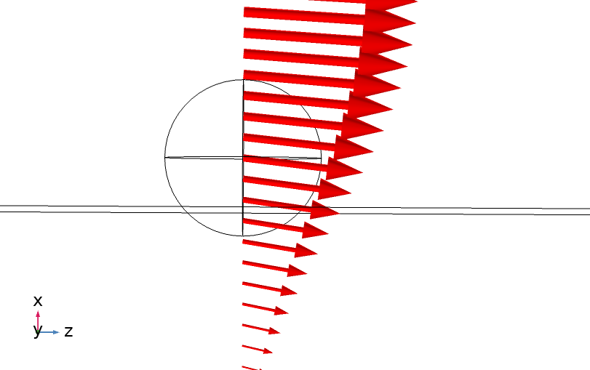
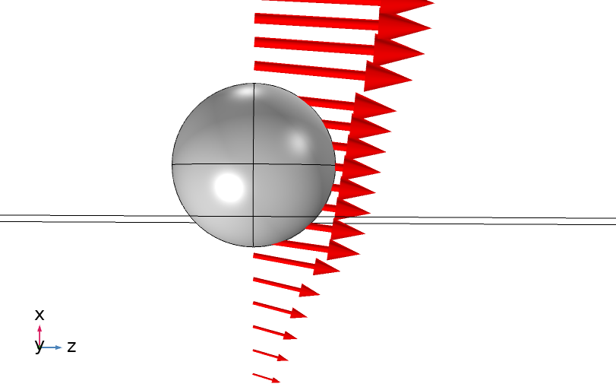

Slide 2
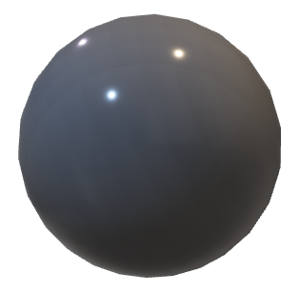
d = O(5µm)
L = O(100µm)
d = O(5µm)
Particles in fluid flow change the background flow to move across streamlines. This causes the particles to naturally self organize.
Particles of different sizes have different effects. Clever devices can use this to separate particles of different sizes.
The particle stops the fluid from curving
The particle interrupts the fluid from sheering

Slide 3
Direction of flow, Re = O(100)
L = O(100µm)
a = O(5µm)
Inlet: random
outlet: laterally focused and ordered.

