Slide 1
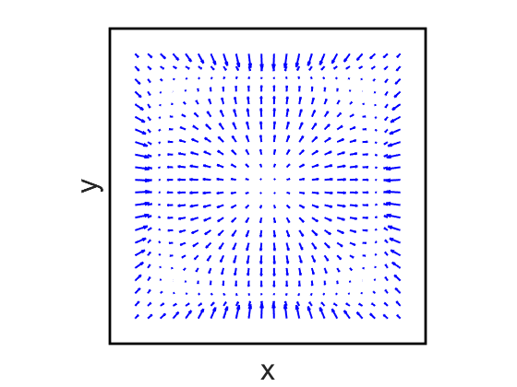
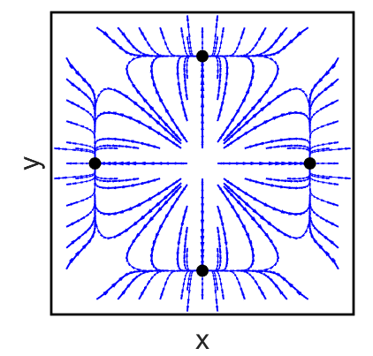
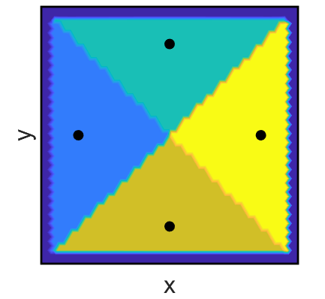
A
B
C
D
Sample Point Spacing | Relative Error of Interpolation
0.12 | 0.6292
0.1 | 0.2916
0.08 | 0.3091
0.06 | 0.1547
0.04 | 0.0741
0.02 | 0.0482

