Slide 1
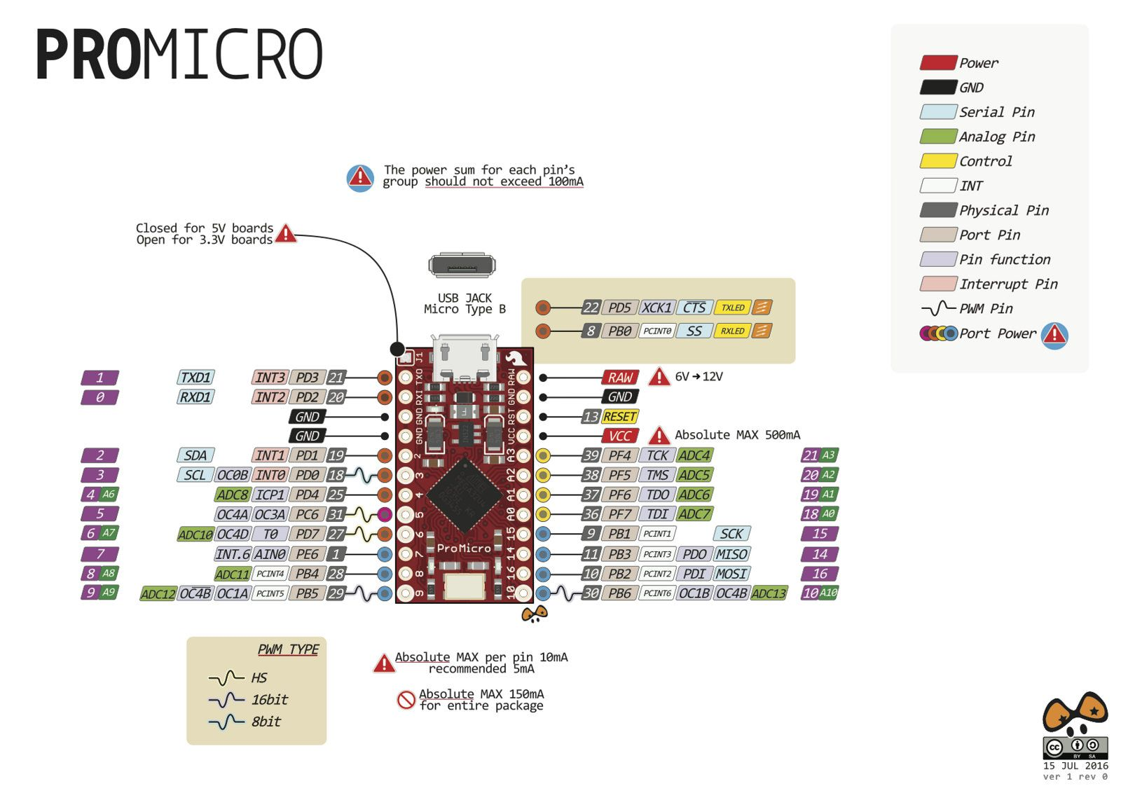
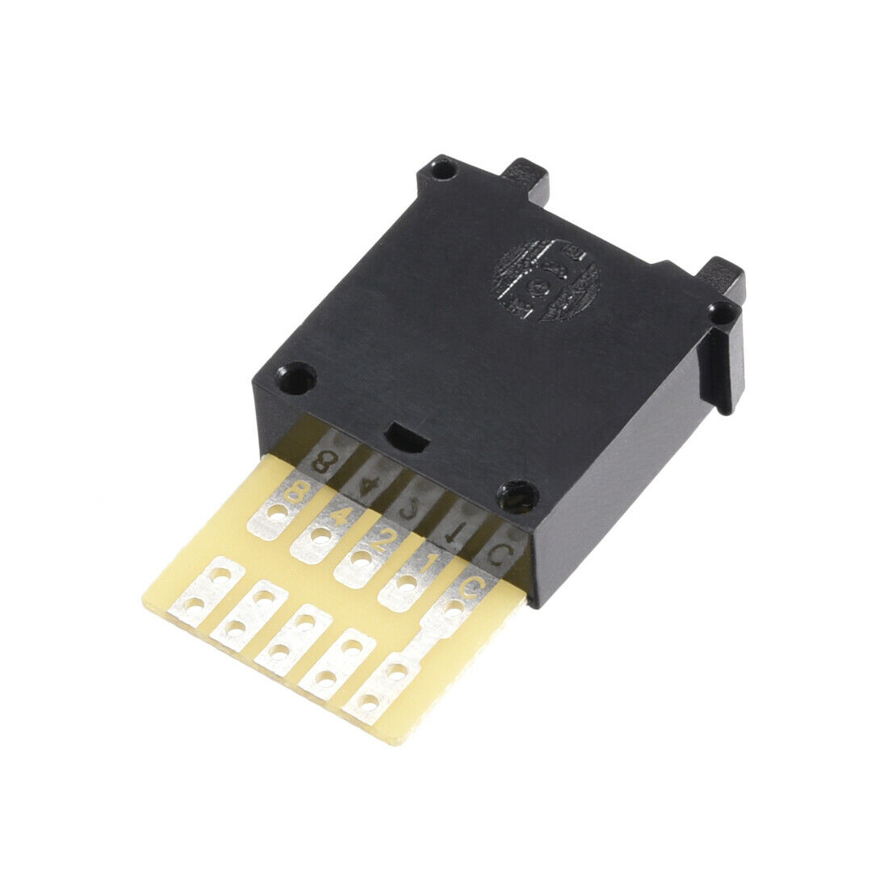
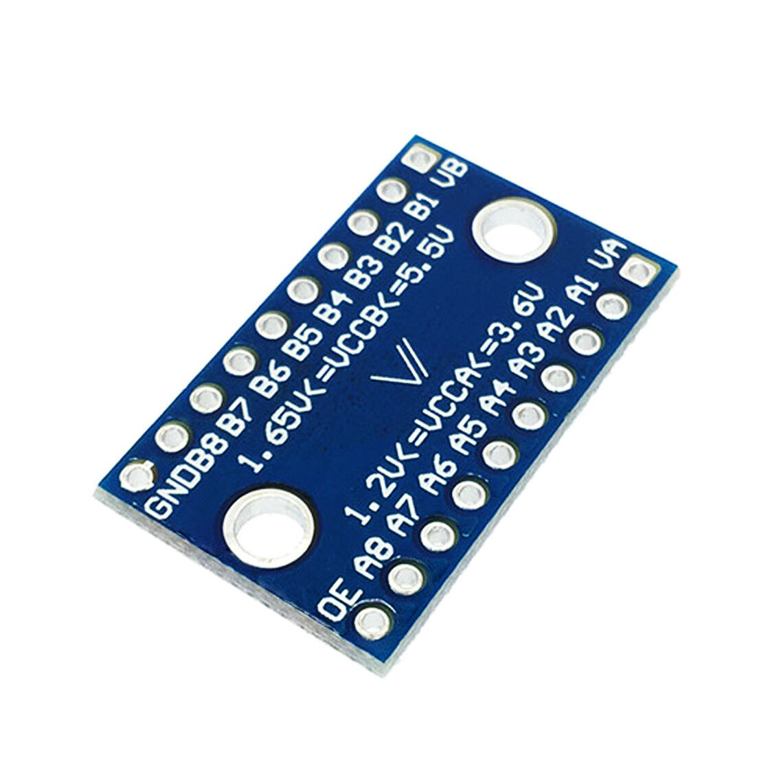
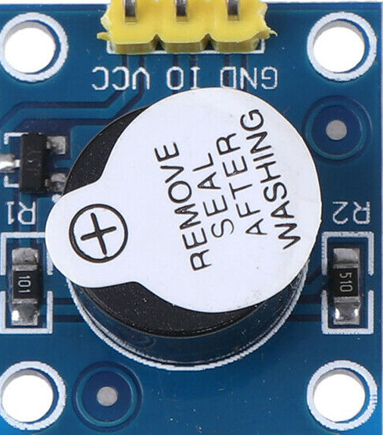
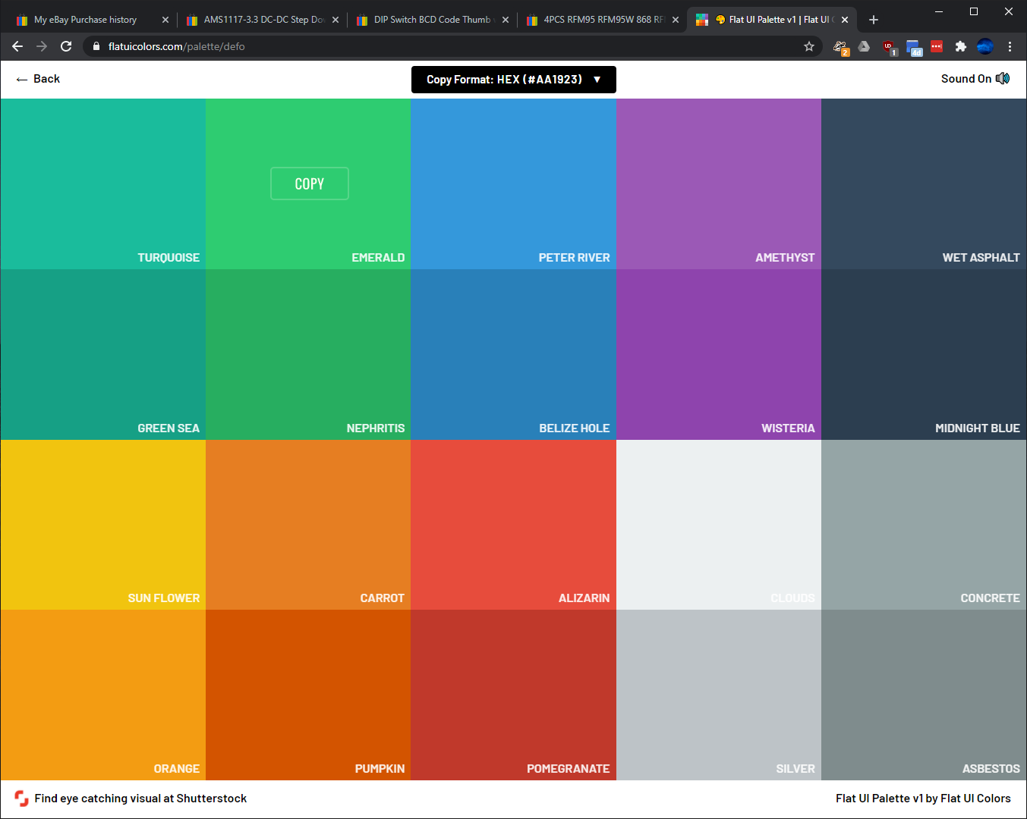
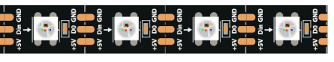
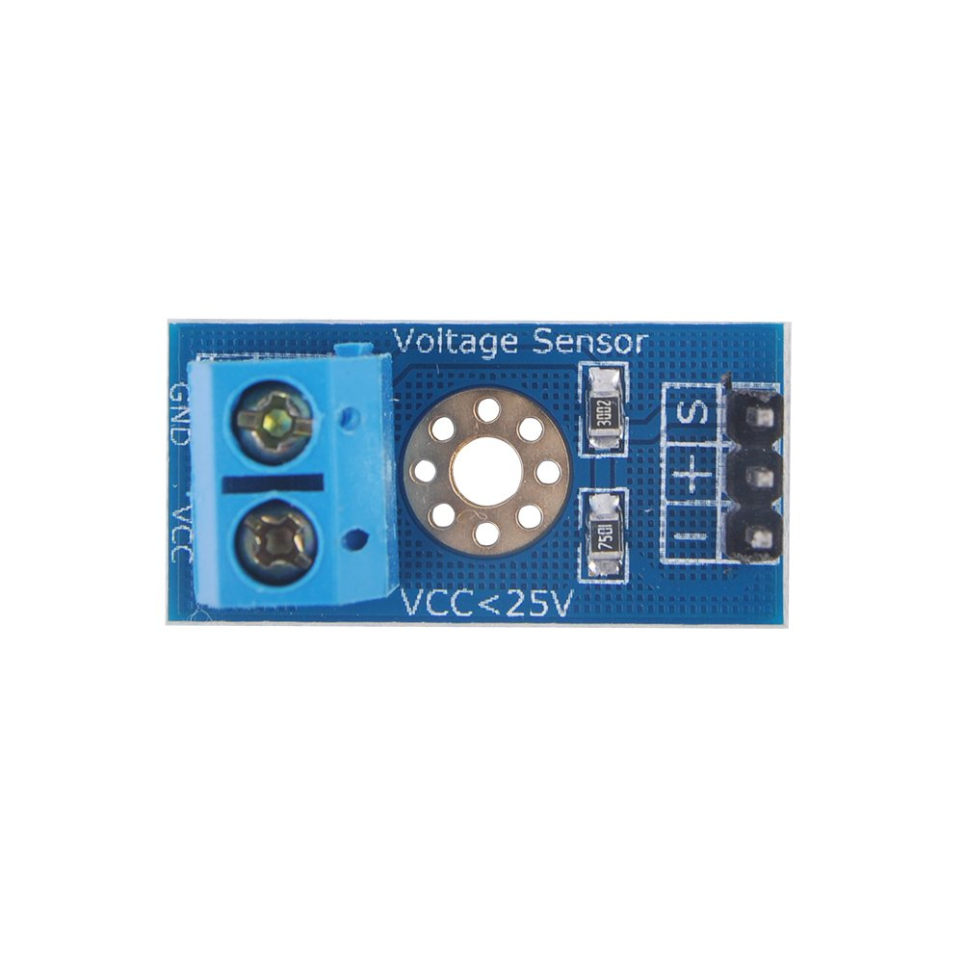
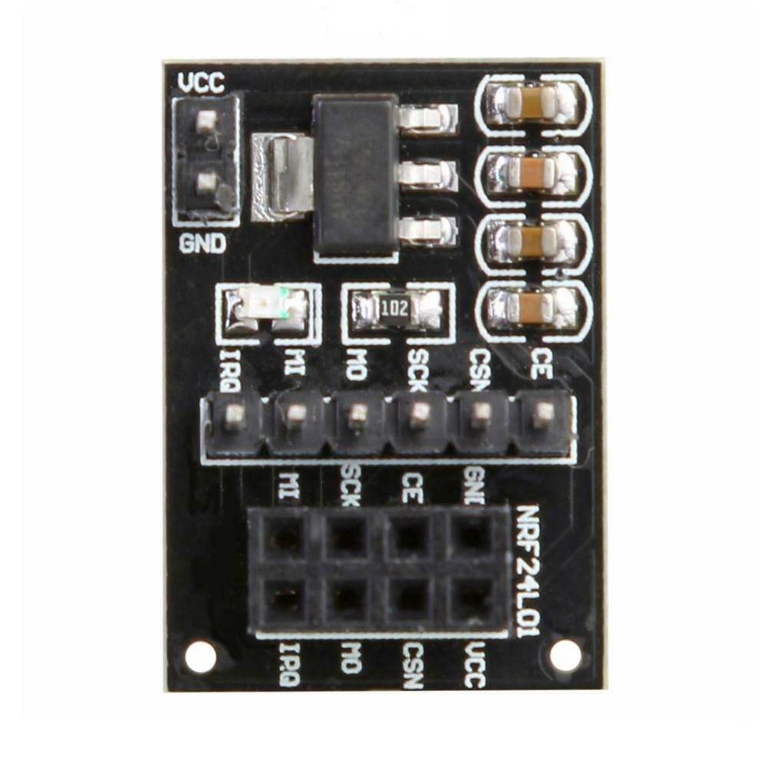
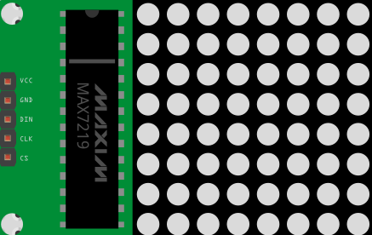
LORA
GND | Black | GND
MISO | White | PA6
MOSI | Grey | PA7
SCK | Purp | PA5
CS | Blue | PB0 / PA4
DI 0 | Grn | PA15 / PA1
3V3 | Yell | 3V3
LIPO V | 1C | 3C
Min | 3.0 | 9.0
Nominal | 3.7 | 11.1
Full | 4.2 | 12.6
CS - DISP
CE
CSN
SCK
MISO
MOSI
NFC
SDA | Purp | PA1
SCK | Blu | PA5
MOSI | Grn | PA7
MISO | Yell | PA6
GND | Or | GND
RST | Red | PA4
3V3 | Brown | 3V3
NFC
SDA | Black | PB0
SCK | White | PB3
MOSI | Grey | PB5
MISO | Purp | PB4
GND | Blue | GND
RST | Grn | PB1
3V3 | Yell | 3V3

Slide 2
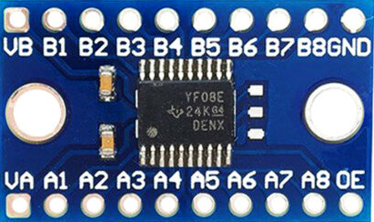
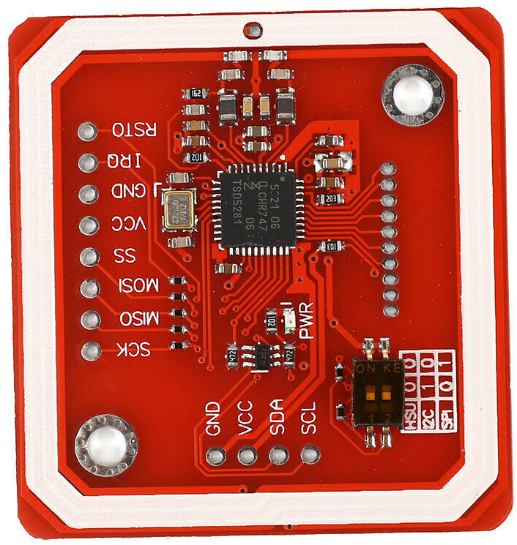
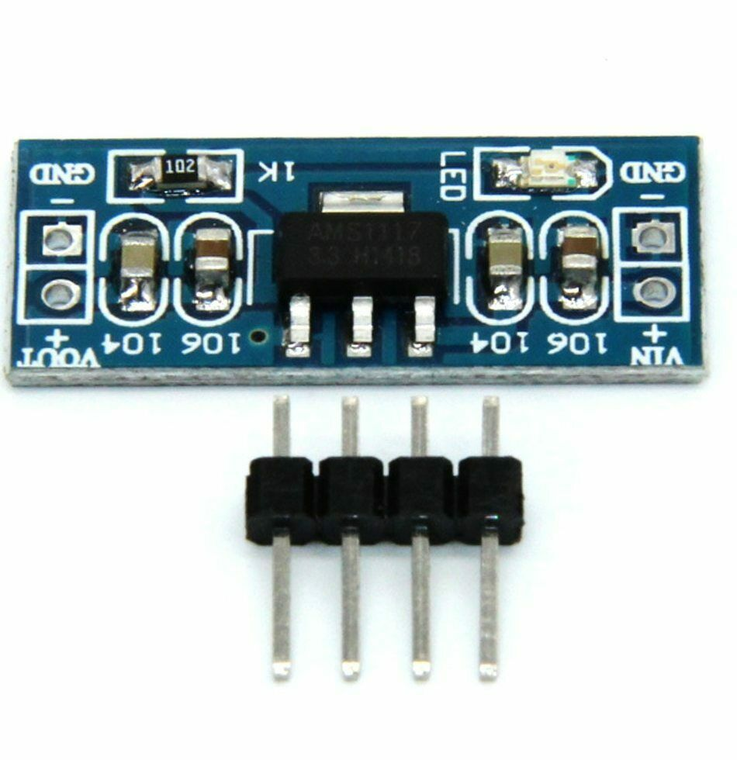
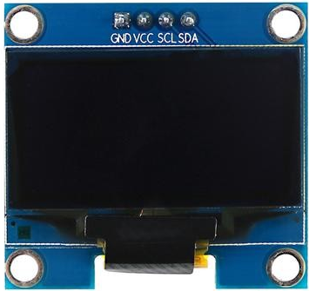
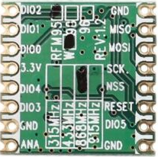
LORA
GND | Black | GND
MISO | White | PA6
MOSI | Grey | PA7
SCK | Purp | PA5
CS | Blue | PB0 / PA4
DI 0 | Grn | PA15 / PA1
3V3 | Yell | 3V3
9 Button Simon Game
LIPO V | 1C | 3C
Min | 3.0 | 9.0
Nominal | 3.7 | 11.1
Full | 4.2 | 12.6
BTN_Matrix_ROW
NFC
SDA | Purp | PA1
SCK | Blu | PA5
MOSI | Grn | PA7
MISO | Yell | PA6
GND | Or | GND
RST | Red | PA4
3V3 | Brown | 3V3
CS (NSS)
SCK
MISO
MOSI
Reset
BTN_Matrix_COL
Note: Arduino Leonardo interrupt pins are 0, 1, 2 & 3 only
NFC
SDA | Black | PB0
SCK | White | PB3
MOSI | Grey | PB5
MISO | Purp | PB4
GND | Blue | GND
RST | Grn | PB1
3V3 | Yell | 3V3

Slide 3
LORA
GND | Black | GND
MISO | White | PA6
MOSI | Grey | PA7
SCK | Purp | PA5
CS | Blue | PB0 / PA4
DI 0 | Grn | PA15 / PA1
3V3 | Yell | 3V3
10 Button Counting
BTN_Matrix_COL
LIPO V | 1C | 3C
Min | 3.0 | 9.0
Nominal | 3.7 | 11.1
Full | 4.2 | 12.6
BTN_Matrix_ROW
NFC
SDA | Purp | PA1
SCK | Blu | PA5
MOSI | Grn | PA7
MISO | Yell | PA6
GND | Or | GND
RST | Red | PA4
3V3 | Brown | 3V3
BTN_Matrix_COL
CS (NSS)
SCK
MISO
MOSI
Reset
Display_CS
BTN_Matrix_COL
Note: Arduino Leonardo interrupt pins are 0, 1, 2 & 3 only
NFC
SDA | Black | PB0
SCK | White | PB3
MOSI | Grey | PB5
MISO | Purp | PB4
GND | Blue | GND
RST | Grn | PB1
3V3 | Yell | 3V3

