Slide 1
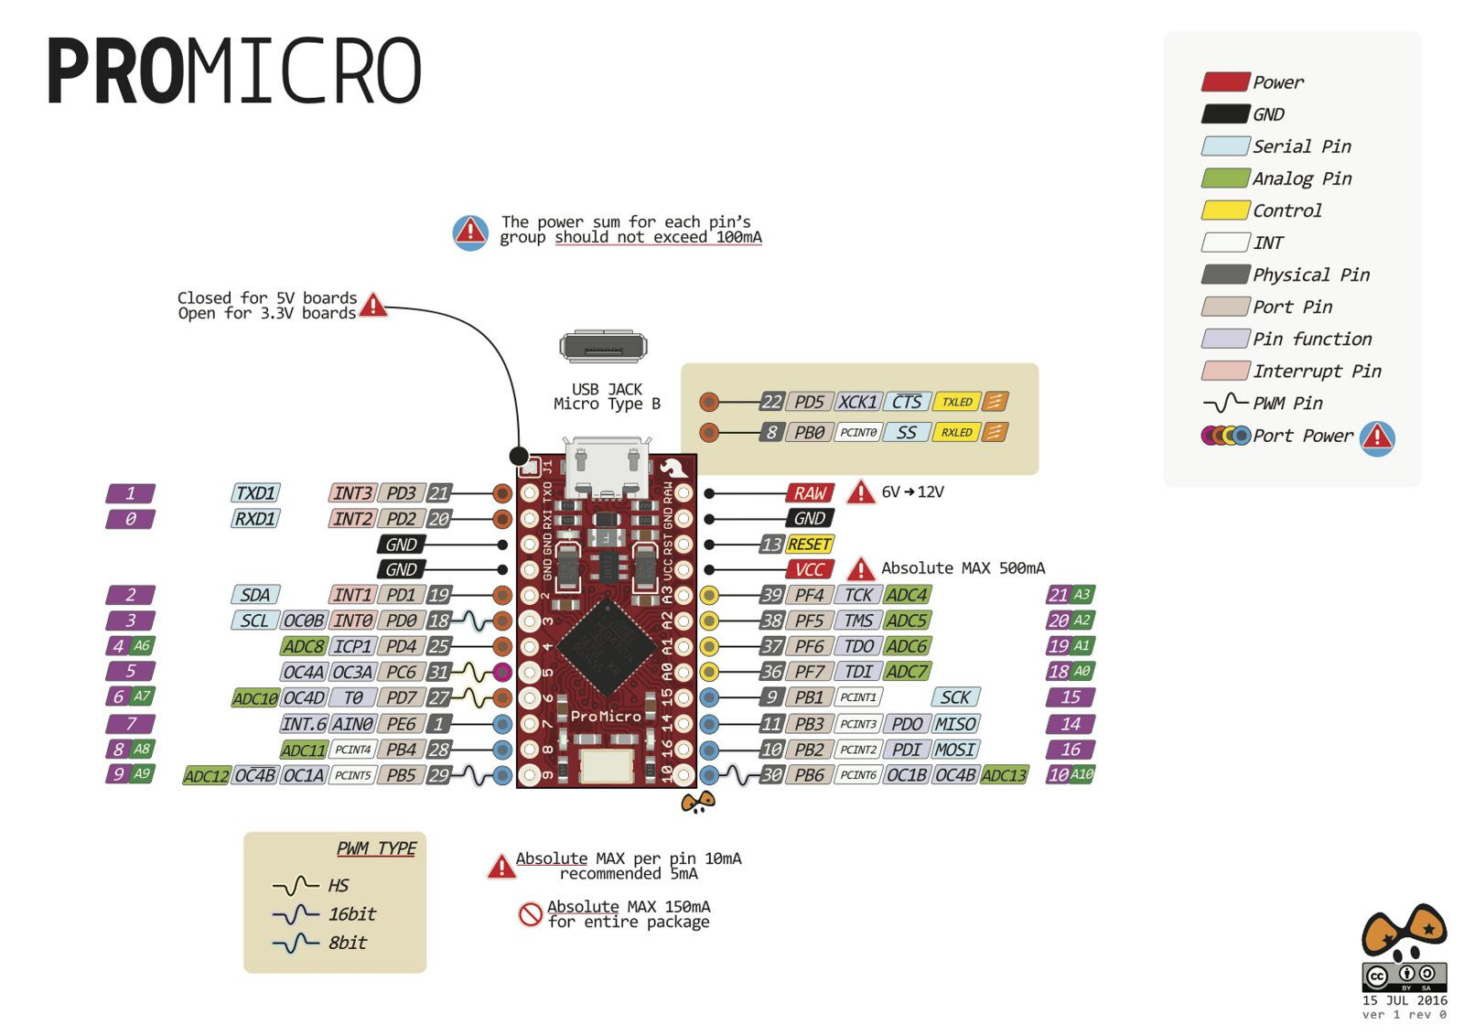
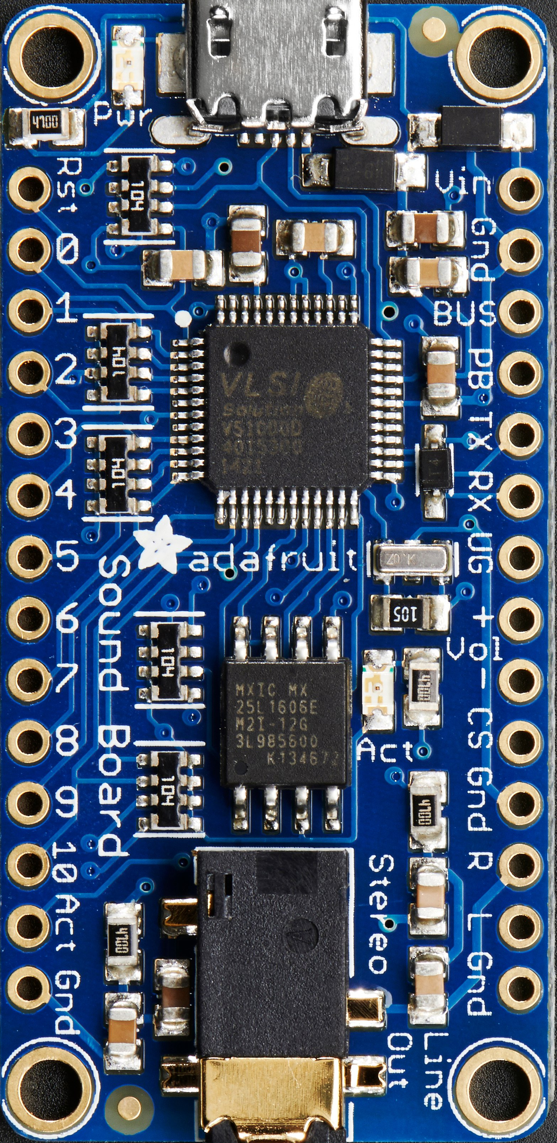
RX SFX
TX SFX
-
-
SCREEN ??
SCREEN ??
RESET SFX
-
-
-
-
-
-
-
-
-
LED RING
STATUS LEDS
TIME BTN
START BTN
-
CAM FOCUS
CAM TRIGGER
PWM OUT

