Slide 1
Predicting segment rail disruptions using imbalance- aware machine learning
Samuel Edozie
Notes:
My project is Predicting rail segment disruptions using imbalance-aware machine learning. I’ll quickly explain the problem, my approach, and the results, then I’ll move into a live demo of the prototype and outputs.

Slide 2
Rail disruption is a rare-event prediction problem
Disruptions cascade
Minor delays on one segment ripple into network-wide knock-on effects, resulting in missed connections, overcrowding, lost time and trust in the service.
But disruptions are rare
On-time movements dominate the dataset. A naive model can score high on accuracy by ignoring disruptions entirely, which is useless for early warning.
Notes:
Rail delays propagate; disruptions are rare. That creates class imbalance, so accuracy is misleading. We need early warning + decision-support risk scoring.

Slide 3
Aim & Objectives
Aim: Build and evaluate an imbalance-aware early-warning prototype that predicts segment-level rail disruption risk and outputs calibrated risk scores for decision support.
Dataset & labelling
Public NJ Transit + Amtrak (NEC) data; segment = directional from→to; reproducible delay-threshold label
Leakage Safe Pipeline
Past-only features; calendar effects and rolling segment history shifted to avoid future info
Baseline & comparators
Logistic Regression (interpretable baseline) vs Random Forest vs XGBoost under identical splits
Imbalance handling
Class weighting as default; SMOTE applied train-only as a sensitivity check, never on test data
Calibrated risk outputs
Probability calibration + tuned operating threshold; ranked segments grouped into risk tiers
Reproducible evaluation
Time-aware splits, PR-AUC / precision / recall / F1 over accuracy,
Notes:
Aim: build an imbalance-aware, leakage-safe prototype for segment-level disruption risk. Objectives: segment mapping, threshold label, time-aware split, compare LR/RF/XGB, evaluate with PR-AUC + P/R/F1, output ranked segments + risk tiers.

Slide 4
Two challenges shape every design decision
Class imbalance
Disruptions are the minority class
Accuracy is misleading ,predicting "no disruption" looks strong but catches nothing
Stricter thresholds (≥10 min) shrink the positive class further and increase imbalance substantially.
Evaluation prioritises PR-AUC, precision, recall and F1 not accuracy
Temporal leakage
Time-ordered data breaks random splits
Random shuffling lets models learn from the future inflated metrics, no real-world value
Splits must be chronological: train on earlier, validate intermediate, test on later
Lag features must be shifted; SMOTE applied train-only, never to validation or test
Notes:
Two risks drive design: temporal leakage (so chronological splits) and class imbalance (so PR-AUC, not accuracy). SMOTE is train-only if used.

Slide 5
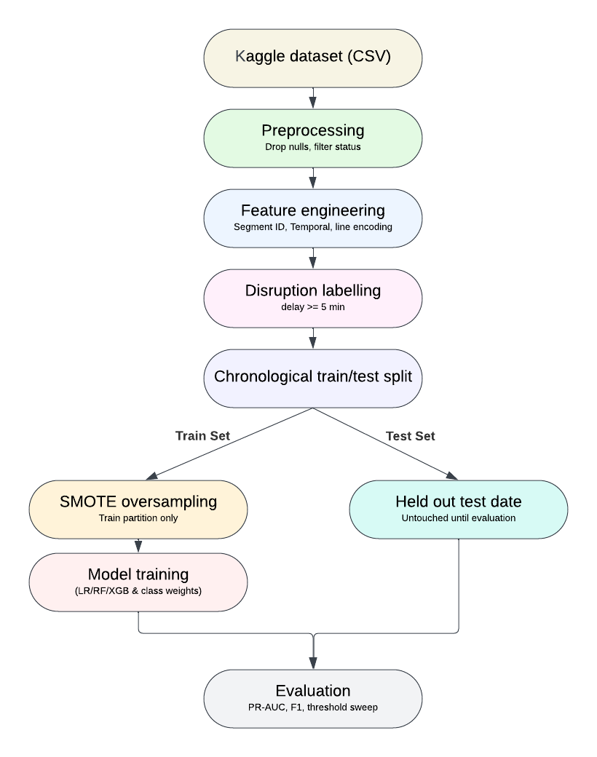
End-to-end leakage-safe pipeline
Guardrails embedded in the pipeline
Time-aware splits
Train on earlier periods, test on later so no random shuffling
Train-only features
SMOTE never touches validation or test partitions
Past-only features
Rolling segment history shifted to use only prior information
Notes:
Ingest CSV → clean → segment ID (from→to) → label (≥5 min) → leakage-safe features → time split → train models → evaluate → calibrated risk ranking.

Slide 6
NJ Transit + Amtrak (NEC) - segment-level labelling
Why this dataset
Stop-level performance records with timestamps and delay measurements which are consistent enough for supervised learning under public-data constraints.
Label distribution by threshold
Why a delay threshold (not incident causes)
Public datasets rarely provide stable, reliable incident-cause labels. A transparent ≥ 5 min delay rule is reproducible and lets the model focus on disruption risk and not causal diagnosis.
Why segment-level (not station-level)
A station can be affected by upstream issues. A directional segment (from → to) localises risk to the specific link where disruption is observed.
Notes:
Using NJ Transit + Amtrak (NEC) logs. Segment-level is more actionable than station-level. Disruption label is delay-threshold proxy because public cause labels aren’t stable.

Slide 7
Three iterative prototypes - risk-managed scope
P1+ P1.5
Feasibility baseline
1–3 months • LR baseline
Single-month → 3-month window
Established label, time split, PR-AUC
Verified pipeline before scaling
Best PR-AUC Score: 0.29
P2
Multi-model comparison
6 months • LR vs RF vs XGB
Class weighting + SMOTE (train-only)
Threshold sensitivity at 5 vs 10 min
XGBoost + CW emerged strongest
Best PR-AUC Score: 0.44
P3
Cross-year + lag features
8 months • cross-year hold-out
Leakage-safe 7-day rolling segment history
Probability calibration + threshold tuning
Ranked segments + risk tiers
Best PR-AUC Score: 0.51
Notes:
“Prototype 1: feasibility baseline (LR) and pipeline correctness. P1.5: expand to 3 months. Prototype 2: 6 months + model comparison + imbalance methods. Prototype 3: cross-year holdout + segment-history features + decision-support outputs

Slide 8
XGBoost + class weighting wins on PR-AUC
Headline metrics (cross-year test)
Best model XGB + Class weights
PR-AUC 0.513
F1 0.509
Recall 0.552
Precision 0.473
Why not SMOTE?
Higher recall (0.71) but precision drops to 0.40 but too many false alarms for early warning.
Notes:
Best model: XGBoost + class weights. Cross-year PR-AUC ≈ 0.513; table shows Precision ≈ 0.473, Recall ≈ 0.552, F1 ≈ 0.509 at the standard eval point. SMOTE boosts recall but drops precision → more false alarms.

Slide 9
Progression and severity sensitivity
Threshold sensitivity (P3, XGB + CW)
PR-AUC across prototypes
Stricter = harder
Tightening to ≥10 min increases class imbalance substantially; PR-AUC and F1 drop sharply. ≥5 min stays the primary label; ≥10 min is reported as a sensitivity check.
Notes:
Performance improves across prototypes mainly from stronger features + time-safe evaluation. Stricter disruption threshold increases imbalance and makes detection harder, so ≥5 min is primary; ≥10 is sensitivity.

Slide 10
Calibrated probabilities, tuned operating point
Threshold sweep — Prototype 3
Why this matters
A binary label tells you if a segment is risky. A calibrated probability tells you how risky it may be and lets operators rank segments and trade off recall vs precision against alert volume.
What was applied
Platt and Isotonic calibration tested via reliability plots; predicted probabilities mapped close to observed disruption frequencies.
Threshold sweep (0.10 → 0.85) selected 0.40 as the operating point and best F1 with non-trivial precision; appropriate where missed disruptions are costly.
Notes:
Calibration improves probability meaning for risk scoring. Threshold tuning sets an operating point depending on false-alarm vs missed-disruption trade-off (I’ll show this live in demo).

Slide 11
Ranked segments and risk tiers - actionable output
Top 5 highest-risk segments
Risk tier distribution (cross-year test)
Rank | Segment | Line | Risk % | Actual | Obs | Tier
1 | Linden → Newark Airport | Northeast Corrdr | 86.30% | 100.00% | 1 | HIGH
2 | Trenton → New Brunswick | Northeast Corrdr | 85.00% | 98.40% | 64 | HIGH
3 | Linden → Metropark | Northeast Corrdr | 82.90% | 66.70% | 3 | HIGH
4 | Linden → New Brunswick | Northeast Corrdr | 82.90% | 100.00% | 1 | HIGH
5 | Linden → Newark Penn Stn | No Jersey Coast | 82.90% | 100.00% | 1 | HIGH
Concentration of risk
4 of the top 5 risk segments sit on the Northeast Corridor, ranking surfaces real operational hotspots, not random noise.
Notes:
Outputs: ranked segments + risk tiers. Predicted vs actual per segment validates that higher predicted risk corresponds to higher observed disruption rates.

Slide 12
Key findings
Boosted trees + class weighting was the strongest configuration
XGB + CW achieved cross-year PR-AUC = 0.513 with stable F1 = 0.509. Robust to time shift.
Lag features mattered more than model complexity
Leakage-safe 7-day rolling segment history drove the P2 → P3 gain (0.44 → 0.51), not tuning.
SMOTE traded precision for recall but not the right fit here
Class weighting kept false alarms manageable; SMOTE inflated recall but hurt PR-AUC.
Time-aware evaluation revealed the real performance
Cross-year hold-out confirmed generalisation; random splits would have inflated metrics.
Calibration turned a classifier into decision support
Predicted probabilities aligned with observed segment rates → actionable ranking and tiers.
Threshold sensitivity exposed the severity trade-off
≥10 min tripled imbalance and halved PR-AUC to ≥5 min held as the primary, defensible label.
Notes:
XGB+CW best under time shift; time-aware evaluation is essential; SMOTE trade-off is recall↑ precision↓; lag/rolling segment history mattered most; calibration makes scores usable

Slide 13
Limitations and where this goes next
LIMITATIONS
FUTURE WORK
Threshold-based label
≥5 min is a proxy as it predicts disruption risk, not incident cause.
Single dataset family
Trained on NJ Transit + Amtrak NEC; cross-network generalisation untested.
Sparse-segment variance
Rare or new segments produce noisier risk scores than well-observed ones
Batch, not live
Pipeline runs offline; no streaming ingestion or real-time scoring.
Richer external features
Weather summaries, planned engineering works, incident logs where available.
Cross-network validation
Apply the pipeline to additional rail networks to test generalisation claims.
Graph-based propagation
Model how disruptions cascade between connected segments using GNNs
Streaming early-warning tool
Live ingestion + rolling lag updates → near real-time segment risk scores.
Notes:
Limitations: proxy label, single network dataset, offline prototype not deployed live. Future work: weather/planned works, more networks, live pipeline, graph modelling if data supports.

Slide 14
Thank you!
Samuel Edozie
https://github.com/SamuelEdozie/rail-segment-disruption-prediction
https://www.linkedin.com/in/samuel-edozie-138769233/

