Slide 1

PROJECT PHASE I
EVALUATION II
SDN-Orchestrated Network Slicing for Vehicular 5G (V2X) Services
Presented to:
Dr. Navin Kumar
TEAM MEMBERS:
Department:
Department of ECE
A. Adharsh
BL.EN.U4ECE23101
Rishabh Bhat
BL.EN.U4ECE23240
Samuel Gerald
BL.EN.U4ECE23245

Slide 2
MAIN OBJECTIVE
Design an SDN-based network slicing solution for V2X communications that isolates safety-critical traffic (e.g., collision warnings) from infotainment traffic (e.g., video streaming), guaranteeing ultra-low latency for safety flows even under network congestion.
Sub-objectives:
• Literature Survey & Requirements: Survey existing SDN/5G slicing and V2X QoS literature; finalize concrete latency and throughput target KPIs per traffic class.
• Network Topology Design [Tools – Mininet-WiFi, Python]: Design emulated topology comprising vehicular nodes, Roadside Access Points (RSU), OVS switches, and SDN controller placement.
• Vehicle Mobility Modelling [Tools – Mininet-WiFi, Python mobility models]: Implement mobility for vehicle nodes (random waypoint / road-constrained) to trigger realistic wireless handoffs during emulation.
• Traffic Generation Pipeline [Tools – iperf3, Python, UDP/TCP]: Generate two flow classes: small periodic UDP safety beacons (CAM/DENM) and bulk TCP infotainment streams to simulate congestion.
• RYU Controller Development [Tools – Ryu Controller, Python, OpenFlow 1.3]: Write a custom SDN controller application that dynamically classifies flows (by UDP port / DSCP / 5-tuple) and installs per-class OpenFlow 1.3 rules.
• QoS & Slice Enforcement [Tools – Open vSwitch (OVS), Linux tc, OpenFlow meters]: Configure OVS queues and OpenFlow meters to enforce guaranteed bandwidth floors and strict priority scheduling per isolated slice.
• Dynamic Orchestration & Monitoring [Tools – Ryu, Python, OVS statistics, OpenFlow]: Poll real-time flow/port statistics from switches and adapt slice resource allocation on the fly upon detecting network congestion thresholds.
• Performance Evaluation & Reporting [Tools – iperf3, Wireshark/tcpdump, Python, NumPy, Pandas, Matplotlib]: Benchmark latency, jitter, throughput, and packet loss with vs. without slicing enabled; generate visual plots and final report.

Slide 3
LITERATURE SURVEY
Title | Problem / Methodology | Final Outcome / Key Finding
1. Distributed Vehicular Computing at the Dawn of 5G: A Survey Alhilal, Braud & Hui — arXiv:2001.07077 | Comprehensive survey of VANET communication (DSRC, LTE, 5G) and computing architectures (Cloud, Edge, Fog). | Mandates ≤50 ms latency and ≥10 Hz broadcast rates for collision-avoidance CAM messages; permits up to 8 parallel 5G slices.
2. Slicing on the Road: Enabling Automotive Vertical through 5G Softwarization Campolo, Fontes, Molinaro, Rothenberg & Iera — Sensors 18(12):4435 | 3-layer architecture validated using RYU controller with OpenFlow 1.3 metering on Mininet-WiFi. | Roaming vehicles achieved significantly lower and more stable latency under active OpenFlow metering caps (e.g., 5 Mbps cap on background traffic).
3. Network Slice Allocation for 5G V2X Networks: Implementation & Assessment Elsevier ScienceDirect Case Study | Python-based allocation framework evaluated under coexisting eMBB, URLLC, and mMTC traffic streams. | Adaptive resource allocation algorithms materially outperform static/equal slice allocations under heterogeneous traffic loads.

Slide 4
LITERATURE SURVEY
Title | Problem / Methodology | Final Outcome / Key Finding
4. Slicing 5G Core Network Based on the Ryu SDN Controller for XaaS ResearchGate Publication | Slicing at forwarding-equipment level via Ryu tenant controller over out-of-band networks without full 5G virtualization. | Confirms a single RYU controller can slice physical topology purely via flow-tables and QoS rules, validating the lightweight design.
5. QoS-Driven Slicing Management for Vehicular Communications MDPI Electronics 13(2):314, 2024 | Mininet-WiFi + RYU combined with PyTorch/Gymnasium reinforcement learning (RDQ3N) for adaptive slice allocation. | Dynamic learning-based slice adjustment provides superior QoS guarantees compared to static configuration during load spikes.
6. Mininet-WiFi: Emulating Software-Defined Wireless Networks Fontes et al. — IEEE CNSM 2015, pp. 384–389 | Extended Mininet emulator with virtual wireless stations, access points, propagation, and mobility models. | Established Mininet-WiFi as a reproducible platform for wireless SDN experimentation.

Slide 5
RESEARCH GAPS IDENTIFIED
Gap 1: Emulation-Scale V2X Slicing
Gap 2: Static vs. Dynamic Reallocation
Most slicing architectures are evaluated analytically or on high-level core simulators. Accessible, open-source testbeds for end-to-end Mininet-WiFi + RYU emulation of safety vs. infotainment traffic remain sparse.
Existing V2X literature primarily focuses on static OpenFlow queue creation. Real-time controller polling and dynamic slice bandwidth reallocation under sudden congestion are under-explored in low-cost testbeds.
Gap 3: Mobility-Aware Slice Handoffs
Gap 4: Standardized Benchmark Metrics
Seamlessly maintaining per-flow slice guarantees while vehicle stations trigger wireless access point handoffs—without deploying heavy 5G Core signaling machinery—lacks simple implementation references.
Prior studies employ widely varying KPI definitions. This project fills the void by establishing a reproducible, standardized “before vs. after” comparison framework measuring latency, jitter, and throughput.

Slide 6
WHAT WE BUILT
An SDN orchestrator (a RYU application) that runs five V2X slices on an emulated network of 6 vehicles, 2 RSUs with edge servers and a 20 Mb/s backhaul.
1. Isolation
Each slice has its own OpenFlow meter. Traffic above the slice budget is dropped, so no slice can take another’s bandwidth.
2. Priority
The controller writes a DSCP mark. Strict-priority queues on the backhaul always send URLLC and platoon packets first.
3.8 s → 25 ms
platoon delay (p95) during an eMBB flood: best effort vs orchestrator
3. Dynamic reallocation
Every 2 s the orchestrator reads the meter counters and shrinks eMBB to what the critical slices leave free. A REST API resizes slices live.
4. Mobility
Handovers are detected and stale rules flushed on every switch, so traffic follows the vehicle. Scripted paths and random waypoint.
0 % loss
for every critical slice under congestion, against 7.7 to 9.8 % without slicing

Slide 7
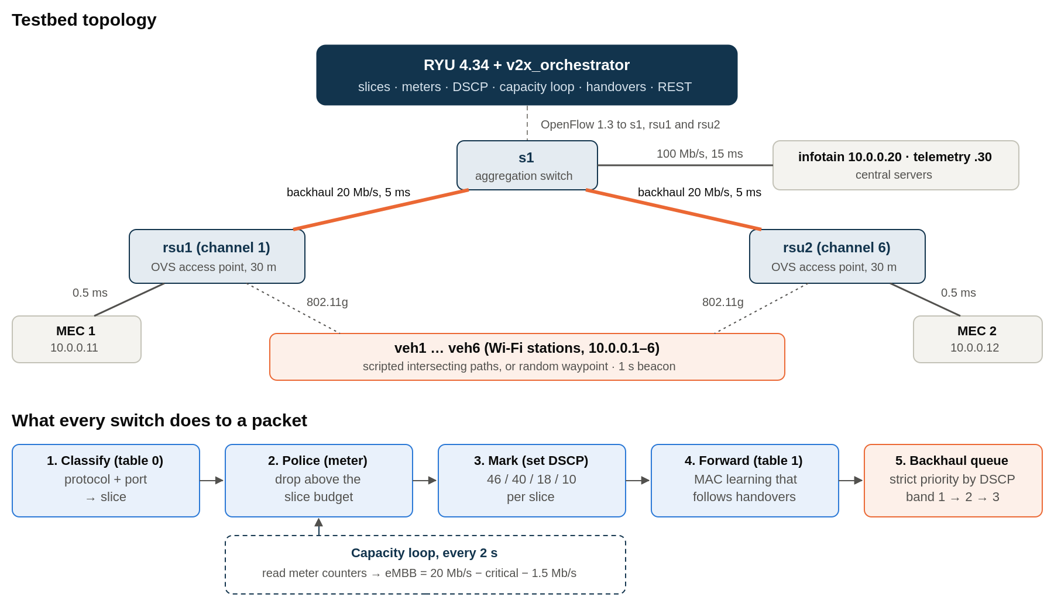
SYSTEM ARCHITECTURE & PACKET PIPELINE

Slide 8
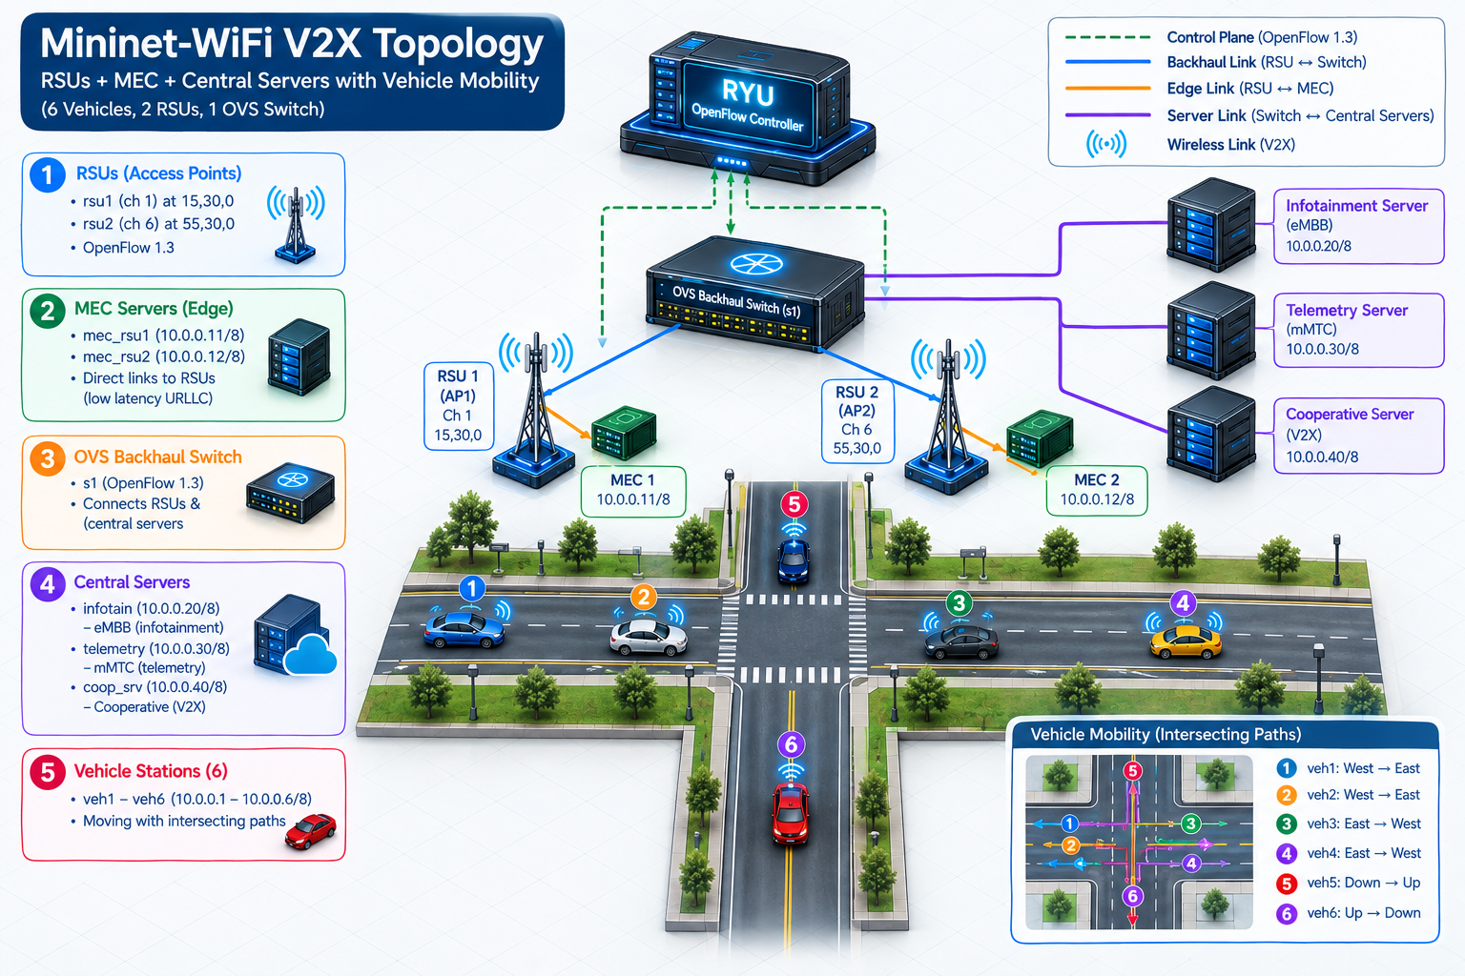
IMPLEMENTATION: MININET-WIFI TOPOLOGY

Slide 9
SLICE CONFIGURATION
Slice | V2X function | Match | Meter, budget | DSCP | Backhaul band | Destination
URLLC | Safety / collision alerts | UDP 5000 | 1, 5 Mb/s | 46 (EF) | 1 (highest) | Edge MEC
Platoon | Cooperative driving (V2V) | UDP 9000 | 2, 4 Mb/s | 40 (CS5) | 1 (highest) | Other vehicle
eMBB | Infotainment / video | TCP 8080 | 3, 12 Mb/s, set by the loop | 10 (AF11) | 3 (lowest) | Central infotain
mMTC | Telemetry / diagnostics | UDP 1883 | 4, 1 Mb/s | 18 (AF21) | 2 | Central telemetry
Best effort | Everything else | any | 5, 2 Mb/s | 0 | 3 (lowest) | any
Correction from Evaluation I
Slices are not mapped to OVS queues 0–3, and URLLC is not “Queue 0”. Each slice is policed by an OpenFlow meter; the DSCP mark selects one of three strict-priority bands on the backhaul links. Rules match both directions (destination and source port), so replies are classified too.

Slide 10
ENFORCEMENT: METERS & PRIORITY QUEUES
Queue tree on both ends of each backhaul link
Meters measured (functional tests)
HTB 20 Mb/s (the link rate)
Test | Offered | Delivered | Limit
URLLC flood | 10 Mb/s | 4.96 Mb/s | 5 Mb/s
mMTC flood | 2 Mb/s | 0.99 Mb/s | 1 Mb/s
Best-effort flood | 4 Mb/s | 1.97 Mb/s | 2 Mb/s
eMBB TCP download | unlimited | 11.3 Mb/s | 12 Mb/s
REST: URLLC set to 3 Mb/s | 10 Mb/s | 2.98 Mb/s | 3 Mb/s
prio, 3 bands band 1 always goes first
Band 1
URLLC, platoon
DSCP 46, 40
Band 2
mMTC
DSCP 18
Band 3
eMBB, best effort
other
netem 5 ms
netem 5 ms
netem 5 ms
Why both?
Meters stop a slice taking more than its share. Priority decides who waits when the link is full anyway: the budgets add up to 24 Mb/s on a 20 Mb/s link.
Packet counters: in a heavy-load trial 61 MB went through band 1 with marking on, and 0 bytes with it off.

Slide 11
DYNAMIC REALLOCATION: THE CAPACITY LOOP
Every 2 s, per switch: eMBB budget = 20 Mb/s − critical load − 1.5 Mb/s headroom
critical load = measured URLLC + platoon rate; 500 kb/s steps; never below 2 Mb/s
What happened in every heavy-load trial (all three switches)
PROTECT_ON
critical 7.9 Mb/s
eMBB 12 → 10.5 Mb/s
ADJUST
critical 8.6 Mb/s
eMBB → 9.5 Mb/s
PROTECT_OFF
critical 0.6 Mb/s
eMBB back to 12 Mb/s
Manual control: REST API on port 8081
The PUT changed the meter at once: the URLLC flow fell to 2.98 Mb/s, then was restored to 5 Mb/s
Bad requests are rejected: 404 for an unknown slice, 400 for a malformed body
GET /v2x/slices
PUT /v2x/slices/urllc {"kbps": 3000}
GET /v2x/events

Slide 12
MOBILITY: PROBLEMS FOUND AND FIXED
Cross-RSU V2V failed after moving
Cause: Only 74/90 pings. The old RSU kept a departed vehicle in its station list and delivered its frames locally.
Fix: RSU settings from Saraiva et al. (ap_max_inactivity 6 s) and a 1 s beacon from each vehicle.
Same-RSU traffic skipped its meter
Cause: The access point bridged two of its own vehicles itself, so the frames never reached OpenFlow.
Fix: Client isolation on the RSUs; the controller sends that traffic back out the same Wi-Fi port.
Coverage hole between RSUs
Cause: Vehicles in the middle of the road were out of range of both RSUs.
Fix: RSU range set to 30 m (13 dBm). Random-waypoint mobility added, seeded so runs repeat.
90/90, three times in a row
Now counted and limited by the platoon meter
Both mobility modes used in the experiments
Handover detection: when a vehicle’s address appears behind a new port, its forwarding rules are deleted on every switch and relearned on the new path.

Slide 13
EDGE VS CENTRAL LATENCY
Round-trip time from a vehicle with the network idle. Safety traffic goes to the edge server of the vehicle’s own RSU.
1.2 ms
to the MEC server of the vehicle’s own RSU
21 ms
to the other RSU’s MEC (crosses the backhaul twice)
40.7 ms
to the central infotainment and telemetry servers
The edge path never touches the congested backhaul, so it stays near 1–2 ms even during the eMBB flood (4.7 ms at p95)
Link model: RSU–MEC 0.5 ms; RSU–s1 20 Mb/s, 5 ms; s1–central servers 100 Mb/s, 15 ms

Slide 14
EXPERIMENT DESIGN
Five setups, each adding one mechanism
Four scenarios
Setup | Meters | Priority | Loop
Best effort | – | – | –
Meters only | ✔ | – | –
Meters + loop | ✔ | – | ✔
Static slicing | ✔ | ✔ | –
Orchestrated | ✔ | ✔ | ✔
Congestion Parked vehicles, light critical traffic, then the eMBB flood
Heavy Critical flows raised to 4.3 and 3.5 Mb/s, so the link really overflows
Handover Vehicles drive between the RSUs while the flows run
Each trial starts from a clean testbed and lasts about 2 minutes
4 UDP probes at 100 packets/s record every packet’s round trip; a 30 s, 4-stream TCP download floods the backhaul
5 repeats of everything: 80 trials
Random Random-waypoint mobility plus the eMBB flood

Slide 15
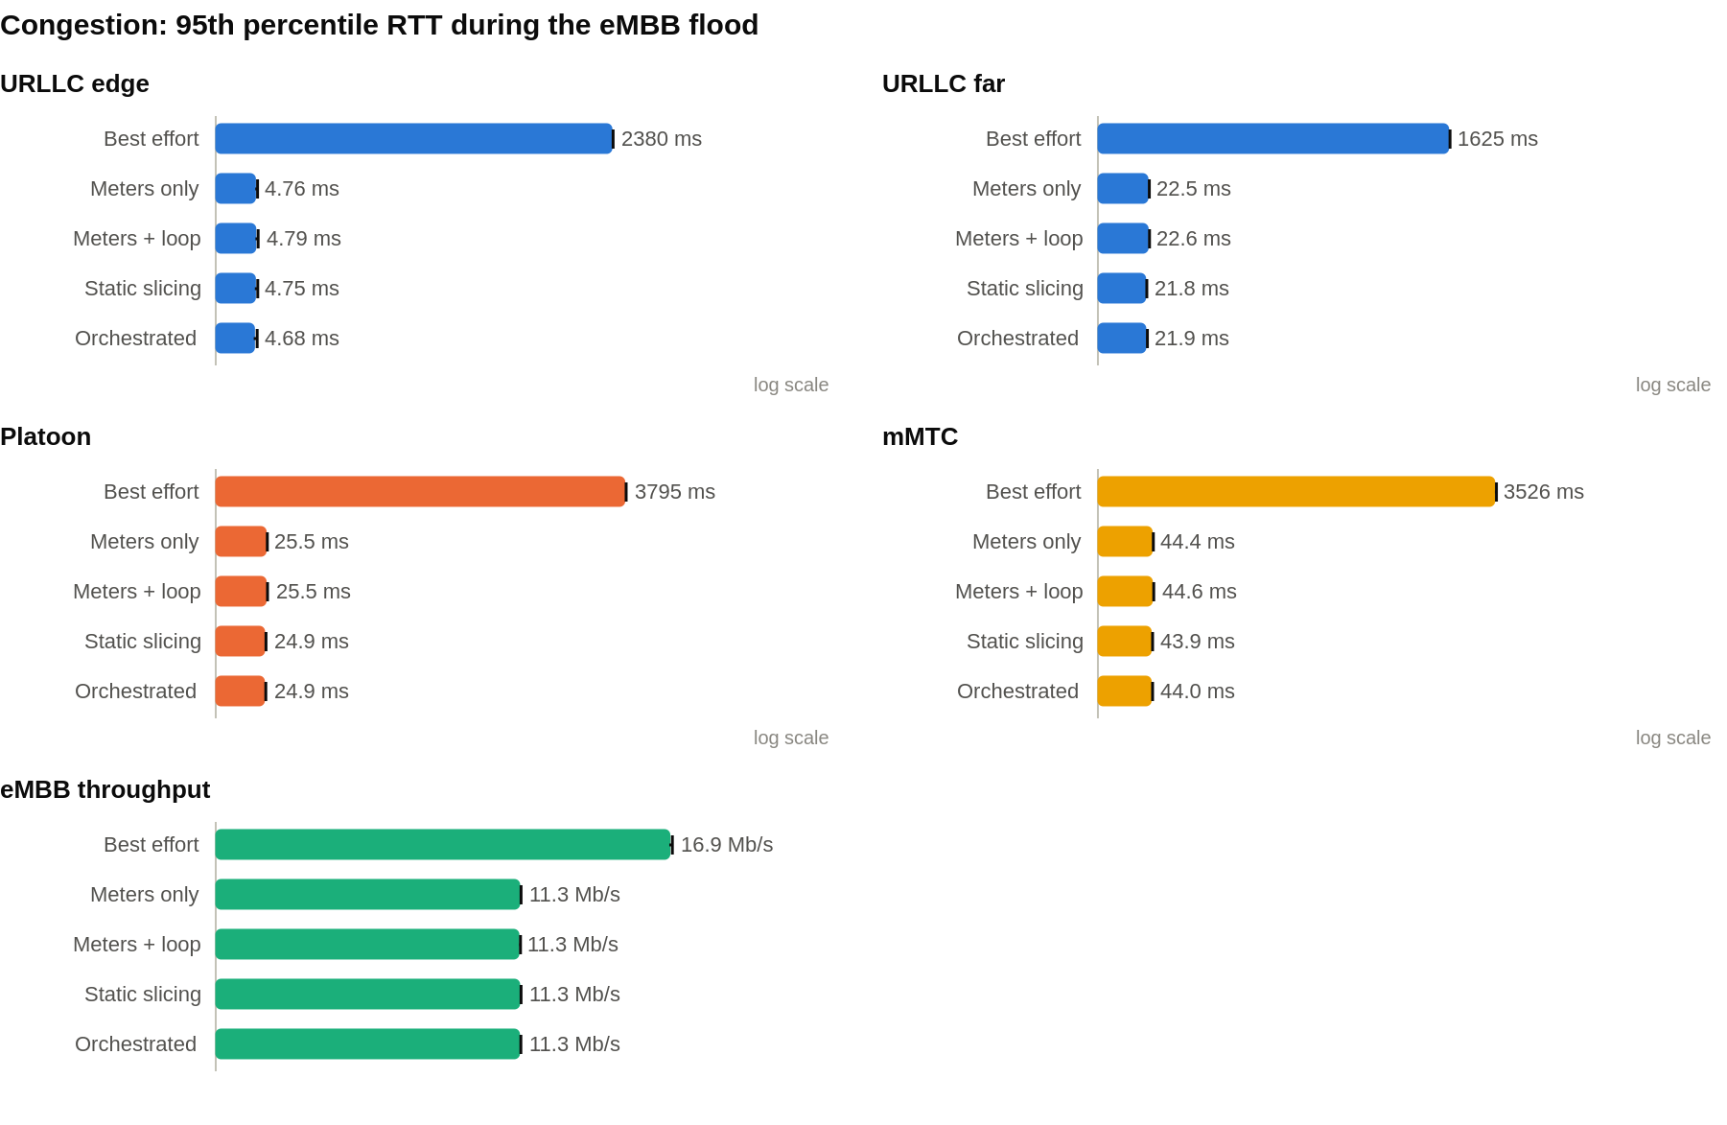
RESULTS: CONGESTION
3.8 s → 24.9 ms
platoon p95, best effort vs orchestrated
Without slicing, eMBB fills the backhaul queue: platoon and mMTC lose 7.7 % and 9.8 % of packets
Any slicing setup caps eMBB (16.9 → 11.3 Mb/s), so the link never overflows: 0 % loss
Priority shaves a little more: jitter 1.5 ms against 1.7 ms
Mean of 5 repeats; whiskers show one standard deviation (under 1 %)

Slide 16
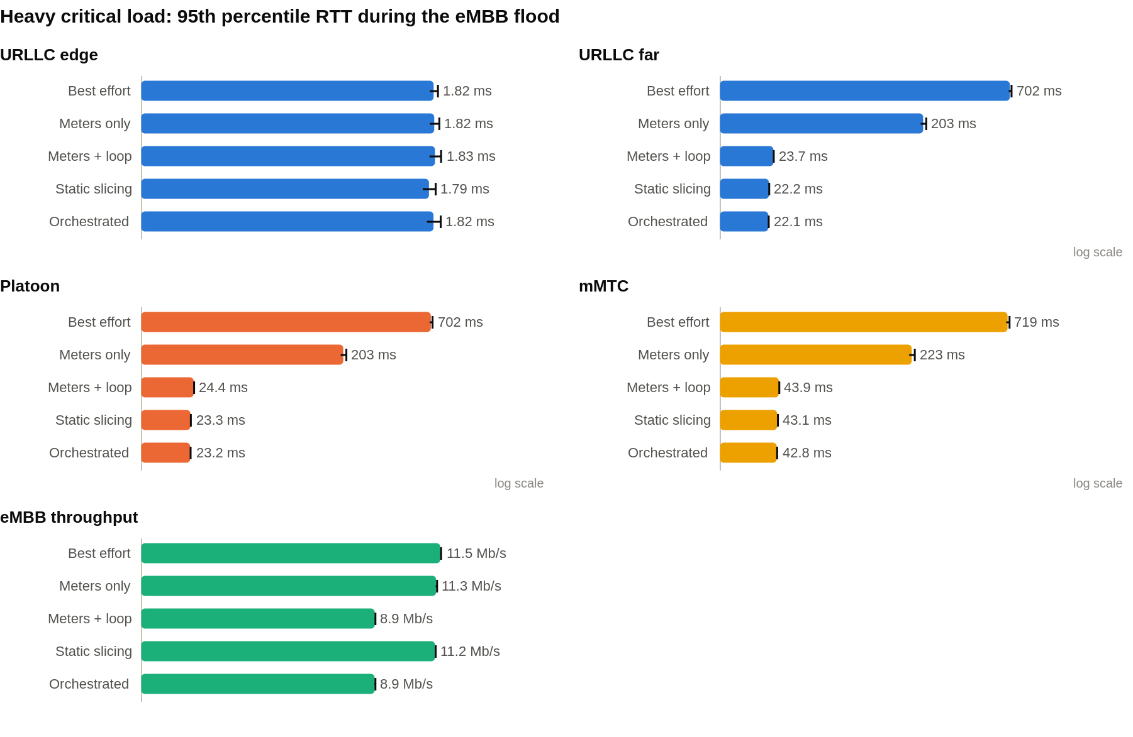
RESULTS: HEAVY CRITICAL LOAD
203 ms → 23 ms
platoon p95, meters only vs full system
Budgets add up to 24 Mb/s on a 20 Mb/s link, so meters alone let it overflow: 203 ms
Loop shrinks eMBB to 8.9 Mb/s: 24.4 ms
Priority lets critical packets skip the queue: 23.3 ms, eMBB keeps 11.2 Mb/s
Both: 23.2 ms, the lowest delay and jitter

Slide 17
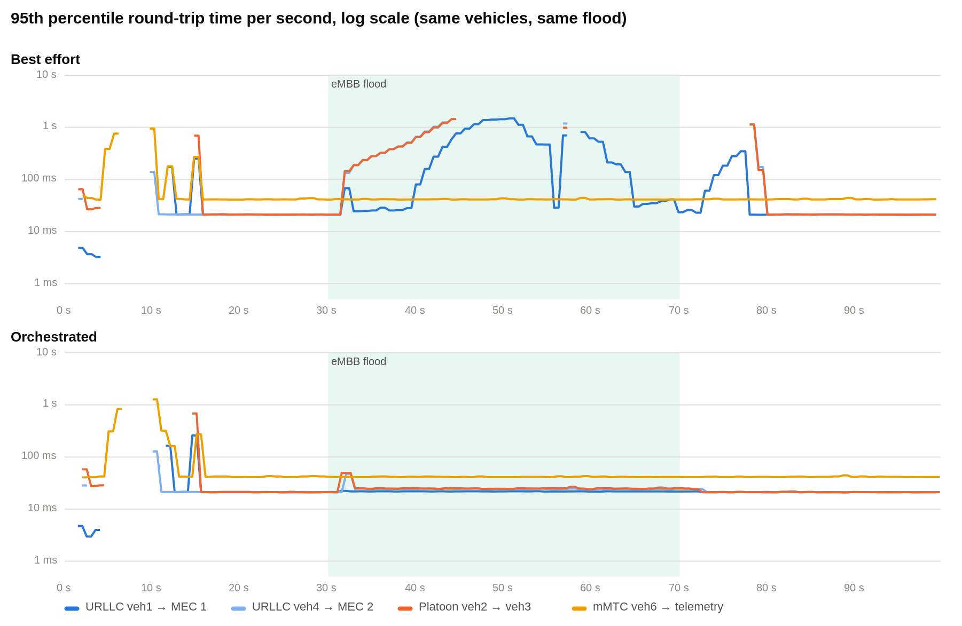
ONE RUN, SECOND BY SECOND
Same vehicles, paths and flood
0–16 s: vehicles drive through the handovers; identical in both runs
30–70 s: eMBB flood (green band)
Best effort: platoon and URLLC climb towards 1 s
Orchestrated: flat at about 22 ms throughout
This is the dashboard recording shown in the demo

Slide 18
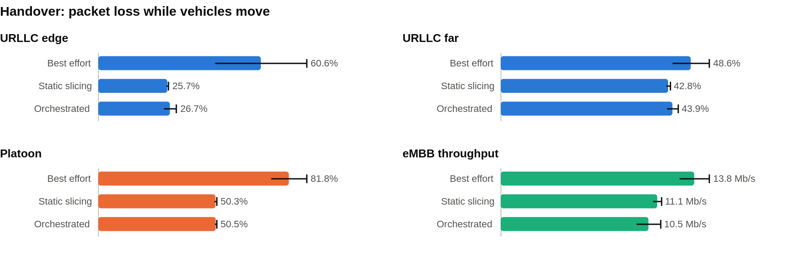
RESULTS: HANDOVER & RANDOM MOBILITY
82 % → 50 %
platoon loss while moving, best effort vs orchestrated
47 % → 22 %
platoon loss under random waypoint (wide spread)
Limitation: a 7–14 s gap at every handover, in every setup
Mininet-WiFi reports the new association within a second, but the first packet reaches the new RSU’s switch 6–10 s later
The emulated station re-associates slowly between RSUs on channels 1 and 6, before any packet reaches OpenFlow, so the controller cannot shorten it
Slicing still halves the loss around it, because the moving vehicles’ traffic no longer waits behind eMBB

Slide 19
DASHBOARD
A web dashboard (python3 dashboard/server.py, port 8090) replays recorded runs or follows the live testbed. No sudo or Docker needed for replays.
Run tab
Map: RSU ranges, backhaul, MEC servers, the six vehicles moving, handover rings
Tiles: worst URLLC delay, platoon loss, eMBB at s1, orchestrator state
RTT per flow, with a second recording to compare against
Slice throughput and eMBB limit per switch; controller events
Experiment results tab
All 80 trials, by scenario, window and measure
Bars with standard deviation, plus a table view
How it works tab
Architecture, slices, the packet path, the loop and the five setups
Used to open the demo
Live mode: sudo bash scripts/run_live_demo_host.sh orchestrated 30, then pick “Live testbed”. Links open a chosen moment, e.g. ?rec=scripted_best_effort&cmp=scripted_orchestrated&t=55

Slide 20
SUMMARY OF CONTRIBUTIONS
1. OpenFlow 1.3 orchestrator: 5 V2X slices, each policed by a meter and marked for strict-priority backhaul queues
2. Capacity-aware loop that reallocates eMBB every 2 s from measured meter counters, plus a REST API for slice resizing
3. Mobility-aware forwarding with handover detection, and RSU settings that make cross-RSU traffic reliable
4. Reproducible benchmark (5 setups × 4 scenarios × 5 repeats) and a dashboard that shows it working
150×
lower platoon delay under congestion
500×
lower URLLC delay to the edge
203 → 23 ms
heavy load: meters only vs full system
< 1 %
spread across 5 repeats (parked scenarios)

Slide 21
MILESTONES & PROJECT TIMELINE
Sub-task | Planned date | Status
1. Literature survey & requirements | Sat, 01 Aug 2026 | ✅ Done
2. Network topology design | Sun, 09 Aug 2026 | ✅ Done
3. Vehicle mobility modelling | Tue, 25 Aug 2026 | ✅ Done
4. RYU controller development | Tue, 01 Sep 2026 | ✅ Done
5. Traffic generation pipeline | Sat, 26 Sep 2026 | ✅ Done
6. QoS & slice enforcement (meters, priority queues) | Sat, 03 Oct 2026 | ✅ Done
7. Dynamic orchestration module | Sat, 10 Oct 2026 | ✅ Done
8. Performance evaluation & report | Sat, 17 Oct 2026 | ✅ Done
9. Dashboard, 80-trial benchmark & analysis | Fri, 06 Nov 2026 | ✅ Done

Slide 22
LIMITATIONS & FUTURE WORK
Shorten the handover gap
Both RSUs on one channel, faster station scanning, then re-measure mobility
Nearest-MEC steering
After a handover, redirect safety traffic to the new RSU’s edge server
Road-constrained mobility
Drive the vehicles from a SUMO road network instead of scripted paths
Scale out
More vehicles and RSUs, to show the controller and the loop scale
Smarter loop input
Count critical traffic after policing, so a misbehaving flow cannot shrink eMBB
Emulation, not hardware
Radio behaviour comes from Mininet-WiFi; we claim comparisons between setups on the same host, not absolute numbers.

Slide 23
REFERENCES
1. Alhilal, A., Braud, T., & Hui, P. — Distributed Vehicular Computing at the Dawn of 5G: A Survey, arXiv:2001.07077.
2. Campolo, C., Fontes, R. R., et al. — Slicing on the Road: Enabling Automotive Verticals through 5G Softwarization, Sensors 18(12):4435, 2018.
3. Fontes, R. R., Afzal, S., et al. — Mininet-WiFi: Emulating Software-Defined Wireless Networks, IEEE CNSM, 2015.
4. Slicing 5G Core Network Based on the Ryu SDN Controller for XaaS — MDPI / ResearchGate.
5. QoS-Driven Slicing Management for Vehicular Communications — MDPI Electronics 13(2):314, 2024.
6. Network Slice Allocation for 5G V2X Networks: Implementation & Assessment — Elsevier ScienceDirect case study.
7. Saraiva, T. et al. — An Application-Driven Framework for Intelligent Transportation Systems Using SDN, IEEE T-ITS 22(8), 2021.
8. Shah, et al. — safety-slice prioritisation during mobility with a DRL xApp, IEEE Trans. Consumer Electronics 71(1), 2025.
9. Ahmad, Gul & Derawi — four-slice priority-weighted dynamic bandwidth allocation, Sensors 26(13), 2026.

