Slide 1
Zelle
Zelle 1
Station
Station
Station 1.2
Station 1.1
Job
Job
Job
Job
Zelle 3
Job
Job
Job
Job
Station 3.2
Station 3.1
Job
Job
Job
Job
Zelle 2
Station 2.2
Station 2.1
Job
Job
Job
Job

Slide 2
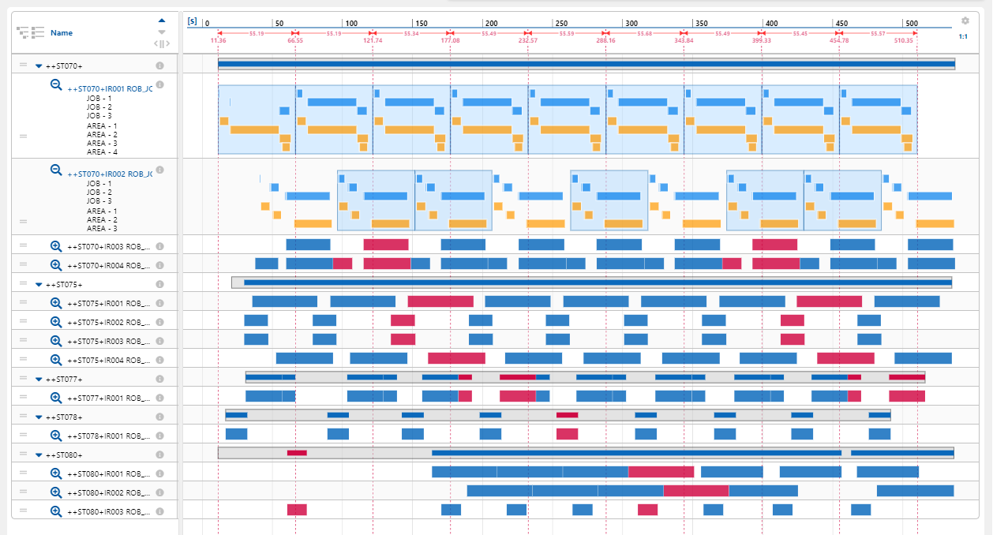
Zelle
Station
Jobs
Jobs
Station
Station
Station
Station

Slide 3
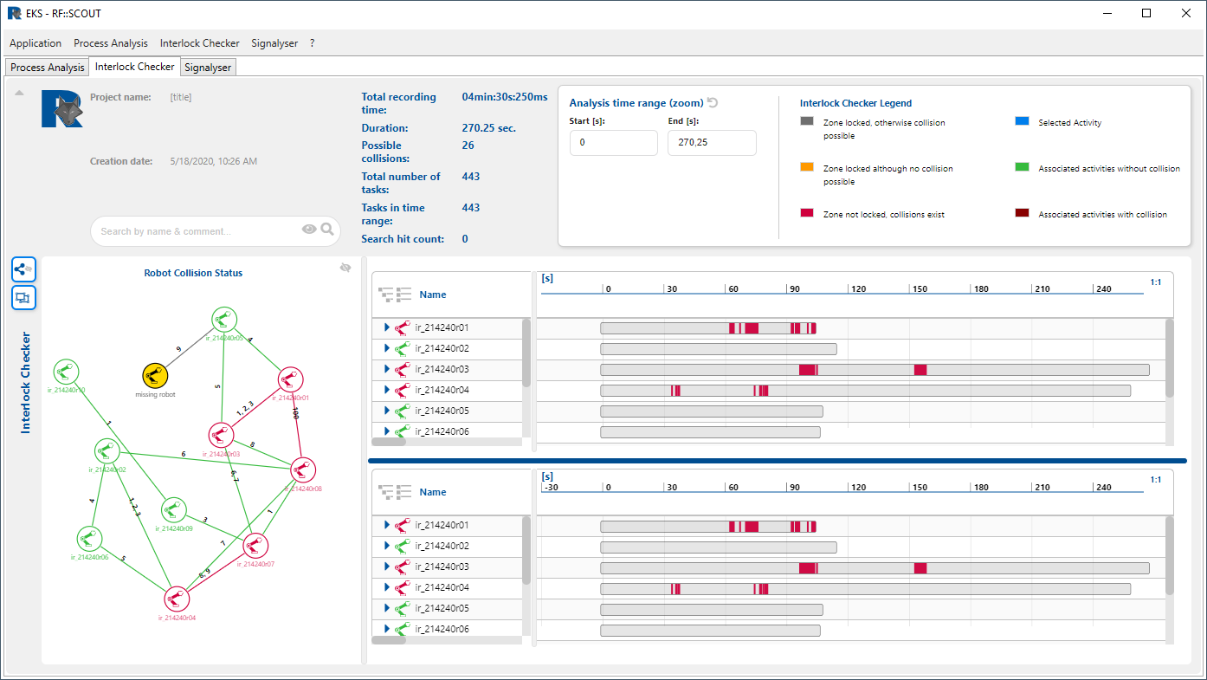
Informationskopfzeile
Buttonleiste
Roboter kollisions Status
Zeitskala
Roboterzeiten
Vergleichs Zeitskala
Vergleichs Roboterzeiten

