Slide 1


R$ 139,99

Slide 2


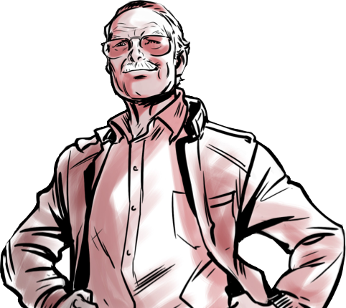
O legado do Heroi
i

Slide 3


The Goddess Colection
$355,60

