Slide 1


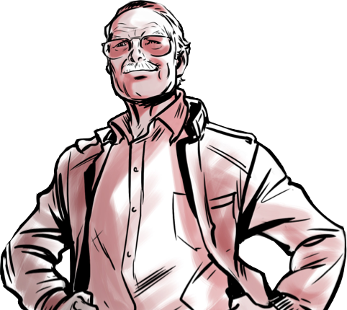
O legado do Heroi
i

Slide 2

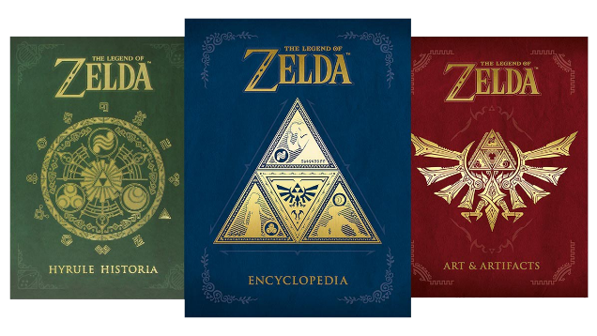
The Goddess Colection
$355,60

