Slide 1
Level 1 Data flow diagram
Exam Board
1.1
Exam board marks a set of exam papers
1.2
They enter the marks into their system
DB 1: Marks database

Slide 2
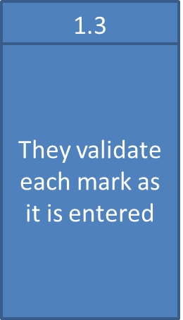
1.4
An error report is generated for any problem marks then re-entered

Slide 3
1.5
Once all marks are entered, they are sorted.
1.6
Pupil’s information retrieved from system
DB 1: Marks database
1.7
New marks entered and records updated

Slide 4
1.8
Summaries of the results and certificates are then sent out
Pupil

