Slide 1
Objectives
Understand different types of connectivity
Review primary memory and secondary storage
Understand data transfer

Slide 2

WiFi
http://computer.howstuffworks.com/wireless-network.htm
Use the link about to create a leaflet on wireless technology and how it works.
You have 20 mins

Slide 3
Using satellites
Satellites are used widely for communication in the media, navigation, video conferencing, data transfer and for military purposes, for example. A transmitter on the ground sends signals to a satellite using microwaves or some other form of transmission. Using a different frequency to avoid interference, the signals are then redirected back to the planet. If it doesn’t reach the intended recipient, it is then bounced to other satellites and on to its destination.

Slide 4
Pros and cons of using satellites for communication
Cost of data transfer is not dependent on distance
Cost of transfer is higher than non-satellite methods.
Satellites can handle a very high number of simultaneous communication lines (they can handle a large bandwidth).
Satellite communications can be used in the remotest parts of the world
There is a short delay in any communication. Weather conditions can also affect the quality of transmission.

Slide 5
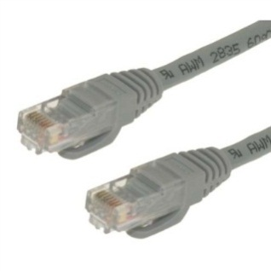
Ethernet
Ethernet is a widely-used design for baseband LANs
Networks connect stations using coaxial cable and can spread over about 100 meters although they can be extended with the right hardware.
As traffic increases on an Ethernet network, the number and frequency of collisions increase. This is because every station is broadcasting to every other one and the more workstations there are broadcasting, the more the communications on the network increase.
Notes:
Ethernet will try its best to prevent data collisions. When it does detect a collision, however, it will have the packets put on the network again but this time with a delay between the events.

Slide 6
Task 1
http://customcable.ca/cat5-vs-cat6/
Use the website above to make notes on the different Ethernet cables
You have 10 minutes

Slide 7
Reducing data collisions on an Ethernet LAN
A switch could be used.
This is a piece of hardware in common use in Ethernet LANs and when one is used it is known as a ‘switched Ethernet LAN’.
A switch can be used to split up the network into areas that improve the efficiency of communication.
It can be used to ensure each station is given a ‘time-slice’ in which to send data.
Two stations can also be given a temporary communication link between them using a switch, to ensure successful communication.

Slide 8
Connecting to the internet
A dial-up connection.
An ISDN connection.
Broadband and baseband (ADSL)
Mobile internet (3g and 4G)
Use the link below to gather notes on connecting to the internet
http://computer.howstuffworks.com/internet-connectivity-channel.htm
You have 40 mins

Slide 9
Connection questions
Q1. What questions should be asked before deciding on a method of connecting PCs to make a network? Q2. Explain the steps in making a secure wireless network using MAC addresses. Q3. What is meant by the pstn? Q4. Describe briefly with a diagram how satellite communication works? Q5. Explain why fibre optic technology is used in some circumstances in networks rather than wires. Q6. Describe and explain how a modem works in a dial-up connection? Q7. Compare broadband internet connections to dial-up internet connections.
Notes:
Public service switched network

Slide 10
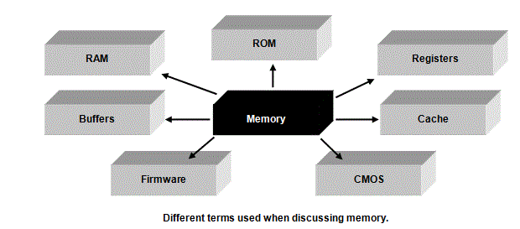
Memory and Storage
Notes:
'storage' devices suggest a place where we store data and applications that are not needed immediately by the CPU. Such devices would include a hard disk, a floppy disk and a CD R/W, for example. Another name for such devices is 'secondary storage devices'. Memory, however, is a place where data and applications needed immediately by the CPU are put. We can refer to memory as the Immediate Access Store or Primary Memory. We can even refer to it simply as the RAM or Random Access Memory'.

Slide 11
Random Access Memory (RAM)
Also known as Immediate Access Store and Primary memory.
This type of memory is the memory you are talking about when you say that your computer has got 256 Mbytes of RAM, for example.
The number is a measure of how much memory you have got, how many applications you can open at the same time and how much data you can store, ready for the CPU to access.
If you have 256 Mbytes of RAM, for example, you have approximately 256 million individual memory locations in which to store applications and data.
Each memory location has its own address and you can store an instruction or a piece of data in each location. The more RAM you have, the more applications you can open at the same time and the more data files you can open as well.
You can never have enough RAM, although, of course, you have to pay for it and there will be a maximum amount of RAM the motherboard in your computer can hold!
RAM is Volatile
Notes:
RAM is volatile. That means that the contents of the memory locations disappear completely once power is removed. The contents only remain whilst your computer is switched on. You may have noticed that sometimes your computer stops working as it should. The contents of the RAM may have become 'corrupted', or mixed up. By 're-booting' your computer, you are clearing out from RAM all of the applications (including the operating system) and data, and then reloading them again into RAM. This often clears any problem with the computer and is certainly one of the first things to try if your computer locks up and becomes unusable.

Slide 12
Read Only Memory (ROM)
This type of memory holds a special program that starts running when the computer is powered up. It holds a part of a program called the BIOS. This program does 2 things.
It checks that the computer hardware is present and correctly working.
It runs a routine that looks for another special program called the bootstrap program. This is usually held in a special place on the hard drive. When it finds it, it loads it into RAM and runs it.
The job of the bootstrap program is to locate the operating system on the hard drive and then load it into RAM and run it. Starting up a computer from a power-off situation to where the operating system has been loaded up is known as 'booting up' the computer.
ROM is Non - Volatile
Notes:
ROM is non-volatile. That means that the contents of ROM are NOT lost when you turn the power off, unlike RAM. The actual program in ROM is put there by the manufacturers of motherboards, for example, around the time the ROM chip is placed in a motherboard. Although it is known as a READ ONLY DEVICE because you cannot generally write to it, It is possible to update the software held in ROM chips through a procedure known as 'flashing'.

Slide 13
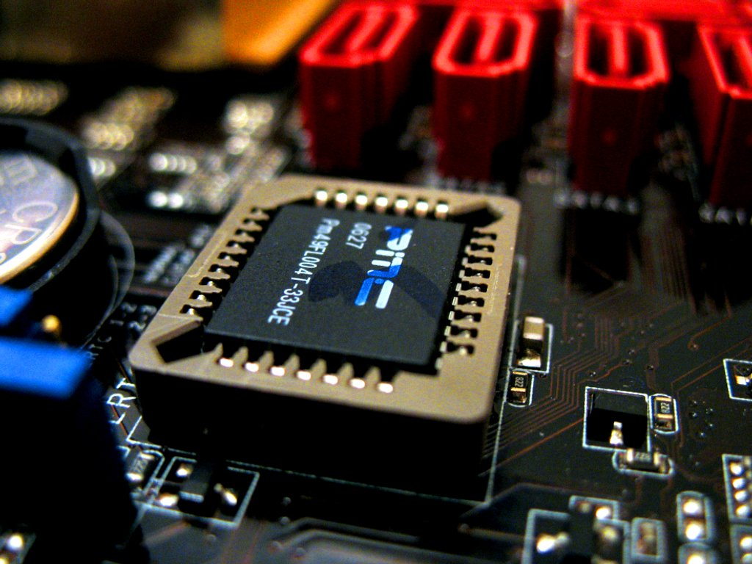
Flashing your BIOS
http://blog.superuser.com/2011/04/03/what-is-flashing-the-bios/
Use the link above to make notes on what is meant by Flashing a BIOS chip
You have 5 Mins
Notes:
Most newer motherboards come with a type of ROM known as flash ROM. Flash ROM allows a user to install an upgrade for their BIOS should the need arise. This might happen because the existing BIOS cannot support some features that the user wants. Perhaps the existing BIOS doesn't have a password-protection utility or cannot support the latest, very large hard drive that has just come onto the market. Whatever the reason, computer users can download and install another, later BIOS. They simply need to identify their own motherboard and chipset and then identify a company who has written a new BIOS. They then have to download the BIOS and follow a set of procedures for getting it into their motherboard's ROM.
This process should not be undertaken lightly. There are many desperate requests for help on the Internet because somebody has attempted to load the latest version of a BIOS and found that their whole computer doesn't function! The message here is, 'Don't try this at home' unless you can afford to have your computer not work on you for a period of time whilst you work out what went wrong and how to put it right!

Slide 14
Why is the operating system not stored in ROM on a personal computer?
The answer is flexibility.
You, the user, can't normally change the contents of ROM.
If you wanted to change operating systems, for example, from Windows 98 to Windows XP, and the operating system was in ROM, you would be stuck!
However, by putting the OS on the hard disk, you can upgrade it anytime you want and you don't need to change the program in ROM.

Slide 15
Registers
We have come across these before! Registers are part of the design of the CPU. They are memory circuits and are very very fast because they are constantly being accessed by the CPU.

Slide 16
Cache
Another type of memory is known as the cache and it is provided in computer systems to speed up processing. Like all memory, it is measured in bytes (or Kbytes, Mbytes etc).
Programs are made up of instructions.
Instructions are fetched from memory using the fetch-decode-execute cycle.
The data that instructions need is also fetched from memory and some data might need to be fetched over and over again, f For example, a constant that is held in memory and used lots of times in lots of calculations.
Fetching data from the IAS takes time and fetching the same data time after time is a waste of time
Processing can be speeded up by storing constantly-needed data in some very fast-access memory.
This will reduce the 'fetch' time.
This fast-access memory is called 'cache'. It is much faster than RAM (but not as fast as registers).
You only get limited amounts of it in a computer system because it is very expensive to make.

Slide 17
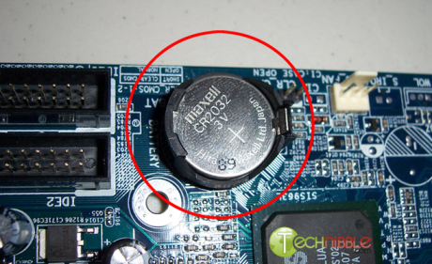
Battery-backed RAM (sometimes known as CMOS)
ROM is used to store part of the BIOS
The rest of the BIOS is stored in battery-backed RAM.
This is RAM, but the computer ensures the power is never removed from it by connecting a battery to it.
This takes over when the main power is removed, when the computer is switched off.
By putting part of the BIOS in battery-backed RAM, you are giving the user the ability to store their own settings, used when the computer boots up.
For example, we have already said that when a computer powers up, the BIOS looks for the bootstrap program. Now it can look for it on a floppy disk and if it doesn't find it, it can then try the hard disk, and if it still doesn't find it, it can look on a CD.
The user can then set the order that the computer looks at the different devices
The user can also use this part of the BIOS to set up and store a computer password, to prevent casual access to the computer. Next time you boot up your computer, take note of which storage device is being looked at first
Notes:
We have already said that RAM is 'volatile' - when you turn the power off, it loses its contents. We have also said that ROM is non-volatile and a user can't change the contents of ROM easily. We also know that ROM is used to store part of the BIOS.

Slide 18
Buffers
A buffer is an area of RAM that has been reserved for one purpose - to aid the transfer of data between different parts of a computer because those parts work at different speeds.
An example of this is the transfer of data between primary memory and secondary storage devices.
Primary memory is part of the CPU and works at very fast speeds compared to secondary storage devices such as floppy drives and hard drives, which are very slow.
If you didn't have a buffer then the transfer would have to take place at the speed of the slowest device and that is an inefficient use of the CPU
It prevents the CPU doing other more important things because it has to take charge of the management of the data transfer.
Notes:
keyboard to the CPU and the transfer of data from the CPU to a printer.
Whilst buffers can indeed be part of the IAS they can also be separate peripherals. You can buy buffers to connect between a computer and an output device such as a printer so that print jobs are immediately sent out of the control of the computer's CPU and into the control of the buffer. Peripherals themselves will come with a certain amount of buffer. A printer might come with a buffer of 8 Mbytes, for example. This can easily be upgraded so that the printer can accept more print jobs and bigger print jobs without needing to call upon any of the CPU's time.

Slide 19
Firmware
A piece of hardware such as a CD ROM is a very complicated device.
It has its own processor to control how it works. Just like the CPU on your computer needs an operating system to make the computer do things, so the processor in each piece of hardware in your computer system needs its own 'operating system' to make that device work.
This 'operating system' is known as firmware.
Firmware is usually held on flash ROM in each device.
You can search the Internet for firmware upgrades for a particular piece of hardware that you have. The first place to start looking is the manufacturer's web site
The same warning that was made when we discussed upgrading the BIOS applies to upgrading firmware
Notes:
You will also see authors referring to both the software and the hardware for a device as firmware. Read widely and then make your own minds up
We have already discussed this type of ROM earlier in this chapter and we know that we can upgrade the software held in it - we can upgrade the firmware.
If something goes wrong, for example, you don't follow the instructions properly or your computer crashes in the middle of the upgrade, then the peripheral may stop functioning altogether. Don't upgrade firmware unless you can afford for things to go wrong!

Slide 20
Primary memory and secondary memory (more commonly referred to as 'secondary storage').
You will often read about primary memory and secondary storage devices in the same sentence as they are sometimes treated together as 'memory'. One way to deal with 'memory' if it is being discussed like this is to classify it into the two types:
primary memory and secondary storage.
Primary memory is the memory that forms part of the CPU circuitry itself. It's the place where applications and data are held for use by the CPU and where results of calculations are put. Secondary storage devices are devices that are connected to the CPU as peripherals e.g. a floppy disk or a hard disk. They store data and applications not immediately needed by the CPU. Primary memory is also known as RAM, Immediate Access Storage or IAS.

Slide 21
READ devices and READ/WRITE memory devices.
Registers, cache, RAM, floppy disks, hard drives and CD-R/W are READ/WRITE devices. That means that data in these devices can be accessed and read but also new data can be written to these devices. ROM, DVDs and some CDROMS are READ ONLY. Data is burnt (written to once) onto these devices and cannot then be changed. They are sometimes called WORM devices (Write Once Read Many times).

Slide 22
Volatile memory and non-volatile memory.
Another way to split memory types up is to divide them between volatile and non-volatile memory. RAM is volatile. That means that when the power is turned off, you lose the contents. Motherboards have a small amount of battery-backed RAM known as CMOS. When the main power is turned off, this type of RAM will keep its contents (as long as the battery works!) Battery-backed RAM keeps the details of the BIOS password, for example. If you forget the password to the BIOS, you can empty the contents of the battery-backed RAM by removing the battery for a minute. ROM is non-volatile, as is the hard drive. When the power is turned off, the contents will not be lost.

Slide 23
Cost, access times and capacity of memory devices.
The price per byte of storing data on the hard drive, for example, is cheap compared to RAM, and cheaper still compared to cache. This is one reason why you can buy huge capacity hard drives but can only usually afford a small amount of cache on your home PC.
The physical distance of the CPU from the memory will effect how fast the CPU can carry out instructions. Memory in the form of registers will be right next to the CPU. These will be accessible very quickly compared to other types of memory. Unfortunately, there isn't enough space in the circuitry to put the RAM next to the CPU. RAM will be built on other circuitry and connected to the CPU via wires (or metallic runs on the motherboard). Access will be slower than access to the registers or cache! (This is one reason why you need a 'WAIT interrupt', to tell the CPU to wait while data gets from the RAM to the CPU.)
You can also discuss the size of memory devices. Registers will be of the order of bytes. Cache will typically be Kilobytes. RAM will be talked about in Megabytes and possibly Gigabytes whereas hard disks will be discussed in Gigabytes or Terabytes.

Slide 24
Questions
Q1. Describe and compare exactly what kind of data each of the following types of memory hold:
RAM.
ROM.
registers.
cache.
battery-backed RAM.
Q2. Explain the terms 'volatile' and 'non-volatile' when applied to memory. Q3. What is the purpose of the 'bootstrap program'? Q4. Explain what is meant by 'booting up a computer'. Q5. Explain why re-booting a computer often sorts out software problems. Q6. How many bytes are there in 256 Mbytes? You should give a) an approximate answer and b) an exact answer. Q7. What does BIOS stand for? Q8. Explain why the operating system on a PC is not held in ROM. Q9. Suggest a reason why the operating system on computer systems such as a digital watch, a mobile phone or a computer-controlled washing machine is held in ROM. Q10. Describe why providing cache to a computer system without any should improve performance. Q11. Describe the purpose of battery-backed RAM. Q12. Suggest different ways of comparing different memory types such as ROM, RAM, cache registers and so on. Q13. Define 'buffer'. Q14. Find out more about the 'WAIT interrupt'. Q15. What is meant by 'flash ROM'? Q16. What is 'firmware'? Q17. What are the dangers when upgrading a BIOS program or firmware?

Slide 25
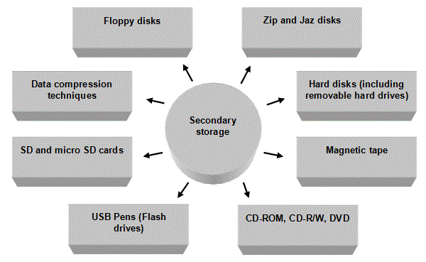
Secondary Storage
Notes:
Introduction Storage devices are non-volatile devices. That means that when the power is removed from them, for example, when you switch your computer off, they retain their contents. You can then retrieve the contents next time you switch your computer on. Storage devices can be used to hold operating systems, applications and files, amongst other types of software. We have already seen that when you want to use an application kept on a storage device, it has to be moved to RAM before you can start using it. This applies to the operating system, your files and any other category of software.
When comparing and contrasting different storage devices, we could use a number of criteria:
Whether they were a magnetic or an optical storage media.
How fast the media can be accessed.
Whether data can be accessed directly or serially.
How much data can be stored on the media.
What the media might typically be used for.
How commonly used the media is.
The cost of the media and the cost of the actual device used to read from or write to it.
Whether the media is read-only or read-write.
How the capacity of secondary storage media is measured - just to remind you Data storage is measured in 'bytes'. When you talk about storage media, however, you quickly end up talking about thousands of bytes, millions of bytes, millions and millions of bytes and so on. There are lots of different ways of talking about these large numbers. We have met the following summary before:1 Kilobyte (1 Kbyte) is 1024 bytes exactly, or 210 bytes exactly, or about 1000 bytes, or about a thousand bytes.
1 Megabyte (1 Mbyte) is 1048576 bytes exactly, or 220 bytes exactly, or about 1000000 bytes, or about a million bytes.
1 Gigabyte (1 Gbyte) is 1073741824 bytes exactly, 230 bytes exactly, or about 1000000000 bytes, or about a thousand million bytes.
So 15 Kbytes is about 15 thousand bytes. 128 Mbytes is about 128 million bytes. 20 Gbytes is about 20 thousand million bytes. More often than not, you don't need to know the exact number of bytes, just an approximation!

Slide 26
Floppy disks
A disk typically stores 1.44 Mbytes, or about one and a half million bytes of data.
Floppy disks are magnetic devices. They are flexible, plastic disks that have been coated in a magnetic substance, either on one side (single-sided) or both sides (double-sided) of the disk.
When a floppy disk is placed into a drive, the disk starts to rotate hundreds of times a second and a 'head' moves over the disk to read from or to write to the disk.
When files are 'saved', areas of the disk are magnetised by the head. When files are 'read', the magnetic areas are picked up and decoded back into data by the head.
The speed that a floppy disk rotates might sound fast but is much slower than a hard drive, which rotates at thousands of times a second. Consequently, it is much slower to read and write to a floppy disk compared to a hard disk.
Floppy disks are known as direct access storage devices. This is because the disk drive head can go straight to a particular place on a disk, find the data and retrieve it. It doesn't have to go through all the other data files first.

Slide 27
Zip disks and Jaz disks
These magnetic disks are similar to floppy disks but have a much higher capacity. Zip disks hold typically 250 Mb whilst Jaz disks hold 2 Gbytes typically. Data on Jaz disks can be accessed very quickly, at the same kind of speed as hard disks. Zip disks are a little slower but still a big improvement on floppy disk data access.

Slide 28
Hard disks
A hard disk is a little like having lots of floppy disks stacked one on top of each other and then sealed in a unit! T
he disks are in fact not floppy at all but hard magnetic disks, each with their own read/write head that moves over the disk that they are responsible for.
We already know that they spin very quickly when compared to floppy disks but hard disks constantly spin, as opposed to floppy disks, which start spinning only when they are needed for a read or a write operation.
No time is wasted, therefore, waiting for a hard disk to get up to speed before you can use it! Both of these reasons explain why floppy disks work much slower than hard disks. Hard disks, like floppy disks, are direct access devices - you can go straight to a file on an area of disk without having to go through all the other files first. Hard disks are used to store applications and data files.
They can hold huge amounts of data compared to a floppy disk.
All personal computers have hard disks, although it is possible for workstations on a network to exist without a hard disk - they make use of the server's hard disk to store applications and data. These types of computers can be referred to as 'thin clients'.
Hard disks can also be used as back-up devices. A computer can be fitted with a second hard disk known as a mirror hard disk. As the name suggests, this second hard disk is used to keep an identical copy of the main hard disk. Then, if the main hard disk fails (and every hard disk, indeed every storage device, will fail sooner or later), you can use the mirror disk to recover your applications and data with the minimum of effort.

Slide 29
Magnetic tape
Magnetic tape can hold lots of data
They are used typically to back-up data files on networks. Network servers often have a back-up device fitted in the server
These rotate automatically each day. The back-up process is automated, so that in the middle of the night, data is backed-up on a new tape and the tape gets ejected from the device.
The Network Administrator then removes the tape in the morning and puts it in a fire safe. Magnetic tape is not a direct access device. It is a serial access device. If you lost one of your files and asked the Network Manager to recover it from a back-up tape, they would have to search through every file until they found the right one. They couldn't go straight to the file in question. For this reason, magnetic tapes are very slow devices, not suitable for fast access applications but ideal for applications where you won't probably need the data - like back-up applications!
They are also cheap to store data on compared to other types of media. You can store more bytes per penny!

Slide 30
CD-ROM
This media is ideal for distributing software because they hold a lot of data (650 Mbytes or more) compared to floppy disks (1.44 Mbytes).
CD-ROMs are direct access media but they do not use magnetic technology
They are optical storage media. They store information on pits in the surface of the CD and then use a laser to scan over the pits. CD-ROMs are read-only devices.
The basic CD unit is very cheap. However, you would need to use a CD-R/W device and a special type of CD if you want to write to as well as read from a CD

Slide 31
CD-R/W
You need to have a special CD-R/W device to write to CDs. The CDs themselves could be of the WORM type (Write Once Read Many times).
This means that you can only write to the CD once but can read from it many times.
This might be suitable if you wanted to make a back-up copy of some software you have bought or wanted to make and distribute some music you had recorded. CDs can also be Read-Write, which means they can be written to many times
A CD that has been created using a CD R/W device can be read from a standard CD-ROM device, usually after the installation of a small utility program.

Slide 32
Digital Versatile Disc (DVD)
This optical, direct access, very fast media can hold approximately 17 Gbytes of data compared to the 650 Mbytes of a standard CD.
A DVD player can read CDs as well as DVDs with the addition of extra software. They are typically used for distributing multimedia, especially high quality video
DVD recorders are also available.

Slide 33
USB pen drive (flash drive)
Removed and rewritable
Can store huge amounts of data
Has no moving parts but consists of a small printed circuit board carrying the circuit elements and a USB connector
Although they are relatively strong, you can corrupt the contents

Slide 34
SD cards and micro SD cards
These small cards can hold very large amounts of data and are ideal for cameras and mobile phones, to hold pictures, videos and music

Slide 35
Compressing data
Data compression refers to the process of 'squashing' data so that you can store more of it in the same space on a storage device. This can be done by using a utility program from within your operating system or using applications such as WinZip. A lot of data sent over the Internet is also compressed because this reduces the amount of time (and cost) of data transfer. It is compressed by the sending computer and de-compressed by the receiving computer. This happens automatically, without the knowledge of the users.

Slide 36
Questions
Q1. Explain the difference between 'memory devices' and 'storage devices'. Q2. For each of the following, write down both an approximation for the number of bytes and an exact number of bytes: a) 34 Kbytes. b) 256 Mbytes. c) 20 Gbytes. Q3. Suggest typical uses for a floppy disk, hard disk, magnetic tape, CD-ROM and DVD. Q4. Explain what is meant by a 'direct access storage device'. Q5. What is meant by a 'mirror hard disk'? Q6. Suggest a suitable back-up strategy for a school network. Outline the hardware and other resources needed. Q7. How many floppy disks' worth of data could fit on a standard 650 Mbyte CD? Q8. How many 650 Mbytes CDs' worth of information can fit onto one DVD? Q9. Explain what is meant by 'data compression'. Q10. What criteria could you use to compare a range of different storage devices? Make a table. In the first column, put the storage devices listed in this section and any others you have come across. Along the top in the first row, put the criteria you could use to compare them (e.g. typical storage capacity, cost per byte, optical or magnetic, typical use etc etc). Now complete your table.

Slide 37
Data Transfer
Introduction - speed mismatch When two devices working at different speeds try to communicate, they have to do so at the speed of the slowest device.
This is not good because the CPU gets tied up managing the transfer of a constant stream of data to a printer, for example.
However, by using a 'buffer', the problem of working at the speed of the slowest device and slowing the CPU down can largely be overcome.
A buffer is simply some memory that improves the efficiency of data transfer between two devices working at different speeds by allowing big blocks of data to be collected together and then sent at once rather than as a stream of data that needs constant CPU management time.
A buffer can also be an external piece of memory designed specifically for the purpose of collecting data from a CPU and then taking over the management of the transfer between itself and the device it is connected to.
Notes:
Introduction - speed mismatch When two devices working at different speeds try to communicate, they have to do so at the speed of the slowest device. This is not good because the CPU gets tied up managing the transfer of a constant stream of data to a printer, for example. That means it can't work on other tasks that may be more urgent than mere printing! However, by using a 'buffer', the problem of working at the speed of the slowest device and slowing the CPU down can largely be overcome. A buffer is simply some memory that improves the efficiency of data transfer between two devices working at different speeds by allowing big blocks of data to be collected together and then sent at once rather than as a stream of data that needs constant CPU management time. A buffer can also be an external piece of memory designed specifically for the purpose of collecting data from a CPU and then taking over the management of the transfer between itself and the device it is connected to.

Slide 38
An example of the use of a buffer
All devices such as printers come with their own buffers and you can usually upgrade the amount of buffer memory you have in the printer.
The bigger the buffer in a printer, the more data it can accept before it tells the computer that is sending the data to stop for a minute because it is full and needs to empty itself (by printing).
Consider sending a file to a printer. The file is held in memory (RAM). We know that RAM works very quickly and we know that all data in and out of the CPU goes via the ALU - that is one of the functions of the ALU. We also know that the printer churns out pages much slower than the speed a CPU can work at. The printer will then store the print job until it is able to complete it.
Notes:
Large buffers are particularly important on networked printers such as those commonly found in schools and colleges.
A lot of people will potentially be sending a lot of work at the same time.
This could result in the system grinding to a halt, as the server tries to manage all of the jobs being sent to the printer. If, however, the jobs could be sent to the printer and stored there, the server would be free to get on with other things and the printer could print at its leisure.

Slide 39
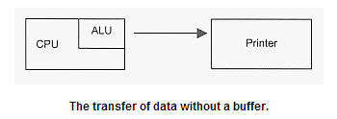
The CPU will take charge of the data transfer. The data goes from the RAM, via the ALU and out to the printer. The printer works very slowly compared to the CPU, however. If you send data constantly, byte by byte, the CPU will have to slow down how fast it sends the data to the printer so that the printer can receive the data. This means, however, that the CPU is not being used as efficiently as possible.

Slide 40
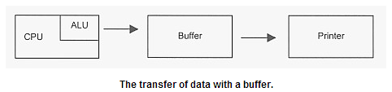
When the CPU wants to send a file, all of the data can be transferred to the buffer in one go. The buffer works at the speed of the CPU so data transfer between the CPU and the buffer is very fast. The CPU is now free to do other tasks while the buffer can transfer data to the printer. This immediately improves the transfer of data because the CPU is not waiting around, trying to constantly send data. It can send data in one, high-speed burst and then get on with something else!

Slide 41
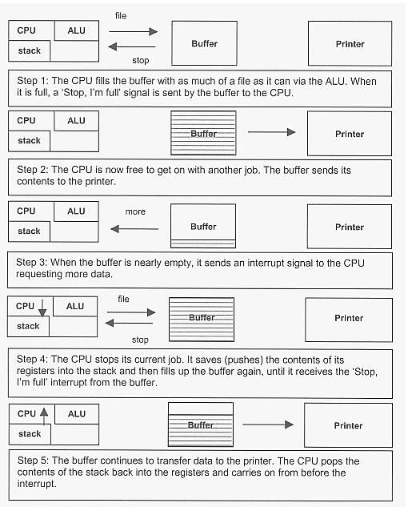

Slide 42
Buffers and interrupts
A complication can arise, however, if you need to send a file to a printer but the whole file won't fit into the buffer because the file is too big for it!
To deal with this situation, we need to use interrupts.
These are simply signals sent to the CPU. They tell the CPU to stop what it is doing and give some time to whoever sent the interrupt. Remember, the CPU, whilst very fast, can only actually carry out one job at a time!
The CPU, via the ALU, fills the buffer with as much of the file as it can.
When the buffer is full, it sends an interrupt to the CPU to say 'Stop'.
The buffer then sends the data to the printer. The CPU, meanwhile, is free to get on with another job. When the buffer is nearly empty, it sends an interrupt signal to the CPU, to say 'More data, please'.
When the CPU gets this interrupt, it checks its priority. The CPU has to decide if the job it is currently doing is more important than filling up the buffer! If it is, then it carries on with what it is doing until it is finished, and then it services the buffer interrupt. If it isn't more important, then it stops doing what it is doing and 'pushes' the contents of its registers onto the stack, thereby saving where it was before the interrupt happened!
The CPU then sends the buffer some more of the file until it gets the 'Stop' signal again.
The buffer resumes sending data to the printer whilst the CPU 'pops' the contents of the stack back into its registers and continues from where it left off before the interruption. This process is repeated until the whole file has been sent!
Notes:
The transfer of data between two devices that work at different speeds can be made far more efficient by using a buffer because we can send data in large blocks rather than in lots of small quantities. We have looked in some detail at how you would transfer a file from memory to a printer using a buffer designed for the purpose, but we could equally have used the example of transferring data from memory to a secondary storage device such as a floppy disk or a hard disk, for example.

Slide 43
Questions
Q1. Explain the problem of 'speed mismatch' when data is transferred between RAM and a hard disk. Q2. Define 'buffer'. Explain how buffers overcome speed mismatch problems when moving data from RAM to a CDR/W. Q3. Define 'interrupt'. Describe how buffers and interrupts aid the transfer of data from RAM to a floppy disk.

Slide 44
Peripherals
A peripheral device is an input, output or storage device that you connect to your CPU. You usually do this by plugging a device in, often in a USB port. The port then makes the necessary connections inside the computer to the CPU.

Slide 45
Input Devices
Keyboard
Touch screens
Graphics tablet
Mice
Scanners
Digital Cameras
Camcorders
Notes:
Keyboards Practically all computers have QWERTY keyboards. These devices can be used to enter in data manually. They are very efficient in the right hands and not so efficient if a user has limited training. In fact, they can be very slow and mistakes are easy to make, although software tools can automatically fix many of them. A lot of work has been done to ensure that keyboards are designed ergonomically. This means that they are designed in a way that takes into account the 'design limitations' of a human being. There is a health and safety problem known as Repetitive Strain Injury (RSI) for people who use keyboards all the time, such as secretaries. The joints in their fingers can become 'worn'.
An important consideration for this kind of manual data input when used to transfer paper-based data into the computer is the design of the user interface. Form-based interfaces should be used because they help the data input operator enter data as quickly and as efficiently as possible. The form on the computer and the paper form should be laid out in a very similar manner. There should be clear sections. In addition, tabbing should be used and validation and verification techniques employed, for example.
Touch-sensitive keyboards and concept keyboards An extension of manual data input into computer systems using keyboards is to use touch-sensitive keyboards and concept keyboards. These types of keyboard have 'keys' which are made up of touch-sensitive areas on a plastic cover. A user presses on the touch-sensitive area to input data into the computer. They have a wide range of applications. They can be used in fast food restaurants. Operators simply press on pictures on the keyboard. This speeds up data input and means that training needs are minimal. They can be used in areas where there is likely to be a lot of dirt such as in factories. Dirt can get into normal QWERTY keyboards and cause them to malfunction but the protective plastic cover on touch-sensitive keyboards stops this happening. They can be used to customise keyboards because some touch-sensitive keyboards (called 'concept keyboards') allow you to program what you want to happen when an area is pressed. You can imagine, for example, designing a concept keyboard for a two year old child, who may have limited co-ordination and cannot yet read. You could provide a keyboard with four big brightly coloured areas. When the child wants to make any selection at all, they just need to touch the right coloured area.
Touch screens This is another manual data input method. A touch screen enables a user to touch their VDU screen to make selections. A plastic cover that has fine wires running through it can be placed over a VDU's screen. A user makes a selection by touching the screen with their finger. The exact position can be calculated from the signals sent back by the wires. Touch screens allow very fast selections from choices. They could be used in places where people need to find out information but may have zero computer skills, for example, an information system in a library or a museum. They would be of limited use if you had to type in a letter, for example.
Graphics tablets Another manual data input method is the graphics tablet. These are touch-sensitive pads that allow you to 'draw' on them with a stylus. The pressure from the stylus on the pad is sent to the computer, which reproduces what was done on the pad in a drawing program or CAD program. These types of data input devices are far more natural for designers to use than trying to use a keyboard and mouse to draw with.
Mice A mouse is a pointing and selecting device used with graphical user interfaces (GUI). There are different kinds of mice around, each with their own advantages and disadvantages although they all broadly do they same thing: point and select. A search on the Internet should enable you to quickly identify different sorts of mice. These include:Standard 2/3 button mice.
Mice with a scrolling wheel to allow you to better navigate applications and web pages.
Optical mice that aren't prone to collecting fluff and dirt and so don't need cleaning.
Mice that use radio waves to connect to the computer instead of wires, so that there is less clutter on the desk.
Ergonomically designed mice, for example, mice that are very small for the small hands of children.
Mice that can work with a serial port, a PS/2 port or a USB port.
Image capture We will frequently want to capture images and get them into a computer. Images can be captured in a number of ways. We will look at scanners, video capture cards and digital cameras.
Scanners Images from magazines or photographs, for example, can be captured using scanners.
Typically, the image is placed on a flat screen or 'bed'.
A cover is placed over the image.
The image is divided up into sections or 'pixels' by the software. The user can tell the software what resolution to use (how many pixels per square centimetre to split the picture up into). The higher the resolution, the better the detail of the image but the bigger the file. Often, low resolution, smaller files will be perfectly adequate for most uses.
A light is passed from one end of the flat bed to the other, so that it passes over the image and over each pixel.
When the light hits each pixel, it gets reflected back. The intensity of the reflection depends on the colour at that pixel. Each pixel's information is stored.
The information about all of the pixels is used by the software to reconstruct a bit map image of the whole picture.
Because bit maps are large files, they are often compressed. This can be done by telling the software to save the image as a different file type that uses compression, such as GIF files or JPG files.
Software tools either within the scanning software or within a drawing package allow the user to manipulate an image in various ways. These typically include allowing the user to 'crop' an image (select just a portion of an image), allowing the user to improve the detail of the image, allowing the adjustment of colours and allowing the user to add special effects such as making a photo image look antique.
Video capture cards A video is made up of a series of pictures, or frames, that are played quickly enough to appear moving. A video capture card is a piece of hardware that is plugged into an expansion slot inside the computer. A user then attaches a video camera or TV, for example, to the video card. When the video or TV is played through the card, the analogue signals that make up the moving picture from these devices are converted into digital images, frame-by-frame and stored. Once you have captured each frame, you can then use the software to do all kinds of clever things. For example, you can edit out frames, reorganise them, save individual frames and transfer them to word processing documents, create your own presentations using presentation software and some of the images or add your own soundtrack.
Digital cameras These cameras do not store images on film. They store images digitally in memory. The images are then transferred to the computer. There are many points that could be made about digital cameras.
The price of digital cameras has been steadily falling over recent years.
The amount of memory is a very important consideration with these cameras, as is the ability of a camera to add memory. This is because storing images is memory-intensive.
Cameras often allow the user to select between high resolution and low resolution modes. If you use a high resolution mode, you will be able to take fewer pictures than low resolution mode.
You can immediately view photos and re-take or overwrite them if they are not what you want.
You can often add extra information easily, such as the date or information about the photo.
Many cameras allow you to add special effects as you take the picture.
Images can easily be combined into digital photo albums and distributed or emailed to friends.
Once the picture has been taken and transferred to the computer, it can be opened in a drawing package and manipulated. Pictures can be cropped, colours changed and parts of the photo 'touched up', for example.
Camcorders Video camera recorders, or camcorders, are cameras that store moving images. There is a wide range of types of camera. Some camcorders store the moving images as analogue signals. You may have heard of VHS, Super VHS or 8mm analogue camcorders. Analogue camcorder films lack really mint quality and lose quality if they are copied. Films made using digital camcorders, on the other hand, have much better quality and don't lose any quality if they are reproduced. This is because the films are stored digitally. Digital Video (DV) and Digital 8 are two of the common digital formats around. Typical features of digital camcorders include the ability to zoom in, record sound, view films through a viewfinder, some have night viewing capabilities, time-lapse photography, picture stability software and special effects.

Slide 46
Questions
Q1. Describe how a scanner works. Q2. What is meant by 'low resolution' and 'high resolution'? Q3. If you save the same picture as a bit map file and then a GIF, which file would be smallest? Why? Q4. What is meant by 'cropping an image'? Q5. Describe how a still image from a TV program could be used in a word processing document. Q6. Suggest some disadvantages of taking photographs with a digital camera. Q7. What is a 'camcorder'?

Slide 47
Output Devices
Dot matrix printers.
Ink-jet printers.
Laser printers.
Plotters.
Visual Display Units.
Speakers.
Headphones.
Notes:
Dot matrix printers. These are relatively slow and noisy and the quality of the hard copy is relatively poor compared to ink-jets and laser printers. They were very common a few years back in the early days of computing. Their uses are far more limited now but they do have one particular advantage. The hard copy is made by pins striking paper. That means that identical copies can be made of a printout by using carbon paper between sheets of paper. This system is used by credit card companies to produce actual copies of receipts when a customer makes a purchase. After a customer's credit card is swiped and authorised, two identical copies of a receipt are printed using small dot matrix printers. Both copies are then passed to the customer, who signs the top copy. This puts a carbon signature on the bottom copy. The customer keeps one copy and the shop keeps the other. You cannot make actual carbon copies with ink-jets or laser printers although of course you can print out two copies of a document!
Ink-jet printers. This type of printer 'sprays' ink onto paper.An ink-jet printer can't produce carbon copies.
An ink-jet printer can produce very high quality black and white as well as colour copies for a very low cost.
An ink-jet printer is a good choice for low volume applications such as small businesses or homes.
Laser printers. These types of printers are in widespread use.A laser printer produces very high quality black and white hardcopy.
A laser printer costs more to buy and run than ink-jets although costs have been steadily falling in recent years.
The price of colour laser printers has been falling to make them within reach of individuals and small businesses.
Refills are expensive compared to ink-jets.
Plotters. Plotters are widely used in some industries.Plotters are used to plot very large drawings such as those needed by engineers and designers whereas standard printers commonly only print up to A4 (and sometimes A3).
Plotters produce very high quality, very accurate, colour drawings.
Plotters are relatively expensive compared to printers.
Visual Display Units. Monitors are ideal for displaying data and information to users. They come in a range of sizes. Larger ones such as 21-inch screens, for example, would be ideal for engineers using Computer Aided Design software applications. 15-inch screens are perfectly acceptable for users using a range of generic applications. CRT (Cathode Ray Tube) monitors (similar to televisions) do take up a lot of space on a desk. Flat panel liquid crystal display screens, often referred to as TFT screens, save a lot of space by comparison. They are not quite as sharp as CRT screens, however, and are more expensive. TFT screens produce less radiation than CRT monitors. Excessive exposure to radiation is seen as a potential risk to computer users. They also use about half the power a CRT screen uses. If you multiply up the savings in power use in an organisation with thousands of computers, the cost-savings do become significant.
Speakers. Some applications such as burglar alarms, factory warning systems and monitoring equipment make use of audio output. Some applications also require sound, such as video-conferencing, using your computer to make phone calls, listening to DVDs or CDs and playing games. There are different ways that audio output from a computer can be achieved.
The cheapest option is simply a pair of speakers powered by the computer. They will plug into the back of the computer, in the speaker output. The quality and level of sound will be perfectly adequate for many applications but they cannot produce a very loud output and cannot produce a very high quality sound.
You could also buy a pair of speakers that come with their own power supply. Although more expensive, they produce a higher quality sound and greater volume.
It is perfectly possible to connect an amplifier to the back of a computer and then pass the amplified signal to some speakers. This is a much more expensive proposition but does produce hi-fi quality sound.
In some noisy environments such as factories, klaxons (sometimes known as 'sirens') are common. These can be computer controlled and can produce a very loud sound that can be heard over noisy machinery.
Headphones. There are situations where a user wants to listen to sound in a public place but doesn't want to disturb others. For example, a user in a library might want to listen to CDs on a computer, or a telesales operator might need to concentrate on what a customer is saying.

Slide 48
Questions
Q8. List as many input, output and storage devices as you can. You should aim for about 30 items in your list! For each one, suggest a real use. Q9. Compare and contrast dot matrix, inkjet and laser printers. Q10. Suggest advantages of a plotter over a laser jet in an architect's office. Q11. Do some research. Compare TFT screens to CRT monitors. Q12. What is a klaxon? What is the unit used to measure how loud sound is? Q13. One input device that has not been discussed is a microphone. This could be used, along with some voice recognition software, rather than a keyboard to input letters that could then be printed out. Do some research on the Internet. List the typical features found in a range of voice recognition applications. Suggest some advantages and disadvantages of using voice recognition software along with a microphone and speakers to produce letters. Q14. What is a tracker ball? What is it used for? Q15. What storage devices do you know? These are peripheral devices as well - you plug e.g. a pen drive into your computer, which then allows communication to take place between the device and the CPU.

