Slide 1
Objectives
Understand the different hardware components within a computer
CPU
Registers
Buses
Connectivity

Slide 2
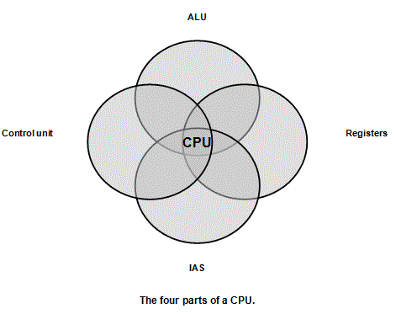
CPU – Central Processing Unit

Slide 3
ALU
The Arithmetic Logic Unit is that part of the CPU that does all the calculations. It has electronic circuits that can manipulate data in various ways. It has three main functions.
It can perform arithmetic calculations on data. For example, it can add and subtract two numbers together or multiply and divide numbers (in binary, of course).
It can perform logical operations on data. These are computations that involve, for example, the use of AND, OR and NOT.
The third job of the ALU is to hold data it has already worked on, ready to be sent out, and to hold data that has been fetched, ready to be processed. All data that goes into and out of the CPU goes via the ALU. The ALU acts like a 'revolving door' for data, letting data pass in as well as out of the CPU.

Slide 4
The Control Unit
This part of the CPU is responsible for managing how instructions are executed.
It is in charge of fetching instructions and data from wherever they are stored in the memory unit.
Its next very important job is to interpret, or 'decode', an instruction so that it knows what has to be done.
Once it has done this, it can then execute the instruction
Any program you write or application you run is made up of a sequence of instructions. When you 'run' a program, it is the control unit that is fetching, then decoding and finally executing every instruction, one after another.
This is known as the 'fetch-decode-execute cycle'.

Slide 5
Register
The registers are an integral part of the CPU.
They are a type of memory that can be accessed very quickly compared to other types of memory. The pieces of information they hold are needed very often. They can be used to store data and control information during a fetch-decode-execute cycle or they can be used to hold values that are generated as part of the ALU working on data.

Slide 6
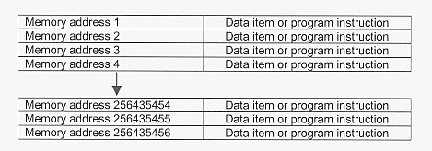
IAS – Immediate Access Store
The IAS is the place where programs and the data that is needed by programs are held, ready to be fetched then decoded and executed by the CPU.
Diagrammatic representation of 256 Mbytes of RAM

Slide 7
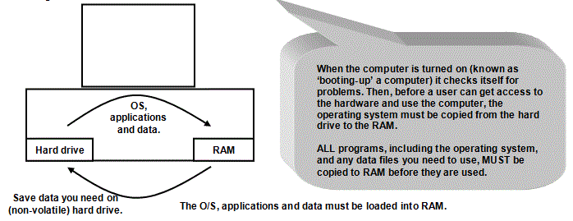

Slide 8
Data or program instruction?
Each 'box' which has an address in RAM holds a bit pattern.
That bit pattern might be a piece of data, such as a number or a character on the keyboard.
It might equally well be an instruction or part of an instruction.
As far as the CPU is concerned, it can't tell the difference.
It 'knows' whether it is a piece of data or an instruction only because the operating system has kept track of which memory locations are used for data and which ones are used for program instructions. (If you remember, one of the jobs of the operating system was memory management).

Slide 9
Primary memory and secondary storage
IAS is sometimes made distinct from storage devices by using the terms primary memory to describe the IAS whilst a hard disk, memory stick and so on are known as secondary storage devices.

Slide 10
Different processors
The materials the processor is made from
Good quality material = reliable
Speed of the slowest component is a restriction
Clock speed.
Pulses to determine the fetch-decode-execute
1Ghz = one hundred million pulses every second
The size of data and address buses.
A highway used to move data around the computer
Restricted by the speed at which the data moves
Word size.
Number of bits the CPU can work with in one clock cycle
E.G 64 bit
Number of cores
Duel core
Quad core

Slide 11
Registers
A CPU has a number of 'registers'. These are very fast memory circuits.
The registers you should know about include: Program Counter (PC) - this holds the address of the next instruction to be fetched and executed.
Current Instruction Register (CIR) - this holds the current instruction being executed
Memory Address Register (MAR) - this holds the RAM address you want to read to or write from.
Memory Data Register (MDR) - this holds the data you have read from RAM or want to write to RAM.
Accumulators - these hold the data being worked on and the results of arithmetic and logical operations
Status Register - this holds information about the last operation e.g. whether the least sum done produced a negative result
Interrupt Register - this holds details about whether an interrupt has happened

Slide 12
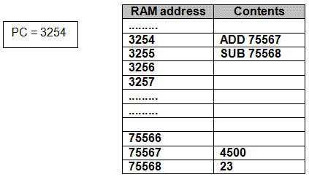
Register Cont

Slide 13
Register cont
FETCH
The CPU reads the contents of the Program Counter to find the address of the next instruction to be fetched, decoded and executed. In our case 3254.
As soon as it is read, the PC increments. PC = PC + 1, or 3255
The contents of 3254 are then put on the MAR.
The address in the MAR is then located in RAM.
The contents of this address are moved to the MDR.
The MDR now holds the instruction that must be executed.
The instruction in the MDR is copied to the CIR.
DECODE
The contents of the CIR are divided. Part of the instruction might be an operation (like ADD) and part of the instruction might be data, or in our case, an address where data can be found, like 75567. The ADD part is known as the OPERATOR and the data part is known as the OPERAND.
The operator (ADD) is decoded by the Control Unit in the CPU, so it knows what it has to do (ADD in our case).
The operand 75567 is put back on the MAR.
The contents of 75567 is then found in RAM and put on the MDR.
EXECUTE
The instruction can now be executed. Arithmetic and logical instructions are carried out using the Accumulator(s) in a CPU.
Signals are sent out to different parts of the CPU to execute the instruction ADD.
In our example, this will result in adding 4500 to whatever is in the Accumulator, and then over-writing the contents of the Accumulator with the result of the addition.
The way registers are used to run programs is often known as the FETCH - DECODE - EXECUTE cycle. This is because that is all the CPU actually does. It fetches instructions, decodes them and then executes them. It does this very quickly indeed, but that is all it does. It is why you sometimes read that computers aren't very clever!

Slide 14
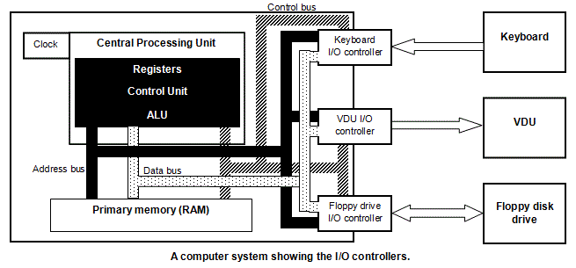
Bus

Slide 15
Different Buses
The address bus. This bus, in black on the diagram, is usually a set of wires that links the CPU to the RAM (and to other places).
The data bus. The dotted channels you can see in the diagram is the data bus.
The control bus. Signals need to be sent around the computer to control when things happen.

Slide 16
CPU
http://www.youtube.com/watch?v=cNN_tTXABUA

Slide 17
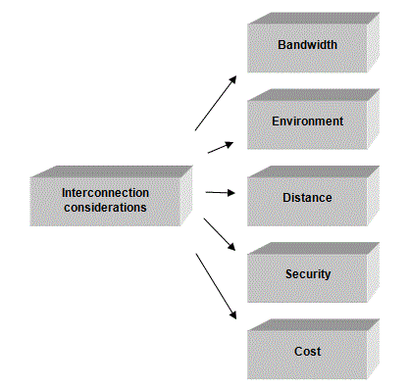
Connectivity - Decisions???

Slide 18
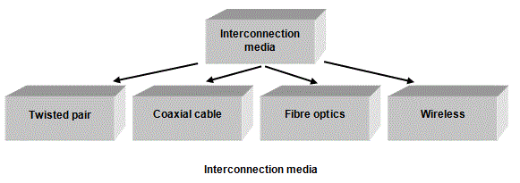

Slide 19
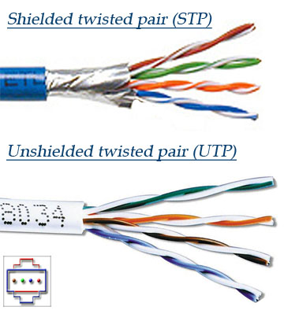
Unshielded Twisted Pair cable (UTP)
It is very light, flexible and
It is used extensively in the home to connect up the telephone system
It consists of pairs of conductors covered in insulation material and then twisted together.
Within one cable, you might have 4 pairs but there are different designs, each with their own characteristics.
Twisting wires together reduces the effects of electrical interference at minimal cost.
Twisting is helpful but you can provide even more shielding from interference by using a silver foil wrapped around the cables. Although you can certainly buy STP (Shielded Twisted Pair) cable, UTP is perfectly sufficient for many networks.

Slide 20
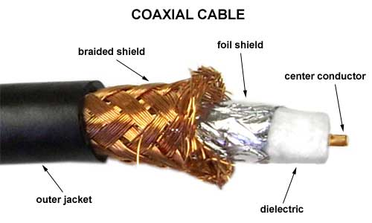
Coaxial cable
Central conducting core covered with some protective insulation.
Wrapped around the insulation is a thin metal sheath that provides the electrical interference protection.
Finally, the cable has an outer covering.
Coaxial cable is the cable used to connect your television aerial to the television.
It is heavier and less easy to manipulate than UTP. It is also more expensive.
You can have longer cable runs than for UTP but still not as long as for fibre optic. This means that you may need fewer repeaters compared to UTP cable, but more than for a fibre optic cable. It is mechanically strong and resistant to interference.

Slide 21
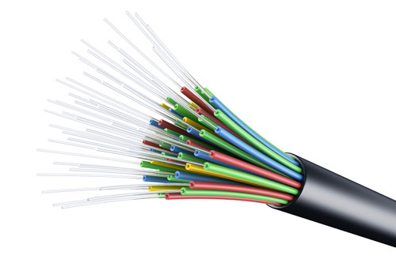
Fibre optic cable
A glass core wrapped in protection within a cable.
Data is sent down the fibre optic cable as light, not electrical signals.
The signals therefore don’t suffer from electrical interference.
Also resistant to the effects of moisture because they are non-metallic, unlike conventional cables, which are metal-based.
The cables themselves are very brittle when compared to conventional metal-based cables and need to be well-protected.
Due to higher bandwidth selected for networks where video-conferencing will be needed.
Becoming cheaper
Often used for the ‘backbone’ of LAN networks.

Slide 22
A wireless LAN
Enables computers to communicate without physically being connected to a network
Uses Routers and repeaters
Devices must have wireless network adapters (either built in or as an add on)

Slide 23
MAC addresses and security of wireless networks
All wireless devices come with a MAC address, or Media Access Control address.
When setting up a secure wireless network, you need to know the MAC address of the device you want to connect with. When you have this number, you have to access the wireless router using the administration login account. You then add the MAC address to the wireless router's list of allowable MAC addresses. The router will then only allow those MAC addresses to access the network and then only if they have the right password.
You can also use Hotspots for example in MacDonalds and Starbucks.
Sometimes they are free and sometimes you have to pay.

Slide 24
Using satellites
Satellites are used widely for communication in the media, navigation, video conferencing, data transfer and for military purposes, for example. A transmitter on the ground sends signals to a satellite using microwaves or some other form of transmission. Using a different frequency to avoid interference, the signals are then redirected back to the planet. If it doesn’t reach the intended recipient, it is then bounced to other satellites and on to its destination.

Slide 25
Pros and cons of using satellites for communication
If you transfer data using satellite technology, the cost of data transfer is not dependent on distance. A short distance transfer costs the same as a long distance one. Overall, the cost of transfer is higher than non-satellite methods. Satellites can handle a very high number of simultaneous communication lines (they can handle a large bandwidth). Satellite communications can be used in the remotest parts of the world, from the arctic to mountainous areas to deserts although the actual equipment is very expensive. One use of this technology has been to provide up-to-date educational materials for schools in remote parts of Africa. Because of the distance between the surface of the planet and the satellites, there is a short delay in any communication. Weather conditions can also affect the quality of transmission.

Slide 26
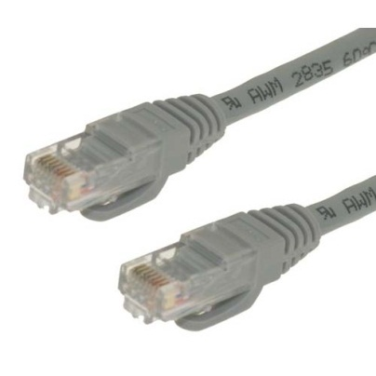
Ethernet
Ethernet is a widely-used design for baseband LANs, working until recently to speeds of up to 10 Mbps.
Now Fast Ethernet (also called 100Base-T) can achieve 100 Mbps and Gigabit Ethernet is faster still.
Ethernet networks connect stations using coaxial cable and can spread over about 100 meters although they can be extended with the right hardware.
As traffic increases on an Ethernet network, the number and frequency of collisions increase. This is because every station is broadcasting to every other one and the more workstations there are broadcasting, the more the communications on the network increase.

Slide 27
Reducing data collisions on an Ethernet LAN
There are strategies for reducing the number of collisions on a network.
A switch could be used.
This is a piece of hardware in common use in Ethernet LANs and when one is used it is known as a ‘switched Ethernet LAN’.
A switch can be used to split up the network into areas that improve the efficiency of communication.
It can be used to ensure each station is given a ‘time-slice’ in which to send data.
Two stations can also be given a temporary communication link between them using a switch, to ensure successful communication.

