Slide 1
Basic Definitions
Hardware. "Hardware is the physical part of a computer system - the processor(s), storage, input and output peripherals".
Software. "Software consists of programs, routines and procedures (together with their associated documentation) which can be run on a computer system".
Input device. An input device "is a peripheral unit that can accept data, presented in the appropriate machine-readable form, decode it and transmit it as electrical pulses to the central processing unit".
Storage device. A storage device is "a peripheral unit that allows the user to store data in an electronic form for a longer period of time and when the computer is switched off. The data can only be read by the computer and is not in human-readable form".
Output device. An output device is "a peripheral unit that translates signals from the computer into a human-readable form or into a form suitable for re-processing by the computer at a later stage".
Peripheral. This "is a piece of equipment (or hardware) which can be connected to the central processing unit. They are used to provide input, output and backing storage for the computer system".

Slide 2
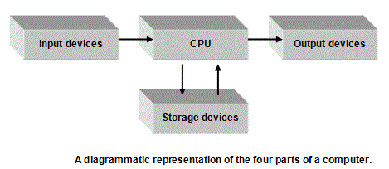
Purpose of I/O and storage systems

Slide 3
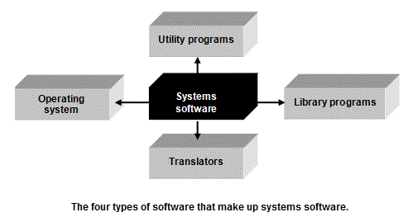
Systems software and application packages

Slide 4
Library programs.
A program library is a collection of programs, each of which do a specific job. Library programs are available for users to call up and use in their own programs. On a network, you may have a library of programs on a server that are available to all users. On a PC, a user may have bought and installed a handy set of library programs for whichever programming language they are using or may use the library programs that came with whichever operating system they installed.

Slide 5
Input devices
Keyboard
Mouse
Joystick
Digital camera
Microphone
Touch screen
Scanner
Graphics tablet
Sensors
Barcode reader
Magnetic strip reader
Magnetic Ink Character Reader (MICR)
Optical Mark Reader (OMR)
Describe each device
What is it?
What is it used for?
What is the technology behind it?

Slide 6
Output Devices
Monitor
Printers
Laser printers
Ink-jet printers
Dot matrix printers
Plotters
speakers
projectors
buzzers
motors
switched outputs
lights
mechanical devices, eg a robot arm
Describe each device
What is it?
What is it used for?
What is the technology behind it?

Slide 7
Storage Devices
Floppy disks
hard disks
CDs
CD R/Ws
DVDs
Zip disks
SD cards
Flash drives
Magnetic tape
Describe each device
What is it?
What is it used for?
What is the storage capacity?

Slide 8
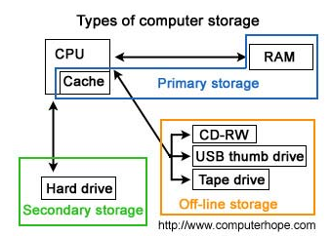
Primary/ secondary storage devices

Slide 9
Systems software and application packages

Slide 10
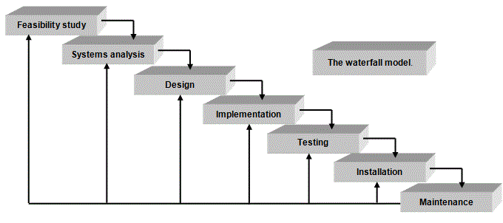
The waterfall model

Slide 11
Analysis documents
Written descriptions of current methods and systems.
Dataflow diagrams (DFDs).
System flowcharts.
Jackson diagrams.
A data dictionary.
Written descriptions of problems.
Requirements specification.
Hardware and software constraints.

Slide 12
Waterfall model
Problem definition
Feasibility study
Information gathering
Analysis
Notes:
Problem definition (what is produced) (what roles)
Feasibility study (what is the criteria)
Information gathering (how is it done)
Analysis

Slide 13
Data flow diagram
Dataflow diagrams, or DFD diagrams, are used to summarise the flow of data around a system.
There are only four basic symbols in a DFD
1) An oval, representing an entity. This is someone or something that puts information into the system or receives information from it.
2) An arrow, representing a flow of data from one place to another.
3) A box, which represents an action or process on some data.
4) A long box, which represents a store of data.

Slide 14
Structure Diagram
Jackson Structure Diagram breaks down a problem into ever-increasing levels of complexity.
It is read from top to bottom (using a different number for each level) and from left to right (using a different number for each process in one level).

Slide 15
Data Dictionary
The name of the data item.
What synonyms there are for the data item.
Data type. (Whether it is a real number, an integer, a text, a character, a Boolean, a date and so on).
Validation rules that apply. (For example, the range of allowable values for integers, the number of allowable characters for text, the allowable characters for a character, the way that the date has to be entered, the number of decimal points allowed, for example).
Examples of typical data entries.
The origin of the data, where it comes from, how it is generated in the first place, where it is stored.
What exactly the data item is used for, what happens to it, why it is part of the system at all.

Slide 16
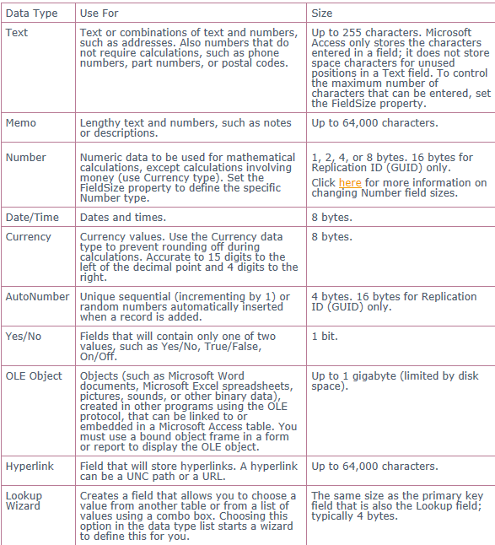

Slide 17
Requirements spec
Requirements Specification (RS) When the Analyst has fully investigated the problem area of a business, they should have produced the following deliverables for the Systems Analysis stage of the systems life cycle:
Written descriptions of current methods.
DFDs of current methods.
System flowcharts.
Structure diagrams of current methods.
A data dictionary of the current system.
A table of problems and why they exist

Slide 18
SMART Requirements
Specific. Each requirement must be clearly described and easily understood by everyone.
Measurable. You should be able to write down tests that can measure the requirement. Requirements such as 'user-friendly', ' easy to use', 'effective' and 'pleasing to the eye' for example, are difficult to measure. 'Fast' is easy to measure because you can set tests e.g. must be able to display a customer's account details in under 0.5 seconds.
Agreed. The customer and the Project Manager must agree on each requirement and the way it will be measured.
Realistic. Each requirement must be realistically achievable, taking into account the resources and budget.
Trackable. The project manager must be able to monitor and measure the progress of the achievement of a requirement. For this to happen, the requirement must be something tangible, something that they can see being developing, something that they can tell has been finished.

Slide 19
Hardware and software constraints
The Analyst needs to produce a list of the hardware and software that is being used in the current system (if applicable). When a list has been drawn up of what exists currently, they should then comment on how this may or may not impact on any future solution. They might be able at this stage to identify that certain software is being considered for a solution, but the software cannot be run on the existing machines because they are not of the right specification, for example. It may be that there are only standalone computers at a business but the analyst is thinking of using email and shared resources that require a network. It may be that an operating system needs to be updated or printing facilities need to be reviewed.
The Analyst should then draw up a list of any new software and hardware that will be needed. They should also justify these proposed purchases to the company so that they are clear about the reasons for spending their money on this equipment.
Once the Requirements Specification is completed and agreed to, the real work can begin! The Systems Analyst can start designing the detail of the new computerised system in the next stage of the systems life cycle - the Design stage.

Slide 20
Design
Reverse of Analysis
SFD
DFD
JSD
Program Specification (what the program does)
Algorithms/Pseudo code (task with Mr Buckland)

Slide 21
Implementation
NOT installed on site
Program is produced by the development team
Teams of developers working on different sections
JSD Modularised so can be broken down into sections

Slide 22
Testing
A company that builds systems has a reputation to protect. They do not want to damage this by producing products that get into the news for the wrong reasons! In some cases, it could cause the company to go bust.
They need customers to say good things about the product they bought because 'word of mouth' will generate new business. This will help the company make bigger profits.
A system that is unreliable will soon be avoided by users. They will find it frustrating to use and will stop using it. Their company can only suffer because they have invested a lot of money in a system that was supposed to bring benefits and a system that doesn't work often makes matters worse.
A system that causes accidents will leave a company open to legal action.
Testing is a stage in the life cycle. The deliverable is the test plan. Test plans are written to ensure that the product does what it is supposed to do, as laid out in the Requirements Specification. It is usually written just after the Requirements Specification has been agreed and should test all of the functions mentioned in the Specification using typical, atypical, borderline, extreme and silly data. It should also be tested to ensure the whole system works together to produce the correct output for some given input.

Slide 23
HW Answer (Data dictionary)
The name of the data item.
What synonyms there are for the data item.
Data type. (Whether it is a real number, an integer, a text, a character, a Boolean, a date and so on).
Validation rules that apply. (For example, the range of allowable values for integers, the number of allowable characters for text, the allowable characters for a character, the way that the date has to be entered, the number of decimal points allowed, for example).
Examples of typical data entries.
The origin of the data, where it comes from, how it is generated in the first place, where it is stored.
What exactly the data item is used for, what happens to it, why it is part of the system at all.

Slide 24
Types of testing
Bottom up testing
Each individual module tested as soon as its written
Each type of test data is used
Tests
Each route through the program
Each piece of code
Accuracy of processing
Meets the original specifications

Slide 25
Types of testing cont
Top down testing
The skeleton of the complete system is tested
Displays a message that a procedure has been executed

Slide 26
Types of testing cont
Black box testing
Independent of the code
Looks at the specification and creates test data to cover all inputs, outputs and program functions

Slide 27
Types of testing cont
White box testing (structural testing)
Dependent on code logic
Program structure rather than its function
Code is studied and tests go through each path at least once
Does not test missing functions

Slide 28
Types of testing cont
Alpha Testing
Carried out by the in-house testing team
Reviews the requirements specification

Slide 29
Types of testing cont
Beta Testing
Testing uses potential users of the new system
Report problems back to the developers
Program is then improved and sent out for further testing

Slide 30
Types of test data
Typical Data
Extreme Data
Erroneous Data
Notes:
Typical Data – Within range
Extreme Data – Edge of range but correct
Erroneous Data – Incorect data

Slide 31
Testing a user login
Username
Letters
Number between 1 and 9
8 characters
Password
Letters
Numbers
Over 8 characters
Uppercase and lower case
Typical Data
Extreme Data
Erroneous Data

Slide 32
Testing task
For your new library system produce test table to show how your system will meet the requirements specification
Describe the test and the data to show how each SMART target has been met
Negative is as good as Positive results
Test Number | Test | Expected outcome | Actual Outcome | Evidence

Slide 33
Installation
Installation of new hardware
Installation of new software and access rights set
Data is added onto the new system before it is used
Conversion to the new system

Slide 34
Conversion
Direct change over
Old system stops one day new system the next
Done over a quiet time e.g. weekend
Fast and efficient
No duplication of work
Disruption if errors are found

Slide 35
Conversion
Parallel conversion
Both systems run at the same time
Could be weeks of a few months
New system can check results from old system
Any problems there is still a working system
Extra work to keep both systems running

Slide 36
Conversion
Phased conversion
Used for larger systems that can be broken down into modules
Separate implementation for each module
May be used where a few accounts are moved to the new system

Slide 37
Conversion
Pilot
New system used by a small portion of the organisation
One branch or factory

Slide 38
Documentation
Technical Documentation
User guide

Slide 39
Technical Documentation
Used by the people managing the day to day use of the system
Hardware requirements
Operating system requirements
How to install software
Customising the system
Multi-user and networked versions
Setting parameters
Registration details
Upgrade instructions
Starting the program
Disks or tapes required
Stationary to be used
Reports and who gets them
Backup procedures
Recovery procedures

Slide 40
User Guide
Aimed at the end user
Senior managers
Middle managers
Clerical workers
It includes (in a way a non specialist will understand)
Menu structure
Navigation
Data entry
Format of reports and how to print
Undo
On-line help
User support (phone number)
Tutorial on various functions

Slide 41
Post Implementation (Evaluation)
Three to six months after implementation
Allows the users to get used to how the system works
Allows management to evaluate the usefulness of the system (month end)
Allows management time to discus the system with the users
Evaluated on
Effectiveness
Usability
Maintainability

Slide 42
Focus
Comparison of the systems actual performance with the anticipated performance objectives
An assessment of each aspect of the system against preset criteria
Errors which were made during system development
Unexpected benefits and problems

Slide 43
Why provide maintenance?
Impossible to produce software that does not need to be maintained
Errors could be discovered
Original requirements modified to reflect changing needs
Hardware developments my give scope for improved software
New legislation

Slide 44
Maintenance
Perfected Maintenance
The system can be made better in some way without changing its functionality e.g. run faster or better reports
Adaptive Maintenance
Changing needs in a company may mean systems need to be adapted e.g. single user to multi user
Corrective maintenance
The correction of previously undetected errors

Slide 45
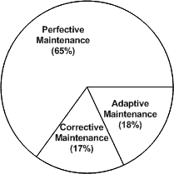

Slide 46
Factors effecting maintainability
Maintenance can be expensive so it is important to create a system that is easy to maintain
Good program design
Well-structured program written in a modular fashion and following standards of best practice
Use of appropriate high-level language
Using tried and tested library routines and components
Good documentation
Record of maintenance tasks

