Slide 1
Input devices
Keyboard
Mouse
Joystick
Digital camera
Microphone
Touch screen
Scanner
Graphics tablet
Sensors
Barcode reader
Magnetic strip reader
Magnetic Ink Character Reader (MICR)
Optical Mark Reader (OMR)
Describe each device
What is it?
What is it used for?
What is the technology behind it?

Slide 2
Output Devices
Monitor
Printers
Laser printers
Ink-jet printers
Dot matrix printers
Plotters
speakers
projectors
buzzers
motors
switched outputs
lights
mechanical devices, eg a robot arm
Describe each device
What is it?
What is it used for?
What is the technology behind it?

Slide 3
Storage Devices
Floppy disks
hard disks
CDs
CD R/Ws
DVDs
Zip disks
SD cards
Flash drives
Magnetic tape
Describe each device
What is it?
What is it used for?
What is the storage capacity?

Slide 4
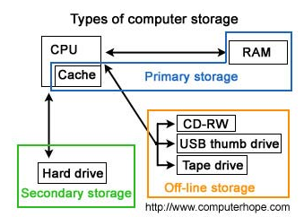
Primary/ secondary storage devices

Slide 5
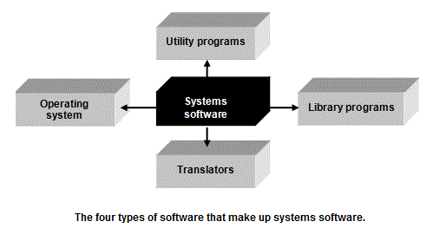
Systems software and application packages

Slide 6
Software
Operating system
Utility programs
Library programs
Translators
Applications software
Describe each type of software in detail
What is it?
What is it used for?

Slide 7
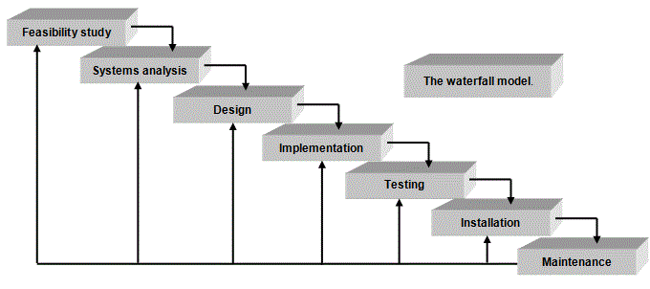
The waterfall model

Slide 8
Task
Write a brief description of each stage of the system life cycle

