Slide 1
Assessment
- Samuel Joshua V [ LVADSUSR184]

Slide 2
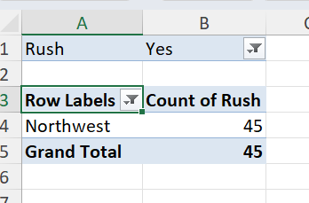
Ques 2 - District with highest number of rush jobs

Slide 3
Explanation for Ques 2:
Method Used: Pivot [Row – Region and Values – Rush(Count)]
Value filter – Top 1
Inference: Northwest is the district with highest number of rush jobs

Slide 4
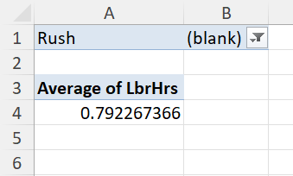
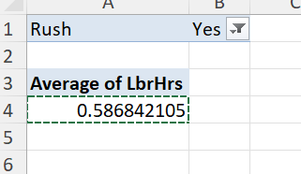
Ques 3: Difference in average labour hours between rush and non-rush jobs

Slide 5
Explanation for Ques 3:
Method Used: Pivot [Values – Labour hours (average) and Filters – Rush]
Inference: Difference is observed
For rush - 0.586842
For non-rush - 0.792267

Slide 6
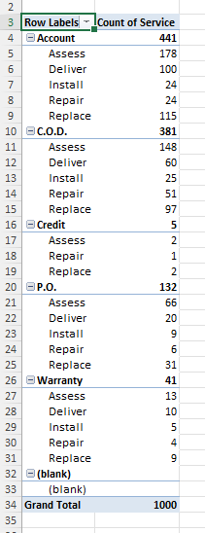
Ques 4: Distribution of payment type across services

Slide 7
Explanation for Ques 4:
Method Used: Pivot [ Row – Payment, Service and Values – Count of service)
Inference: A clustered column chart has been created that gives a proper breakup of the payment type across services

Slide 8
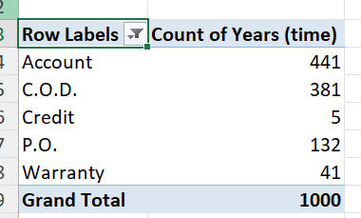
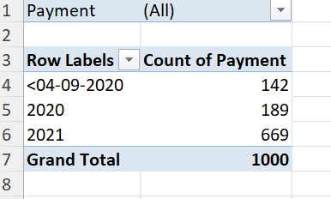
Ques 5: Trend in payment over time

Slide 9
Explanation for Ques 5:
Method Used: Pivot
Two types of visualization has been done, one with years as rows and another as payment method breakup for count of years(payment – rows).
Inference: From a time-point of view, there has been an upward trend over the years.
Inference: From a payment method point of view, account seems to hold an upward trend while credit has a lower trend

Slide 10
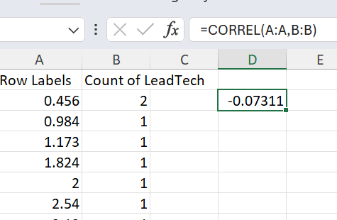
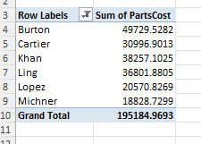
Ques 6: Any relation between number of technicians used and cost of parts

Slide 11
Explanation for Ques 6:
Method used: Pivot [Row – Cost of parts and Values – Count of Lead Tech)
CORREL function used afterwards.
Inference: Weak correlation observed
Another inference: This can also be viewed using a different pivot with row as lead tech and value as cost of parts)

Slide 12
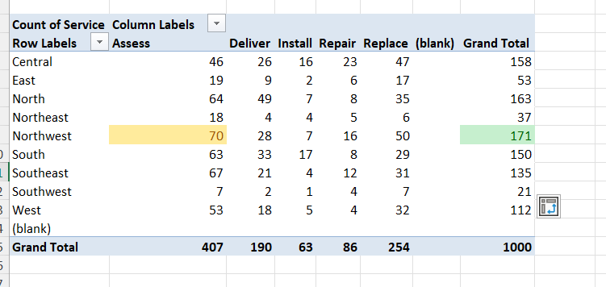
Ques 7: Common type of service in districts

Slide 13
Explanation for Ques 7:
Method used: Pivot [Row – District, Column – Service and Values –Count of service)
Inference: District wise service requests has been noted
Inference: Assess district is common among districts, especially super high in Northwest region

Slide 14
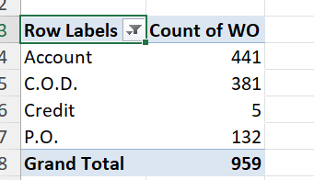
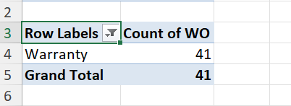
Ques 8: Payment types for work order with and without warranty labour

Slide 15
Explanation for Ques 8:
Method Used: Pivot [Row – Payment, Filter – warranty labour and Values – WO(Count)]
INFERENCE: Significant difference is noted
Account takes the top spot for ones without warranty labour while warranty is covered with warranty labour

Slide 16
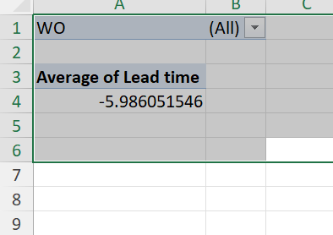
Ques 1: Avg lead time

Slide 17
Explanation :
Method used: Pivot
Lead time found from workday- request day
Pivot [Lead time in values (AVERAGE) and WO in filter

Slide 18
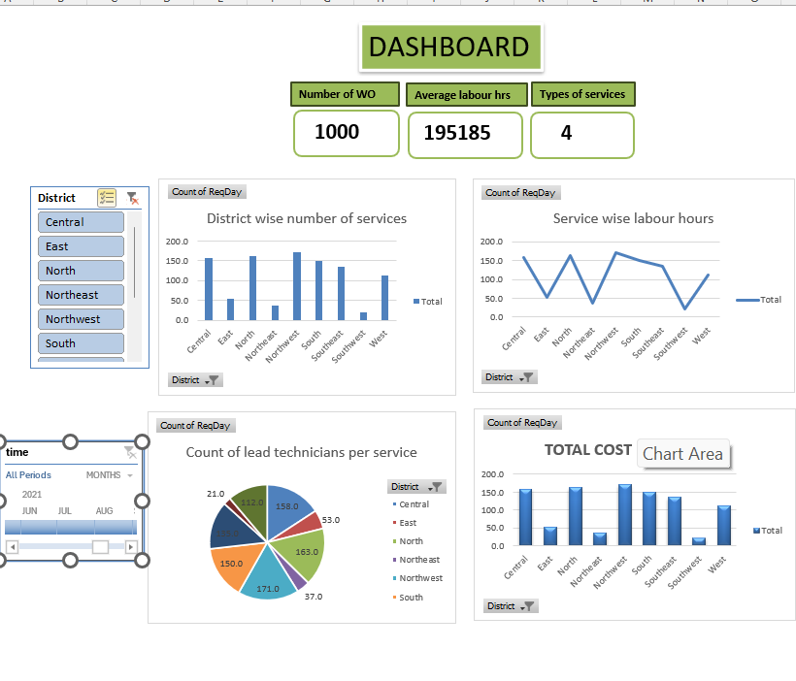
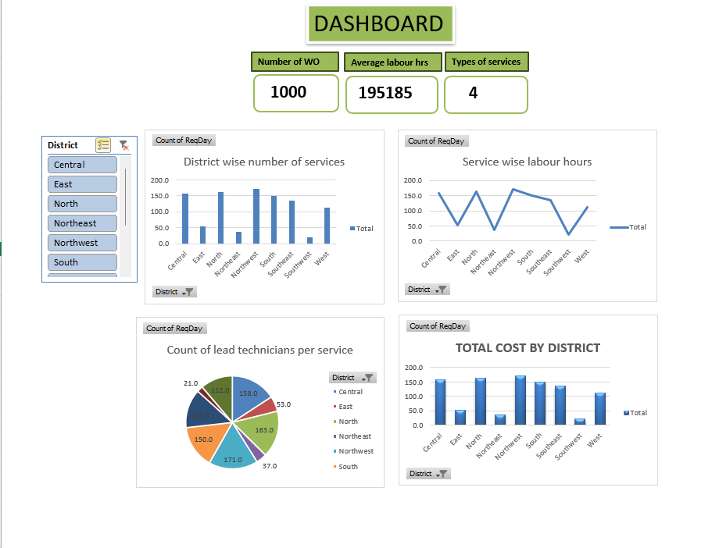
Dashboard

