Slide 2
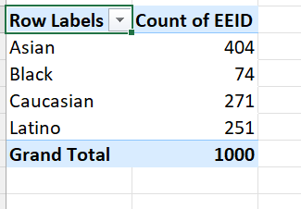
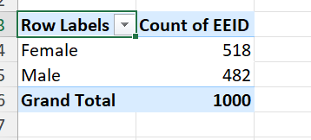
Ques 1:

Slide 3
Pivot table is used.
Ethnicity is first analysed by dropping it into the rows and with the employee id in the values.
Inference: Asian – Highest and Black – lowest
Similarly, gender is then analysed by dropping it into the rows and with the employee id in the values.
Inference: Female more than male

Slide 4
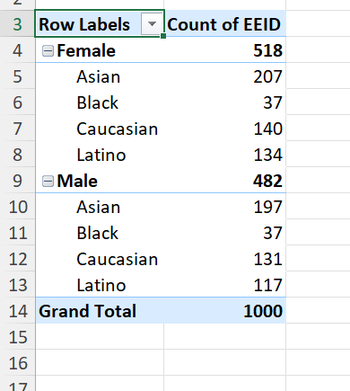
Collective analysis – Detailed info:

Slide 5
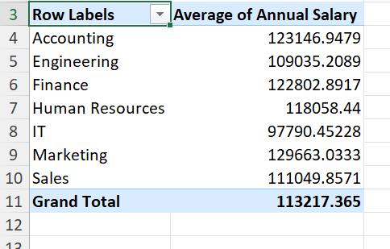
Ques 3:

Slide 6
Using pivot table, department is slotted into rows and annual salary into values.
The aggregation is changed to average.
Inference - There is not a significant in average salaries for different deparments but there is still a minor difference. Majority lie between 100000-125000.
Only for IT, the value drops to less than 100000.

Slide 7
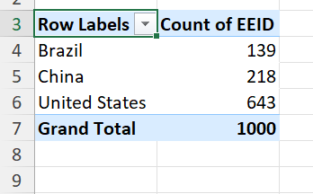
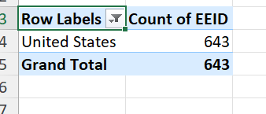
Ques 4:

Slide 8
Using pivot table, country is dropped into rows and employee id to the values.
Count is the aggregation applied to the id.
Inference - US – Highest
Filtering is applied to get this inference

Slide 9
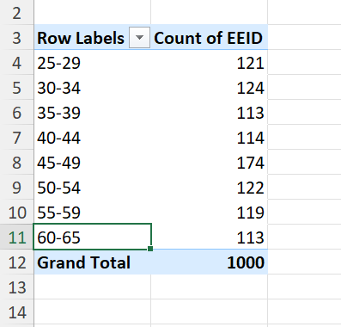
Ques 5:

Slide 10
Age is dropped into the rows and employee id to the values.
Count is the aggregation.
For age range, grouping is done.
Inference: Majority of employees in the age range of 45-49

Slide 11
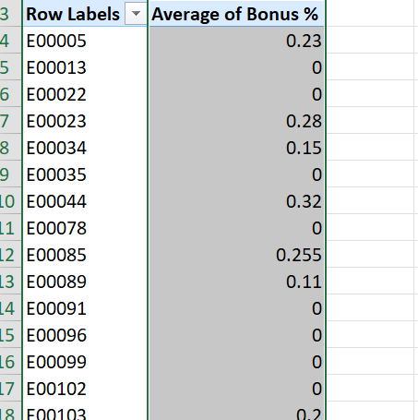

Ques 6:

Slide 12
Using pivot, employee id is dropped into rows and then the bonus percent into the values.
Average is the aggregation.
After this, the average for the values are found.
Average function is applied to get the average value.

Slide 13
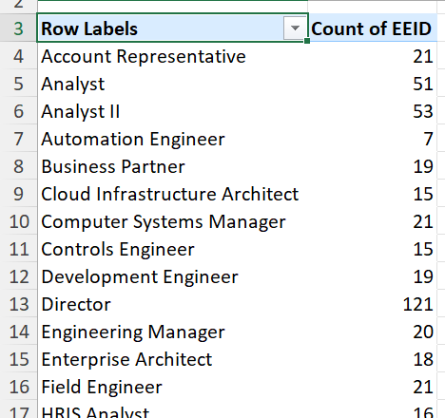
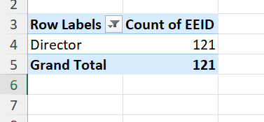

Slide 14
Pivot is used.
Job title – rows
Employee id – values
To get the most, value filter is applied to job title and top 1 is applied.
Ans: Director

Slide 15
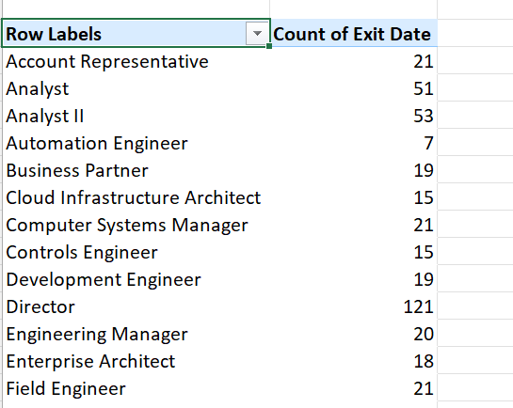
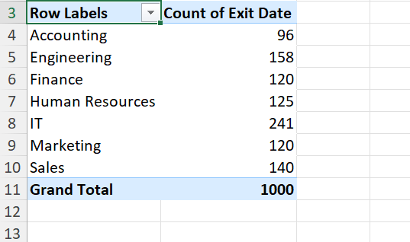
Ques 8

Slide 16
Pivot
First, department in rows and exit in values
Second, job title in rows and exit in values
Inference- IT has seen more exits, Director job seems demanding to create exits potentially.

Slide 17
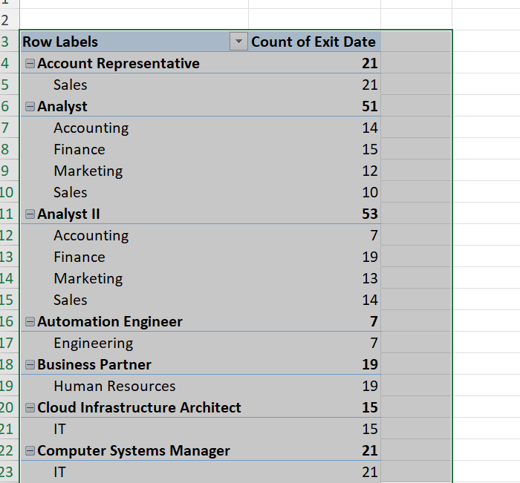
Collective analysis

Slide 18
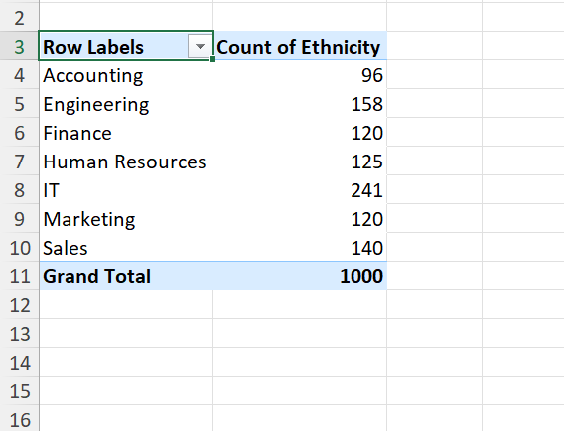
Ques 9

Slide 19
Pivot is used.
Department Rows
Ethnicity – Values
Inference – Some departments seem to be diverse.
Especially when it comes to IT.
Accounting on the other hand lacks

Slide 20
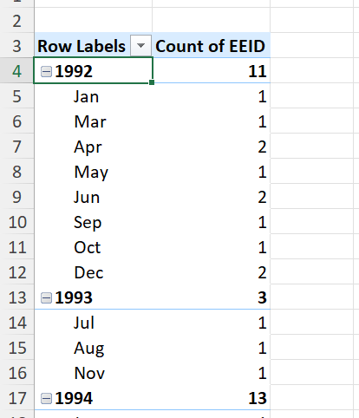
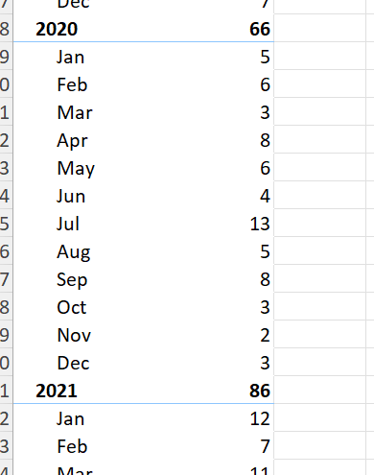
Ques 10

Slide 21
Pivot is used.
Row and values filled.
Increase is spotted in the recent years when compared to the first few years.

