Slide 1
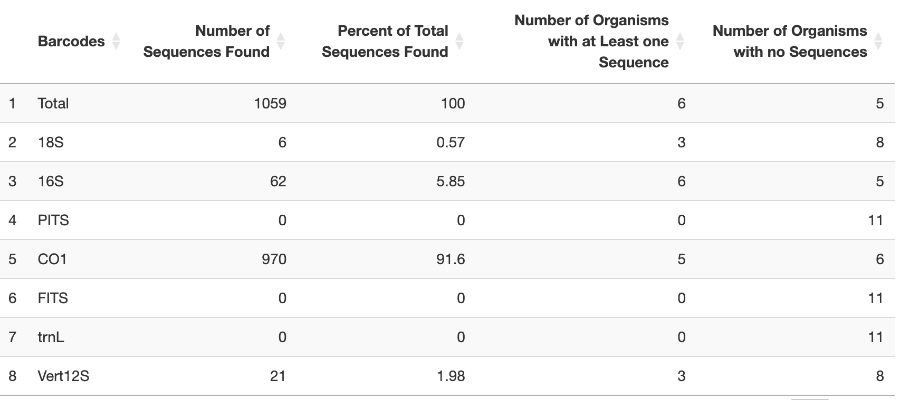
CRUX summary data

Slide 2
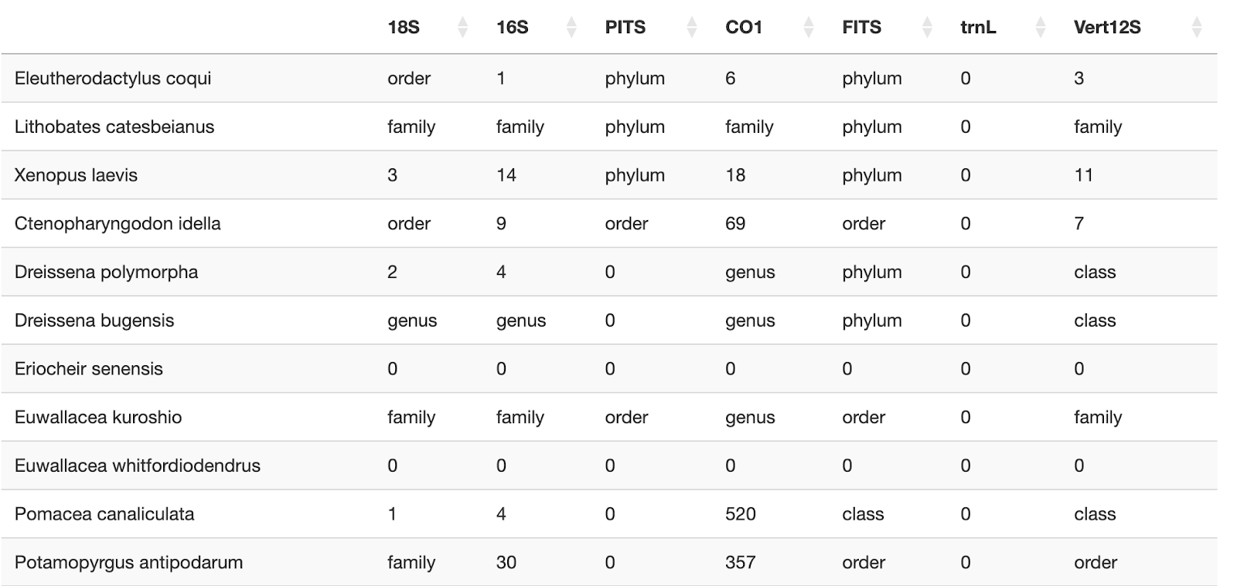
CRUX coverage matrix

Slide 3
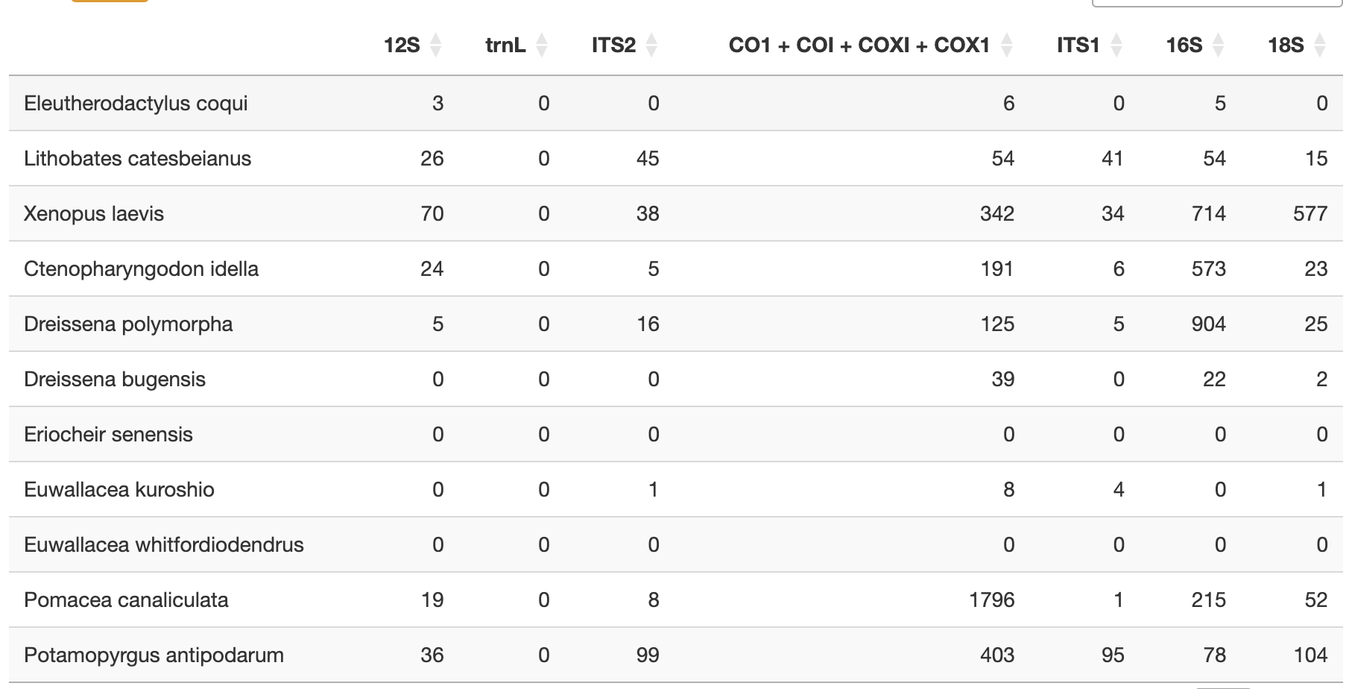
NCBI coverage matrix

Slide 4
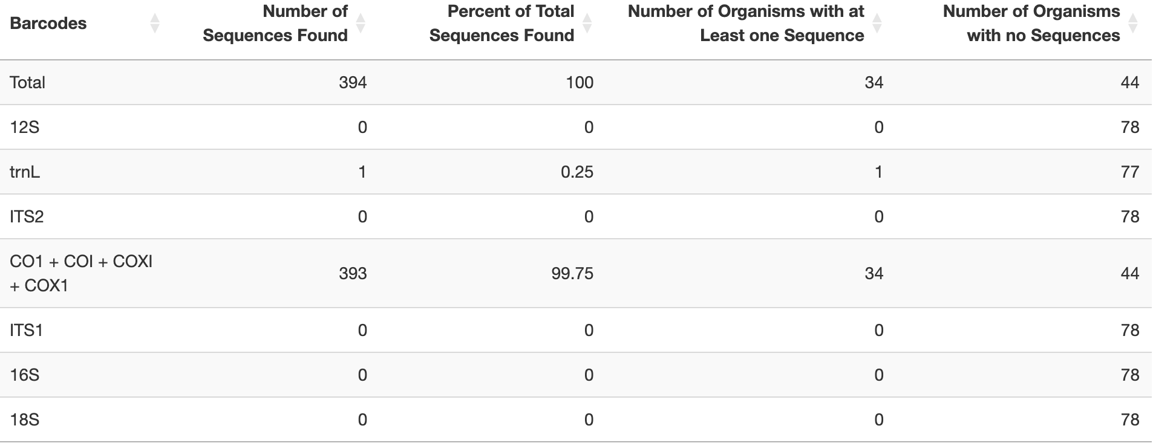
NCBI coverage matrix

Slide 5
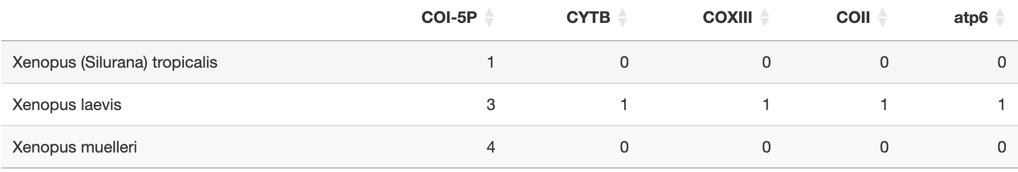
BOLD coverage matrix

Slide 6
BOLD coverage matrix

Slide 7
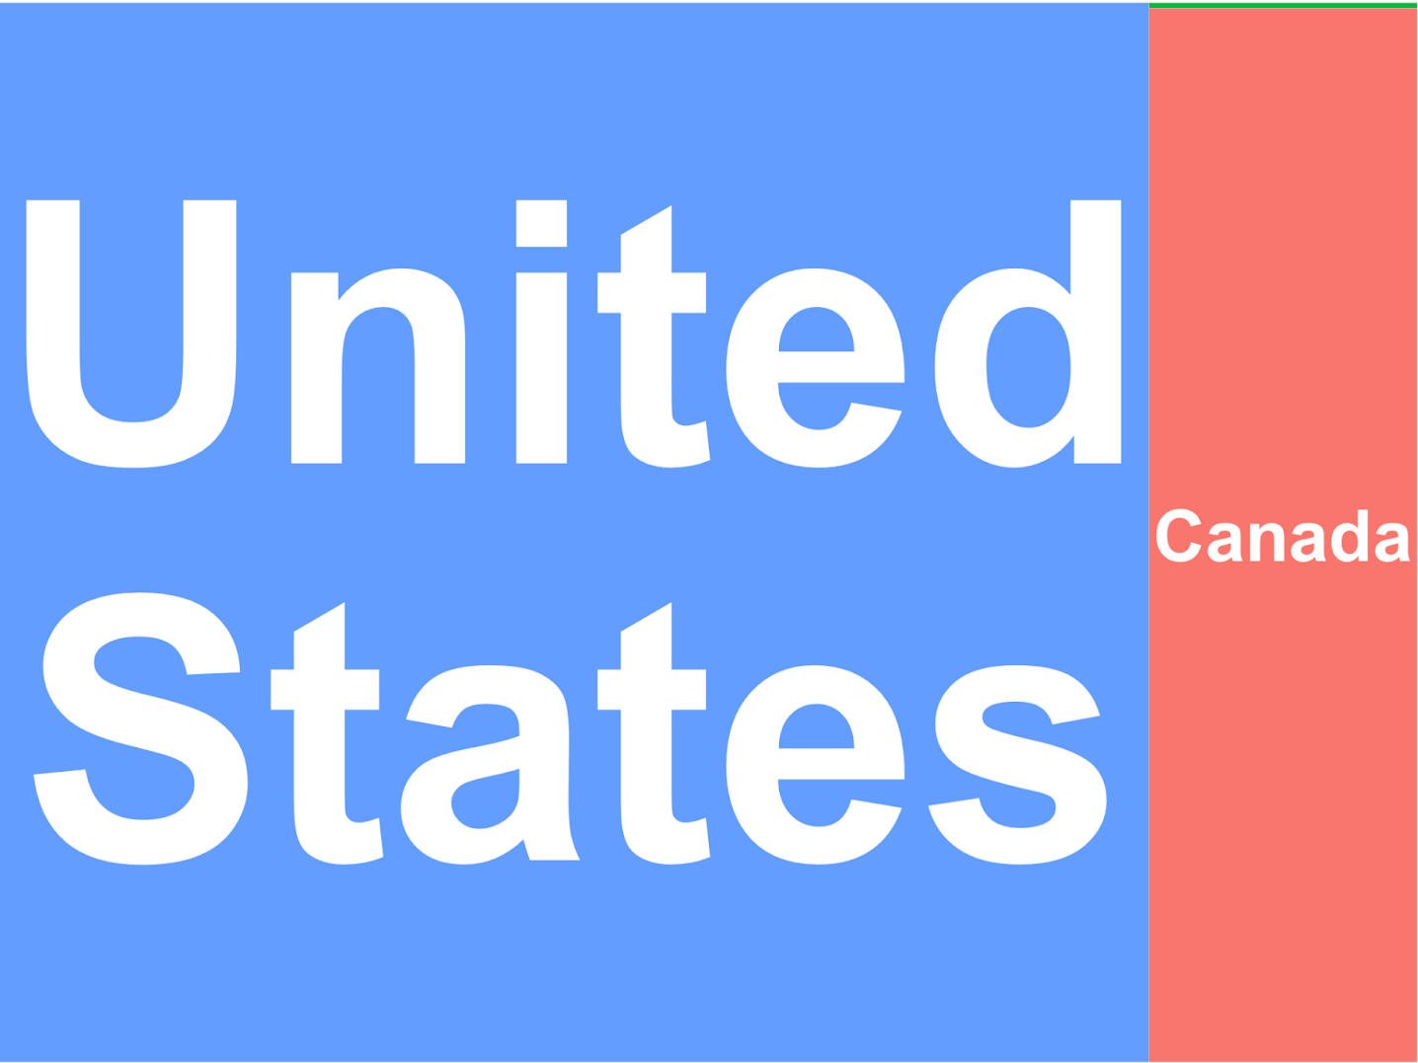
BOLD country tree map
United States Canada Ireland

Slide 8
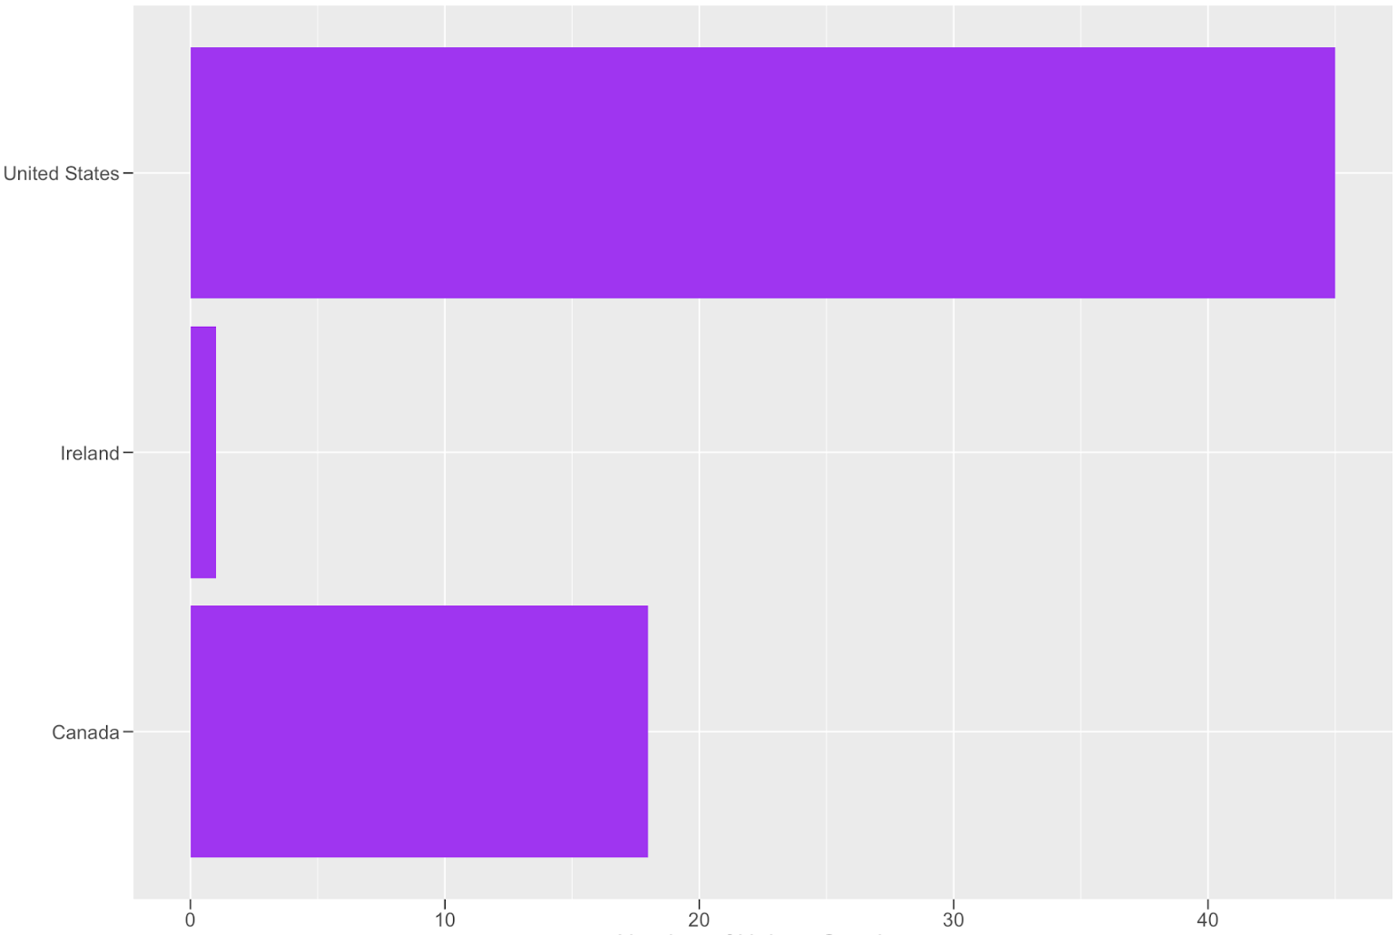
BOLD country bar plot
Number of unique species

Slide 9
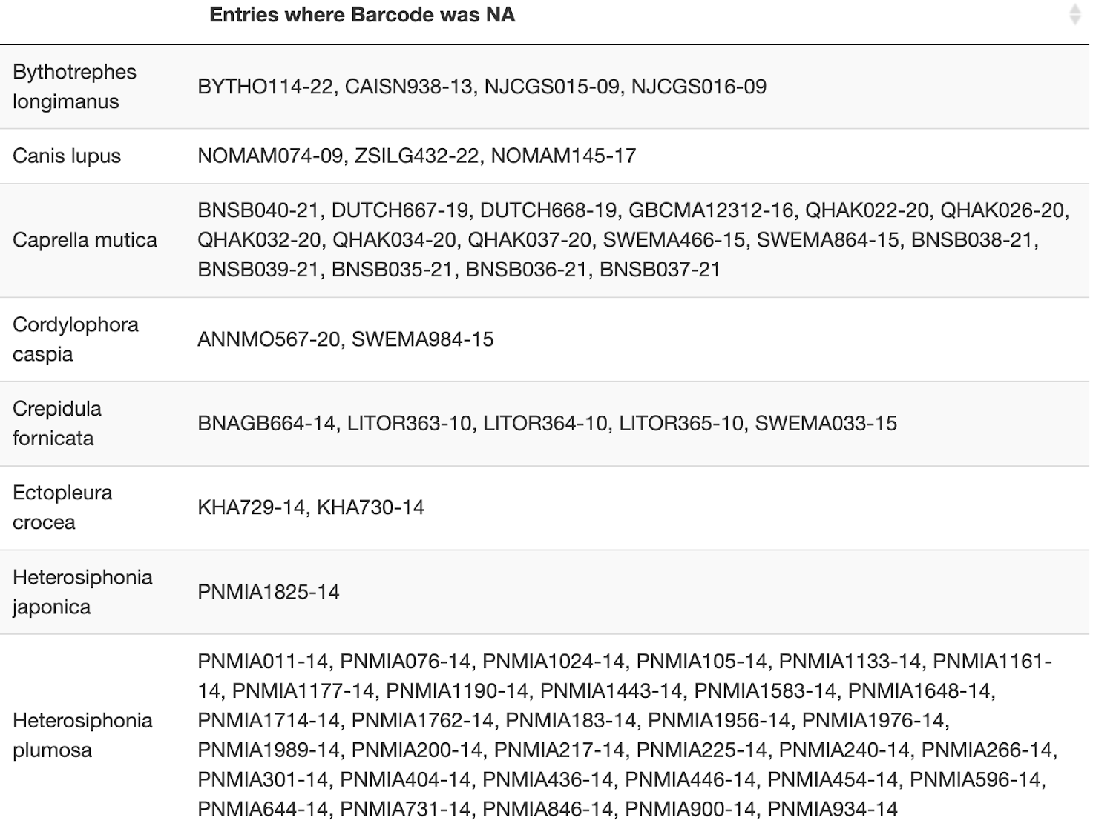
BOLD unlabeled barcodes

Slide 10
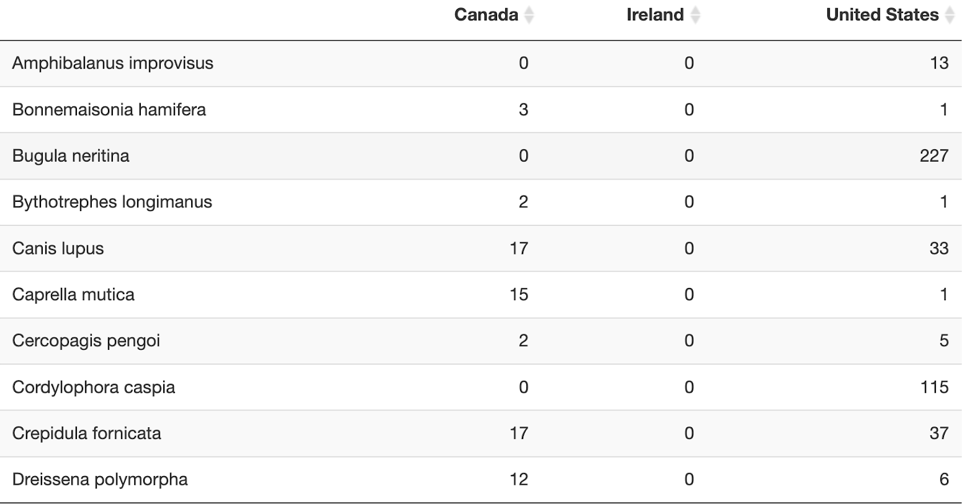
BOLD country table

Slide 11
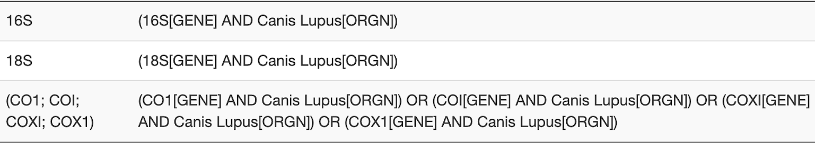
NCBI search queries

Slide 12
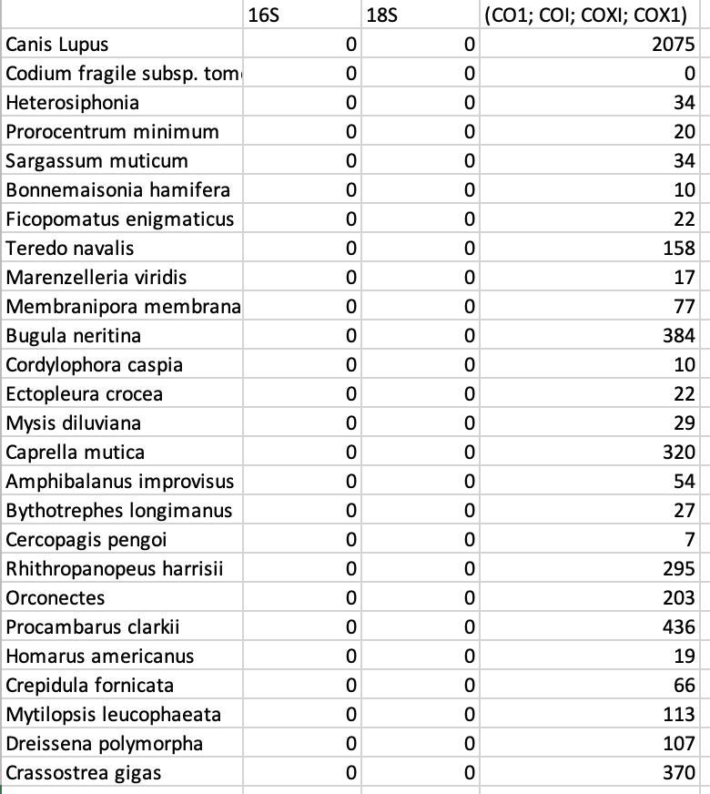

Slide 13
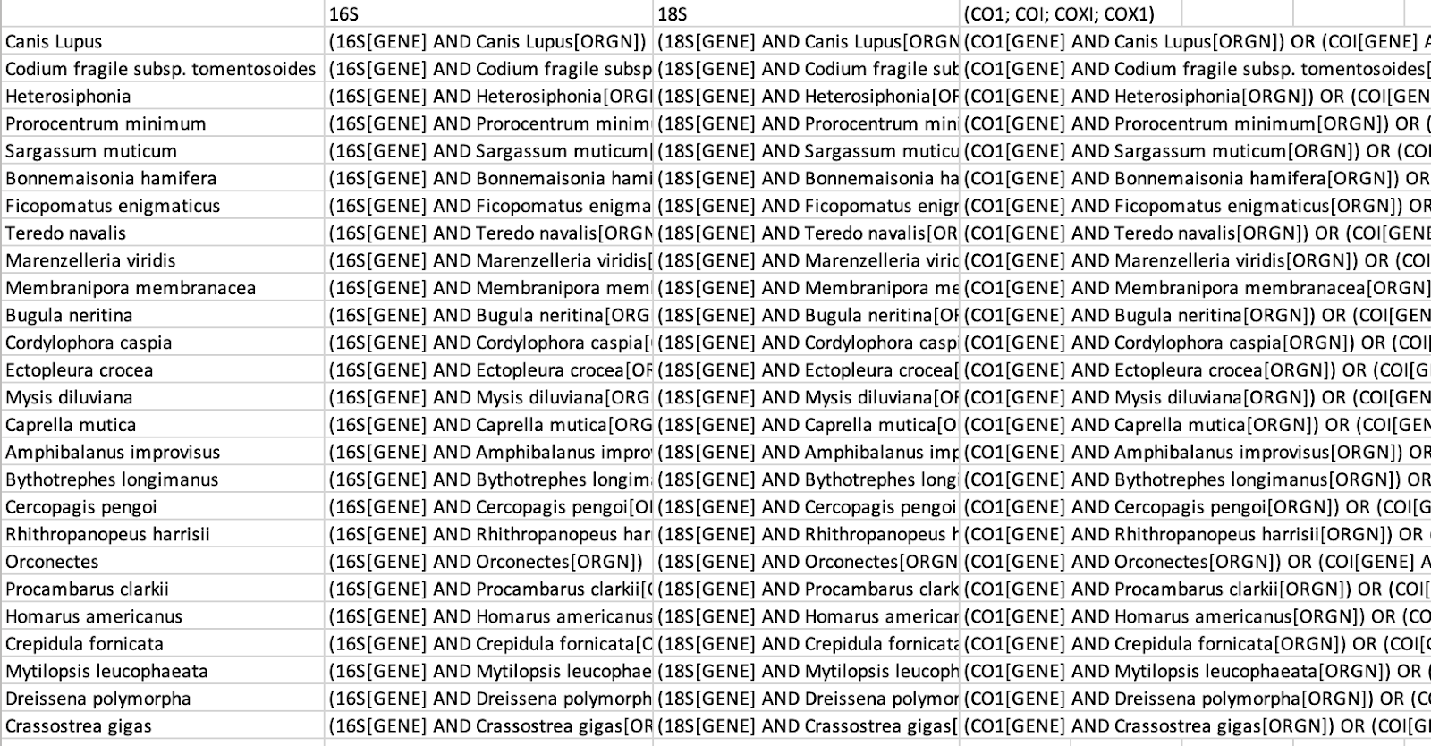

Slide 14
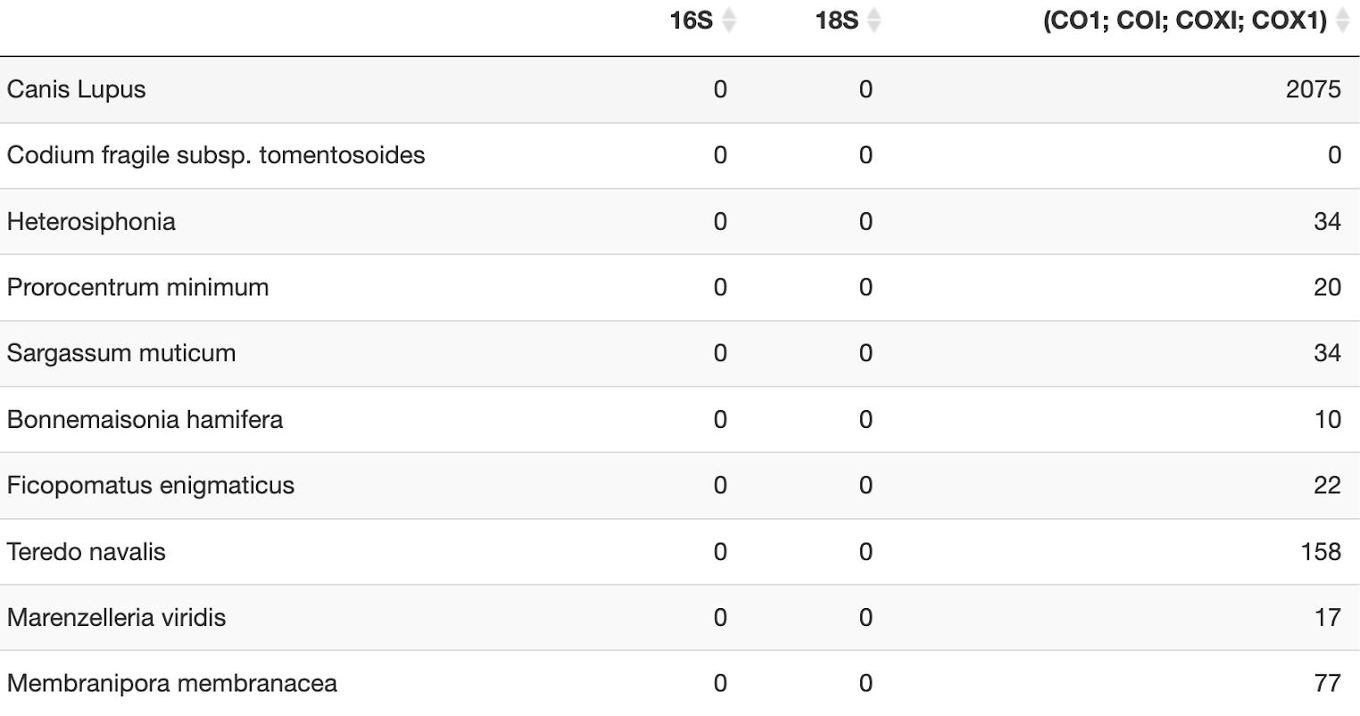
NCBI Coverage Matrix

Slide 15
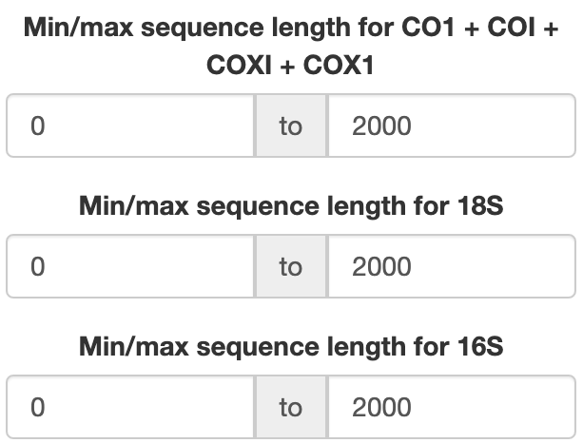

Slide 16
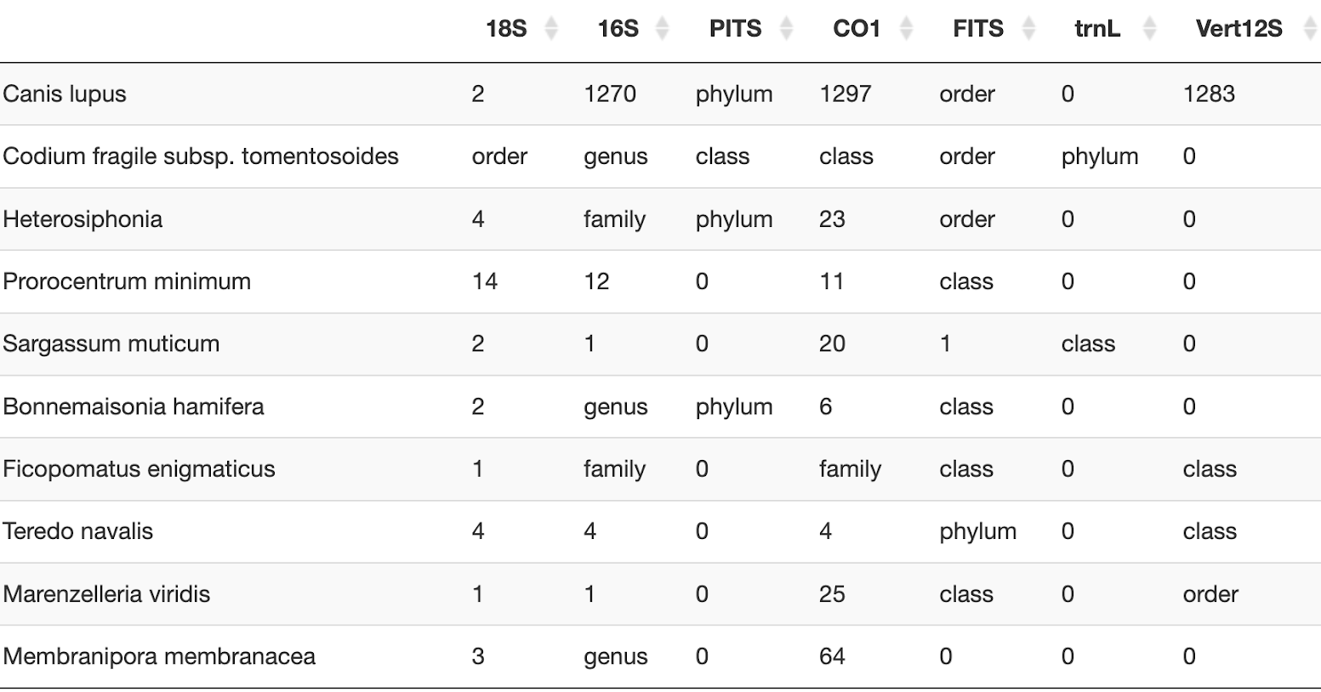
CRUX coverage matrix

Slide 17
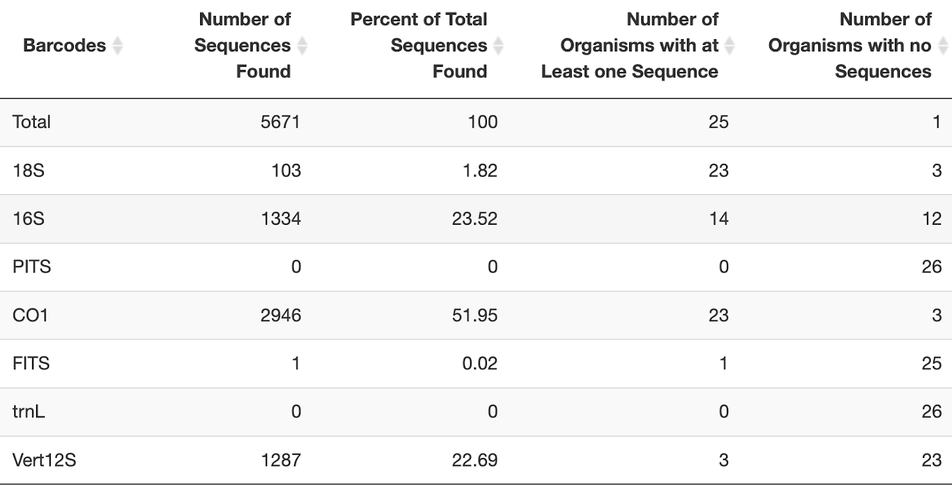
CRUX summary data

Slide 18
