Slide 1
March Madness Prediction
Zach Bell, Guillaume Boneheure, Paula Pieper

Slide 2
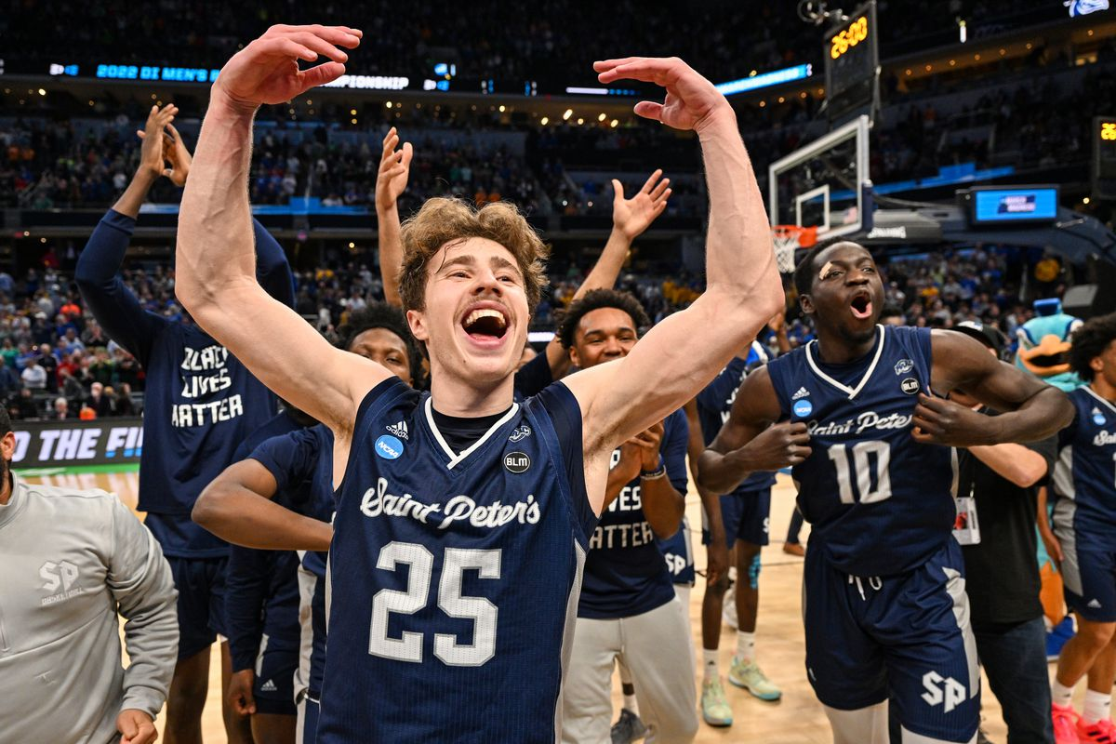
Why?
70 million competed in a bracket guessing competition
The best bracket last year correctly guessed 27/32 games in the first round of the tournament
161 perfect brackets left after 16 games on ESPN Competition of 17 million

Slide 3
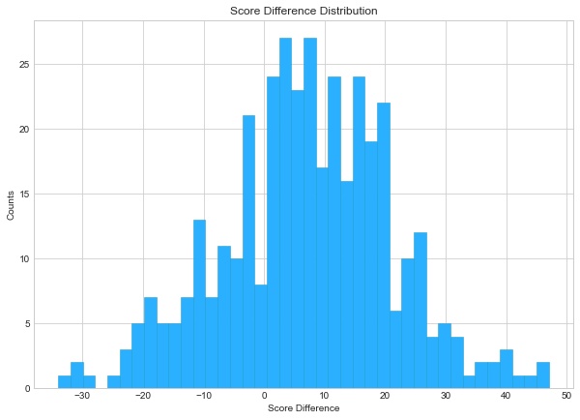
INITIAL Goal: Score DIFFERENCE
Predicting score difference allows us to pick winner
Regression
Represents degree of competition

Slide 4
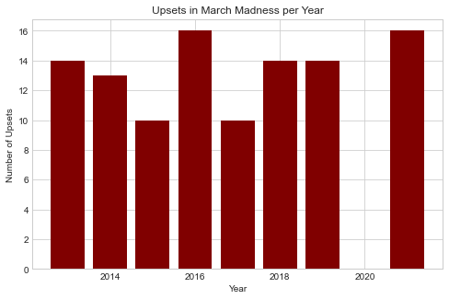
Second Goal: Upset classification
Most Times the better ranked team wins
Classification
Reduces noise and gives clear signal
Best bracket last year guessed 27/32 of first round correctly
3/5 of wrong Guess were upsets

Slide 5
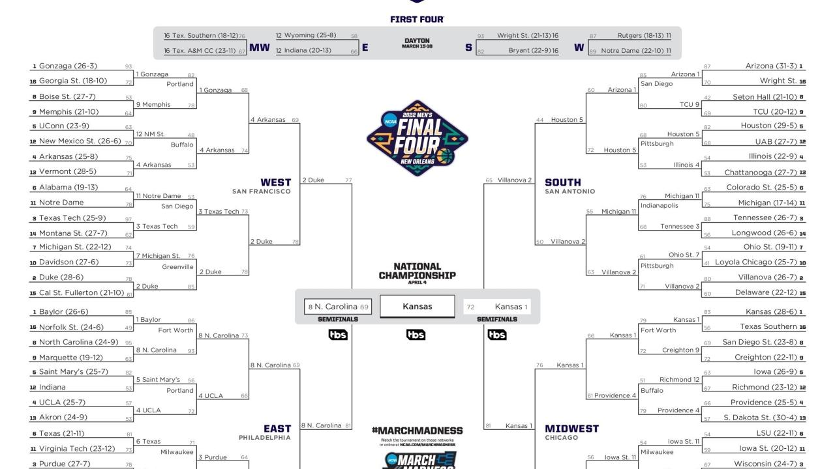
What is an Upset?

Slide 6
Method: Score Difference Regression
Linear Regression
XGBoost, Cart
Holistic, Sparse

Slide 7
Feature Importance and interpretation
Linear Regression
XGBoost, Cart
Holistic, Sparse

Slide 8
Method: Upset Classification
Logistic Regression
XGBoost and Cart Classification
Optimal Classification Tree

Slide 9
Feature Importance
Logistic Regression
XGBoost and Cart Classification
Optimal Classification Tree

Slide 10
Example Tree

Slide 11
REsults

Slide 12
Implications

