Slide 1
EM600B
June 2024

Slide 2
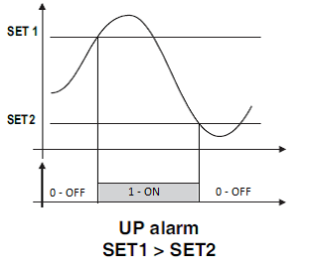
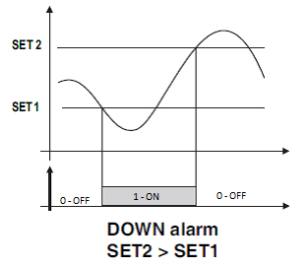
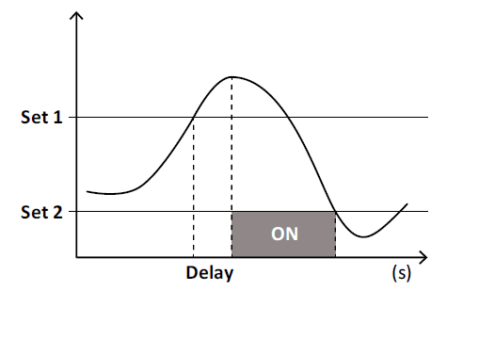
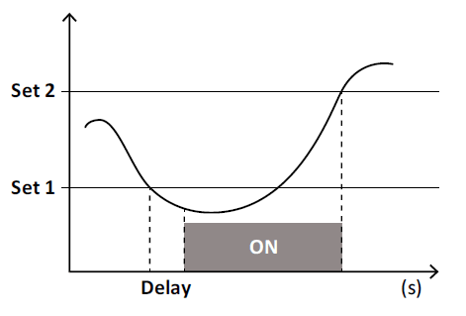
EM600B
Alarms module
4 alarms that can be linked to:
W_sys
VA_sys
VAR_sys
Power Factor system
I1, I2, I3
V1, V2, V3
V12, V23, V31
Frequency
W1, W2, W3

Slide 3
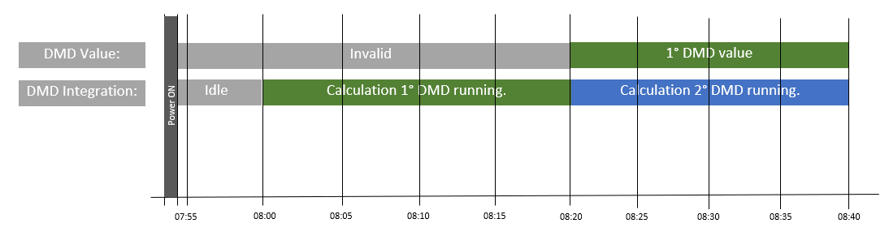
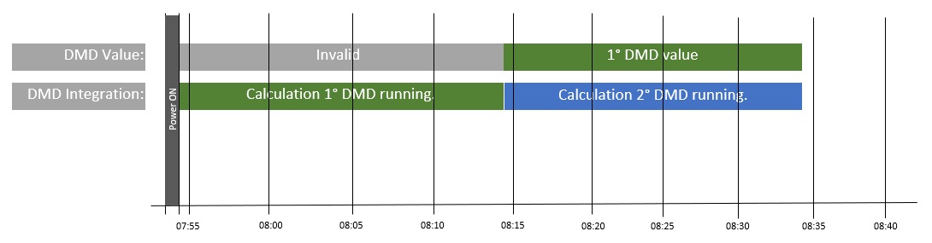
EM600B
DMD calculation module
RTC Synchronization: ON
DMD time interval = 20 minutes
DMD time interval:
1 minute
5 minutes
10 minutes
15 minutes
20 minutes
30 minutes
60 minutes
RTC Synchronization: OFF
DMD time interval = 20 minutes
Variables linked to DMD:
I1
I2
I3
W1
W2
W3
W_sys
VA_sys

Slide 4
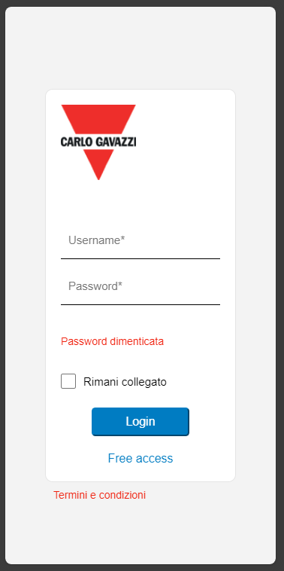
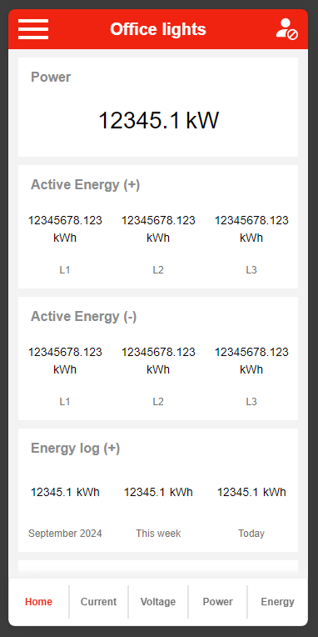
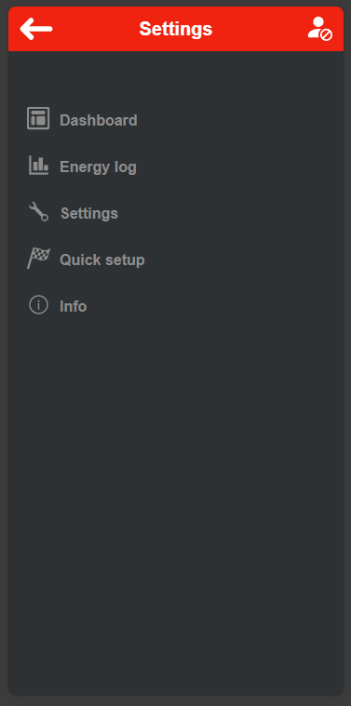
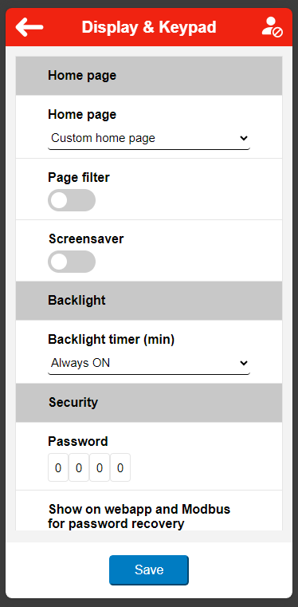
EM600B
Web Server

Slide 5
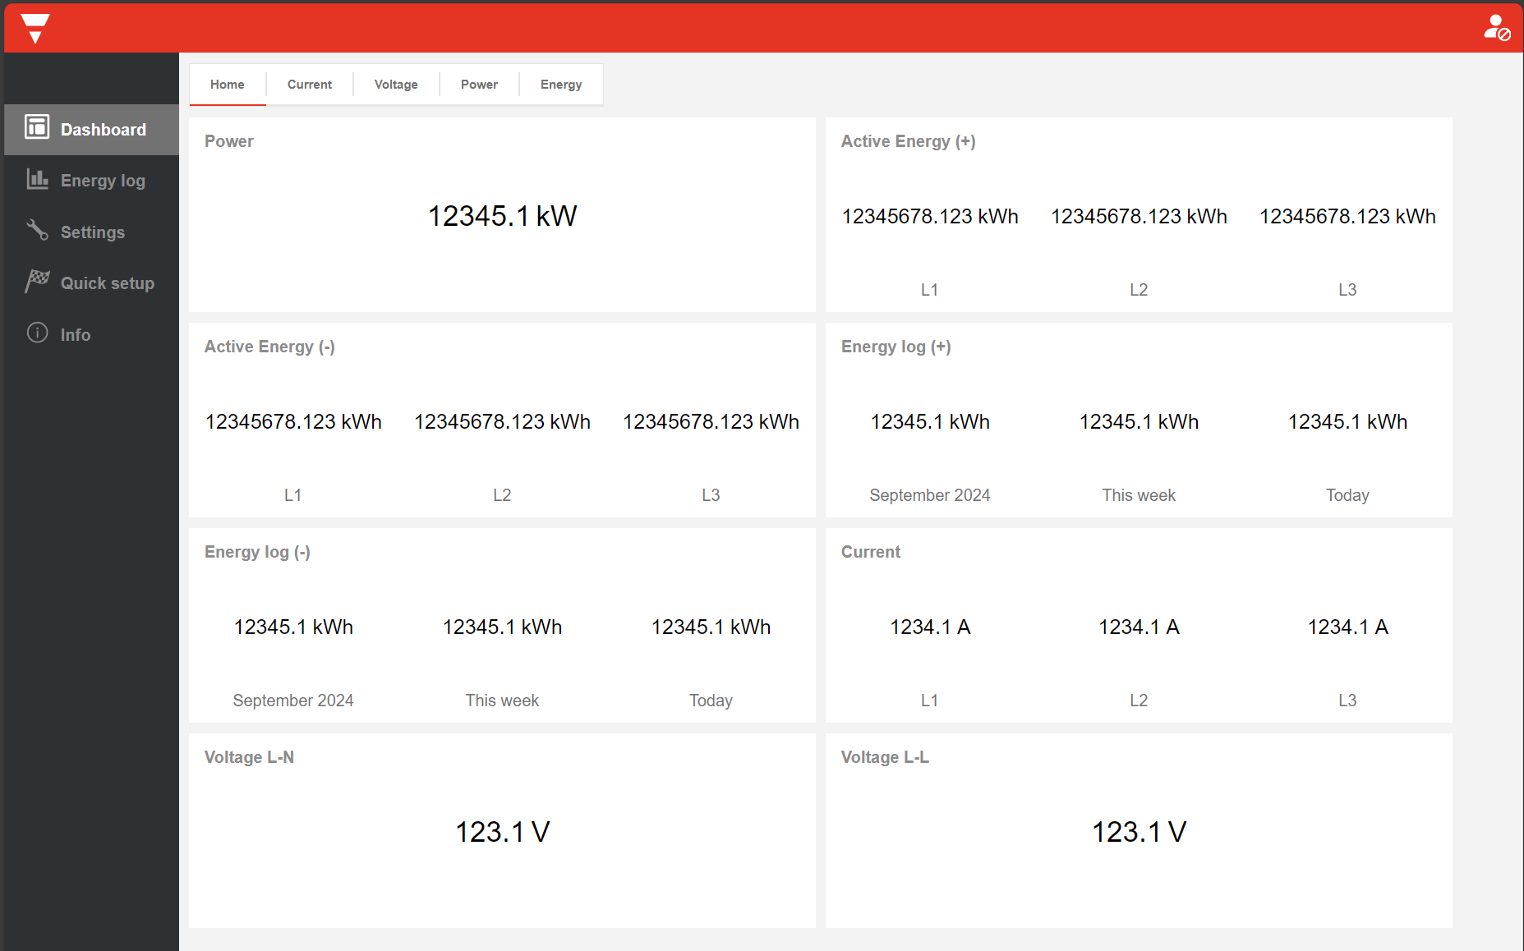
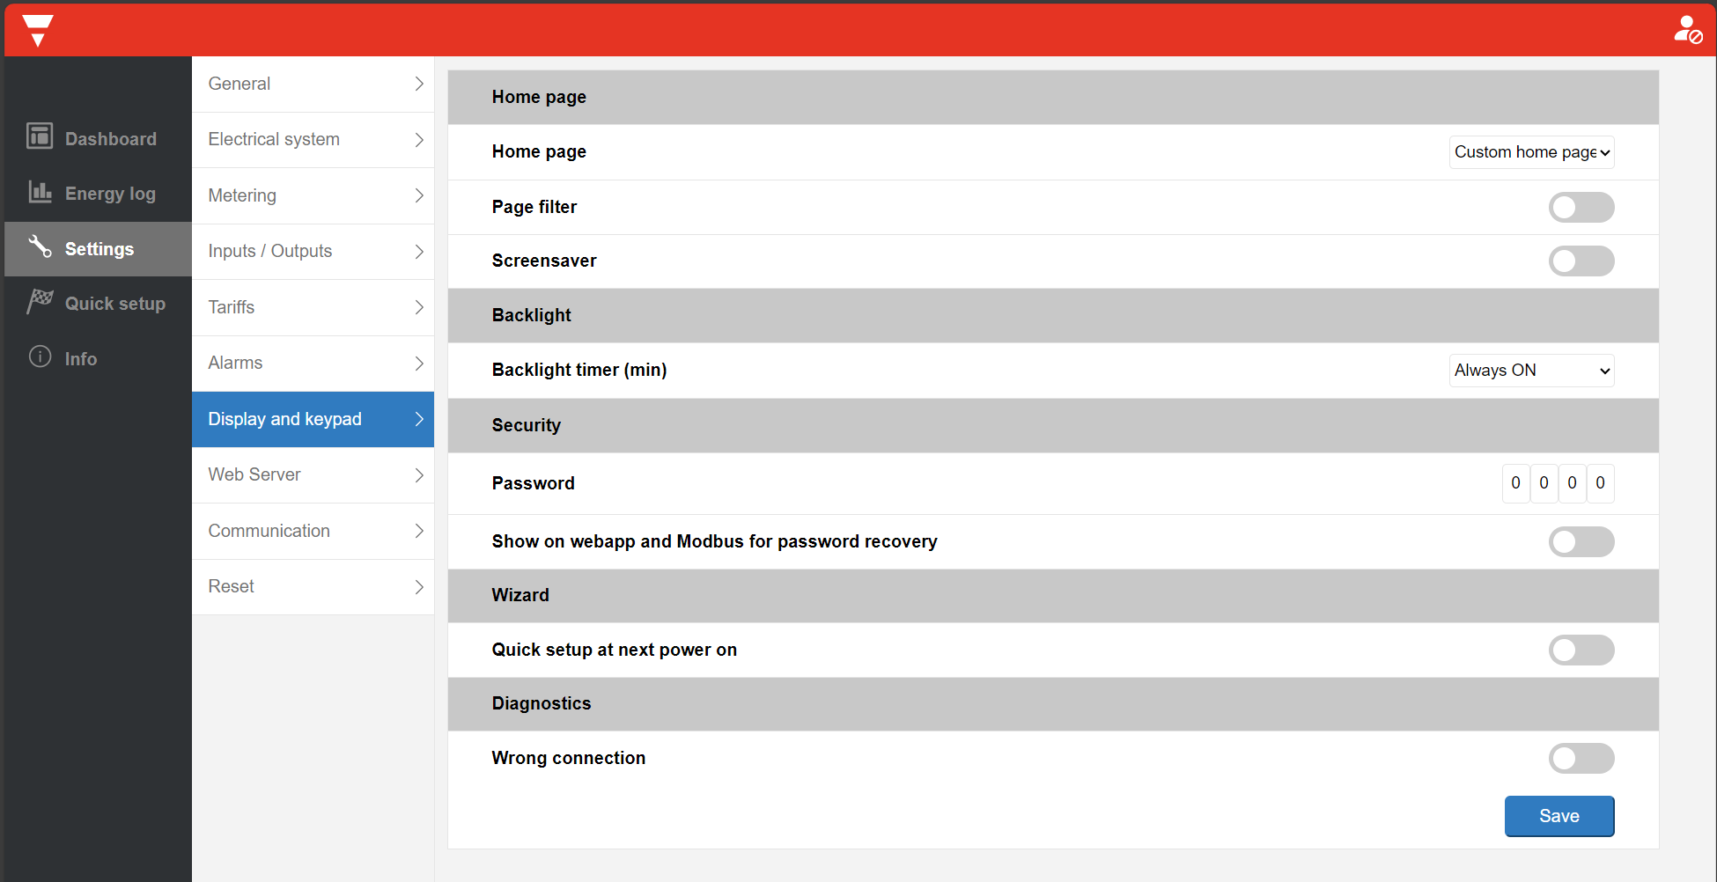
EM600B
Web Server

