Slide 1
Recording social preferences regarding Carbon Dioxide Removal (CDR) in agriculture Group discussion followed by a questionnaire
13.11.2024

Slide 2
Agenda
Thematic input (10 minutes)
Discussion (35 minutes)
Survey introduction (5 minutes)
Survey (30-40 minutes)

Slide 3
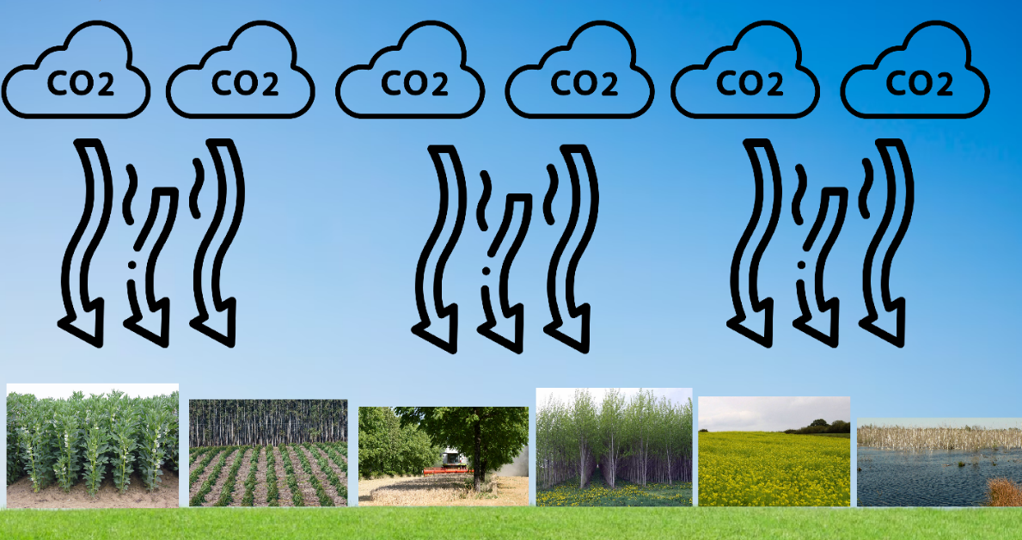
Thematic input Carbon Dioxide Removal (CDR) in general
CDR: engl. Carbon Dioxide Removal = Carbon dioxide is extracted from the air → serves climate protection, as carbon dioxide in the air acts as a greenhouse gas and contributes significantly to global warming
Source: Own depiction

Slide 4
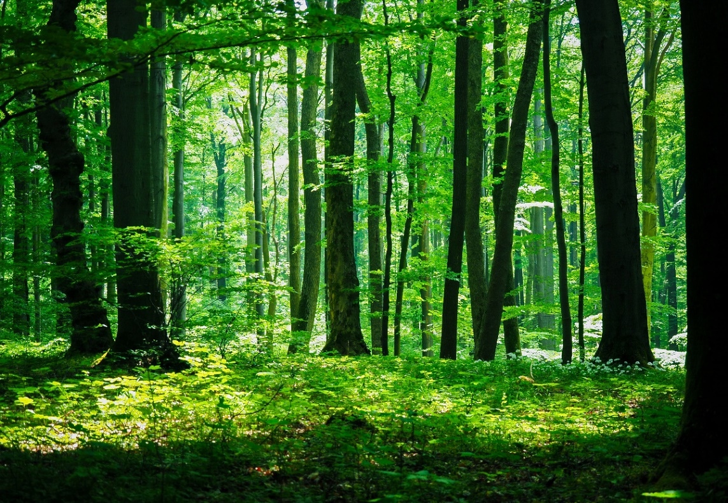
Thematic input Concrete methods
Afforestation
Source : Günter Hohensträter

Slide 5
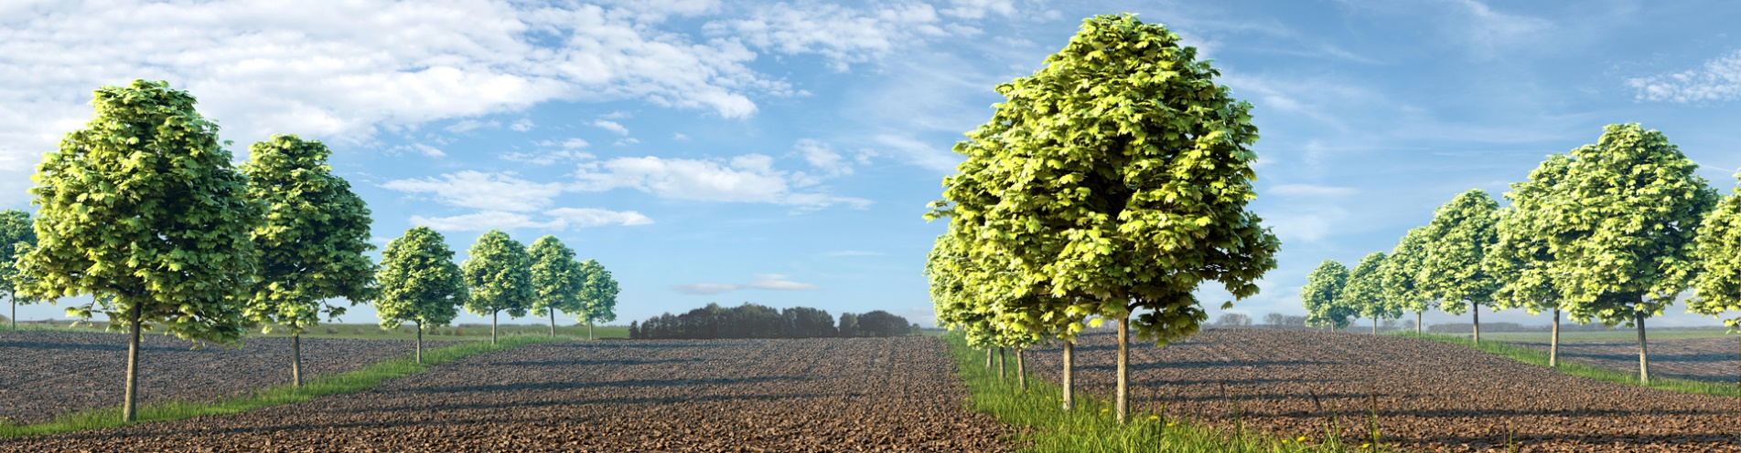
Thematic input Concrete methods
Afforestation
Agroforestry
Source : Biohof Garvsmuehlen

Slide 6
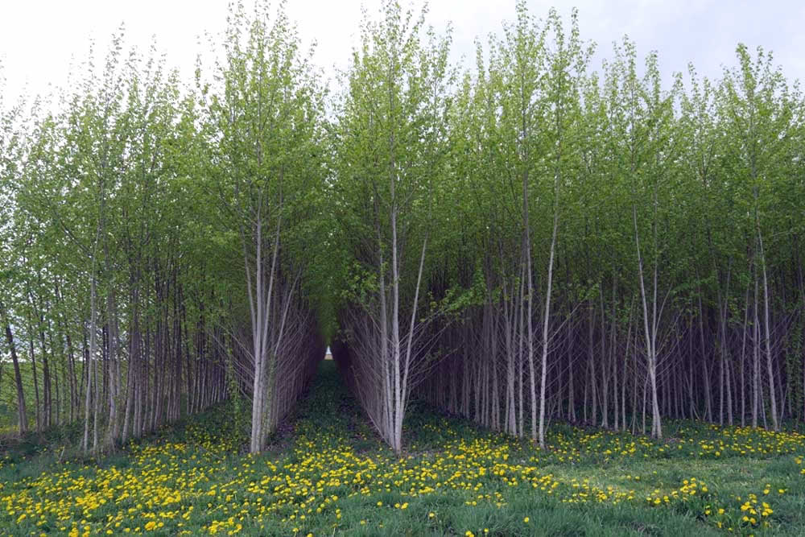
Thematic input Concrete methods
Afforestation
Agroforestry
Short rotation coppices
Source : Landesbetrieb Landwirtschaft Hessen

Slide 7
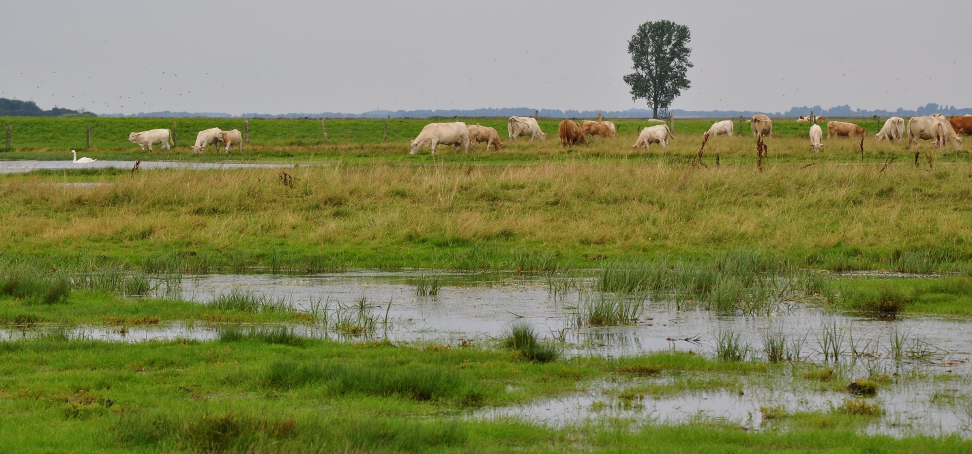
Thematic input Concrete methods
Afforestation
Agroforestry
Short rotation coppices
Rewetting
Source : Franziska Schmacka, Universität Greifswald

Slide 8
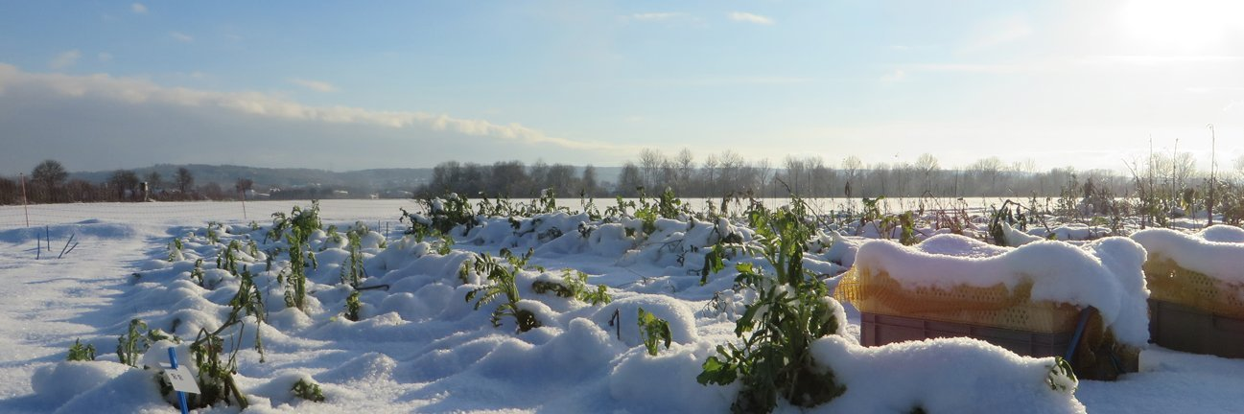
Thematic input Concrete methods
Afforestation
Agroforestry
Short rotation coppices
Rewetting
Cover cropping
Source : Isabelle Reinhard, Universität Bonn

Slide 9
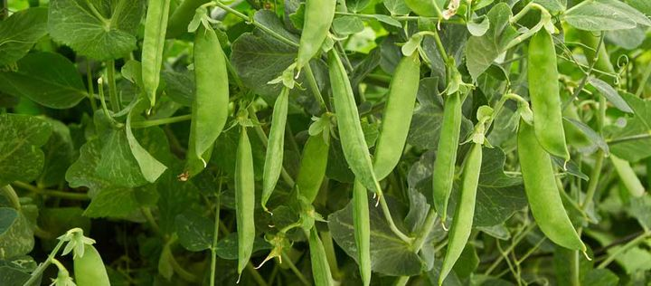
Thematic input Concrete methods
Afforestation
Agroforestry
Short rotation coppices
Rewetting
Cover cropping
Leguminous crops
Source : Vladyslav Siaber

Slide 10
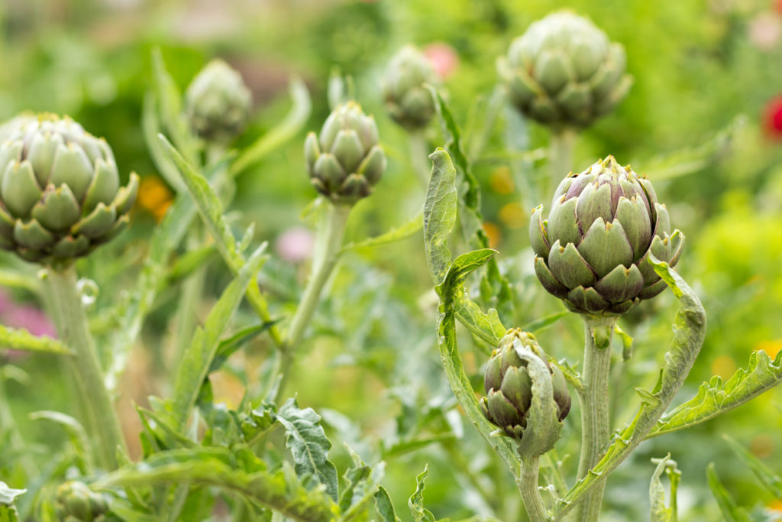
Thematic input Concrete methods
Afforestation
Agroforestry
Short rotation coppices
Rewetting
Cover cropping
Leguminous crops
Perennial crops
2022
2023
2024
Source : Guterboden.de

Slide 11
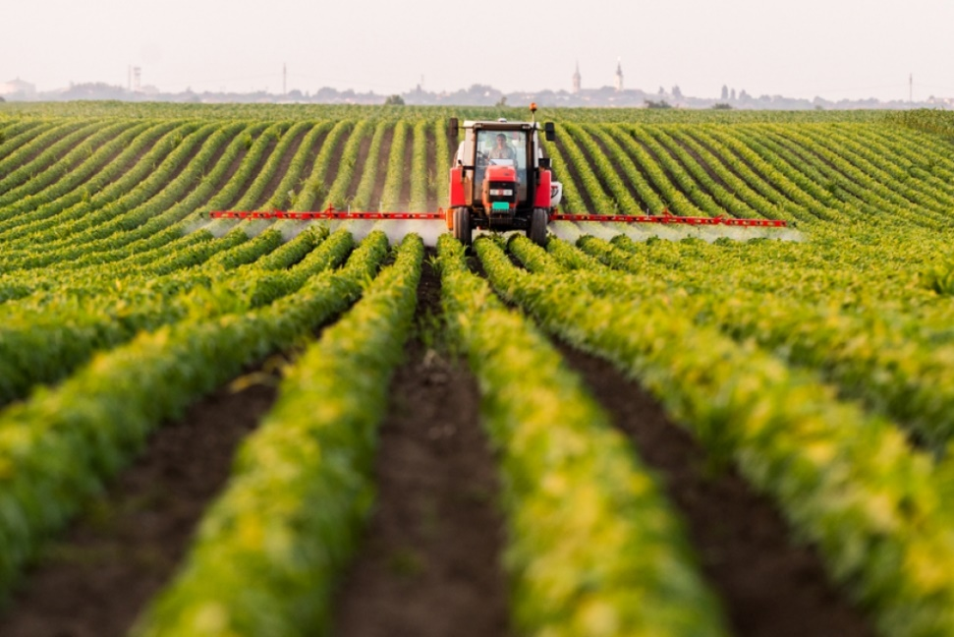
Thematic input Concrete methods
CDR-Methoden
Afforestation
Agroforestry
Short rotation coppices
Rewetting
Cover cropping
Leguminous crops
Perennial crops
„Traditional“ agricultural practice
Source : Gartenjournal.net

Slide 12
Thematic input Possible negative effects
„If carbon dioxide can be sucked out of the air anyway, why should we blow less of it into the air?”
CDR could reduce incentives to emit less carbon dioxide
Science comes to different conclusions as to whether this effect actually exists.

Slide 13
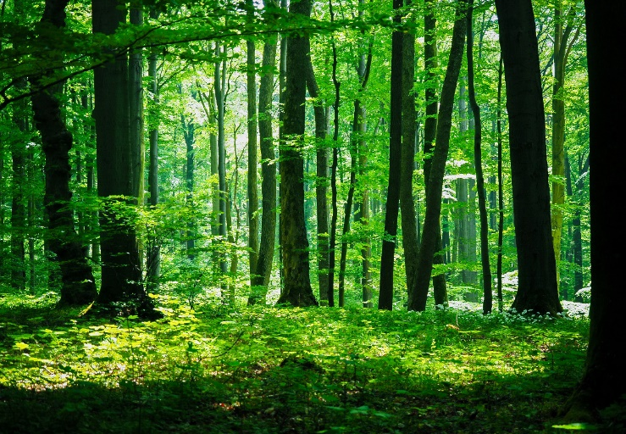
Thematic input Ecosystem services of CDR methods (example: forest)
Ecosystem = Living beings + inanimate nature → Ecosystem services = benefits that people derive from ecosystems
Better soil quality
Habitat for biodiversity
Trees provide shade
Leisure activities
(hiking, mushroom
collecting, hunting, etc.)
Windbreak
Prevention of soil erosion
Flood protection
Source : Günter Hohensträter

Slide 14
Thematic input Ecosystem services of the CDR methods
The provision of ecosystem services depends on various factors, such as
Site conditions (climate and weather conditions, human influence, soil quality, etc.)
How the methods are organised (e.g. mixed forests vs. monocultures)
→ There is uncertainty as to whether the ecosystem services that are intended to be achieved will actually be achieved by a particular measure.

Slide 15
Thematic input Costs of implementing the methods
Implementation of the methods can incur costs, such as
Actual expenses (e.g. for the planting and maintenance of trees),
Possible crop losses (and thus less income),
Reduction in land value (less income on disposal),
And possible others.

Slide 16
Discussion Task
How do you rate CDR in general? (1 minute speaking time per person)
Jointly draw up a ranking of CDR methods. Please argue why individual measures are better than others in your opinion. (20 minutes time)

Slide 17
Discussion First task
How do you rate CDR in general? Why?
(1 minute speaking time per person)

Slide 18
Discussion Second task
Together with the other participants, please draw up a ranking of the CDR methods presented.
Please argue why you think individual methods are better than others
(25 minutes time)

Slide 19
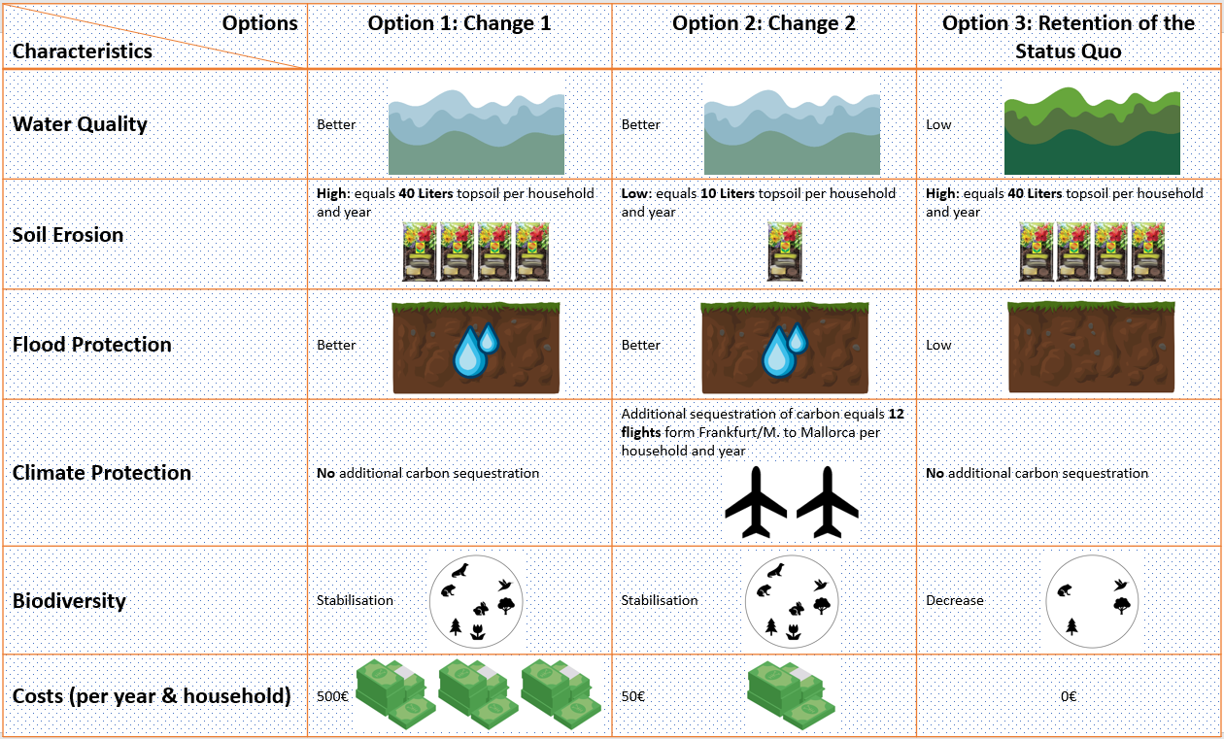
Survey introduction Choice experiment
Questionnaire consists of several parts, including the selection experiment
Example:
→ Please imagine that the federal government is planning a draft law that pays farmers for providing services that are beneficial to the environment, such as improving water quality.
→ The programme would be financed from tax revenue. This means that you would pay directly for the implementation of your preferred option.

Slide 20
Survey introduction Choice experiment
There will be a total of 18 such tables. Please choose one of the three options for each table. Please decide freely and independently of the previous tables and according to your own preferences. In particular, please bear in mind that you do not have to pay any money for your choice in the previous tables, as only the choice of option in the current table counts. It is also important that your choice is realistic. So please think carefully about the amount of money your household is able and willing to pay.

Slide 21
References
https://www.biohof-garvsmuehlen.de/agroforst https://www.bzfe.de/lebensmittel/vom-acker-bis-zum-teller/huelsenfruechte/huelsenfruechte-erzeugung/ https://www.gartenjournal.net/monokultur https://guterboden.de/artischocke-mehrjaehrig https://llh.hessen.de/umwelt/biorohstoffnutzung/energetische-nutzung/thermische-nutzung/feldtag-kurzumtriebsplantagen-ein-rueckblick/ https://naturfotografen-forum.de/o1515086-Im%20gr%C3%BCnen%20Wald https://www.oekolandbau.de/boeln-forschung/forschungsergebnisse/eip-forschungsergebnisse/naehrstoffmanagement-und-langfristig-gesicherte-ertragssteigerung-in-oekologischen-marktfruchtbetrieben/ https://www.uni-greifswald.de/universitaet/information/aktuelles/detail/n/wiedervernaessung-von-mooren-internationale-konferenz-an-der-universitaet-rostock-51021/

