Slide 1
Airline Passenger Satisfaction Project
Analysis & Deployment

Slide 2
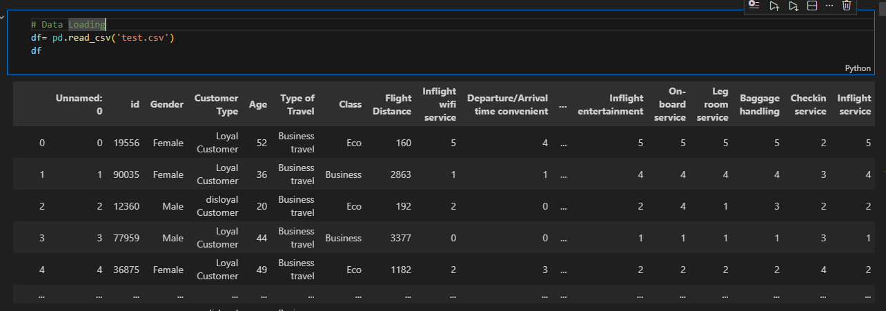
Data Analysis Steps
  1. Load and inspect dataset

Slide 3
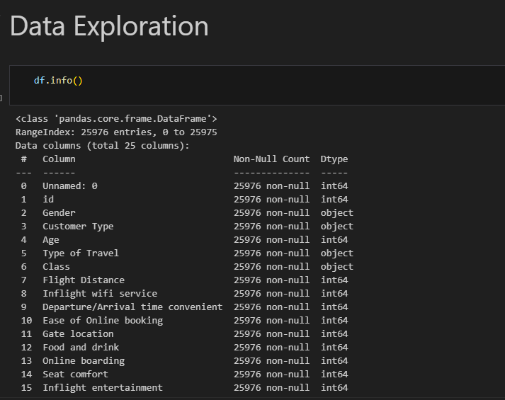
2- Data Exploration

Slide 4
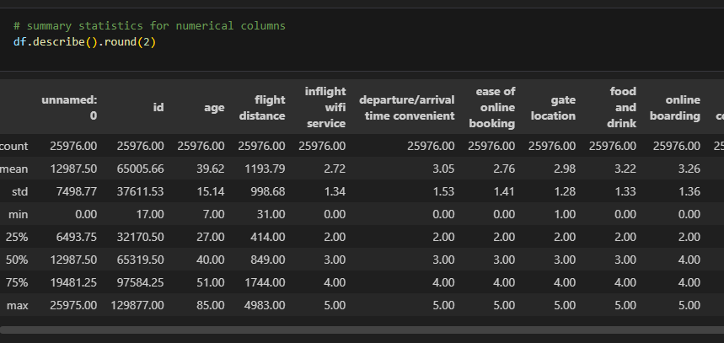
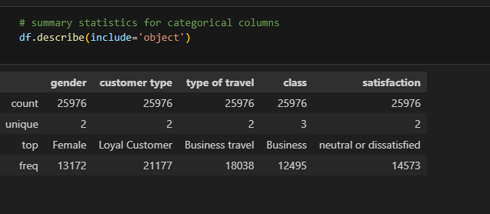
Check summary statistics

Slide 5
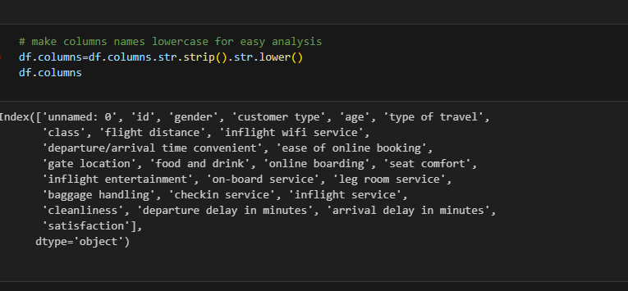
  3. Clean data (drop unwanted columns, fix data types, remove duplicates)

Slide 6
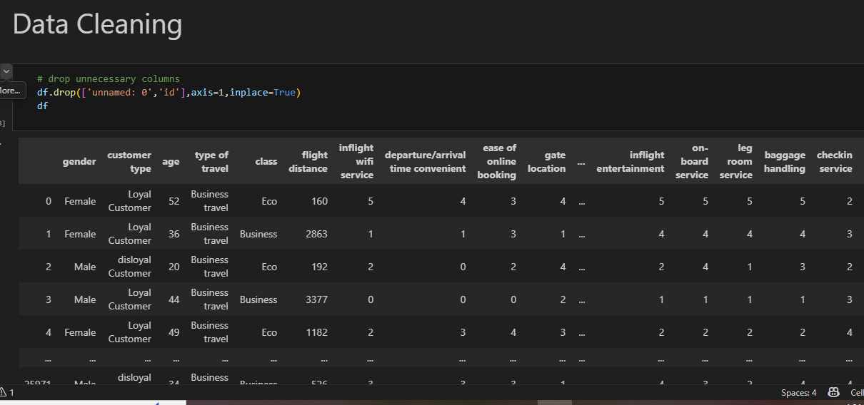
Drop unnecessary columns

Slide 7
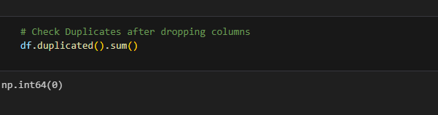
Check for duplicates

Slide 8
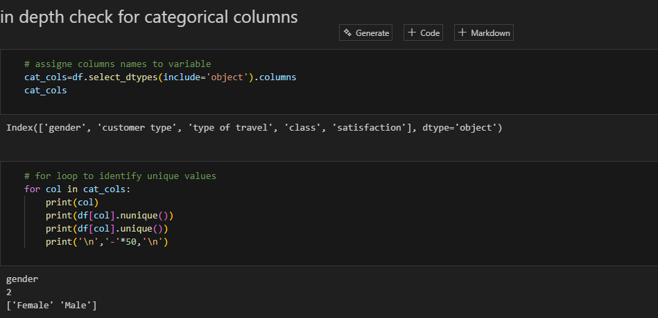
In depth check (categorical)

Slide 9
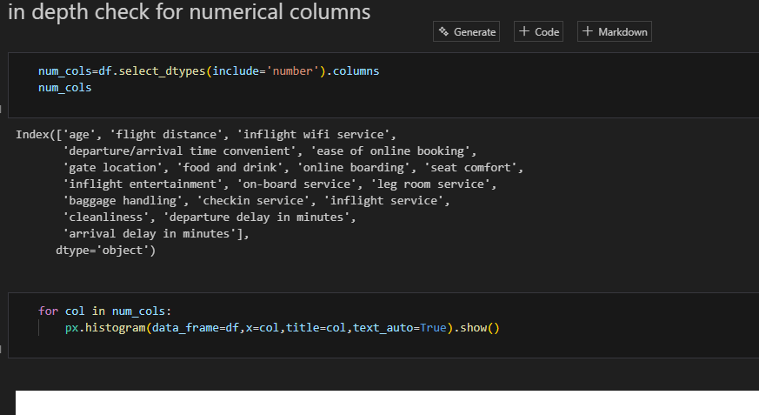
In depth check (numerical)

Slide 10
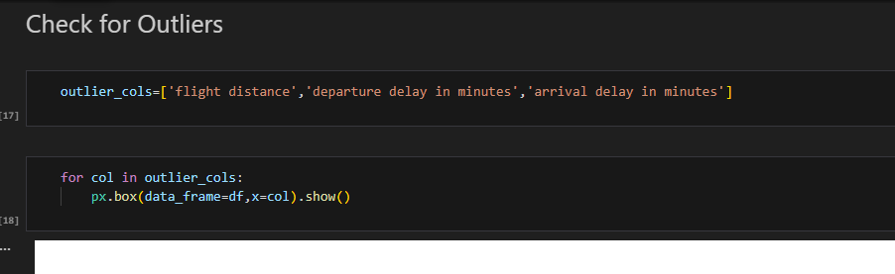
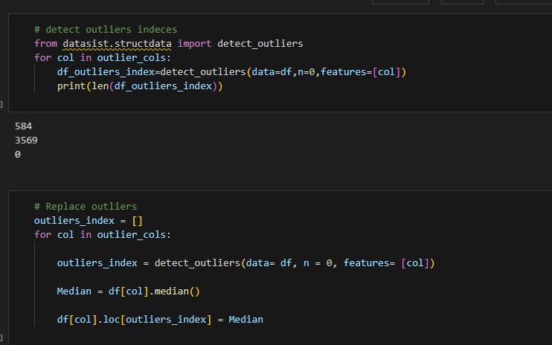
4. Handle outliers using median replacement

Slide 11
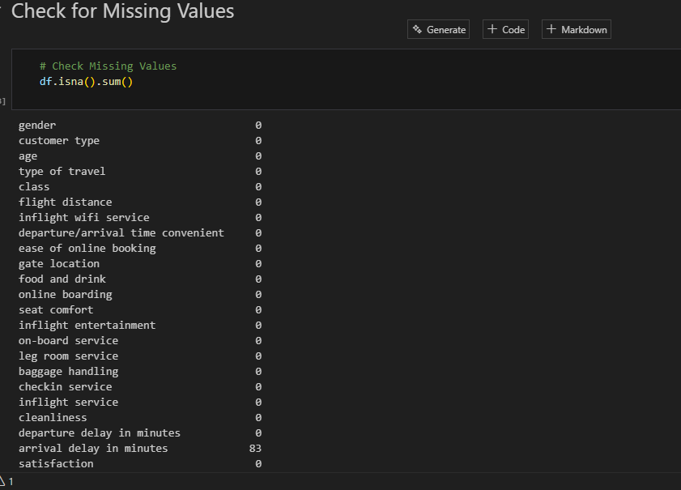
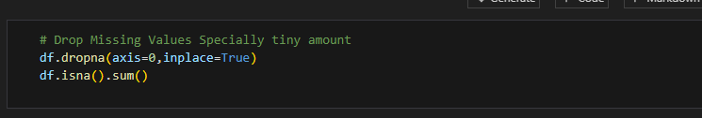
5. Check missing values

Slide 12
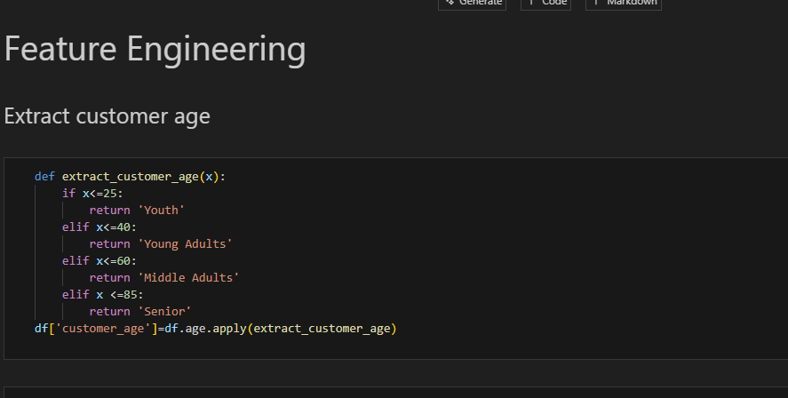
6. Feature engineering (customer age groups)

Slide 13
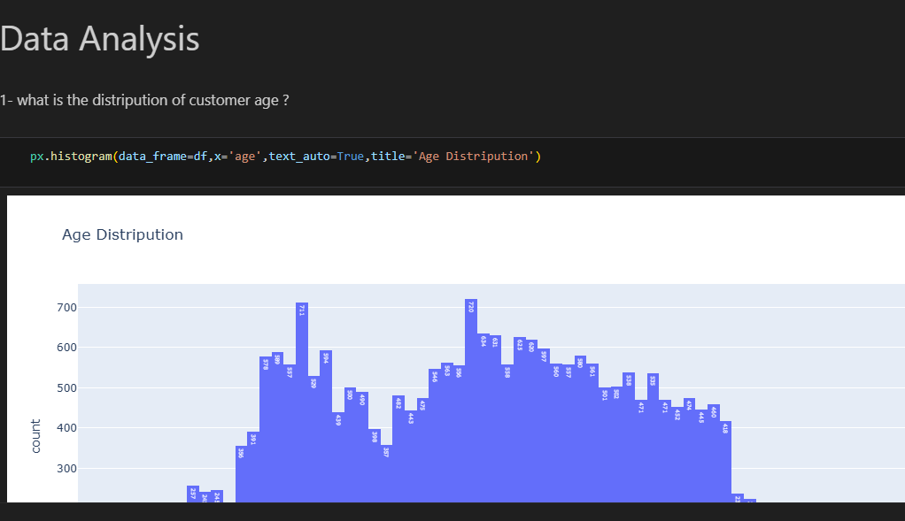
7. Perform EDA (histograms, pie charts, bar charts)

Slide 14
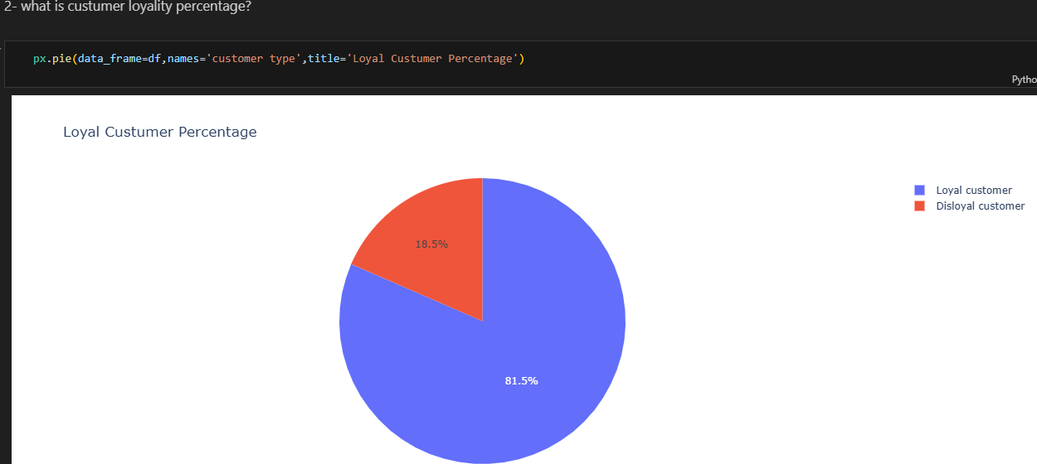
Analysis questions

Slide 15
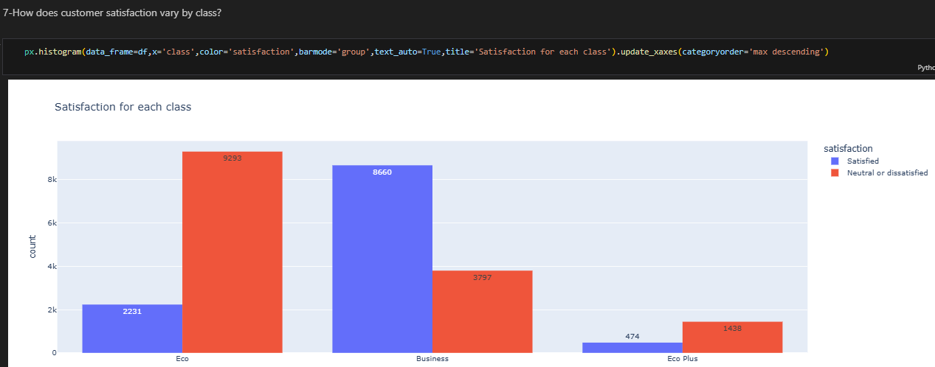
Q.2

Slide 16
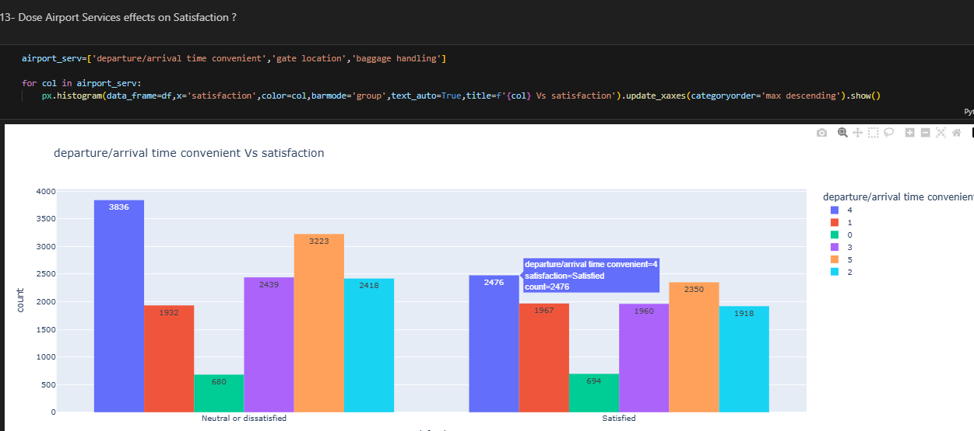
Q.3

Slide 17
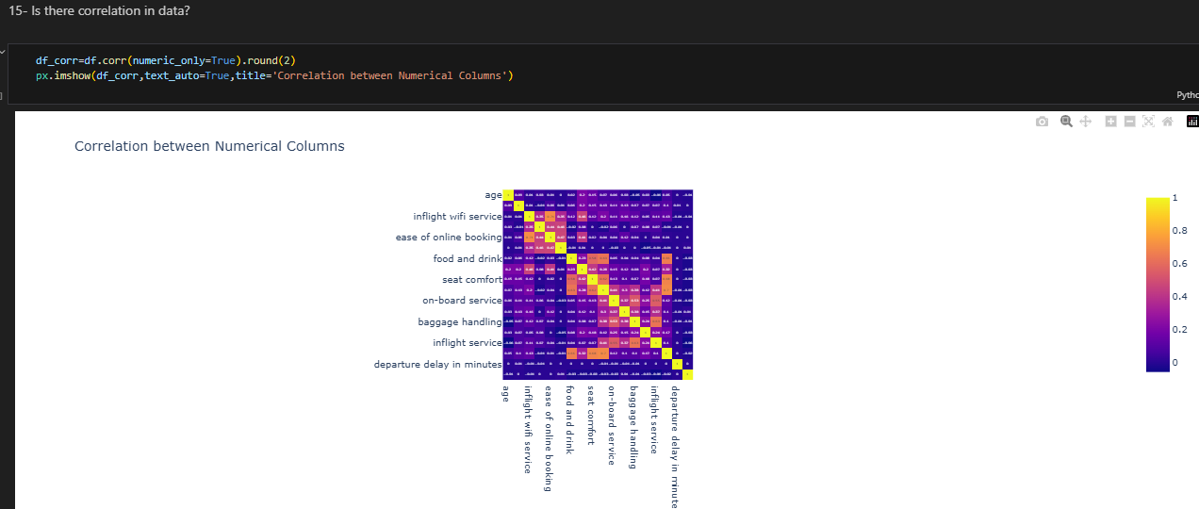
8. Check correlations

Slide 18
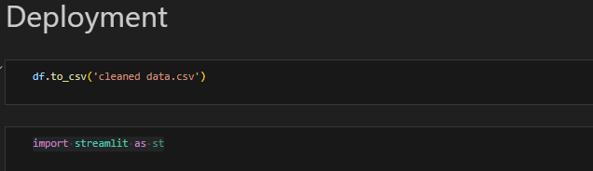
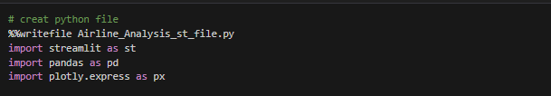
Deployment Steps
  1. Create Streamlit file (app.py)

Slide 19
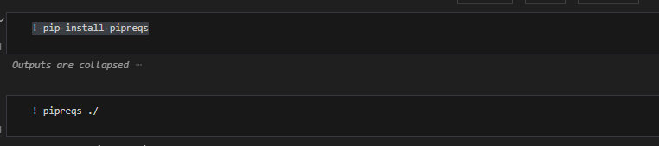
  2. Generate requirements.txt using pipreqs

Slide 20
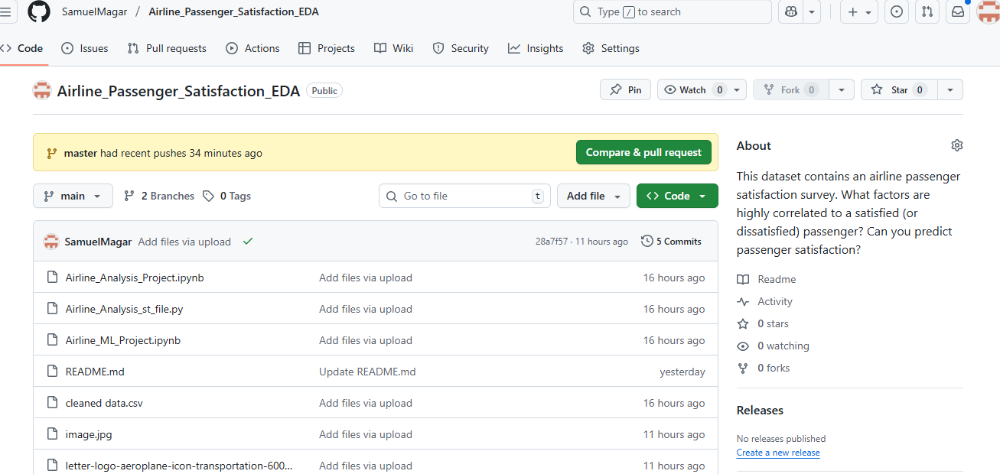
3. Upload project to GitHub

Slide 21
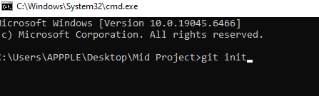
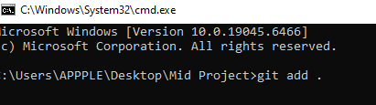

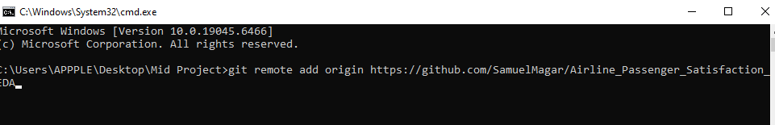
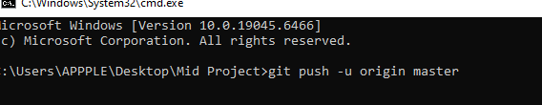
5. Connect your GitHub repository

Slide 22
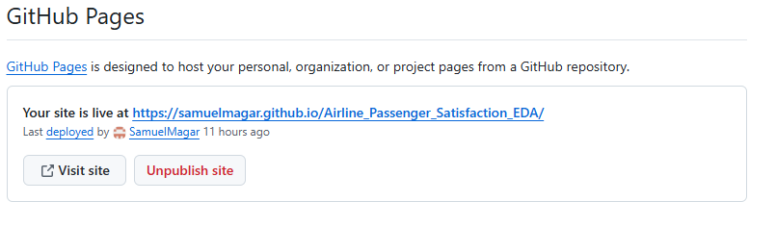
7. Deploy and obtain global link

