Slide 1
Bitcoin Analysis

Slide 2
Raw Data
4 CSV files:
btc_usd: raw data from bitcoin over time by minute from 2012 to 2017
btc_hacks: data related to reported hacks
S&P500 and NASDAQ: files with data over time for those indicators

Slide 3
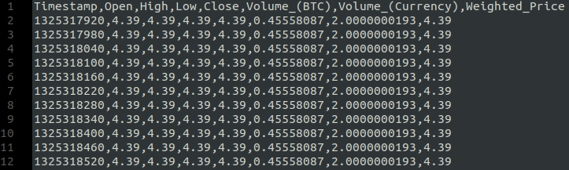
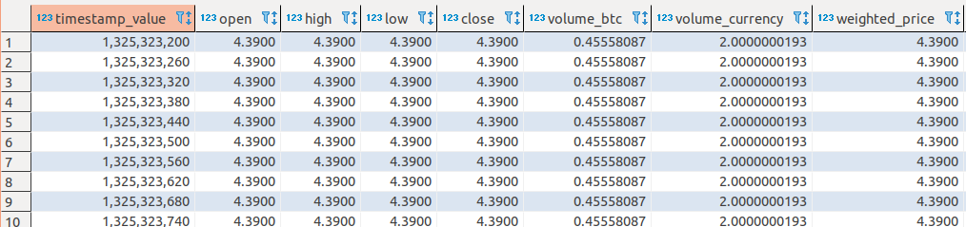
Data importing from csv to PostgreSQL
Data imported from flat file to a DB.
Helps accessing and save data transformation intermedium steps
This is done for all 4 CSVs each to a table.

Slide 4
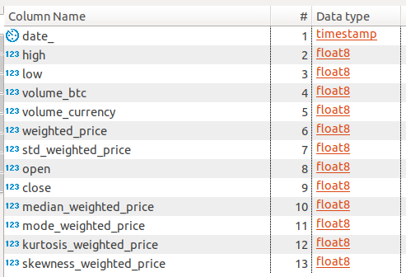
btc_usd: Preprocessing
Convert timestamp to datetime
Resample data from by min to by day:
Low = min(low)
High = max(high)
Volume = sum(volume)
Value = mean(value)
Open = first(open)
Close = last(close)
Created some statistics about the day:
Median, mode, standard deviation, kurtosis and skewness

Slide 5
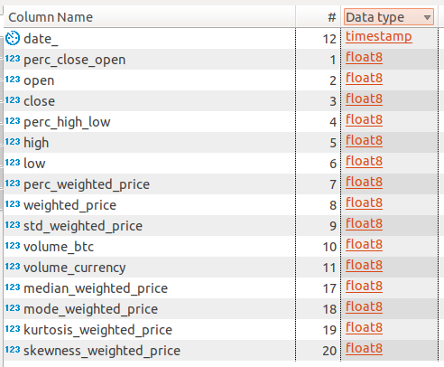
btc_usd: Processing
Create some ratio variables:
A ratio between the high and low in the day
A ratio between the open and close value
A ratio between today and yesterday mean value

Slide 6
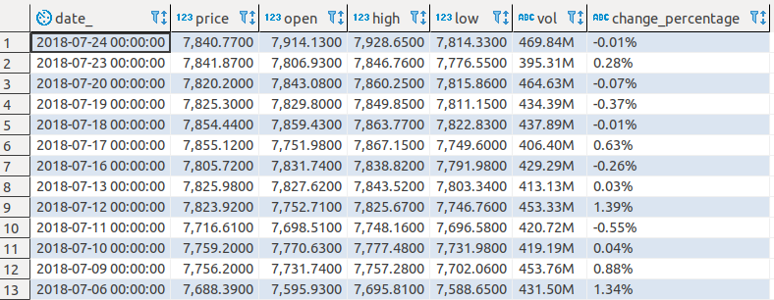
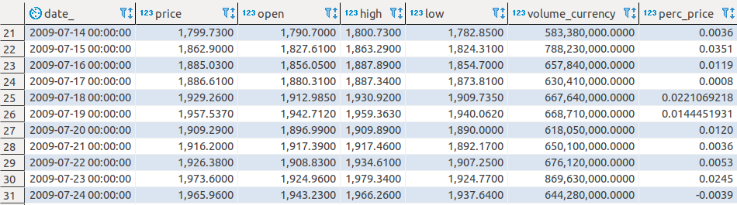
NASDAQ and sp500: Preprocessing
Clean and convert some variables:
Vol
Change_percentage
Resample daily to be able to fill weekends
Created some ratios:
A ratio between the high and low in the day
A ratio between today and yesterday mean value

Slide 7
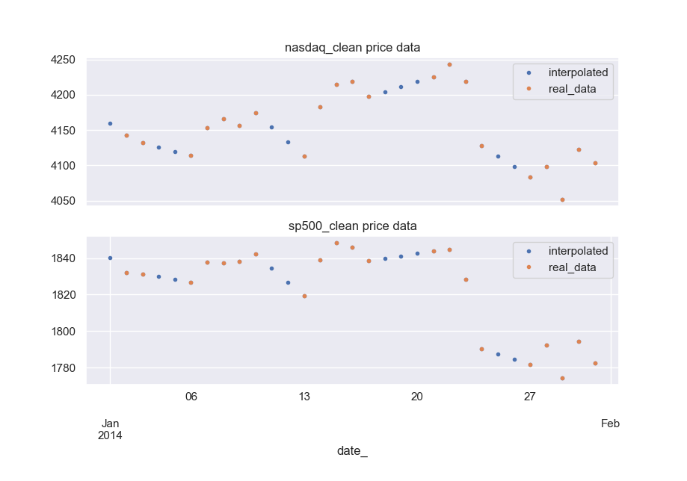
NASDAQ and sp500: weekends
1st approach: interpolation
Suffers from data leakage because we need next Monday
2nd approach: linear regression using last 5 days

Slide 8
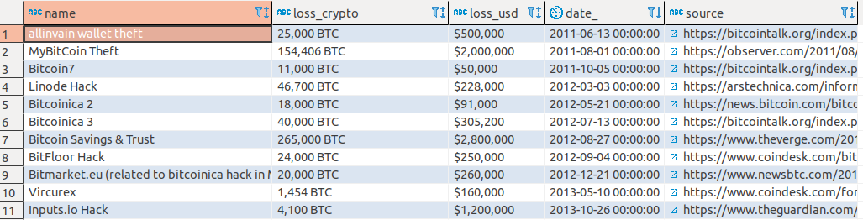
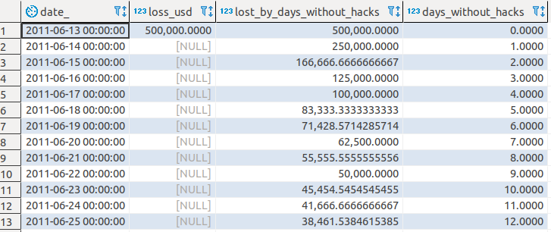
btc_hacks: Preprocessing
Cleaning loss_usd
Resample:
Create a variable to count days since the last hack
Create a variable which is the value of the last hack divided by the days without hacks

Slide 9
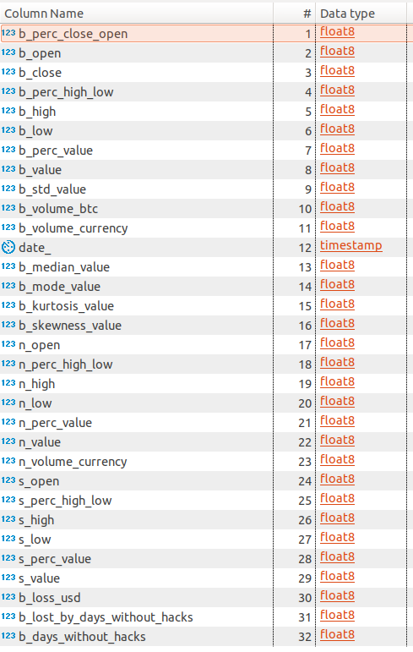
Data fusion in one table
Data is then joined in one table using the date as a global key.
Adding prefixes to avoid columns with the same name:
b_: btc_usd and btc_hacks
s_: sp500
n_: nasdaq

Slide 10
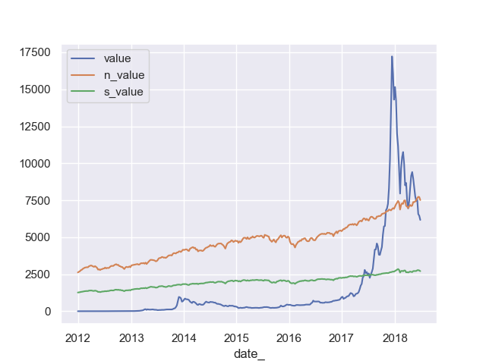
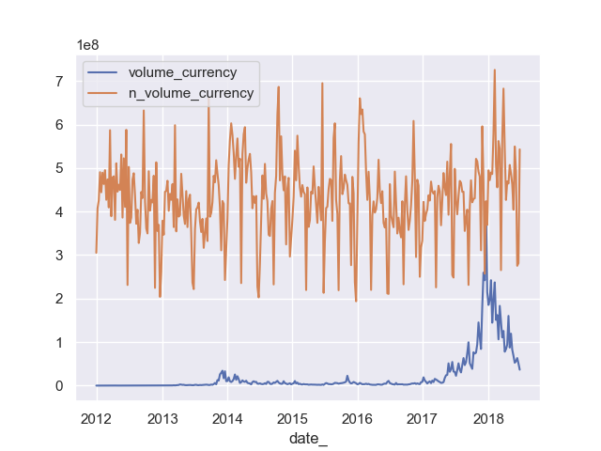
Dataset analysis
Bitcoin value vs stock value
Bitcoin volume vs Nasdaq Volume

Slide 11
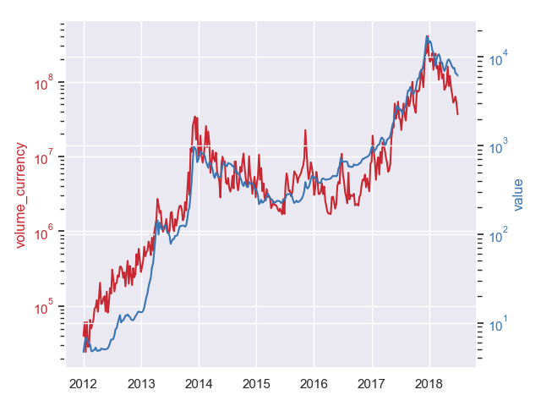
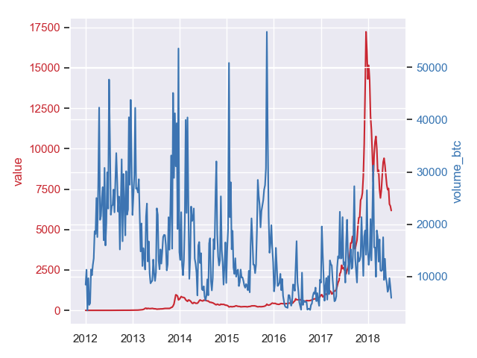
Bitcoin value vs volume
Vs volume in currency
Vs volume in btc units

Slide 12
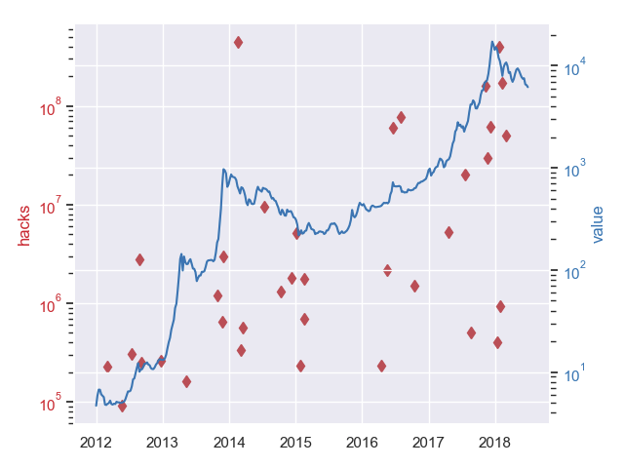
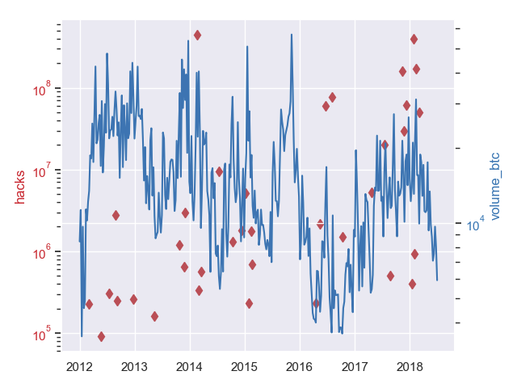
Bitcoin vs Hacks
Value vs Hacks
Volume in btc vs hacks

Slide 13
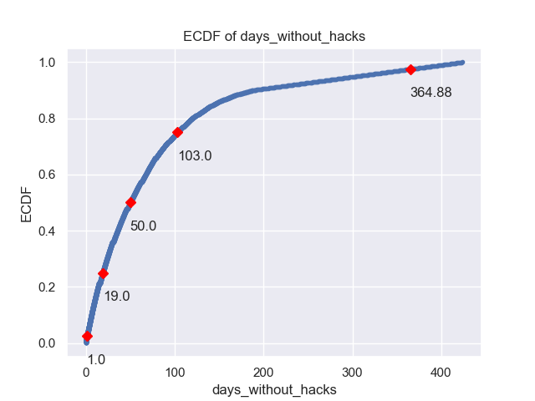
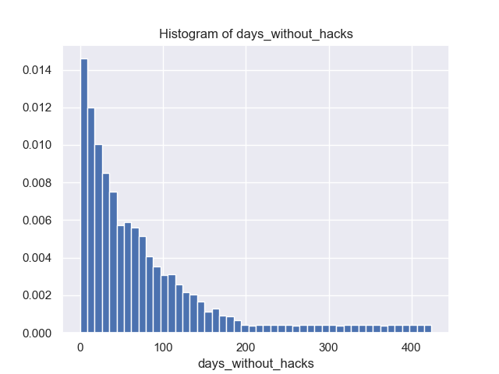
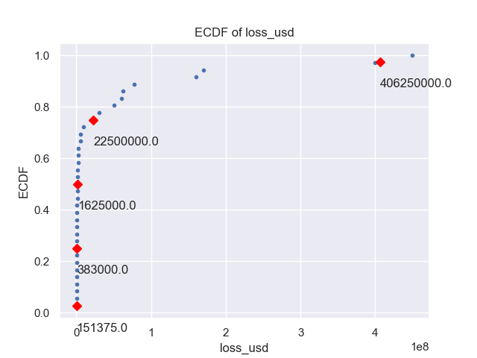
Bitcoin vs Hacks

Slide 14
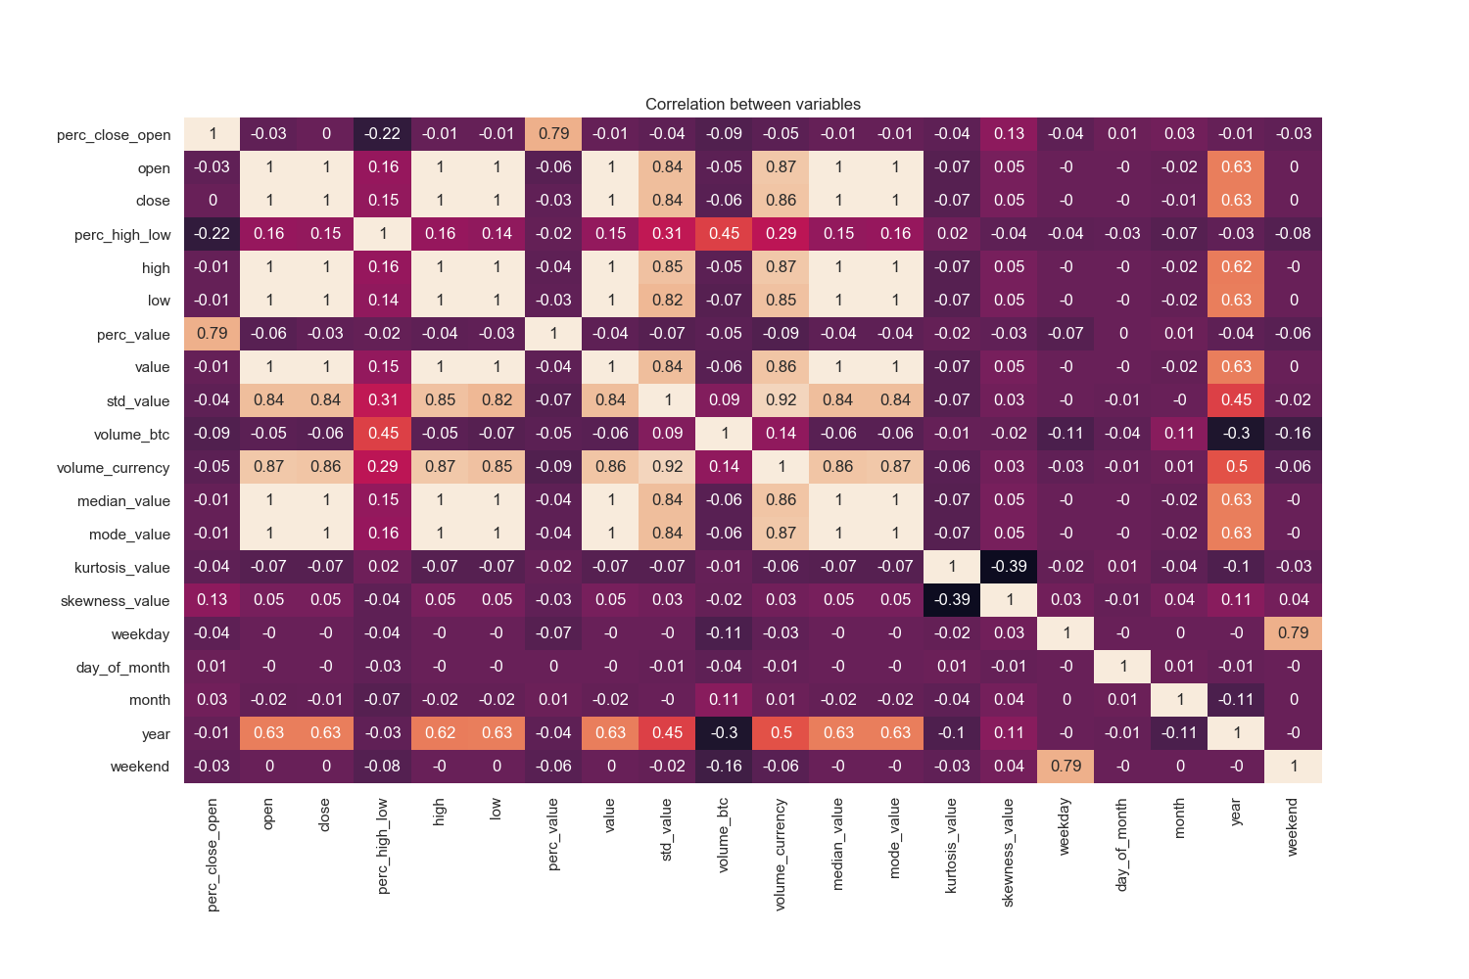
Correlation

Slide 15
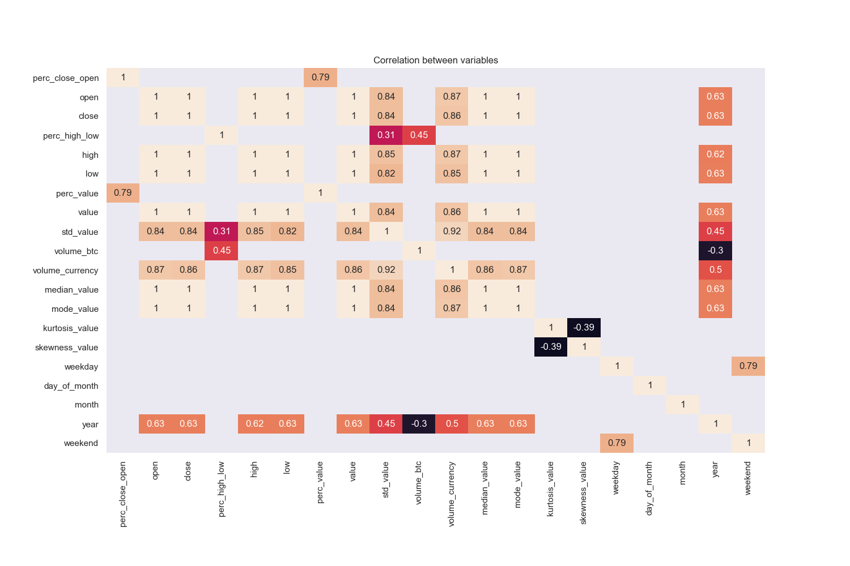
Correlation

Slide 16
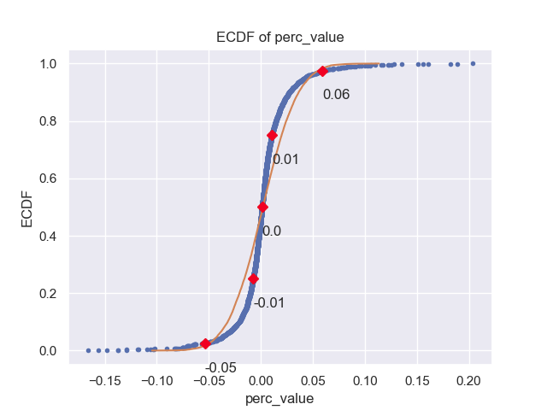
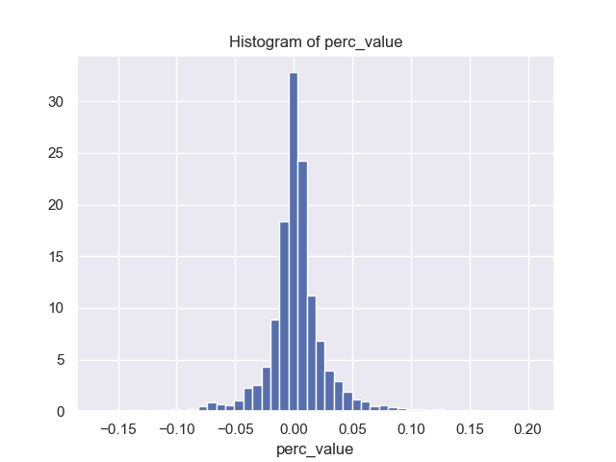
Bitcoin change in value by day

Slide 17
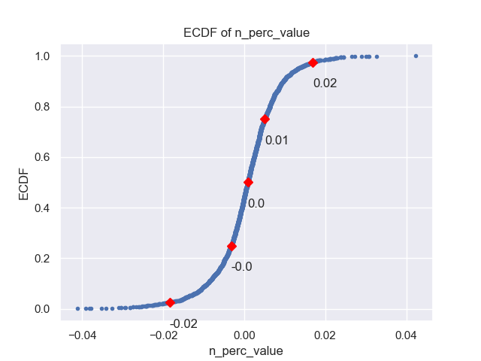
Bitcoin vs Nasdaq change value

Slide 18
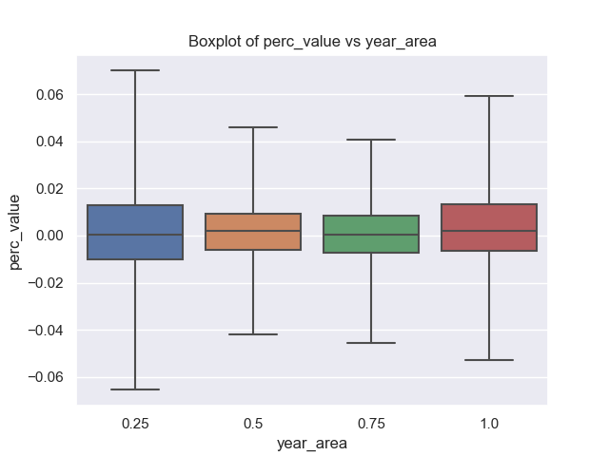
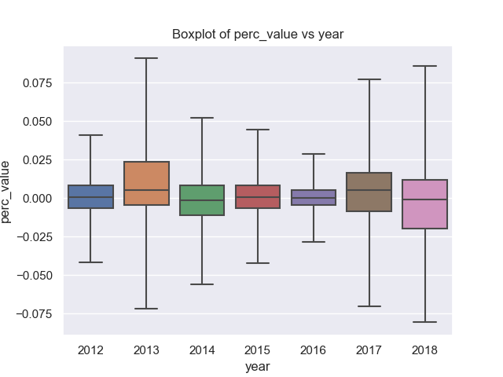
Bitcoin change value by aggregation
By year area
By year value

Slide 19
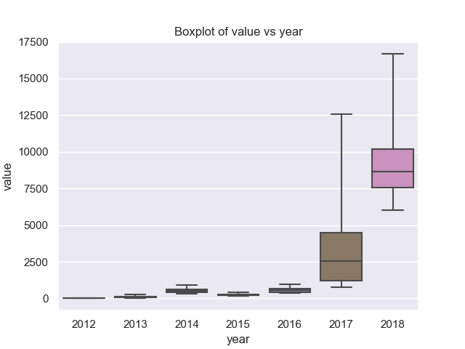
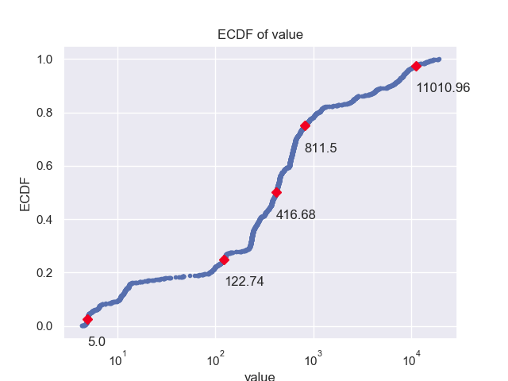
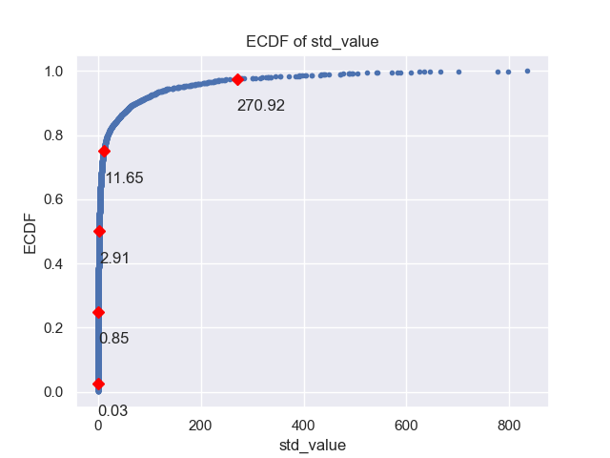
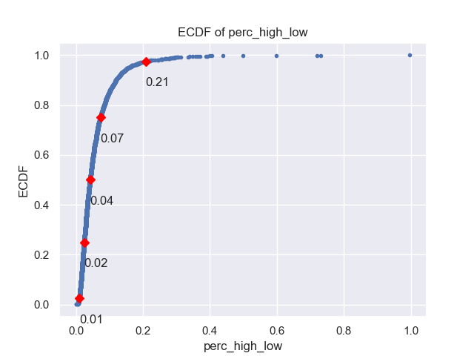
Bitcoin value

Slide 20
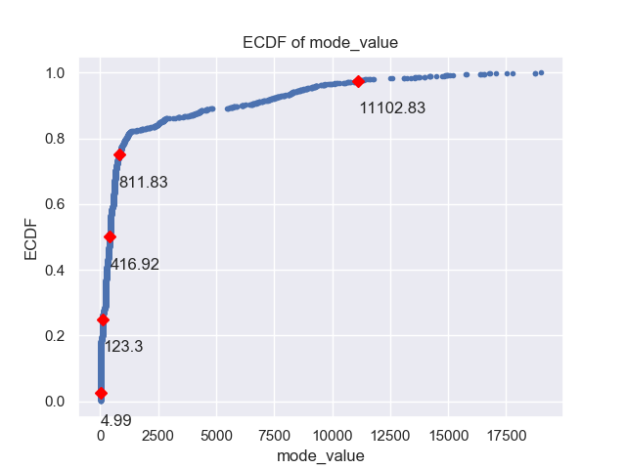
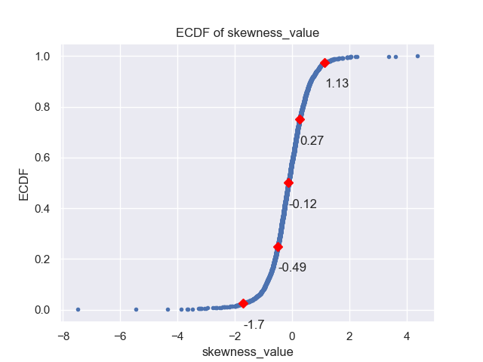
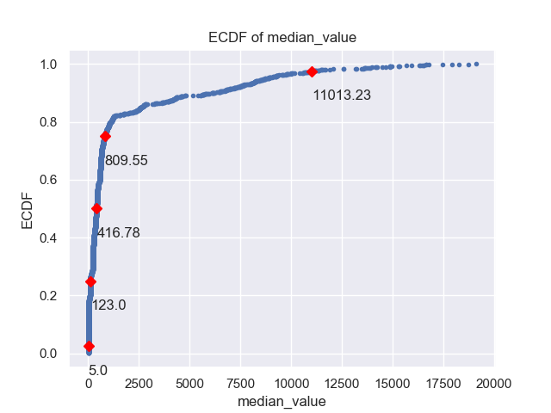
Bitcoin: Skewness

Slide 21
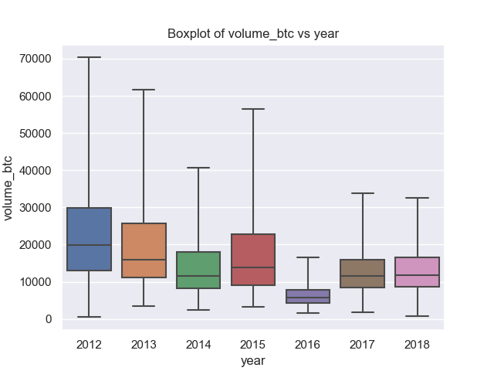
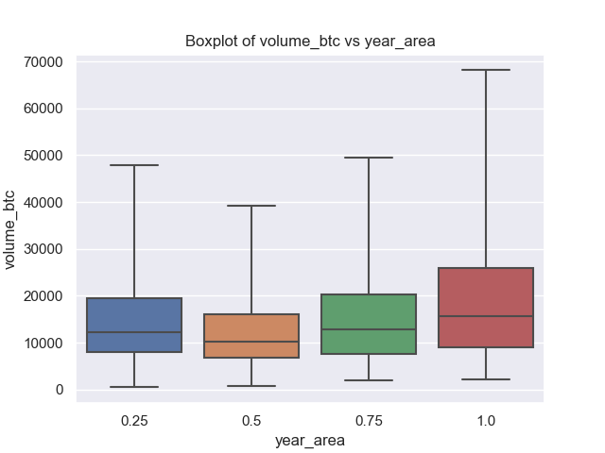
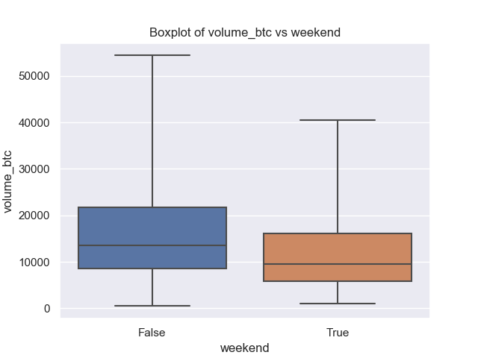
Bitcoin: volume

