Slide 1
Enhancing Network Efficiency : Integration of MAC protocol using dynamic bandwidth allocation AND Selective repeat with cumulative acknowledgement
Harry Pu
Samuel Ning

Slide 2

Motivation: MAC protocols integration
MAC protocols operates in DATA LINK layer.
Control how devices share the same medium.
Notes:
Now we will MAC protocols,, operate in the data link layer. Their primary purpose is to define how devices share the same medium effectively

Slide 3
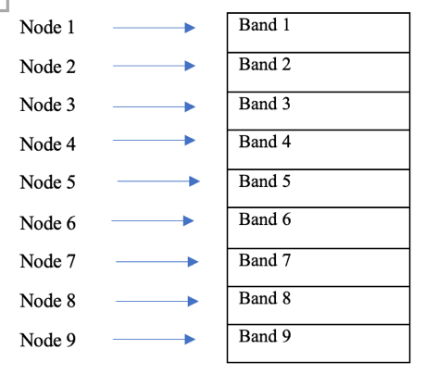
Motivation: MAC protocols integration
FDMA (Frequency Division Multiple Access)
Drawback: Unused Bandwidth
Notes:
FDMA is a type of MAC protocol that allows multiple devices to transmit at the same time by dividing the channel into different frequencies. However, there can in unused bandwidth and lead to lower efficiency.

Slide 4
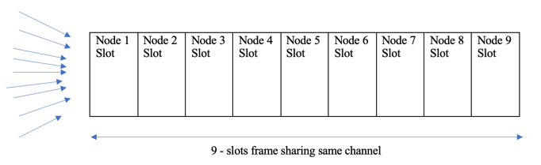
Motivation: MAC protocols integration
TDMA (Frequency Division Multiple Access)
Drawback: Inactive time slot.
Notes:
TDMA supports multiple accesss by allocating time slots to different devices in a cyclic manner. But TDMA also suffers from wasted resources due to inactive devices holding up the bandwidth during their time slot.

Slide 5
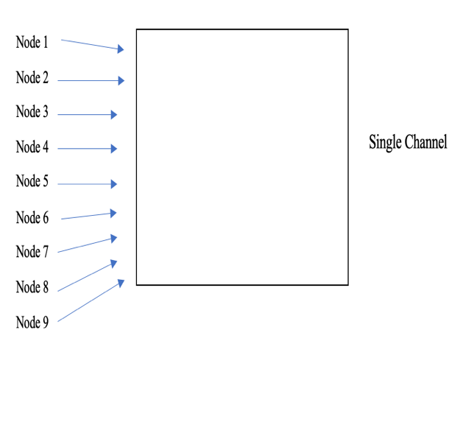
Motivation: MAC protocols integration
Random Access
Drawback: Higher collisions with large number of devices.
Notes:
Although the random access protocol does not waste any bandwidth, an increased number of devices can result in more collisions and lead to inefficiency

Slide 6
Motivation: MAC protocols integration
Attempt to improve transmission efficiency and throughput:
A mechanism that allocates bandwidth resource dynamically to different devices based on each device's bandwidth requirement.
Notes:
To effectively use the channel's bandwidth, and to improve the overall throughput, we need a mechanism that allocates bandwidth dynamically , based on device's bandwidth requirement

Slide 7
Motivation: MAC protocols integration
But how to know each devices bandwidth requirement?
Not a focus of this project. We assume it’s already known.
Possible solutions:
RNN machine learning, statistical model, AI…
Notes:
But how can we know each device's bandwisth requriement? We assume it is already known in this project.
We can use RNN machine learning to process device's short term traffic data, and make prediction of their bandwidth usage. In addition, we can also use AI or statictical model to make the prediction.

Slide 8
The simulation conditions:
Uses Python Simpy, a event driven simulation framework.
All simulation has 9 nodes with various data load for transmission, node 1 has the lowest data load and node 9 has the highest (know node’s bandwidth requirement).
Runs simulation for 1000 time units.
Full bandwidth for the channel is fixed.
Notes:
Here are some conditions of our simulation:
We ran all our MAC protocol simulations using the Python Sim pi framework. : All simulations has 9 nodes sending data with various loads from 1 to 9, where node 1 has the lowest data load, and node 9 has the highest data load. It is also assumed that our total bandwidth of the channel does not change. All simulations ran for 1000 time units.

Slide 9
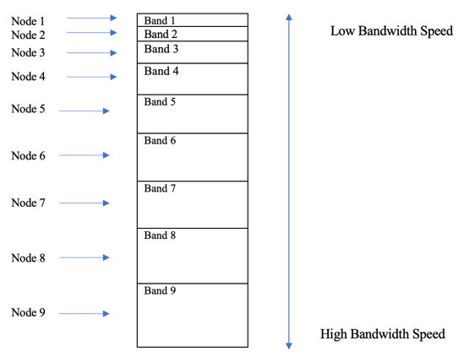
Uniform vs. Stratified Bandwidth allocation in FDMA
Uniform
Stratified
Notes:
The first improvement is to use stratified bandwidth allocation in FDMA. In the uniform allocation allprach, all nodes has the same bandwidth speed, regardless of their data load. In the stratified appraoch, the 9 nodes are assigned to a bandwidth speeds proportional to their data loads. That is, a node with a higher data load is assigned to a band with higher bandwidth, and vice versa.

Slide 10
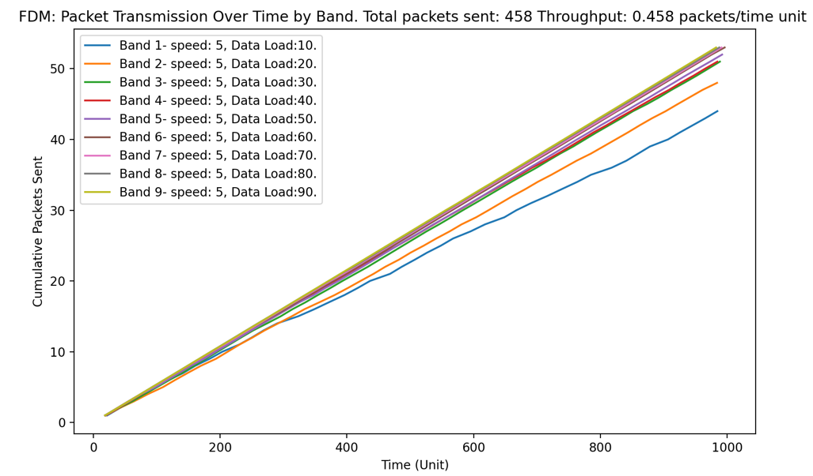
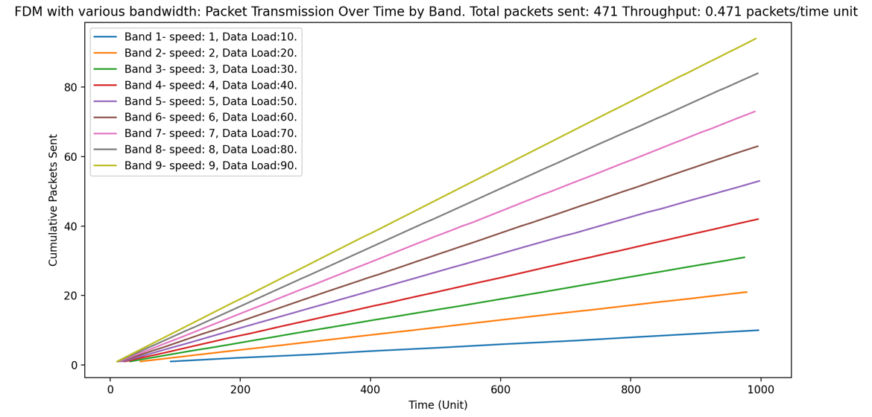
Simulation Results: Uniform vs. Stratified Bandwidth allocation in FDMA
Uniform
Stratified
Notes:
Our simulation results show the stratified bandwidth approach has a slightly higher overall throughput , which is 0.47 packets/time unit. On the left you can see all nodes have similar number of trnasmissions with unifrom bandwith. with stratified approach on the right, the busier nodes tranmit faster than the nodes with lower data load, whcih in turns increase the overall througput .

Slide 11
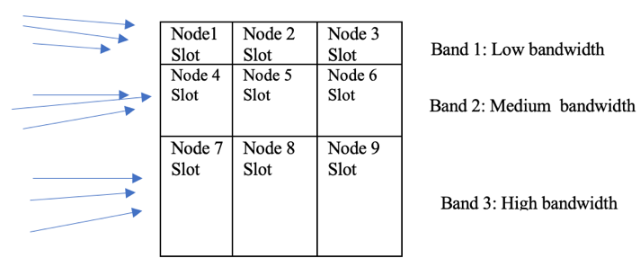
FDMA+ TDMA- Reduce idling time slot in TDMA
TDMA
FDMA + TDMA
Notes:
The second improvement we simulated is to intergrate FDMA with TDMA to reduce idling time slot in the original TDMA protocol. The 9 nodes are divided into 3 groups based on their data load: Node 1, 2, 3, are put in the first band, which has the lowest bandwidth. Node 7, 8, 9 are placed in the 3rd band , whcih has the highest bandwdith speed.

Slide 12
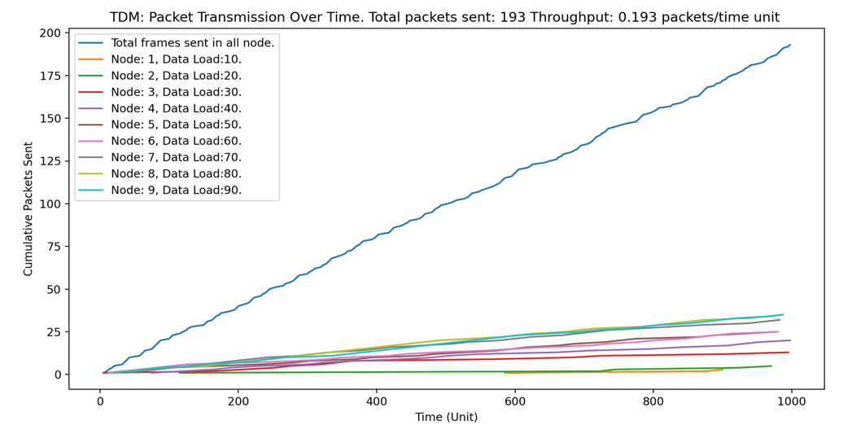
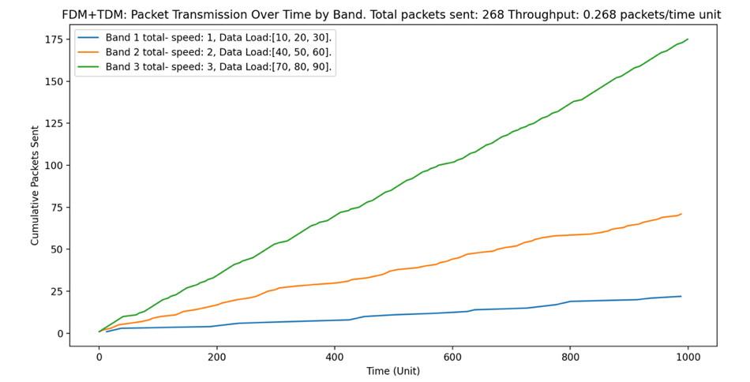
Simulation Results:FDMA+ TDMA
39% increase in throughput
TDMA
FDMA +TDMA
Notes:
The graph on the left shows the packets sent using TDMA. All 9 nodes share the same bandwidth in a single channel, resulting in an overall throughput of 0.193 packets/time unit and 193 packets sent (see mechanism in figure 3.2). Then, the 9 nodes are divided into 3 groups based on data load: low (10,20,30), medium (40,50,60), and high (70,80,90), and placed into 3 bands with low, medium, and high bandwidth speeds, respectively (see mechnism in figure 4.5). Figure 4.1 shows that this approach increases the throughput by around 39%, from 0.193 packets/time unit to 0.268 packets/time unit. Figures 4.2, 4.3, and 4.4 show the packets sent by each band, with increasing throughput from band 1 to band 3. This is expected since band 1 has the lowest bandwidth and nodes with lower data load, while band 3 has the highest bandwidth and nodes with high data load.

Slide 13
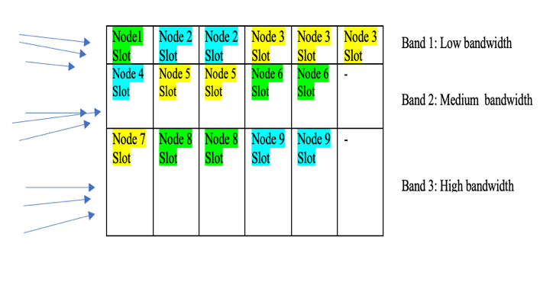
FDMA+ TDMA with Dynamic Slot Allocation
Regular FDMA +TDMA
With dynamic time slot allocation

Slide 14
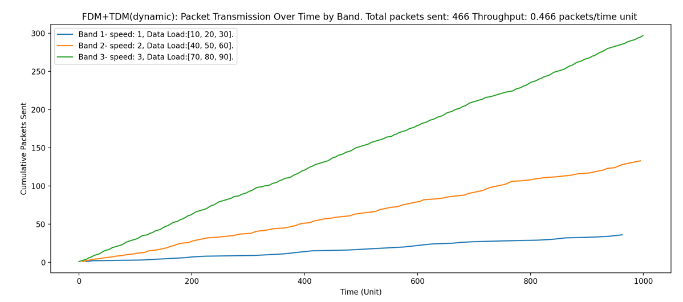
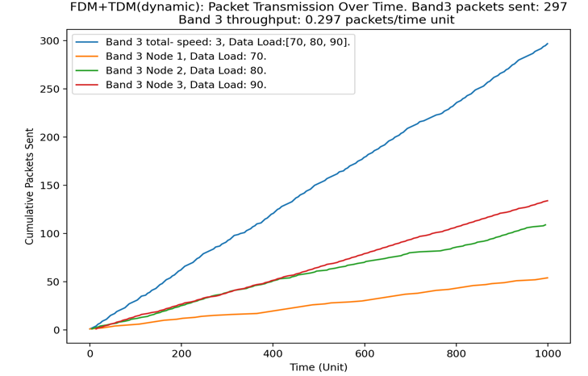
Simulation Results: FDMA+ TDMA with Dynamic Slot Allocation
268 frames -> 466 frames.
Throughput: 74% higher than without dynamic time slot
Allocation.
Node with higher data load strats to pick up speed.

Slide 15
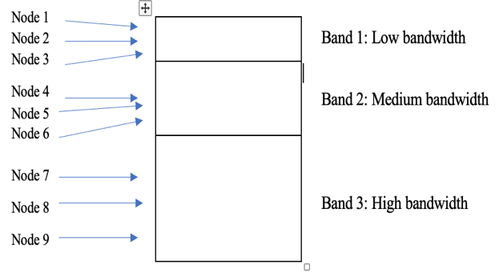
FDMA + Random Accesss
Random Access
FDMA + Random Access

Slide 16
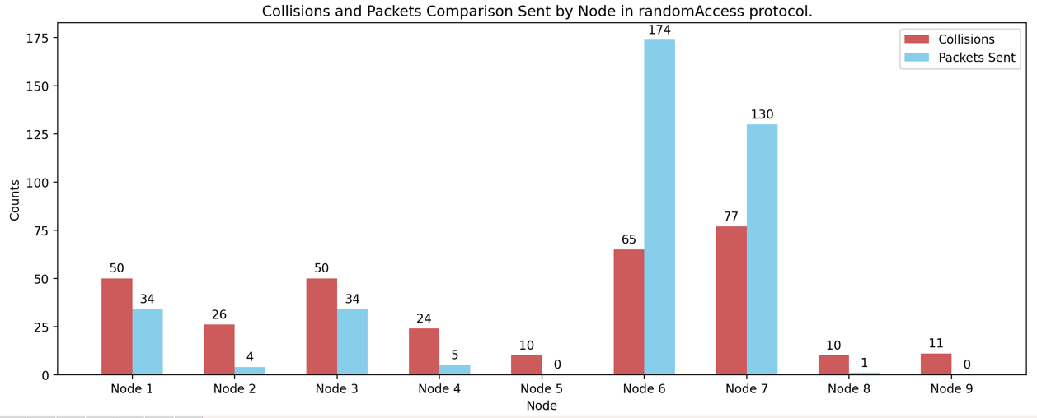
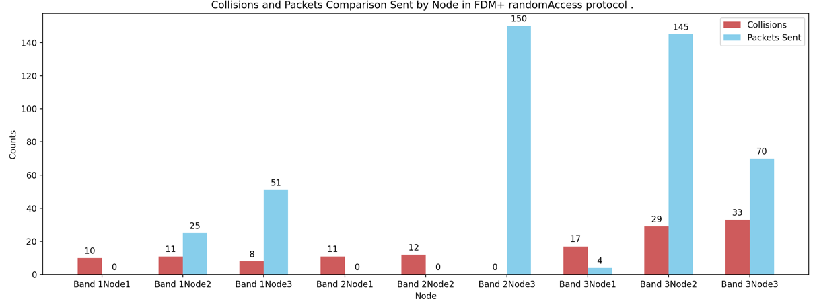
Simulation Result: FDMA + Random Access
Random Access: High collision rate: 45.8%
FDMA + Random Access: Lower Collision rate: 22.7%
Throughput improves by 16.5%, from 0.38 to 0.46 packets/time unit.

