Slide 1
THIS WEEK IN AI
13-19 JUN 2026
Capital met capability.
The three stories that actually moved the needle this week.
Augmented Team

Slide 2
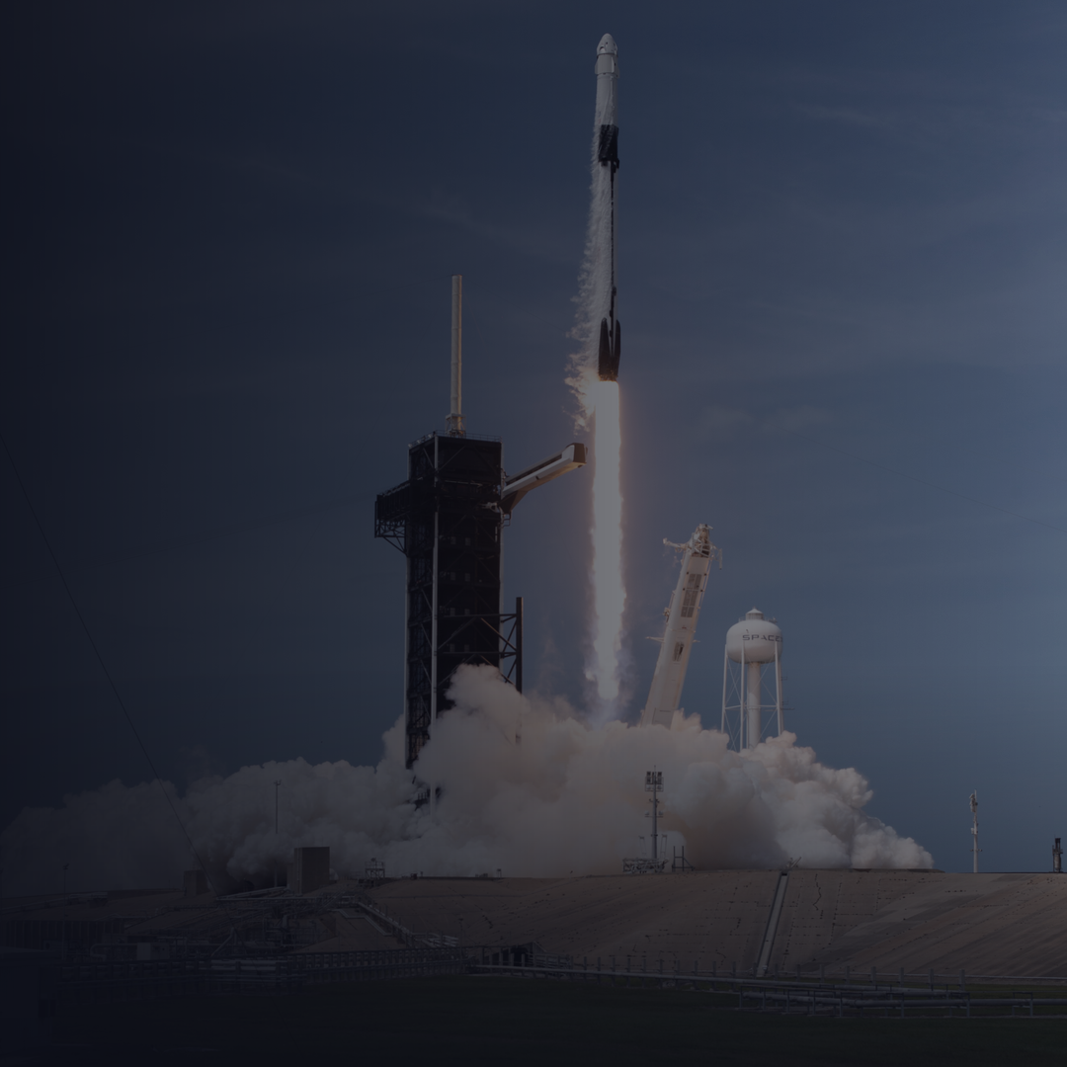
MARKETS
01 / 03
SpaceX just ran the biggest IPO in history.
Priced at $135 a share on 11 June, SPCX opened on the Nasdaq the next day and closed up 19%. Roughly $75B raised at a ~$1.75T valuation.
$75B raised · +19% day one
Augmented Team
Photo: NASA / Joel Kowsky

Slide 3

MODELS
02 / 03
Shipped its most capable model. Then it got pulled.
Claude Fable 5 launched on 9 June for long-horizon, agentic work. Three days later a US export directive suspended it over a suspected jailbreak. Capability and control collided in real time.
Augmented Team

Slide 4
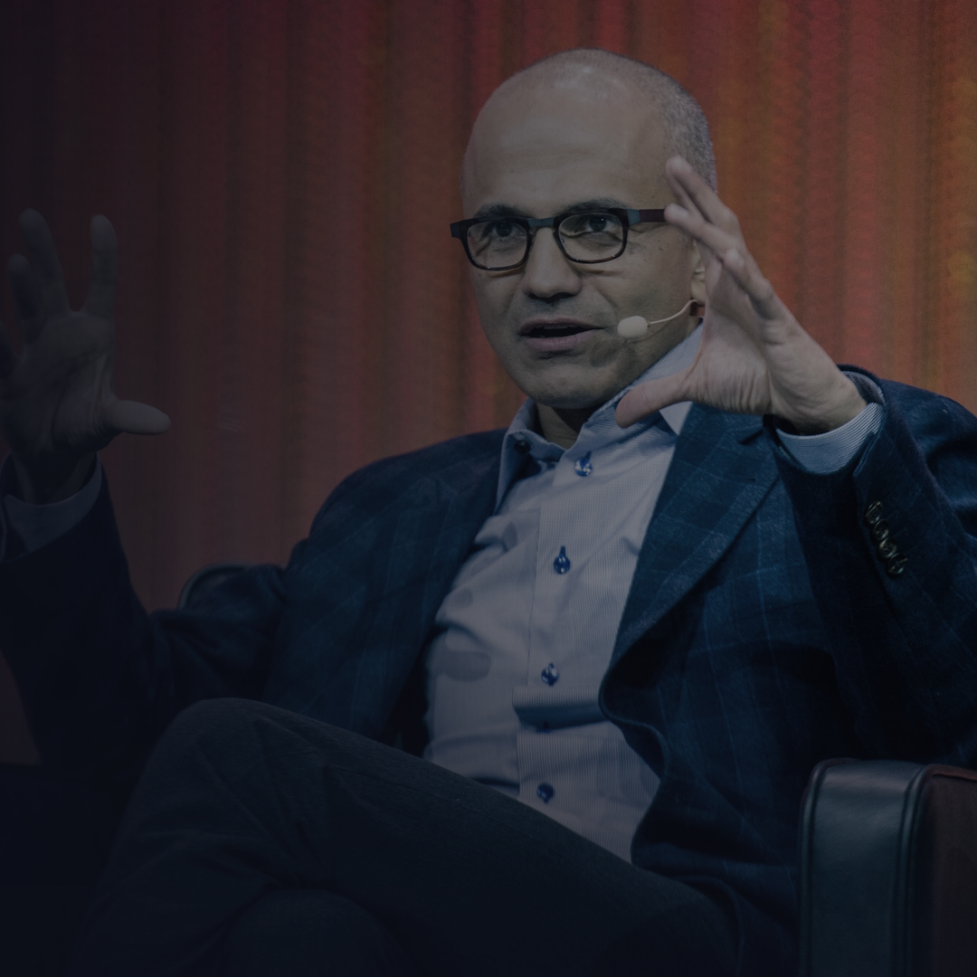
STRATEGY
03 / 03
Nadella: every firm now needs token capital.
The edge is not picking the best model. It is the learning loop you build on top of models, where your people (human capital) and your AI capability (token capital) compound together.
Augmented Team
Photo: LeWeb Photos · CC BY 2.0

Slide 5
THE TAKEAWAY
Owning your token capital is the whole game.
Money is chasing capability. Capability is outrunning control. And the sharpest operator in tech just said the moat is the loop you own. Renting tools does not compound. An operating model you own does.
Augmented Team

Slide 6
AUGMENTED TEAM
We install the compounding edge.
Build the loop. Own the capability. Compound the advantage. Follow for next week's edition of This Week in AI.
Augmented Team

