Slide 1
Prix de vente de maisons à King County
Matis Brassard-Verrier, Alyson Marquis, Alexis Picard et Samuel Provencher

Slide 2
R Markdown
This is an R Markdown presentation. Markdown is a simple formatting syntax for authoring HTML, PDF, and MS Word documents. For more details on using R Markdown see http://rmarkdown.rstudio.com.
When you click the Knit button a document will be generated that includes both content as well as the output of any embedded R code chunks within the document.

Slide 3
Slide with Bullets
Bullet 1
Bullet 2
Bullet 3

Slide 4
Slide with R Output
summary(cars)
## speed dist ## Min. : 4.0 Min. : 2.00 ## 1st Qu.:12.0 1st Qu.: 26.00 ## Median :15.0 Median : 36.00 ## Mean :15.4 Mean : 42.98 ## 3rd Qu.:19.0 3rd Qu.: 56.00 ## Max. :25.0 Max. :120.00

Slide 5
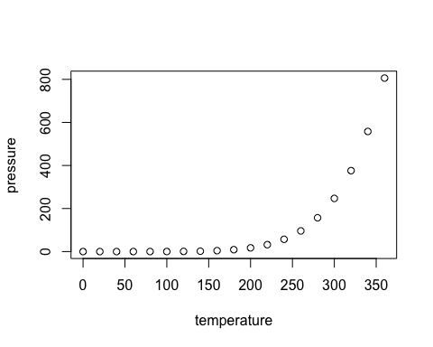
Slide with Plot

Slide 6
Bibliographie
Kaggle, harlfoxen (2017). House sales in King County, USA. Récupéré le 27 février 2020 de https://www.kaggle.com/harlfoxem/housesalesprediction.
Max Kuhn (2020). caret: Classification and Regression Training. R package version 6.0-85. https://CRAN.R-project.org/package=caret
Terry Therneau and Beth Atkinson (2019). rpart: Recursive Partitioning and Regression Trees. R package version 4.1-15. https://CRAN.R-project.org/package=rpart
Stephen Milborrow (2019). rpart.plot: Plot ‘rpart’ Models: An Enhanced Version of ‘plot.rpart’. R package version 3.0.8. https://CRAN.R-project.org/package=rpart.plot

Slide 7
Bibliographie
A. Liaw and M. Wiener (2002). Classification and Regression by randomForest. R News 2(3), 18–22.
Brandon Greenwell, Bradley Boehmke, Jay Cunningham and GBM Developers (2019). gbm: Generalized Boosted Regression Models. R package version 2.1.5. https://CRAN.R-project.org/package=gbm
Jerome Friedman, Trevor Hastie, Robert Tibshirani (2010). Regularization Paths for Generalized Linear Models via Coordinate Descent. Journal of Statistical Software, 33(1), 1-22. URL http://www.jstatsoft.org/v33/i01/.
Alina Beygelzimer, Sham Kakadet, John Langford, Sunil Arya, David Mount and Shengqiao Li (2019). FNN: Fast Nearest Neighbor Search Algorithms and Applications. R package version 1.1.3. https://CRAN.R-project.org/package=FNN

