Slide 1



Ethics

Slide 2
What is Ethics?
Ethics is defined as a method, procedure, or perspective for deciding how to act and for analyzing complex problems and issues (Resnik, 2020)​
When it comes to research, ethics refer to the norms and values that guide decisions regarding the collection of data and analysis of said data, as well as the dissemination of findings (Mirza, Bellalem & Mirza, 2023).
“If a choice must be made between doing harm to a participant and doing harm to the research, it is the research that is sacrificed.” (Mack et al., 2005)
Resnik, D. B. (2020). What is Ethics in Research & Why is it Important? National Institute of Environmental Health Sciences.
Mirza, H., Bellalem, F., & Mirza, C. (2023). Ethical Considerations in Qualitative Research: Summary Guidelines for Novice Social Science Researchers.​
Mack et al. (2005). Qualitative Research Methods: A Data Collector's Field Guide​

Slide 3
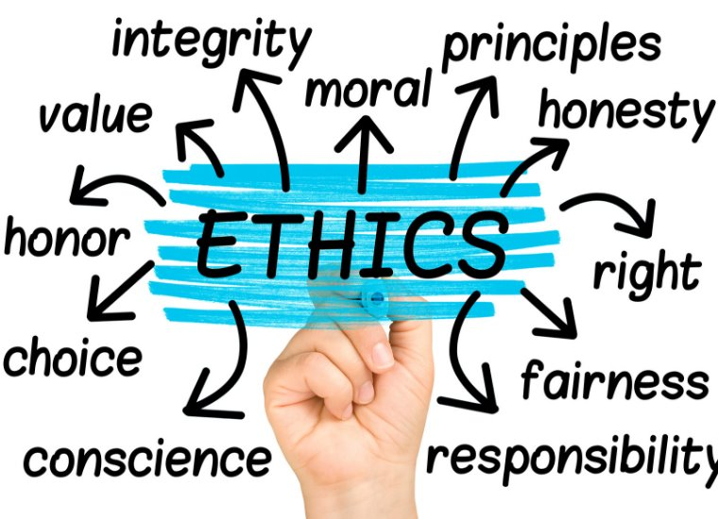
Ethical Considerations
According to Mirza, Bellalem, & Mirza (2023) these are some key ethical considerations:
​Respect for persons – Treating participants with dignity.​
Informed consent – Voluntary and informed agreement.​
Confidentiality & anonymity – Protecting identities.​
Trustworthiness – Ensuring integrity and transparency.​
Avoiding harm – Psychological, emotional, or reputational.​
Conflict of interest – Maintaining objectivity.​
Santa Clara University (2019)​
https://www.scu.edu/mobi/resources--tools/blog-posts/ethics-in-life-and-business/ethics-in-life-and-business.html
Mirza, H., Bellalem, F., & Mirza, C. (2023). Ethical Considerations in Qualitative Research: Summary Guidelines for Novice Social Science Researchers.​

Slide 4
Qualification Research
Qualification research means research conducted in fulfilment, or partial fulfilment, of a qualification.
Qualification research must be ethically approved by a REC situated within the University.
Ethical approval is in place before research data collection or any interaction with research participants commences.
Ethical approval is renewed if and when this is required.
Any amendments to ethically approved research are managed in accordance with Faculty research ethics operating procedures.
Adverse events occurring during research are reported in accordance with Faculty research ethics operating procedures.
Retrospective ethical approval will not be considered under any circumstances.
Research requiring secondary use of existing data requires prospective ethical approval.

Slide 5
Responsibilities of Faculty REC
The objective of the REC is to protect the interests of research participants and research affiliates.
Faculty RECs are responsible for ensuring that the proposed and amended research meets relevant ethical norms and standards and is aligned with the guiding principles of research ethics.
Faculty RECs have the right to suspend research pending an inquiry into unethical research conduct, as detailed in their standard operating procedure (SOP).

Slide 6
Ethics Process
Research ethics applies to undergraduate and postgraduate students, postdoctoral research fellows (PDRFs), full-time and part-time staff, visiting academics and research associates, or any other person engaging in research and affiliating themselves to the University in the process.
Research begins when a research ethics application receives ethical approval, and research ends when data collection and analysis is complete.
Ethical approval means the outcome of a process of ethical review by a research ethics committee (REC) indicating that research has complied with the required ethical norms and standards.

Slide 7
Primary Data Collection
Data is gathered directly from humans via interviews, survey, focus groups, questionnaires, etc.
Data is gathered from animals
This approach requires Form A to be completed
For any study that conducts primary data gathering, the Personal Information Impact Assessment must be completed

Slide 8
Minimum Requirements for Submission of Form A
Request to conduct study at organization
Permission/Waiver letter from the organization/s if applicable.
The permission letter must be on a company letter head, signed and dated.
Must be signed by an authorized person
In some cases, the organization may request ethical clearance first, if applicable, proof of request must be submitted during ethics application. If clearance is granted, it will be conditionally granted until the permission is received and reviewed by the JBS REC. Until final permission is provided by the REC, no data collection can commence.
Informed consent
There is a template but must be contextualized to the requirements of the study

Slide 9
Minimum Requirements for Submission of Form A
Interview questions/ focus groups questions/surveys
Once these questions have been approved by the JBS REC, there cannot be changes, any changes must go through an amendment process.
For existing questionnaires, details of use must be clearly stated.
It is the responsibility of the student and supervisor to ensure adherence to rules of use.
Completed Personal Information Impact Assessment Form.
Completed Form A
Signed and dated by both student and supervisor.

Slide 10
Secondary Data Collection
Data is gathered from secondary sources. There is no engagement/interaction with human or animals.
This requires Form B to be completed
If private data is to be used, company permission/waiver must be submitted.
The permission letter must be on a company letter head, signed and dated.
Must be signed by an authorized person

Slide 11
Minimum Requirements for Submission of Form B
Request to conduct study at organization
Permission/Waiver letters from the organization/s if applicable.
The permission letter must be on a company letter head, signed and dated.
Must be signed by an authorized person
In some cases, the organization may request ethical clearance first, if applicable proof of request must be submitted during ethics application. If clearance is granted, it will be conditionally granted until the permission is received and reviewed by the JBS REC. Until final permission is provided by the REC, no data collection can commence.
Completed Form B
Signed and dated by both student and supervisor

Slide 12
Ethical Clearance Exemption
Only secondary data is used and from publicly available sources. There is no engagement/interaction with human or animals and no private data usage.
Form C to be completed

Slide 13
Resubmission
When resubmitting any ethical clearance, the complete pack must be resubmitted.
All updated documents must be signed and dated by both student and supervisor.
A summary document detailing the changes requested must be provided. Align to the feedback received from the JB REC.

Slide 14
Amendments
When an amendment is requested, the data collection must halt.
An amendment application would be reviewed in totality.
All submission documents must be updated and sent together with the amendment document, which details the amendment.

