Slide 1
Personal AI Running Coach
Human-ai interaction I
Group AI
Felix Walter, Samuel Ringl, Lukas Herk
Notes:
Herk Lukas

Slide 2
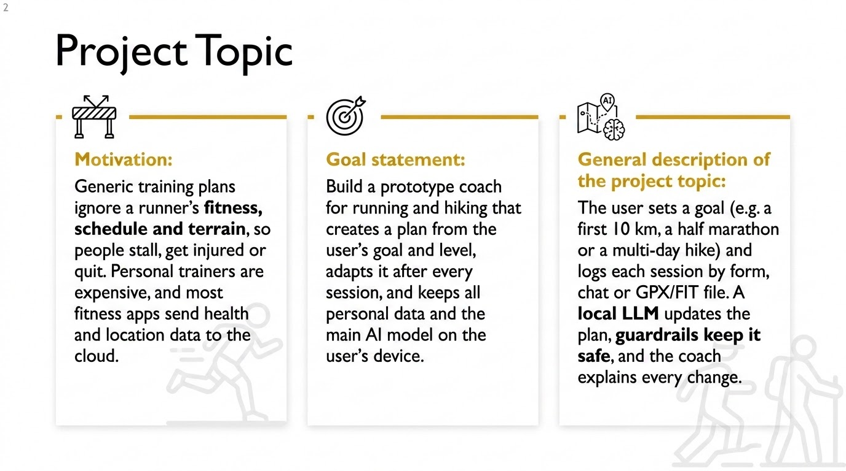
Notes:
Herk Lukas

Slide 3

AI In your Project
Notes:
Felix Walter

Slide 4
AI in your project
What is the AI in your project?
A local LLM (Ollama or similar) acting as a running coach. It plans the training and explains it, rule-based guardrails check every plan.
What is the perception (input) of the AI?
Onboarding questionnaire, session logs (distance, time, effort), chat messages and GPX/FIT files.
How is the reasoning carried out?
After each session the profile is updated. The LLM proposes next week's plan from it, guardrails reject unsafe plans.
What is the outcome or action?
Updated weekly plan, next-session tip, the reason for each change, and warnings (e.g. after repeated pain).
Notes:
Felix Walter

Slide 5
AI in your project
What models are used, where do you get them, how do you test them?
Pre Trained open models (Llama 3.1 8B, Qwen 2.5 7B, Mistral 7B) from Ollama, no own training. Tested with simulated users: fast progress, skipped runs, injury, long break.
Does the AI require any data storage? How do you implement that?
Yes: profile, runs and chat in a local SQLite database, recent history goes into the prompt.
Does the AI share data with other instances? Or is it private to the user / session?
Private, stays on the device. Only questions the local model can't answer go to an external service, without personal data and after the user confirms.
Notes:
Felix Walter

Slide 6
AI In your project
What does the AI need to understand from the human?
Goal, level, constraints (time, terrain, injuries) and how each session felt.
How do you capture information (perception) to help the AI understand that what you need from the human?
Onboarding form, log form with perceived effort, chat notes and GPX/FIT import.
What does it need to explain the human?
Why the plan changed, based on the user's data, what would be sent externally, current training status.
What situations do you expect to see in training? What unexpected situations could there be?
Expected: steady progress, missed or hard sessions, changing schedules. Unexpected: pain reports, unrealistic goals, impossible logs, long breaks, off-topic questions.
Notes:
Felix Walter

Slide 7
AI In your project
What knowledge does the intelligent technology need about humans in general?
General training principles: gradual load increase, recovery and rest days, typical progression rates. They are built into the prompt and the guardrails.
Does it need information about what other humans like, do, buy, watch… etc?
No. It does not use data from other users.
What knowledge does the intelligent technology need about the human counterpart?
The user's goal, level, constraints (time, terrain, injuries) and feedback after each session.
Does it need a previous history about what the user liked, did, bought, watched…etc?
Yes. The user's own training history and feedback, stored locally, is the basis for every plan change.
Notes:
Felix Walter

Slide 8
Human In your Project
Notes:
Samuel Ringl

Slide 9
Human Interface in your project
How does the human provide input to the AI?
Through a web app: onboarding form, quick session log, chat window and GPX/FIT file upload.
How does the human get feedback (output) from the AI?
Plan view, chat replies with explanations, progress charts, and a confirmation dialog before anything leaves the device.
What does the human need to understand from the AI?
Why the coach recommends something, how sure it is, and which data stays local.
Notes:
Samuel Ringl

Slide 10
Human Interface in your project
What technologies will you use in the interface for human input?
A web app with forms, chat and file upload. It also works in a phone browser.
What technologies will you use in the interface for feedback?
The same app: plan view, chat output and charts. Answers are generated by the local LLM via Ollama or similar.
Is there a connection between the interfaces? Is there a shared data storage, eg. History?
Yes. Input and feedback share one local database, so plan, chat and charts use the same history.
Notes:
Samuel Ringl

Slide 11
The Plan
Notes:
Herk Lukas

Slide 12
Roadmap
First steps.
Set up Ollama and compare models, define profile, plan format, guardrails and database, build onboarding.
Rough milestones (what has to be in place when so you can progress).
M1 December 15. 2026
Onboarding, first plan, logging (form, GPX/FIT), local storage.
M2 January 11.2027`
Adaptation loop, chat explanations, external fallback, tests with simulated users.
Requirements or needs:
Do you need access to hardware?
A laptop with about 16 GB RAM.
Do you need access to software?
Free tools like(Ollama, Python, Streamlit, SQLite) and an API key.
Will you work in the lab?
No.
Notes:
Herk Lukas

Slide 13
Thank you!
Next class
Notes:
Herk Lukas

Slide 14

HAI Project Rules
- Include an AI that exhibits: i) perception, ii) reasoning, iii) action. You have to implement some method for the AI to adapt or update with recent information.
- Include an interface for humans to deliver input to i) perception and get feedback through ii) action. The user interface can be the implementation of the perception and action parts. For example, a chat system will have a text input for the human to type (perception) and a text output where the AI responds (action).
- It is a prototype and it has to cover the components necessary for the human-ai interaction, instead of building a complete system.

