Slide 1


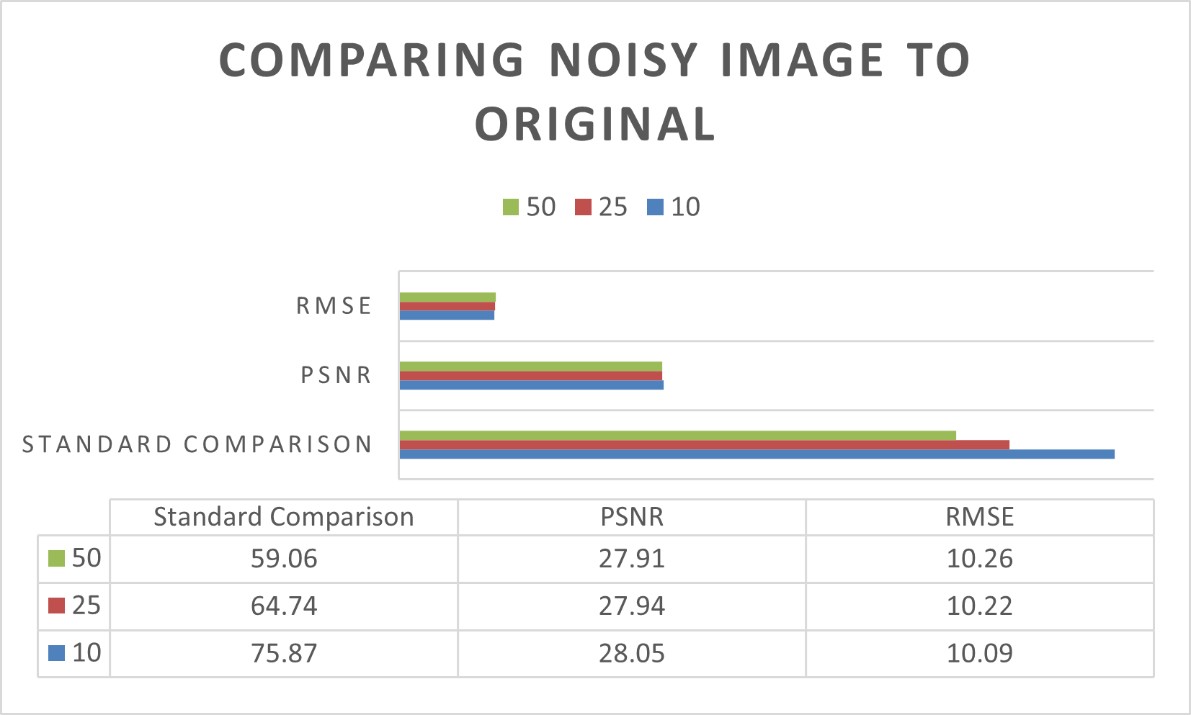
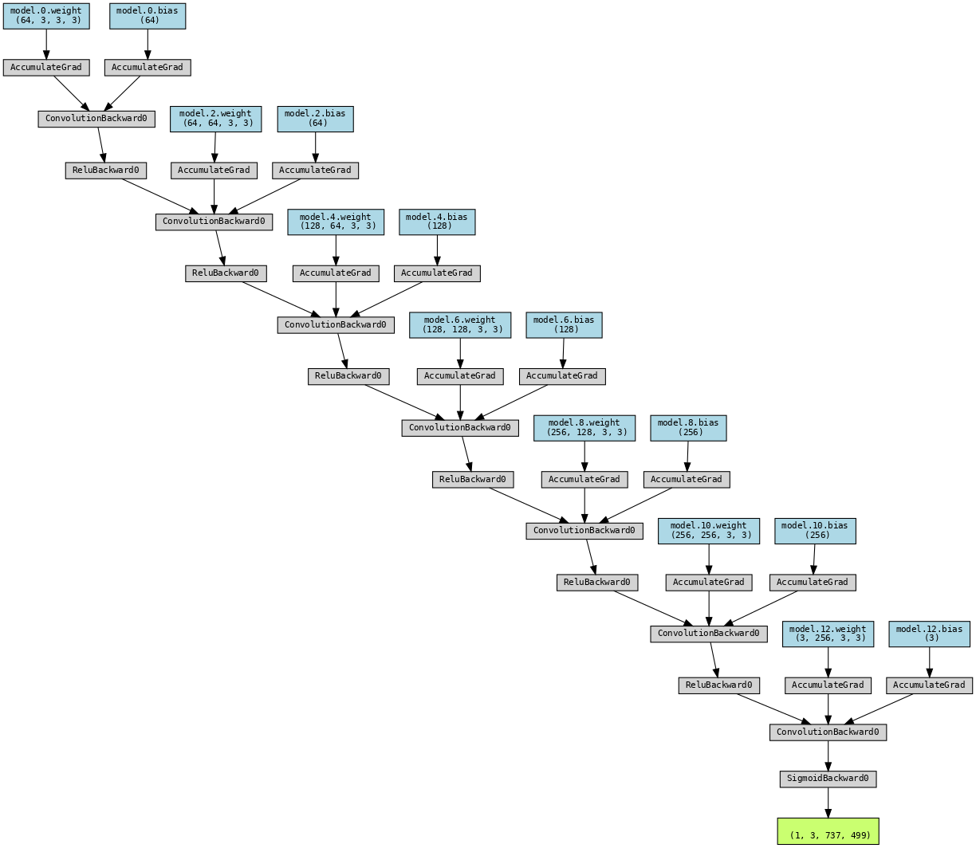
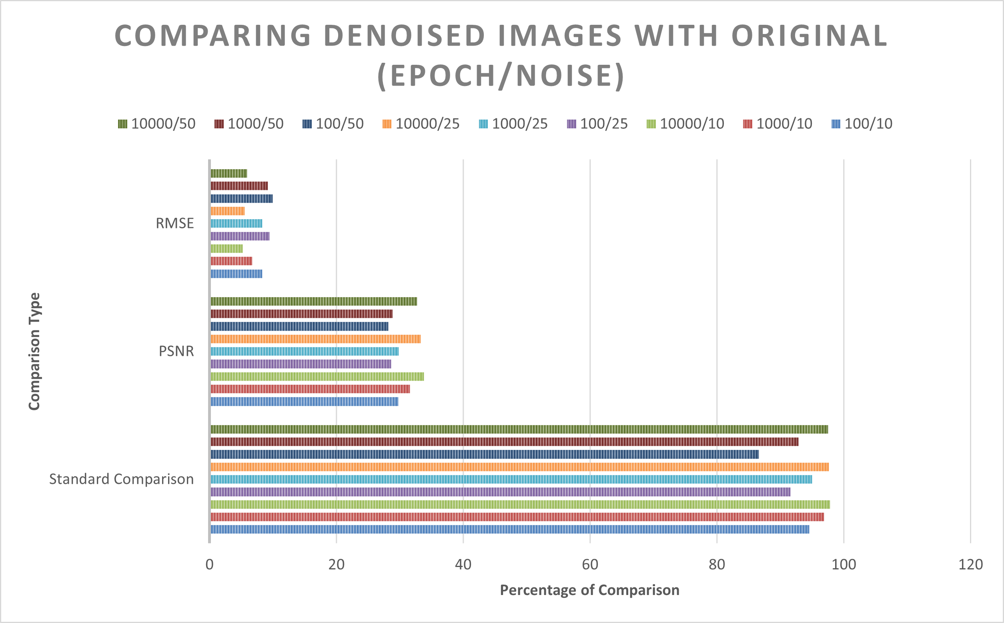

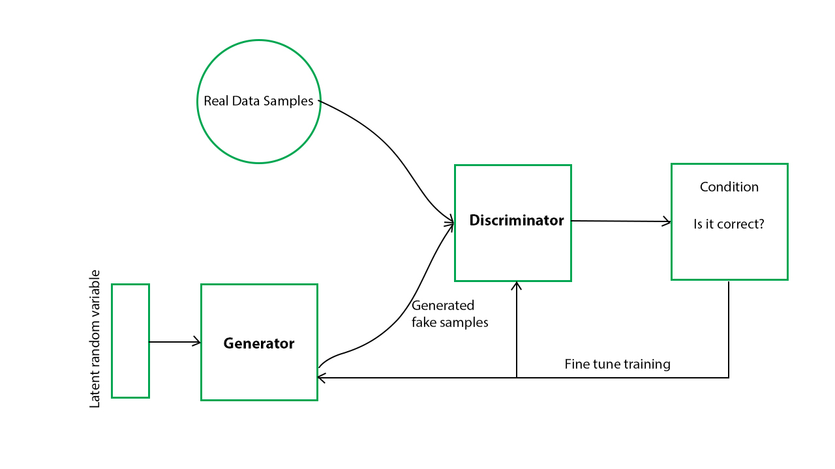
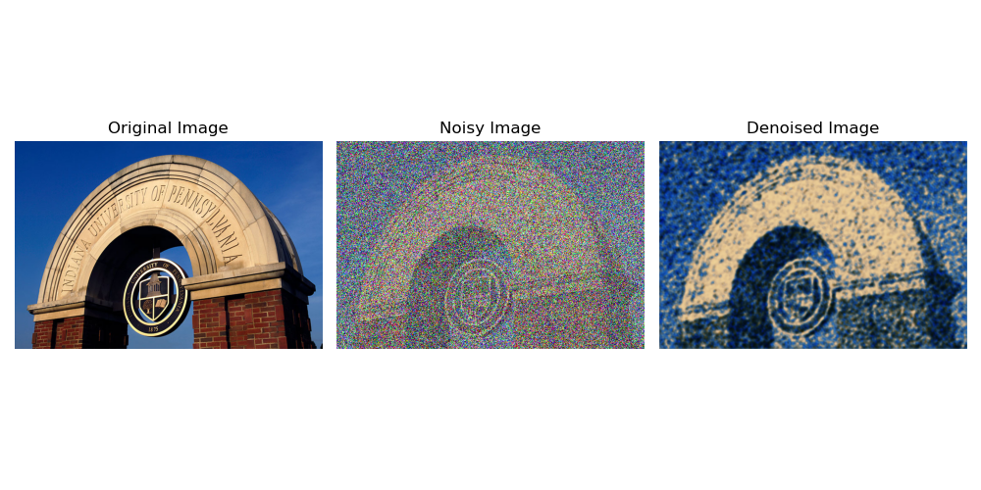
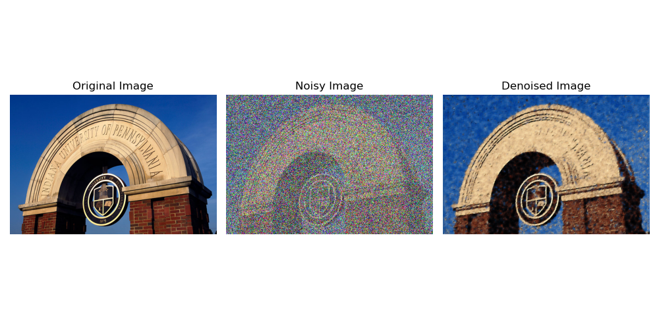
Denoising Images Using Generative Adversarial Networks
Samuel Rocco • Indiana University of Pennsylvania • ztmcc@iup.edu • Advisor: Dr. Soundararajan Ezekiel
Objective
Methodology
We subjected the base image to many different noise levels with various trial run sizes and the final comparisons are very similar to the original image.
To utilize GAN (Generative Adversarial Networks) as a form of denoising images
We will study the process of denoising and how well it works on different severity of noise within an image
PyTorch is a machine learning framework that is used within python for various machine learning and Artificial Intelligent algorithms
Output images will be compared with the base image to then study how well the comparison is
A set of convolutional layers are used to transform the noisy input image into the denoised image.
Figure 5: Comparing Noise to Original
The generator is trained in conjunction with a discriminator, which aims to distinguish between real (clean) images and fake (generated) images
Problem
Create an array of images that are all from a singular base image, each one having different intensity of noise.
Create a machine language script that has the ability to process images and utilize a Generative Adversarial Network to accomplish the denoising processes
Figure 2: Generator Model
Results
Figure 6: Comparing Denoised to Original
Denoising Charts
While using a combination of different approaches to researching the ability of GAN or denoising images, We utilized the IUP archway photo as my base image. Noise was added to the image at three different attenuations, 10, 25, and 50 utilizing Laplacian noise. Then the images were passed through the GAN at 3 different times for each attenuation, each one at a different EPOCH amount (number of trials), and then studied for pattens.
Conclusion
The tests demonstrate that utilizing Generative Adversarial Networks was a success, and that images can be denoised from mostly any state back to a high percentage of the original image.
References
nVidia: https://nvlabs.github.io/denoising-diffusion-gan/
Image Denoising: https://www.mdpi.com/2079-9292/11/15/2445
Figure 1: Generative Adversarial Network Model
Figure 3: Denoised image 100 epochs and 50 attenuation noise
Figure 4: Denoised image 10000 epochs and 50 attenuation noise

