Slide 1
ETL Process : COVID 19
Sam, Kam & Lizz

Slide 2
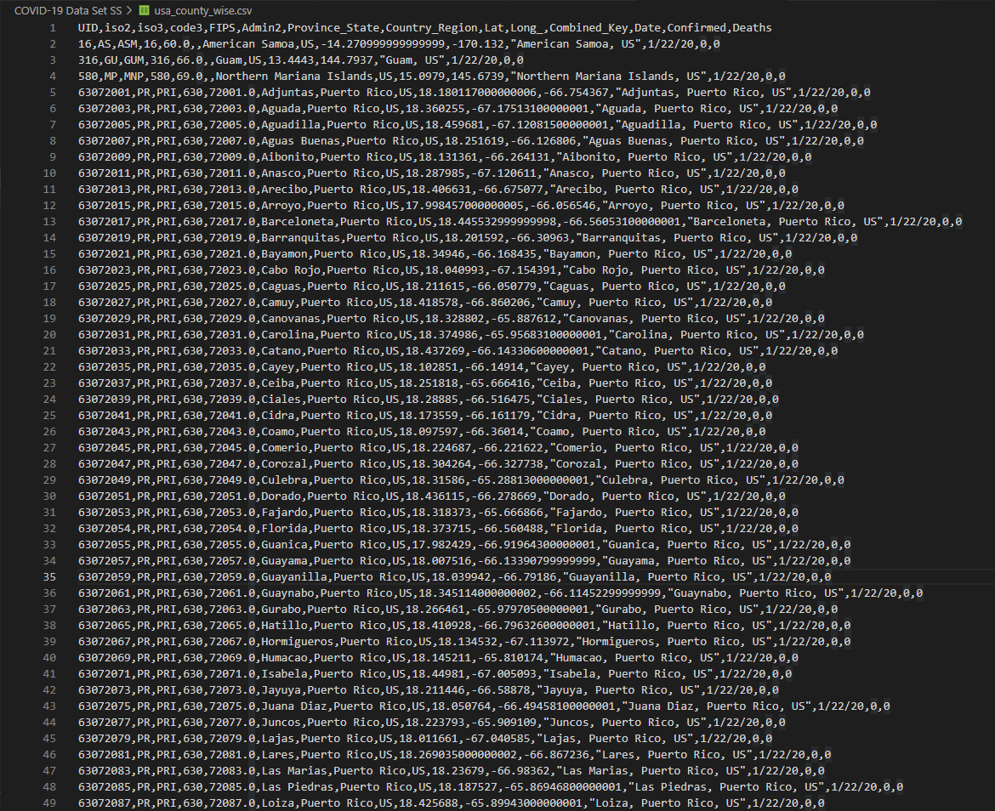
Raw Data
Lots of confusing points
Most information doesn't help tell a story but rather further confuse
Some data while it might teach more takes a lot of time to learn so we simplified it for the average person.

Slide 3
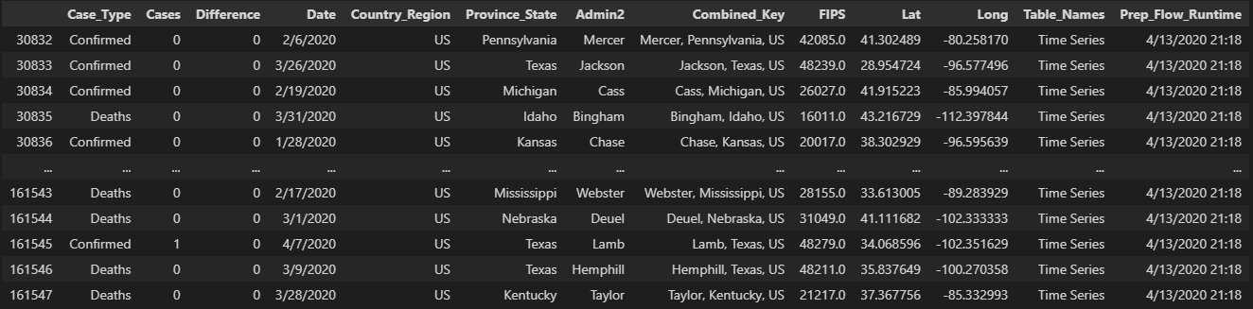
E : Extract
Method we used was reading a csv file into pandas.
Sources
Kaggle COVID 19 DATASET - Devakumar K . P.
Data.World COVID-19 case-counts-test- zathompson
Data.World John Hopkins COVID-19 Case Tracker

Slide 4
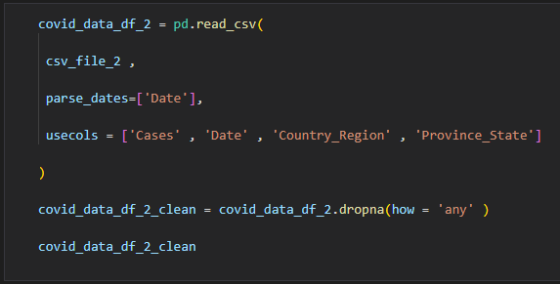
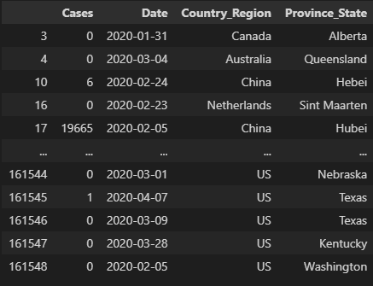
T: Transform
Data we read in a lot of the time was already cleaned.
We were very selective about what stats we chose to show
We aimed to give more of a digestible amount of information
We also had to work with Dates to make sure that there weren’t problems moving info from the Dataframe to PgAdmin4

Slide 5
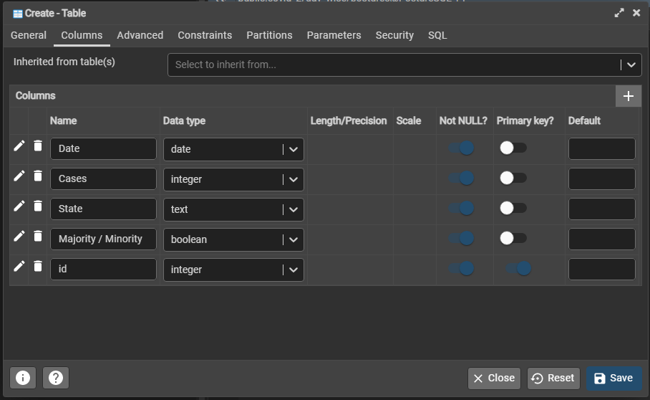
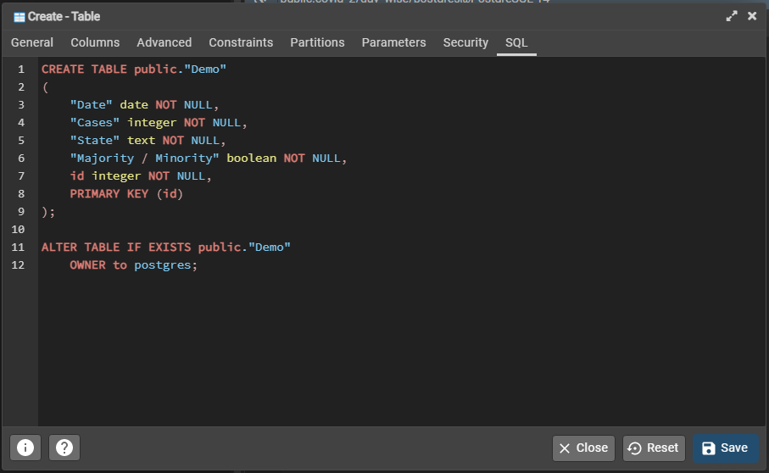
L : Load
The most complicated portion of this project
Taught about how shifting data from one program to another can be so sensitive.
Using alternative methods to those we learned in class
Lots of experimentation

Slide 6
New Ideas
Reading in csv files , selecting data , and changing data type in one single action
Creating tables manually when thing go awry.
Don’t name your database and/or tables the same name or it won’t read in the code correctly

Slide 7
Q & A

Slide 8
Sources
https://www.kaggle.com/datasets/imdevskp/corona-virus-report?select=covid_19_clean_complete.csv
https://data.world/zathompson/covid-19-case-counts-test/workspace/file?filename=COVID-19+Cases.csv
Johns Hopkins COVID-19 Case Tracker - dataset by associatedpress | data.world

