Slide 1
Protein Design
Rocco Moretti
Rosetta Workshop
December 2019

Slide 2
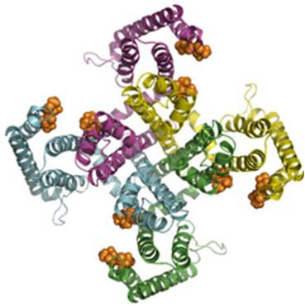
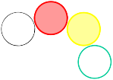





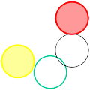
Protein Design is the Inverse Protein Folding Problem
Protein Folding Problem
Y
D
T
P
P
R E W
Sequence
Structure
H
K
F
S
P
Inverse Folding Problem
Given a protein fold – which primary sequence(s) can fold into it?

Slide 3
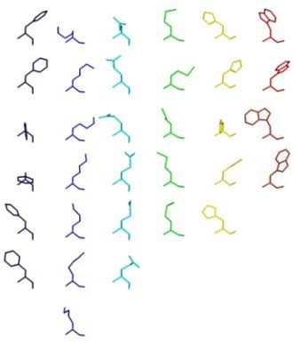
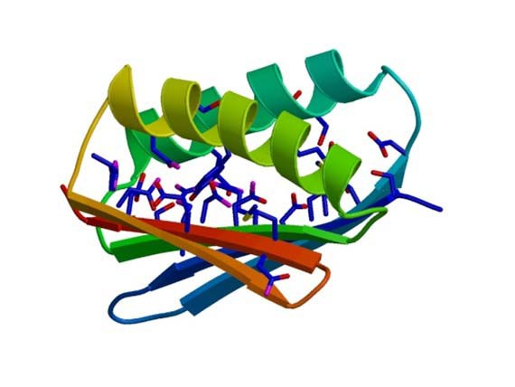
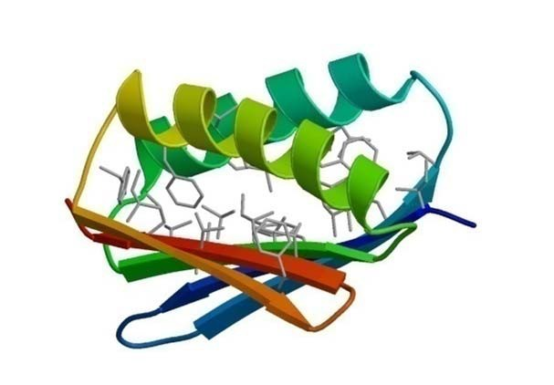
Protein Design Uses the Rosetta Energy Function and Local Rotamer Libraries
Local Rotamer Bias
Approximate interactions
between sidechains using
the distribution of
sidechain conformations
seen in known protein
structures
Simulated Annealing Monte Carlo optimization
Energy function
•VDW interactions
•solvation
•hydrogen bonding potential
•elec interactions
•rotamer probability

Slide 4
Iterative Optimization of Sequence and Conformation in Rosetta
Small backbone
movements
Fixed BB design
random perturbation of one or several backbone torsion angles
Mutation and fast side-chain optimization using a rotamer representation
gradient-based minimization with respect to backbone and side chain torsion angles
Minimization (relieve clashes)

Slide 5
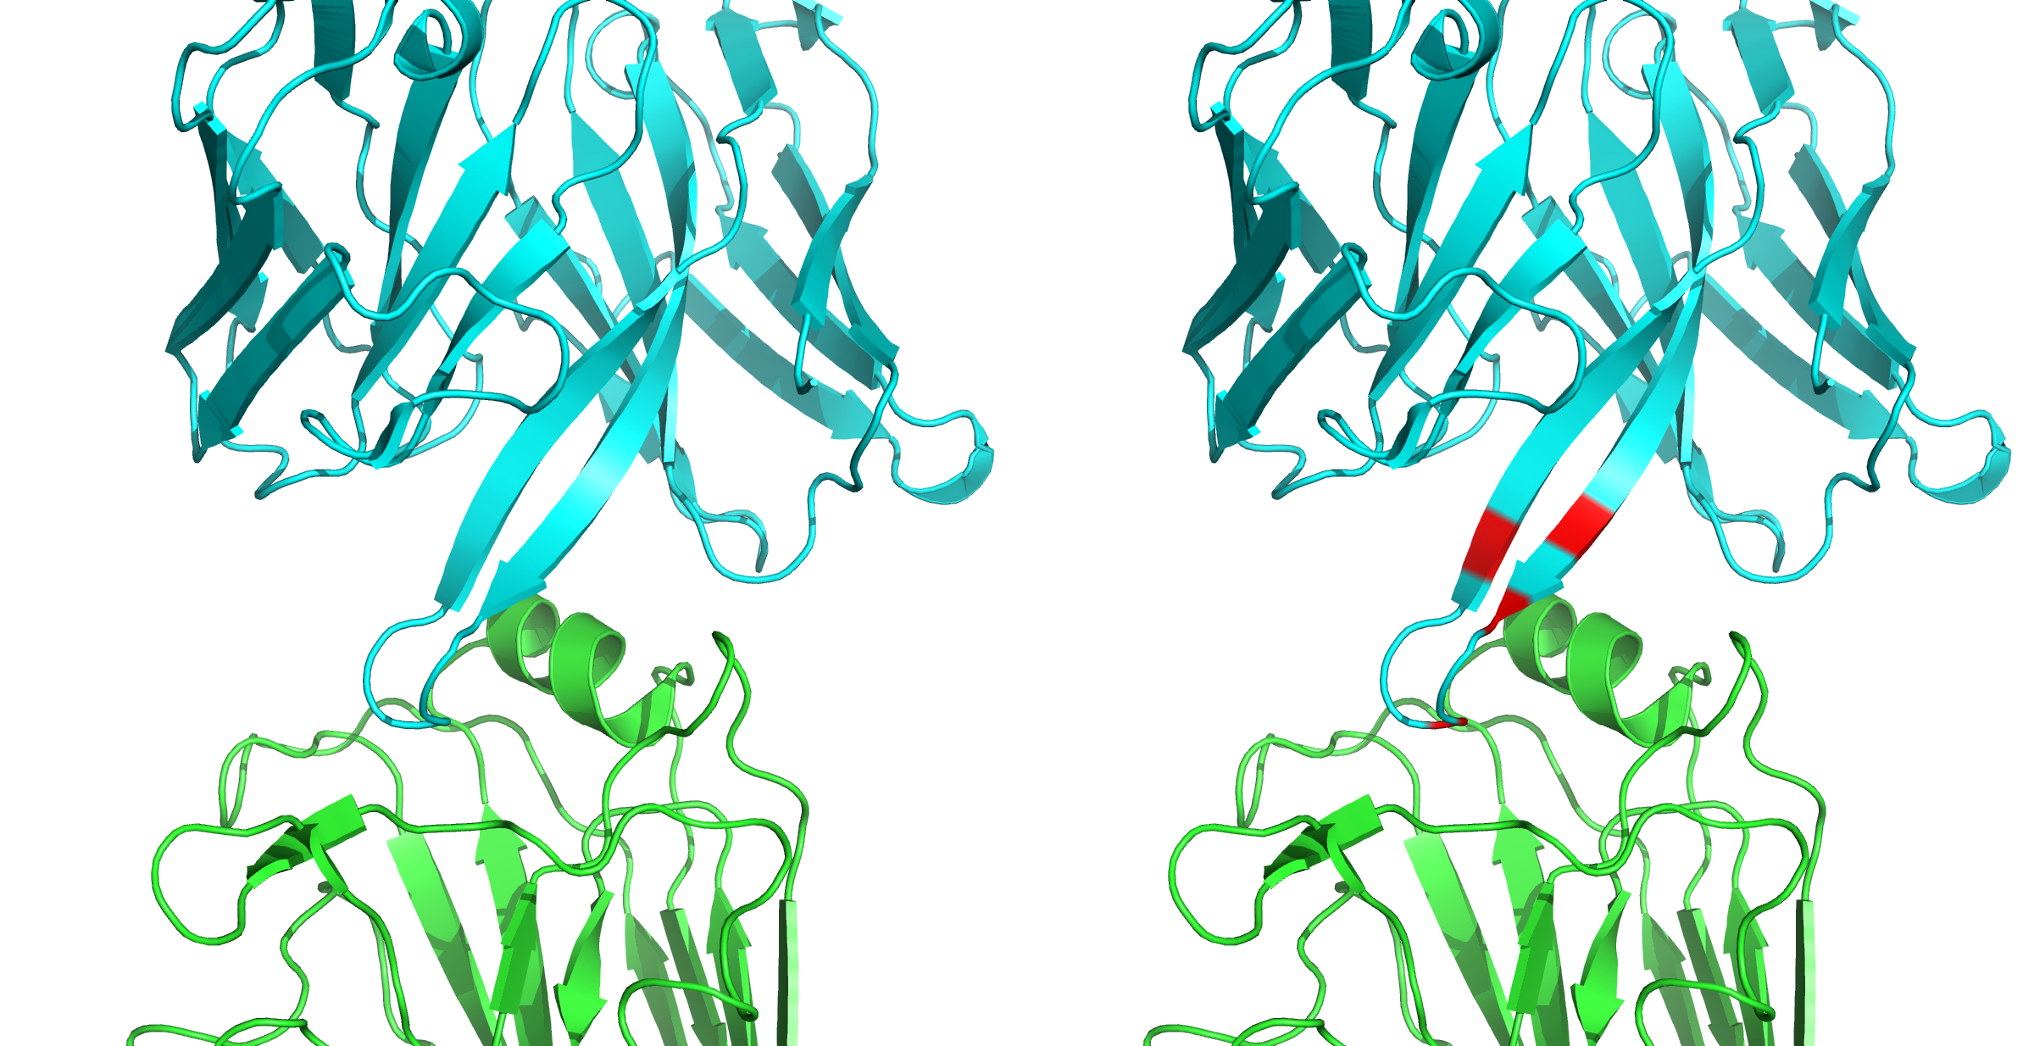
Single-state design
Also known as redesign
for antibodies: computational affinity maturation
Goal: take an existing antibody-antigen complex and optimize the antibody sequence for tighter binding
Antibody
Design
Antigen
PDB ID 4yk4

Slide 6
Single-state design protocol overview
Create Input
Download PDB
Process PDB
Relax
Run FastRelax
Design
Create XML file
Create resfile
Run
Design/
Control
Analysis
Create Sequence Logo
Inspect best sequences

Slide 7
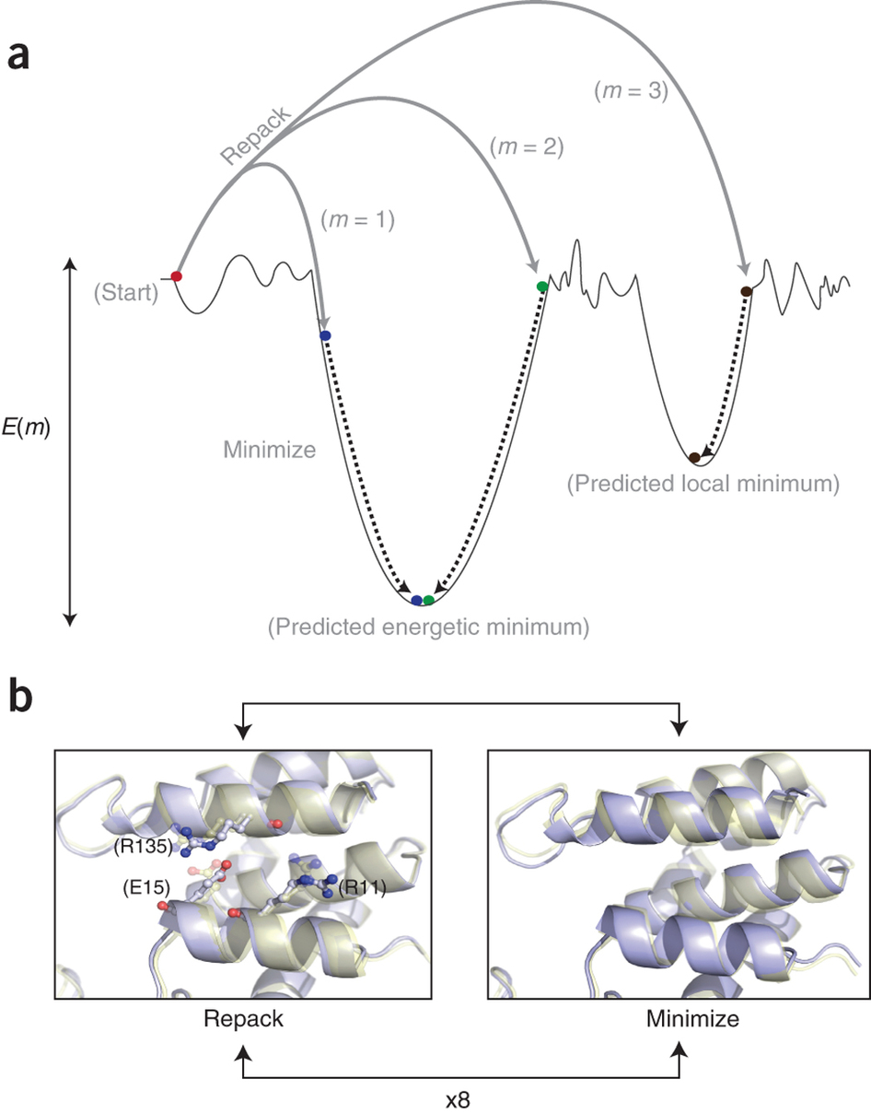
Relax
Run FastRelax
FastRelax is designed to optimize the protein backbone/side chains to model at an energy minimum
Helps relieve clashes that may introduce artifacts into design
Benchmarks show as little as 1 Å backbone movement can completely change sampled sequences
-constrain_relax_to_start_coords
keeps things close to inputs
Combs, et al, Nat. Prot. 2013

Slide 8
Design
Create XML file
Please open
protein_design/single_state_design/input_files/design.xml
Where should you start looking?
<PROTOCOLS>
Run the design protocol
<Add mover=“design” />
Calculate interface metrics for the final sequence
<Add mover=“analyze” />
</PROTOCOLS>
<PackRotamerMover name=“design” scorefxn=“REF2015”
task_operations=“ifcl,rrf” />

Slide 9
Design
Create XML file
Create resfile
Design and repack residues based on resfile
<ReadResfile name=“rrf” filename=“4HKX.resfile”/>
Do only design the residues specified below (the interface)
NATRO
start
30 H ALLAA
31 H ALLAA
…
152 L ALLAA
155 L ALLAA
…
333 A NATAA
334 A NATAA
Free sequence design on heavy and light chain interface residues
Repack the antigen, do not mutate

Slide 10
Design
Create XML file
Create resfile
Autogenerate resfile: Use the python script protein_design/scripts/define_interface.py
Interface: any atom within a cutoff (default 5 Å) of any atom in the opposing chain.
Not Interface
Interface
Not Interface

Slide 11
Analysis
Total score: score of the entire complex
Binding energy: difference in energy between the bound and unbound partners
Binding density: Binding energy divided by the buried surface area. Prevents a low binding energy by increasing buried surface area.

Slide 12
Analysis
<InterfaceAnalyzerMover name=“analyze” scorefxn=“REF2015” packstat=“0” pack_input=“0” pack_separated=“1” fixedchains=“H,L” />
packstat: activates packstat calculation (packing statistics, Rosetta holes); can be slow so it defaults to off
fixedchains: comma-delimited list of chain ids to define a group in the interface.
pack_separated: repack the exposed interfaces when calculating binding energy? Usually a good idea.
pack_input: prepack before separating chains when calculating binding energy? Useful if these are non-Rosetta inputs

Slide 13
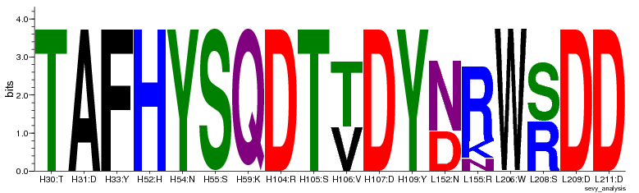
Analysis
Create Sequence Logo
Useful to quickly see which residues are being designed, and what amino acids are being put there
Made by WebLogo application through
protein_design/scripts/design_analysis.py
http://weblogo.berkeley.edu/

Slide 14
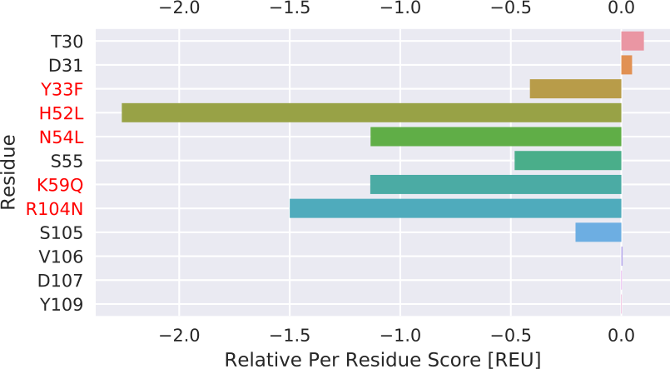
Analysis
Create Sequence Logo
Inspect best sequences
Use the python script located in protein_design/scripts/PerResidueEnergies.py
Plots relative per residue energies.
(input pose – design pose)
Values smaller zero indicate improvements relative to the input pose
Red: Mutations

Slide 15
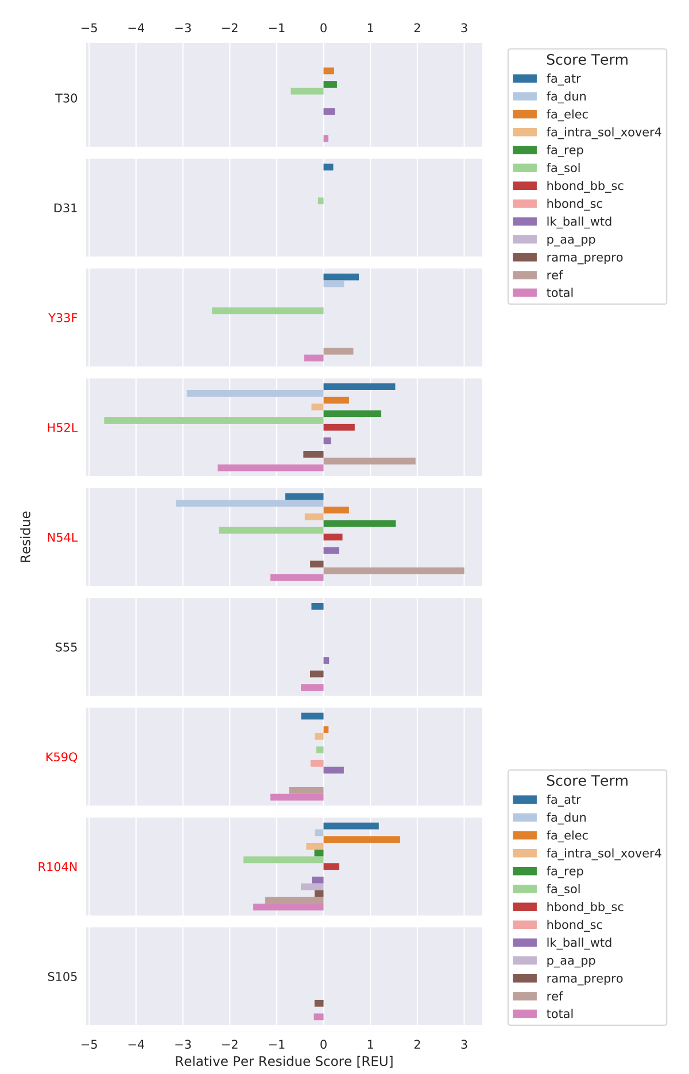
Analysis
Create Sequence Logo
Inspect best sequences
Position specific score changes for each Rosetta scoring term
REF 2015 scoring terms:
The Rosetta All-Atom Energy Function for Macromolecular Modeling and Design
Alford et al (2017)
Made by supplementary script through
protein_design/scripts/PerResidueEnergies.py

Slide 16
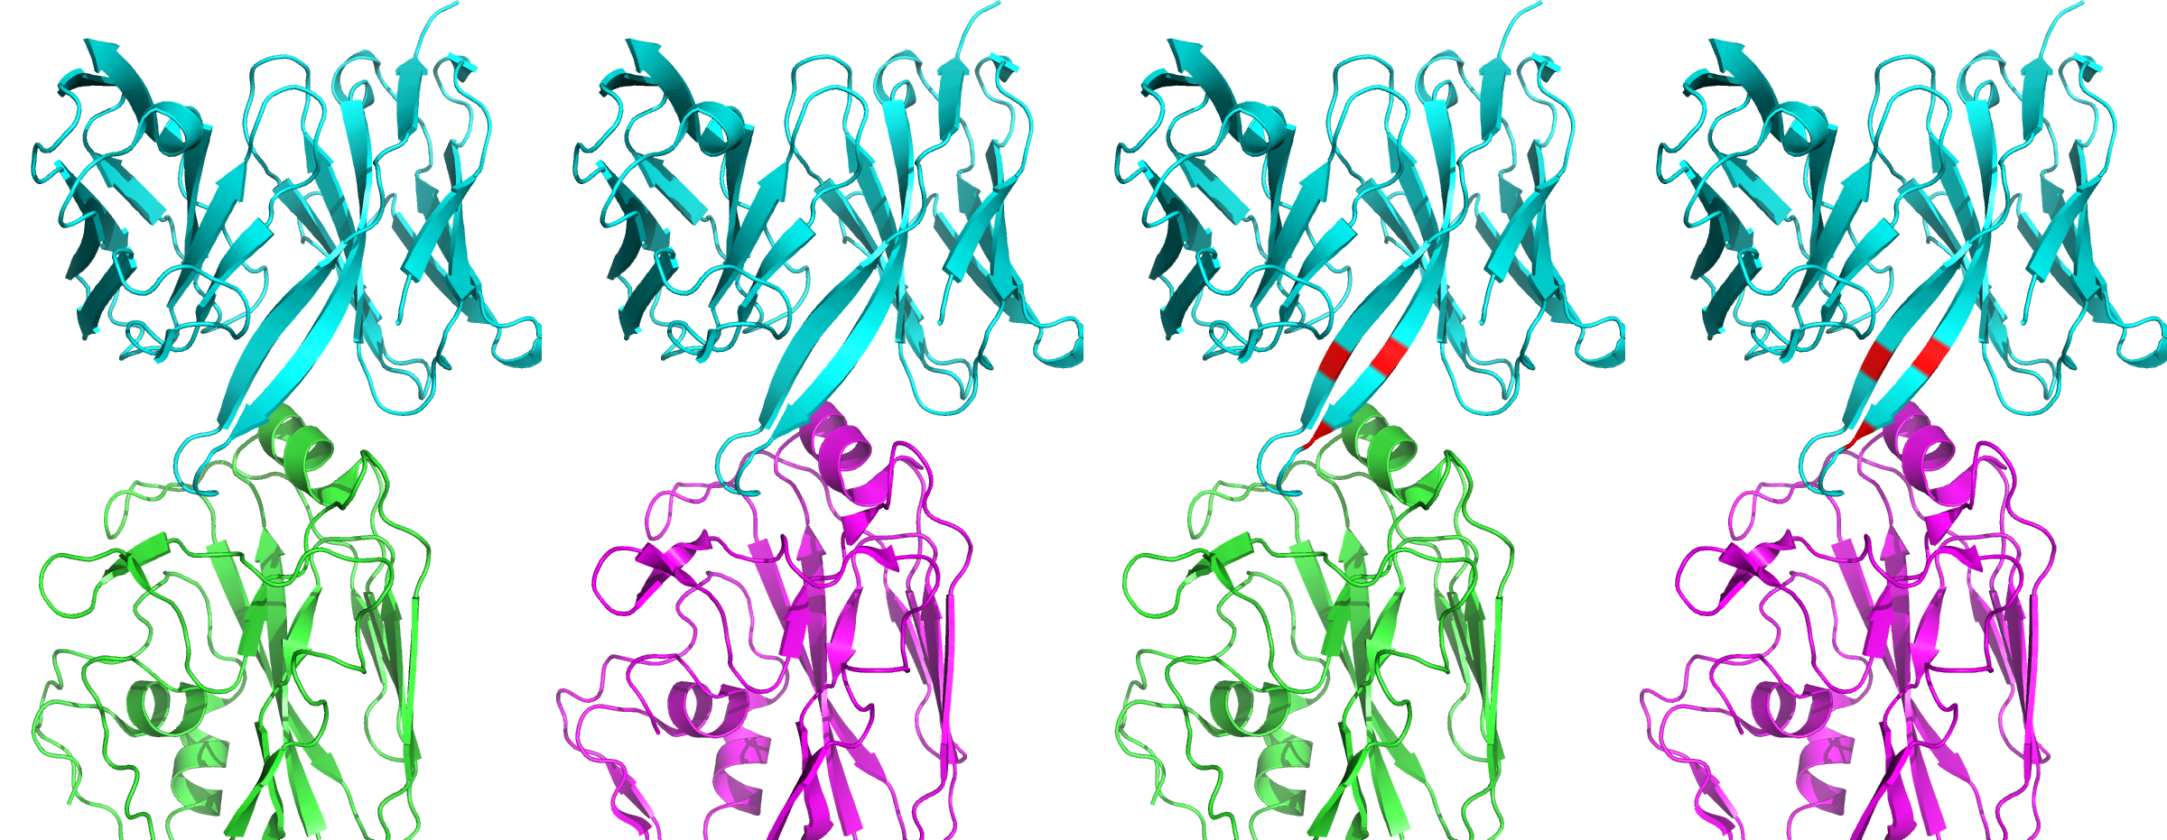
Multistate design
Multistate design: Optimize ONE sequence for low energy in MULTIPLE structures (states)
Redesign an antibody to recognize multiple targets
Antibody
Still the Same
Antibody
Antigen 1
Antigen 2
PDB ID 4yk4

Slide 17
Single-state design protocol overview
Create Input
Download PDB
Process PDB
Relax
Run FastRelax
Design
Create XML file
Create resfile
Run
Design
Control
Analysis
Create Sequence Logo
Inspect best sequences

Slide 18
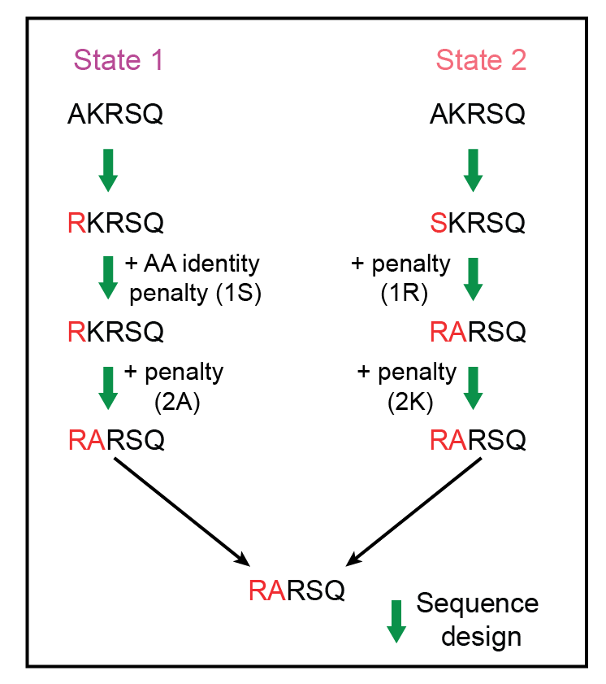
REstrained CONvergence in MSD (RECON)
Sevy, A. M., Jacobs, T. M., Crowe, J. E. & Meiler, J. PLoS Comput. Biol. 11, e1004300 (2015).
Notes:
Each state can have different resfiles, so these residues don’t have to have the same numbering in every state
However same number of designable residues must be present in all!

Slide 19
Design
Create XML file
Please open
protein_design/multi_state_design/input_files/design.xml
<PROTOCOLS>
Run four rounds of design
<Add mover=msd1 />
<Add mover=msd2 />
<Add mover=msd3 />
<Add mover=msd4 />
Find a consensus sequence
<Add mover=finish />
Calculate interface metrics
<Add mover=analyze />
</PROTOCOLS>
Multiple design operations with gradually forcing the design to one consensus sequence
Differ in constraint weight
Agree on the final consensus sequence (if yet unclear)

Slide 20
REstrained CONvergence in MSD (RECON)
MSDMover 1
MSDMover 2
MSDMover 3
FindConsensusSequence
Sevy, A. M., Jacobs, T. M., Crowe, J. E. & Meiler, J. PLoS Comput. Biol. 11, e1004300 (2015).
Notes:
Each state can have different resfiles, so these residues don’t have to have the same numbering in every state
However same number of designable residues must be present in all!

Slide 21
Design
Create XML file
Create resfile
State 1
(State 3 ...)
State 1
State 2
NATRO
start
30 H ALLAA
31 H ALLAA
…
152 L ALLAA
155 L ALLAA
…
332 A NATAA
334 A NATAA
NATRO
start
30 H ALLAA
31 H ALLAA
…
152 L ALLAA
156 L ALLAA
…
332 A NATAA
333 A NATAA
334 A NATAA
Designed residues must match 1-to-1 … but structurally, not numerically
States can differ in the number of residues being repacked

Slide 22
Rosetta Protein Design Applications

Slide 23
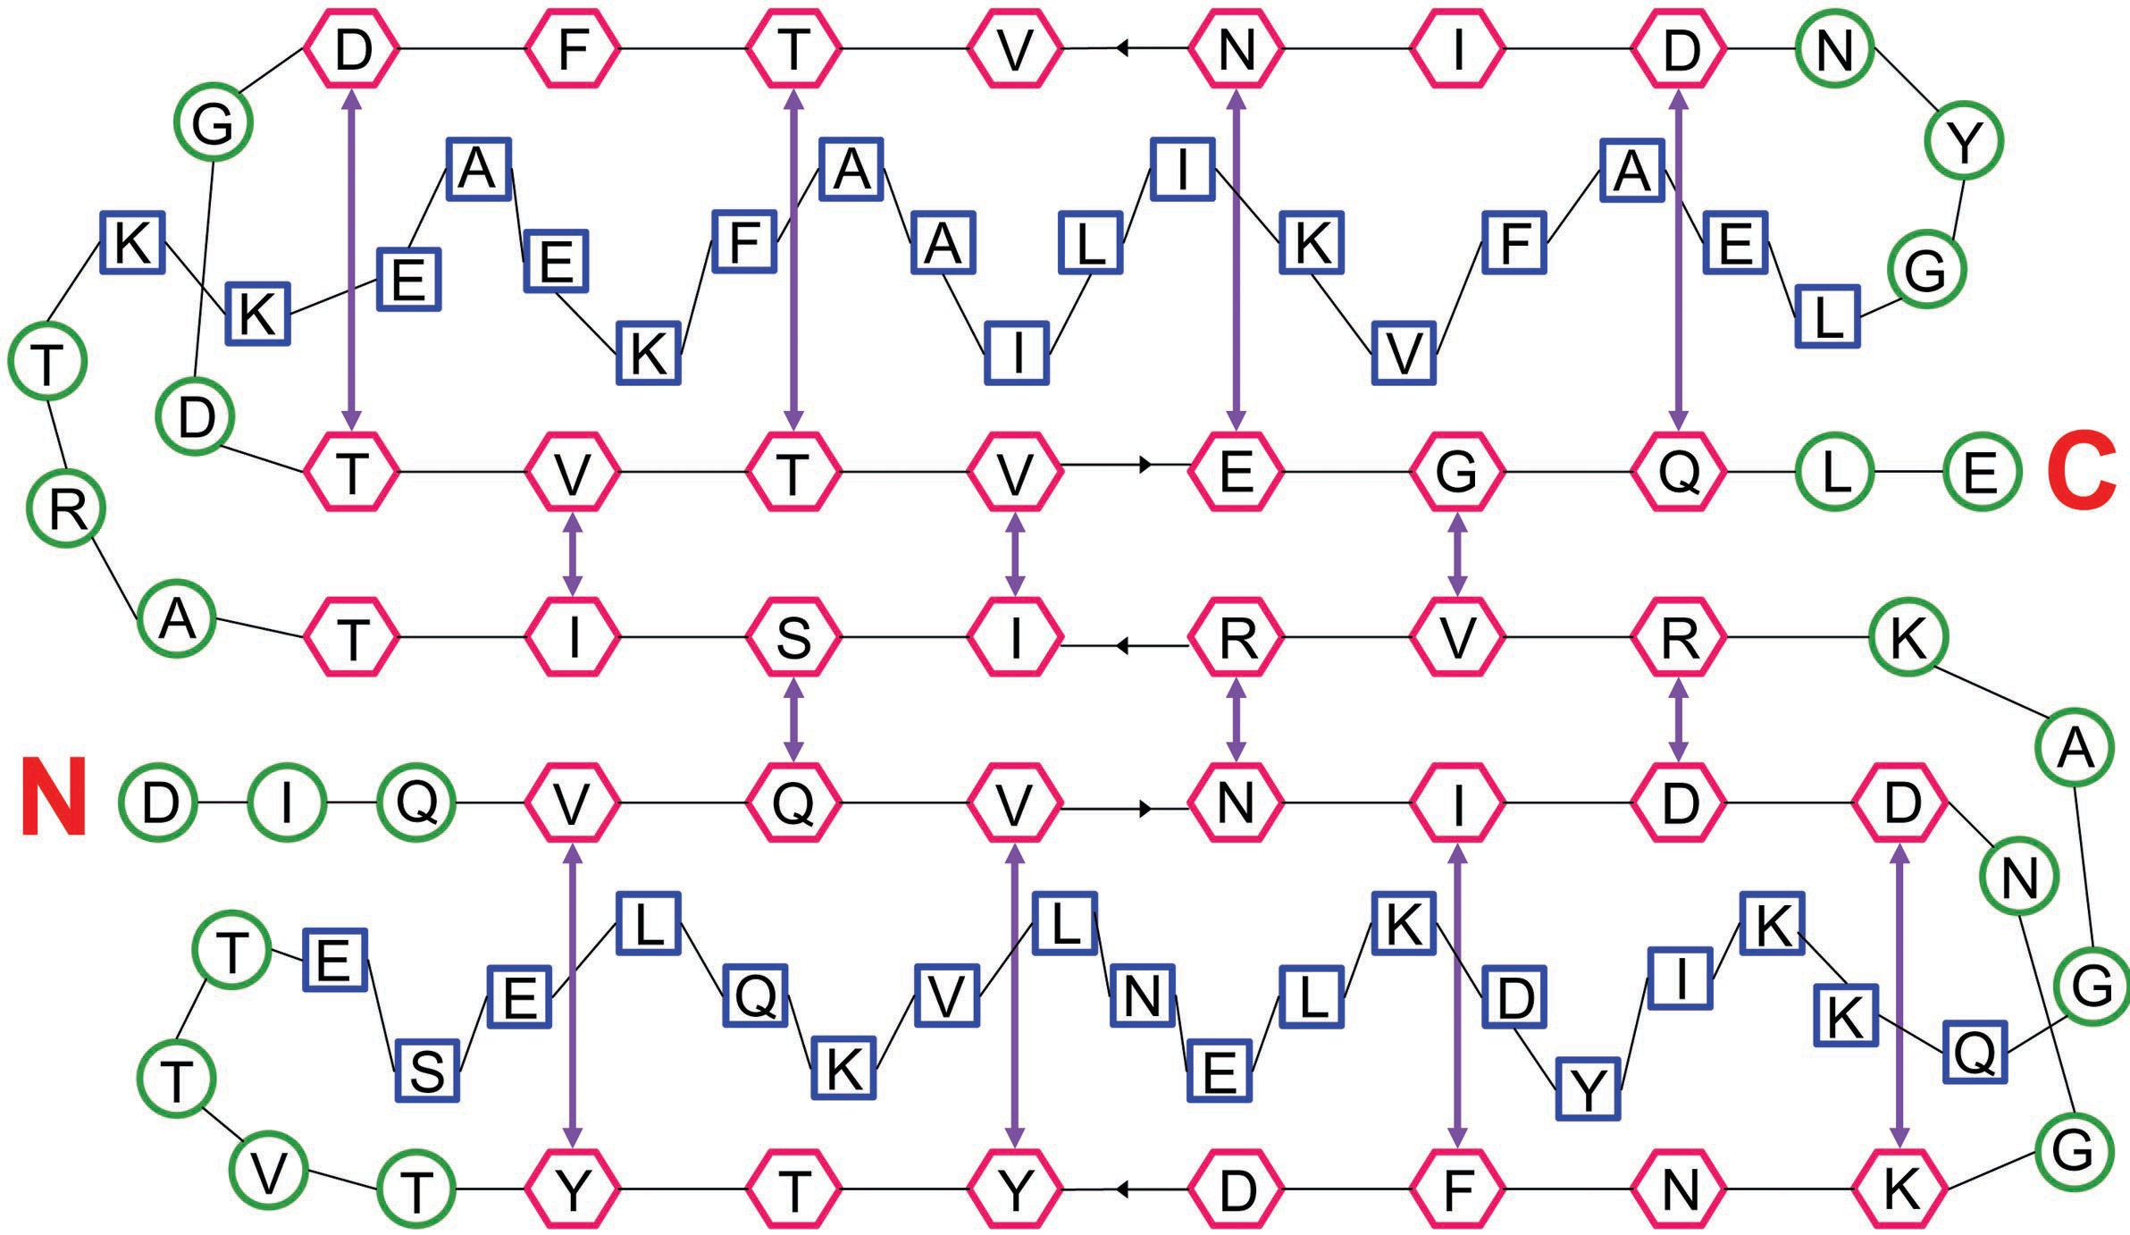
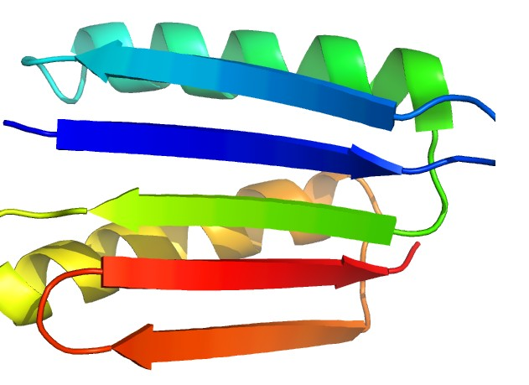
De Novo Design of a Novel Fold
Top7 “back-of-the envelope” drawn topology not found in the PDB at time of design
Iterative fixed backbone design + backbone perturbations
Kuhlman, B. et al. (2003). Design of a novel globular protein fold with atomic-level accuracy. Science 302, 1364–1368.

Slide 24
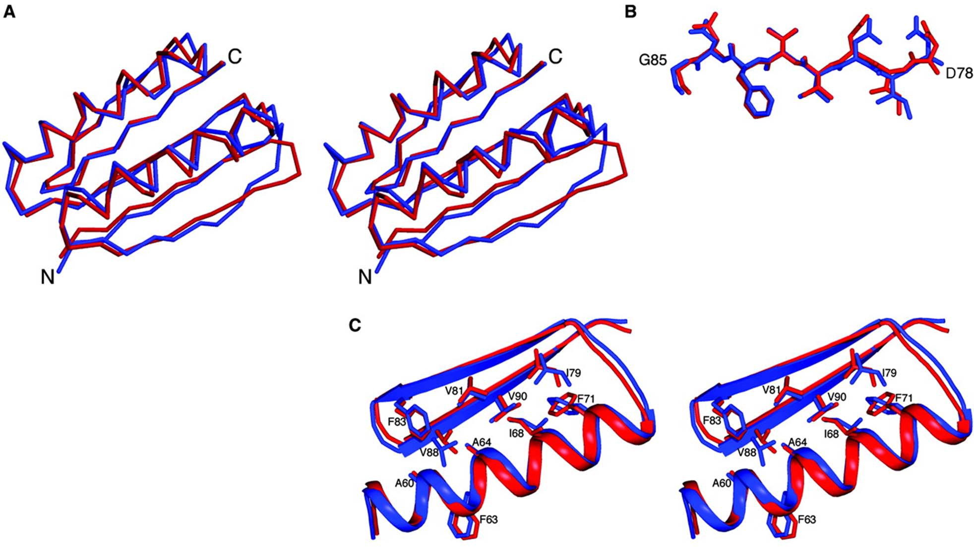
Atomic Level Accuracy of Design (blue)
to X-ray structure (red)
Kuhlman, B. et al. (2003). Design of a novel globular protein fold with atomic-level accuracy. Science 302, 1364–1368.
Notes:
1.2 Angstrom RMSD

Slide 25
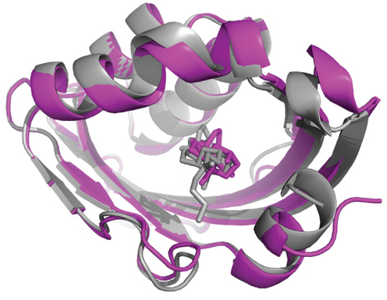
Design of Protein-Ligand Interfaces
RosettaMatch to identify stable backbone
Sequence Design:
Round 1 = maximize binding affinity for ligand
Round 2 = protein stabilization
Computational model = grey
X-ray structure = purple
Tinberg, C.E., Khare, S.D., Dou, J., Doyle, L., Nelson, J.W., Schena, A., Jankowski, W., Kalodimos, C.G., Johnsson, K., Stoddard, B.L., Baker, D. (2013). Computational design of ligand-binding proteins with high affinity and selectivity. Nature 501 212-216

Slide 26
Additional Design Applications
Novel Enzyme Design – RosettaMatch and RosettaDesign
Siegel, J.B. et al. (2010). Computational design of an enzyme catalyst for a stereoselective bimolecular Diels-Alder reaction. Science 329, 309–313
Novel Protein Therapeutic Design
Fleishman, S.J. et al. (2011). Computational design of proteins targeting the conserved stem region of influenza hemagglutinin. Science 332, 816–821.
Design of a thermally stabilized enzyme
Korkegian, A., Black, M.E., Baker, D., and Stoddard, B.L. (2005). Computational thermostabilization of an enzyme. Science 308, 857–860.
Design of self-assembling proteins as nanomaterials
King, N.P., Sheffler, W., Sawaya, M.R., Vollmar, B.S., Sumida, J.P., Andre, I., Gonen, T., Yeates, T.O., Baker, D. (2012). Computational Design of Self-Assembling Protein Nanomaterials with Atomic Level Accuracy. Science 336 1171-1174

Slide 27
Additional Design Applications
Design of symmetric superfolds to understand protein folding evolution
Fortenberry, C. et al. (2011). Exploring symmetry as an avenue to the computational design of large protein domains. J. Am. Chem. Soc. 133, 18026–18029.
Rational epitope design
Wu, X., et al. (2010). Rational design of envelope identifies broadly neutralizing human monoclonal antibodies to HIV-1. Science 329, 856– 861.
Rational vaccine design
Jardine, J., et al. (2013). Rational HIV Immunogen Design to Target Speciﬁc Germline B Cell Receptors. Science.

