Slide 1
Protein-Protein Docking
Nina Bozhanova
Rosetta Workshop
December 2019, Leipzig

Slide 2
Does Protein A Dock (or Bind to) Protein B?

Slide 3
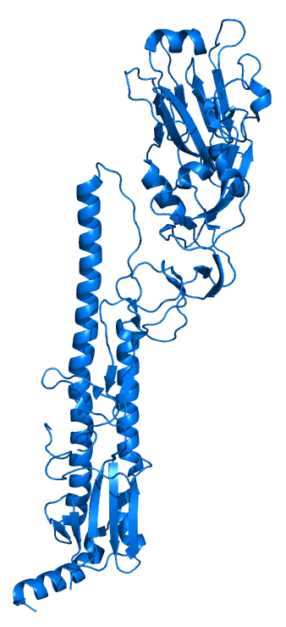
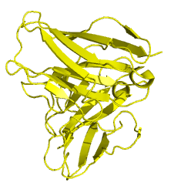
Does Antibody A bind Antigen B?

Slide 4
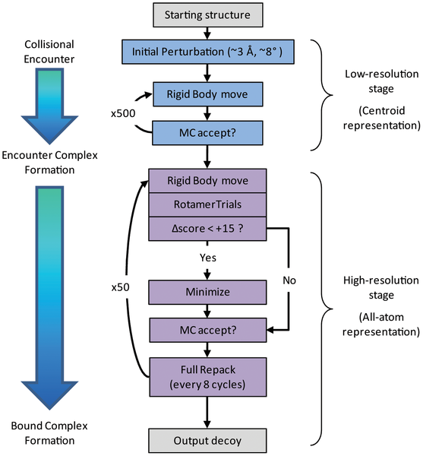
Overview – Rosetta Protein Docking
Mimics natural process of protein interaction
Hint: Incorporate experimental data to decrease conformational search space!!
Chaudhury et al, PlosONE, 2011
Notes:
Sparse search to identify favorable binding poses
adaptive rotation and translational steps adjusted dynamically to achieve an acceptance rate of 25%.
Lowest energy structure moved into refinement phase
Refinement phase
1) Rigid Body Move
0.1 Ang and 3 deg translation and rotation
2) RotamerTrials to optimize sc conformation
3) RB move energy minimized
Min only if score change is <15
MC test
Full repack of sc every 8 steps with MC test at end
4

Slide 5
General Docking Protocol
1. Prepare input files
Input structures
RosettaScripts XML File
Options File
2. Perform docking
3. Analyze results
Plot Score vs. RMSD
Examine interface
Notes:
Input structures
5

Slide 6
Step 1 – Prepare Input Files

Slide 7
Preparing your docking XML file
Open the docking_full.xml file:
gedit ~/rosetta_workshop/tutorials/proteinprotein_docking/
input_files/docking_full.xml
Notes:
7

Slide 8
docking_full.xml
<ROSETTASCRIPTS>
<SCOREFXNS>
</SCOREFXNS>
<TASKOPERATIONS>
<InitializeFromCommandline name="ifcl"/>
<RestrictToRepacking name="rtr" />
Restrict to residues within a distance and vector cutoff of the protein-protein interface
<RestrictToInterfaceVector name="rtiv" chain1_num="1,2" chain2_num="3,4" CB_dist_cutoff="10.0" nearby_atom_cutoff="5.5" vector_angle_cutoff="75" vector_dist_cutoff="9.0" />
Fix residues known experimentally to be critical in interaction
<PreventResiduesFromRepacking name="prfrp" residues="11,41,345" />
</TASKOPERATIONS>
<FILTERS>
</FILTERS>
<MOVERS>
MINIMIZATION MOVERS
Single cycle of FastRelax to minimize backbone of docking partners
<FastRelax name="minimize_interface" scorefxn="REF2015" repeats="1" task_operations="ifcl,rtr,rtiv,prfrp" />
DOCKING MOVERS
<Docking name="dock_low" score_low="score_docking_low" score_high="REF2015" fullatom="0" local_refine="0" optimize_fold_tree="1" conserve_foldtree="0" ignore_default_docking_task="0" design="0" task_operations="ifcl,prfrp" jumps="1"/>
<Docking name="dock_high" score_low="score_docking_low" score_high="REF2015" fullatom="1" local_refine="1" optimize_fold_tree="1" conserve_foldtree="0" design="0" task_operations="ifcl,prfrp" jumps="1"/>
<SaveAndRetrieveSidechains name="srsc" allsc="0" /> Speeds the move from centroid to full atom mode
</MOVERS>
<APPLY_TO_POSE>
</APPLY_TO_POSE>
<PROTOCOLS>
Run docking protocol
<Add mover="dock_low"/>
<Add mover="srsc" />
<Add mover="dock_high" />
Minimize interface
<Add mover="minimize_interface" />
</PROTOCOLS>
<OUTPUT scorefxn="REF2015" />
</ROSETTASCRIPTS>

Slide 9
docking_full.xml
<ROSETTASCRIPTS>
<SCOREFXNS>
</SCOREFXNS>
<TASKOPERATIONS>
<InitializeFromCommandline name="ifcl"/>
<RestrictToRepacking name="rtr" />
Restrict to residues within a distance and vector cutoff of the protein-protein int
<RestrictToInterfaceVector name="rtiv" chain1_num="1,2" chain2_num="3,4" CB_dist_cu
Fix residues known experimentally to be critical in interaction
<PreventResiduesFromRepacking name="prfrp" residues="11,41,345" />
</TASKOPERATIONS>
<FILTERS>
</FILTERS>
<MOVERS>
MINIMIZATION MOVERS
Single cycle of FastRelax to minimize backbone of docking partners
<FastRelax name="minimize_interface" scorefxn="REF2015" repeats="1" task_operations
DOCKING MOVERS
<Docking name="dock_low" score_low="score_docking_low" score_high="REF2015" fullato
<Docking name="dock_high" score_low="score_docking_low" score_high="REF2015" fullat
<SaveAndRetrieveSidechains name="srsc" allsc="0" /> Speeds the move from centroid t
</MOVERS>
<APPLY_TO_POSE>
</APPLY_TO_POSE>
<PROTOCOLS>
Run docking protocol
<Add mover="dock_low"/>
<Add mover="srsc" />
<Add mover="dock_high" />
Minimize interface
<Add mover="minimize_interface" />
</PROTOCOLS>
<OUTPUT scorefxn="REF2015" />
</ROSETTASCRIPTS>

Slide 10
docking_full.xml
<ROSETTASCRIPTS>
<SCOREFXNS>
</SCOREFXNS>
<TASKOPERATIONS>
<InitializeFromCommandline name="ifcl"/>
<RestrictToRepacking name="rtr" />
Restrict to residues within a distance and vector cutoff of the protein-protein int
<RestrictToInterfaceVector name="rtiv" chain1_num="1,2" chain2_num="3,4" CB_dist_cu
Fix residues known experimentally to be critical in interaction
<PreventResiduesFromRepacking name="prfrp" residues="11,41,345" />
</TASKOPERATIONS>
<FILTERS>
</FILTERS>
<MOVERS>
MINIMIZATION MOVERS
Single cycle of FastRelax to minimize backbone of docking partners
<FastRelax name="minimize_interface" scorefxn="REF2015" repeats="1" task_operations
DOCKING MOVERS
<Docking name="dock_low" score_low="score_docking_low" score_high="REF2015" fullato
<Docking name="dock_high" score_low="score_docking_low" score_high="REF2015" fullat
<SaveAndRetrieveSidechains name="srsc" allsc="0" /> Speeds the move from centroid t
</MOVERS>
<APPLY_TO_POSE>
</APPLY_TO_POSE>
<PROTOCOLS>
Run docking protocol
<Add mover="dock_low"/>
<Add mover="srsc" />
<Add mover="dock_high" />
Minimize interface
<Add mover="minimize_interface" />
</PROTOCOLS>
<OUTPUT scorefxn="REF2015" />
</ROSETTASCRIPTS>

Slide 11
PROTOCOLS
<PROTOCOLS>
Run docking protocol
<Add mover="dock_low"/>
<Add mover="srsc" />
<Add mover="dock_high" />
Minimize interface
<Add mover="minimize_interface" />
</PROTOCOLS>
In the PROTOCOLS section we can see that we will run 4 movers – which are defined in the MOVERS section above

Slide 12
MOVERS
<ROSETTASCRIPTS>
<SCOREFXNS>
</SCOREFXNS>
<TASKOPERATIONS>
<InitializeFromCommandline name="ifcl"/>
<RestrictToRepacking name="rtr" />
Restrict to residues within a distance and vector cutoff of the protein-protein int
<RestrictToInterfaceVector name="rtiv" chain1_num="1,2" chain2_num="3,4" CB_dist_cu
Fix residues known experimentally to be critical in interaction
<PreventResiduesFromRepacking name="prfrp" residues="11,41,345" />
</TASKOPERATIONS>
<FILTERS>
</FILTERS>
<MOVERS>
MINIMIZATION MOVERS
Single cycle of FastRelax to minimize backbone of docking partners
<FastRelax name="minimize_interface" scorefxn="REF2015" repeats="1" task_operations
DOCKING MOVERS
<Docking name="dock_low" score_low="score_docking_low" score_high="REF2015" fullato
<Docking name="dock_high" score_low="score_docking_low" score_high="REF2015" fullat
<SaveAndRetrieveSidechains name="srsc" allsc="0" /> Speeds the move from centroid t
</MOVERS>
<APPLY_TO_POSE>
</APPLY_TO_POSE>
<PROTOCOLS>
Run docking protocol
<Add mover="dock_low"/>
<Add mover="srsc" />
<Add mover="dock_high" />
Minimize interface
<Add mover="minimize_interface" />
</PROTOCOLS>
<OUTPUT scorefxn="REF2015" />
</ROSETTASCRIPTS>

Slide 13
MOVERS
<MOVERS>
MINIMIZATION MOVERS
Single cycle of FastRelax to minimize backbone of docking partners
<FastRelax name="minimize_interface" scorefxn="REF2015" repeats="1" task_operations
DOCKING MOVERS
<Docking name="dock_low" score_low="score_docking_low" score_high="REF2015" fullato
<Docking name="dock_high" score_low="score_docking_low" score_high="REF2015" fullat
<SaveAndRetrieveSidechains name="srsc" allsc="0" /> Speeds the move from centroid t
</MOVERS>
In the MOVERS section we’ve defined 4 different movers

Slide 14
Docking movers
<Docking name=(string) score_low=(string) score_high=(string) fullatom=(bool) local_refine=(bool) jumps=(Integer vector) optimize_fold_tree=(bool) conserve_foldtree=(bool) design=(bool) ignore_default_docking_task=(bool) task_operations=(comma-separated list)/>
Terms | Definition
score_low | scorefxn for centroid-level docking
score_high | scorefxn for full atom docking
fullatom | if true, do full atom docking
local_refine | if true, skip centroid.
jumps | where should we carry out rigid body motions (not used here)
optimize_fold_tree | should DockingProtocol make the fold tree for this pose
conserve_fold_tree | should DockingProtocol reset the fold tree to the input one after it is done
design | interface design for all chains downstream of the rb_jump
ignore_default_docking_task | allows you to ignore the default docking task and only use the ones defined in your task_operations section

Slide 15
Docking movers
2 Docking Movers have been defined – low res and high res docking
<Docking name="dock_low" score_low="score_docking_low" score_high="REF2015" fullatom="0" local_refine="0” ignore_default_docking_task="0" design="0" task_operations="ifcl,prfrp" jumps="1"/>
<Docking name="dock_high" score_low="score_docking_low" score_high="REF2015" fullatom="1" local_refine="1” design="0" task_operations="ifcl,prfrp" jumps="1"/>
Additionally a mover to speed the move from centroid (low res) to full atom (high res) docking
<SaveAndRetrieveSidechains name="srsc" allsc="0" />

Slide 16
Minimization movers
Use a single round of FastRelax to refine the backbone of both docking partners
<FastRelax name=”minimize_interface” scorefxn=”REF2015” repeats=”1” task_operations=”ifcl,rtr,rtiv,prfrp” />
Notes:
16

Slide 17
TASKOPERATIONS
<ROSETTASCRIPTS>
<SCOREFXNS>
</SCOREFXNS>
<TASKOPERATIONS>
<InitializeFromCommandline name="ifcl"/>
<RestrictToRepacking name="rtr" />
Restrict to residues within a distance and vector cutoff of the protein-protein int
<RestrictToInterfaceVector name="rtiv" chain1_num="1,2" chain2_num="3,4" CB_dist_cu
Fix residues known experimentally to be critical in interaction
<PreventResiduesFromRepacking name="prfrp" residues="11,41,345" />
</TASKOPERATIONS>
<FILTERS>
</FILTERS>
<MOVERS>
MINIMIZATION MOVERS
Single cycle of FastRelax to minimize backbone of docking partners
<FastRelax name="minimize_interface" scorefxn="REF2015" repeats="1" task_operations
DOCKING MOVERS
<Docking name="dock_low" score_low="score_docking_low" score_high="REF2015" fullato
<Docking name="dock_high" score_low="score_docking_low" score_high="REF2015" fullat
<SaveAndRetrieveSidechains name="srsc" allsc="0" /> Speeds the move from centroid t
</MOVERS>
<APPLY_TO_POSE>
</APPLY_TO_POSE>
<PROTOCOLS>
Run docking protocol
<Add mover="dock_low"/>
<Add mover="srsc" />
<Add mover="dock_high" />
Minimize interface
<Add mover="minimize_interface" />
</PROTOCOLS>
<OUTPUT scorefxn="REF2015" />
</ROSETTASCRIPTS>

Slide 18
TaskOperations
<TASKOPERATIONS>
<InitializeFromCommandline name=”ifcl”/>
<RestrictToRepacking name=”rtr” />
<RestrictToInterfaceVector name=”rtiv” chain1_num=”1,2” chain2_num=”3,4” CB_dist_cutoff=”10.0” nearby_atom_cutoff=”5.5” vector_angle_cutoff=”75” vector_dist_cutoff=”9.0” />
<PreventResiduesFromRepacking name=”prfrp” residues=”11,41,345” />
</TASKOPERATIONS>
Initialize from command line – allows the mover to read options from the command line
Restrict to repacking – default behavior is design (very important)
Restrict to Interface Vector – restrict which residues are operated on within a given geometry
Prevent Res From Repacking – stop experimentally known residues from repacking
Notes:
Emphasize RTR
Restricts the task to residues defined as interface by core/pack/task/operation/util/interface_vector_calculate.cc Calculates the residues at an interface between two protein chains or jump. The calculation is done in the following manner. First the point graph is used to find all residues within some big cutoff(CB_dist_cutoff) of residues on the other chain. For these residues near the interface, two metrics are used to decide if they are actually possible interface residues. The first metric is to itterate through all the side chain atoms in the residue of interest and check to see if their distance is less than the nearby atom cutoff (nearby_atom_cutoff), if so then they are an interface residue. If a residue does not pass that check, then two vectors are drawn, a CA-CB vector and a vector from CB to a CB atom on the neighboring chain. The dot product between these two vectors is then found and if the angle between them (vector_angle_cutoff) is less than some cutoff then they are classified as interface. The vector cannot be longer than some other distance (vector_dist_cutoff).
18

Slide 19
Preparing your options file
Open the docking.options file:
gedit ~/rosetta_workshop/tutorials/proteinprotein_docking/
input_files/docking.options
Notes:
19

Slide 20
docking.options
-docking # the docking option group
-partners AB_HL # set rigid body docking partners
-dock_pert 3 8 # set coarse perturbation parameters (degrees and angstroms)
-dock_mcm_trans_magnitude 0.1 # refinement translational perturbation
-dock_mcm_rot_magnitude 5.0 # refinement rotational perturbation
-s 3gbm_HA_3gbn_Ab.pdb # input model
-run:max_retry_job 10 # if the mover fails, retry 10 times
-use_input_sc # add the side chains from the input pdb to the rotamer library
-ex1 # increase rotamer bins to include mean +- 1 standard deviation
-ex2 # increase rotamer bins to include mean +- 2 standard deviations
-out # out option group
-file # out:file option group
-scorefile docking.fasc # the name of the model score file
-score:weights ref2015.wts # Set ref2015 as default score function

Slide 21
Important options
Option Terms | Definition
docking:partners AB_HL | sets rigid body docking partners – chains must be in this order in the PDB
docking:randomize 1 | randomize the first docking partner – should be passed to run global docking (not used in this tutorial)
docking:dock_pert 3 8 | set coarse perturbation parameters (angstroms and degrees)
docking:dock_mcm_trans_magnitude 0.1 | refinement translational perturbation
docking:dock_mcm_rot_magnitude 5.0 | refinement rotational perturbation

Slide 22
Step 2 – Run Rosetta (see tutorial)

Slide 23
Step 3 – Analyze Results

Slide 24
Perform analysis
Score vs. RMSD plots to identify a docking funnel
In experimental studies, the ‘native structure’ is a good scoring structure, one that fulfills experimental restraints, or a cluster center
It may be necessary to cluster and dock again, using the top cluster centers as starting templates. This will help to drive the models into an energy well. The ‘correct’ model will continue down into an energy well while incorrect models will stall.
Look at the structures
Unsatisfied polar residues
Binding density
Average Degree of Residue Burial
Fleishman, S. J.; Baker, D., Role of the biomolecular energy gap in protein design, structure, and evolution. Cell 2012, 149 (2), 262-73
Fleishman, S. J.; Whitehead, T. A.; Strauch, E. M.; Corn, J. E.; … ; Baker, D., Community-wide assessment of protein-interface modeling suggests improvements to design methodology. Journal of molecular biology 2011, 414 (2), 289-302.

Slide 25
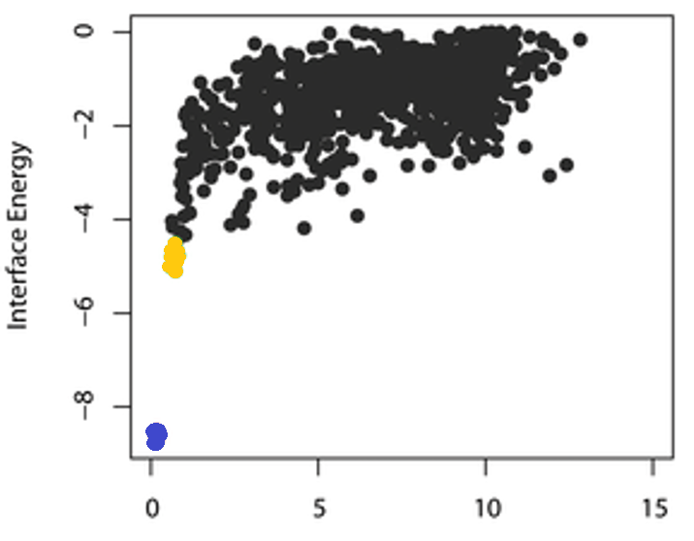
Score vs RMSD plots – identifying a docking funnel
Key features:
Native complex is kept at low RMSD, low scoring
Good models are sampled (< 2 A RMSD)
Score function distinguishes between low and high RMSD models
Rmsd (Å)
Black – Full docking protocol
Yellow – Top models
Blue – Refinement of native complex
Notes:
RB failure – correct models scored at same level as incorrect models
BB failure – even refinement of unbound partners does not result in native-like structures
Discrimination Failure – native-like conformations are never recognized by the scoring function
25

Slide 26
Today’s Tutorial
cd ~/rosetta_workshop/tutorials/
protein-protein_docking/
firefox protein-protein_docking_tutorial.html

Slide 27
Cross docking experiment

Slide 28
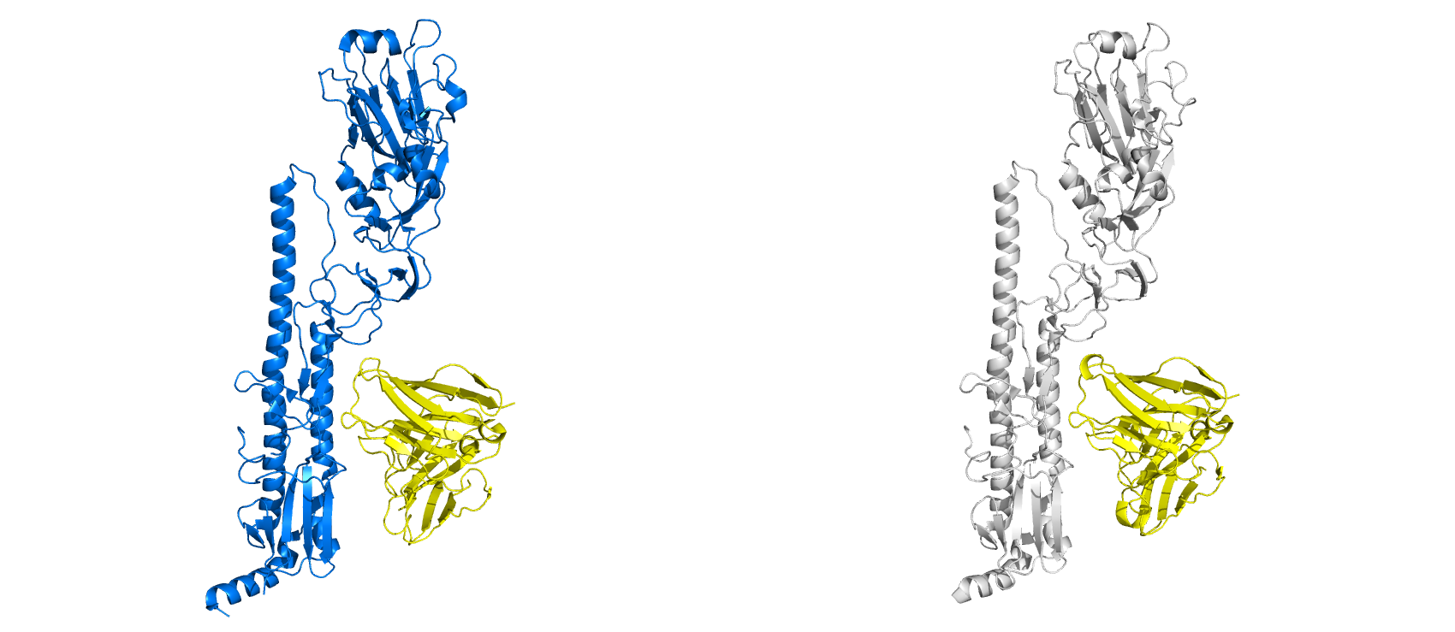
Ab CR6261 bound to both H5 and H1 HA
3GBM
3GBN

Slide 29
Ab CR6261 bound to both H5 and H1 HA
3GBM
3GBN
Cross-docking experiment – HA from PDB 3GBM, Ab from PDB 3GBN
The Ab have the same sequence, but slightly different structure
Not very interesting – but important! Simple benchmarking (or control) experiment, does something that should bind actually bind in Rosetta

Slide 30
Reference List
Docking
Gray, J. J.; Moughon, S.; Wang, C.; Schueler-Furman, O.; Kuhlman, B.; Rohl, C. A.; Baker, D., Protein-protein docking with simultaneous optimization of rigid-body displacement and side-chain conformations. Journal of molecular biology 2003, 331 (1), 281-99.
Daily, M. D.; Masica, D.; Sivasubramanian, A.; Somarouthu, S.; Gray, J. J., CAPRI rounds 3-5 reveal promising successes and future challenges for RosettaDock. Proteins 2005, 60 (2), 181-6.
Chaudhury, S.; Sircar, A.; Sivasubramanian, A.; Berrondo, M.; Gray, J. J., Incorporating biochemical information and backbone flexibility in RosettaDock for CAPRI rounds 6-12. Proteins 2007, 69 (4), 793-800.
Sircar, A.; Chaudhury, S.; Kilambi, K. P.; Berrondo, M.; Gray, J. J., A generalized approach to sampling backbone conformations with RosettaDock for CAPRI rounds 13-19. Proteins 2010, 78 (15), 3115-23.
Sivasubramanian, A.; Sircar, A.; Chaudhury, S.; Gray, J. J., Toward high-resolution homology modeling of antibody Fv regions and application to antibody-antigen docking. Proteins 2009, 74 (2), 497-514.
Sircar, A.; Gray, J. J., SnugDock: paratope structural optimization during antibody-antigen docking compensates for errors in antibody homology models. PLoS computational biology 2010, 6 (1), e1000644

Slide 31
Reference list continued
Design
Fleishman, S. J.; Whitehead, T. A.; Ekiert, D. C.; Dreyfus, C.; Corn, J. E.; Strauch, E. M.; Wilson, I. A.; Baker, D., Computational design of proteins targeting the conserved stem region of influenza hemagglutinin. Science 2011, 332 (6031), 816-21.
Fleishman, S. J.; Corn, J. E.; Strauch, E. M.; Whitehead, T. A.; Karanicolas, J.; Baker, D., Hotspot-centric de novo design of protein binders. Journal of molecular biology 2011, 413 (5), 1047-62.
Der, B. S.; Machius, M.; Miley, M. J.; Mills, J. L.; Szyperski, T.; Kuhlman, B., Metal-mediated affinity and orientation specificity in a computationally designed protein homodimer. Journal of the American Chemical Society 2012, 134 (1), 375-85.
Mandell, D. J.; Kortemme, T., Computer-aided design of functional protein interactions. Nature chemical biology 2009, 5 (11), 797-807.
Joachimiak, L. A.; Kortemme, T.; Stoddard, B. L.; Baker, D., Computational design of a new hydrogen bond network and at least a 300-fold specificity switch at a protein-protein interface. Journal of molecular biology 2006, 361 (1), 195-208.
Analysis
Fleishman, S. J.; Baker, D., Role of the biomolecular energy gap in protein design, structure, and evolution. Cell 2012, 149 (2), 262-73.
Fleishman, S. J.; Khare, S. D.; Koga, N.; Baker, D., Restricted sidechain plasticity in the structures of native proteins and complexes. Protein science : a publication of the Protein Society 2011, 20 (4), 753-7.
Fleishman, S. J.; Whitehead, T. A.; Strauch, E. M.; Corn, J. E.; … ; Baker, D., Community-wide assessment of protein-interface modeling suggests improvements to design methodology. Journal of molecular biology 2011, 414 (2), 289-302.

