Slide 1
Rosetta Scaffolding
Cristina E. Martina
PostDoc, Meiler Lab
Leipzig Rosetta Workshop
December 2019
cristinaelisamartina@gmail.com

Slide 2
Why we need motif grafting and scaffold design?

Slide 3
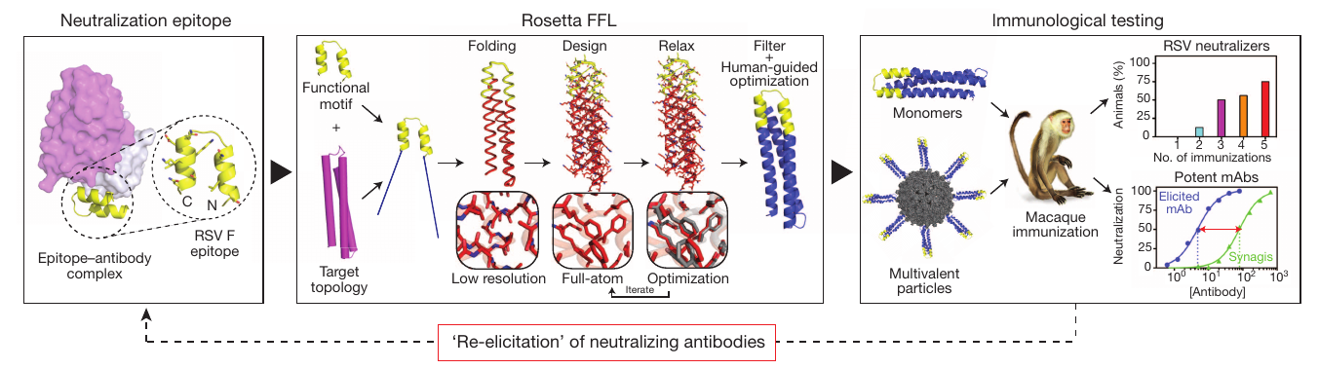
Why scaffolding?
Engineering therapeutics
- immunogen design
- vaccine design
- antibody design

Slide 4
Why scaffolding?
Engineering therapeutics
- immunogen design
- vaccine design
- antibody design
Stabilizing flexible domains
Adding functions/interaction

Slide 5
Which options does Rosetta offer?

Slide 6
Rosetta scaffolding:
Rosetta Motif Graft:
1- SideChain graft Rosetta_script (xml file) Scaffold design
2- Backbone graft Rosetta_script (xml file) Scaffold design
Rosetta Functional Folding and Design:
3- FunFolDes Rosetta_script (xml file) Scaffold/Loop design
Rosetta Motif Design:
4- RosettaRemodel Rosetta application Scaffold/Backbone design

Slide 7
Rosetta Motif Graft
(tutorials 1 and 2)

Slide 8
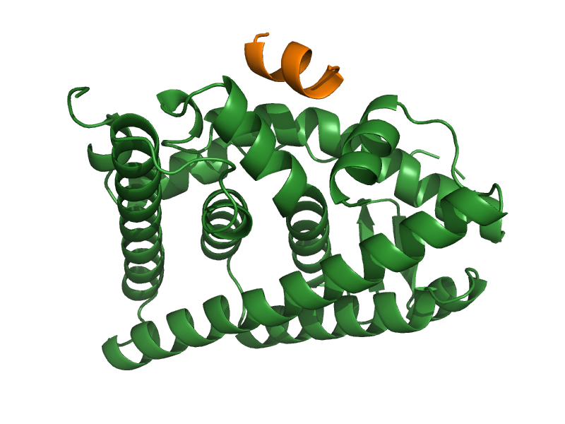
Scaffolding Tutorial:
Coactivator, helical peptide
Estrogen Receptor
(ERα)

Slide 9
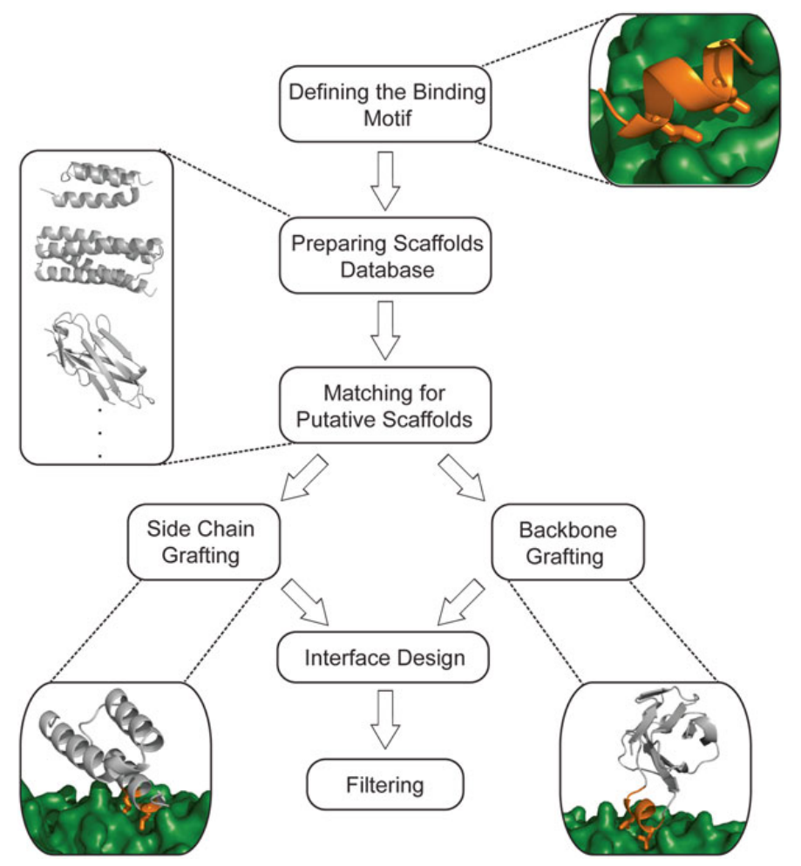
1 & 2 - Rosetta Grafting:
RMSD < 0.5 Å
RMSD > 0.5 Å
(Silva D, 2016)

Slide 10
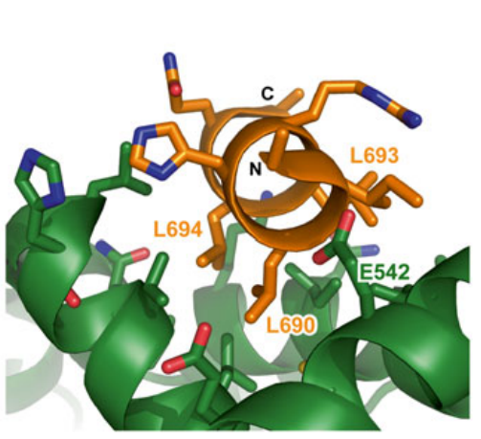
Defining the Binding Motif:
Coactivator
(LXXLL motif)
Motif.pdb
Estrogen Receptor
(ERα)
Context.pdb
(Silva D, 2016)

Slide 11
Scaffold Database:
Advanced search from RCSB-PDB:
- High-resolution diffraction data ( < 2.5 Å (better < 2.0 Å))
- Protein has been reported to be expressed in E. coli
- Single protein chain in the asymmetric unit
- No bound ligand or modified residues
Scaffold proteins must be energy minimized using Rosetta

Slide 12
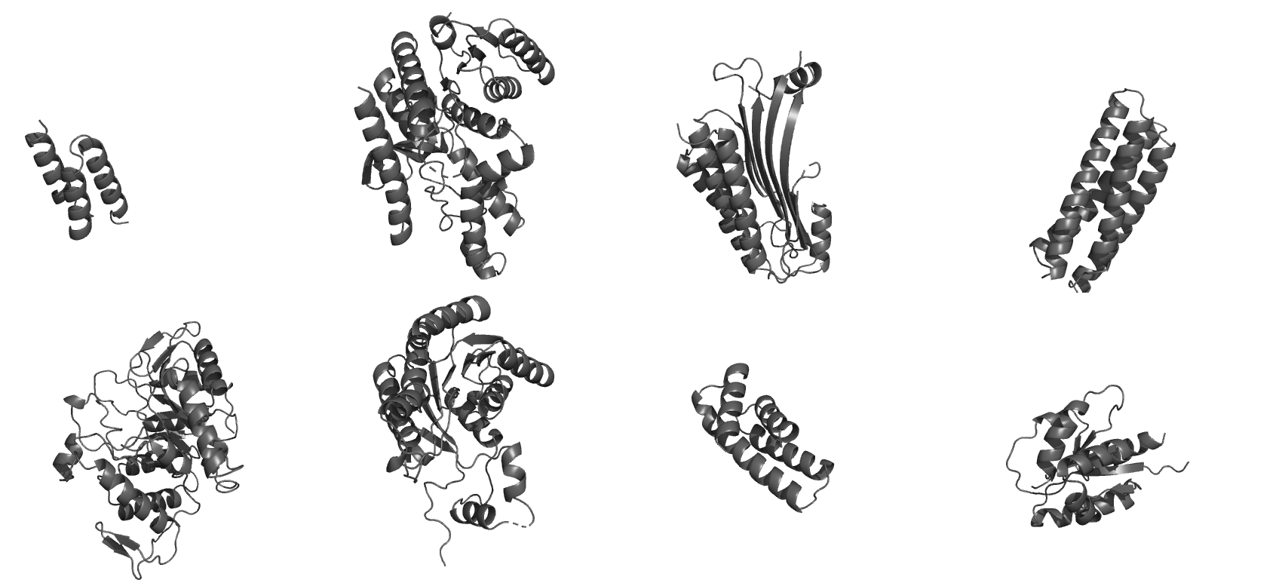
Scaffold Database:
Scaffold(s).pdb

Slide 13
1- Side-Chain Grafting

Slide 14
1- Side-Chain Grafting:
Protocol (xml file):
1- Transplant Side-chains
2- Re-design surroundings residues
Select best models
- binding energy (ΔΔG < 0)
- shape complementarity (Sc > 0.65)
- buried unsatisfied H-bonds (low)
Filtering (user):

Slide 15
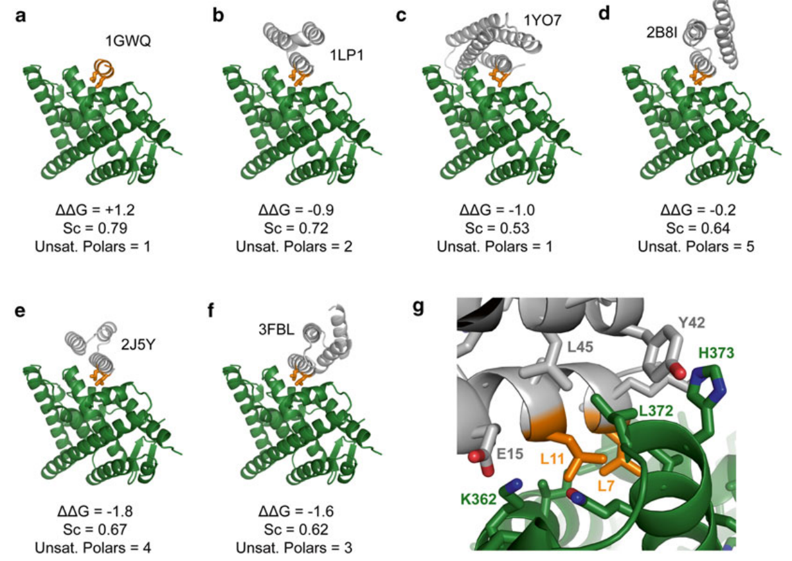
1- Side-Chain Grafting:
(Silva D, 2016)

Slide 16
1- Side-Chain Grafting:
XML file:
<ROSETTASCRIPTS>
<TASKOPERATIONS>
<ProteinInterfaceDesign name="pido" repack_chain1="1" repack_chain2="1" design_chain1="0"
design_chain2="1" interface_distance_cutoff="8.0"/>
<OperateOnCertainResidues name="hotspot_repack">
<ResiduePDBInfoHasLabel property="HOTSPOT"/>
<RestrictToRepackingRLT/>
</OperateOnCertainResidues>
</TASKOPERATIONS>
<SCOREFXNS>
</SCOREFXNS>
<FILTERS>
<Ddg name="ddg" confidence="0"/>
<BuriedUnsatHbonds name="unsat" confidence="0"/>
<ShapeComplementarity name="Sc" confidence="0"/>
</FILTERS>
<MOVERS>
<MotifGraft name="motif_grafting" context_structure="context.pdb" motif_structure="motif.pdb" RMSD_tolerance="0.3"
NC_points_RMSD_tolerance="0.5" clash_score_cutoff="5" clash_test_residue="GLY" hotspots="3:7"
combinatory_fragment_size_delta="2:2" full_motif_bb_alignment="1" graft_only_hotspots_by_replacement="1"
revert_graft_to_native_sequence="1"/>
<build_Ala_pose name="ala_pose" partner1="0" partner2="1" interface_cutoff_distance="8.0" task_operations="hotspot_repack"/>
<Prepack name="ppk" jump_number="0"/>
<PackRotamersMover name="design" task_operations="hotspot_repack,pido"/>
<MinMover name="rb_min" bb="0" chi="1" jump="1"/>
</MOVERS>
<PROTOCOLS>
<Add mover_name="motif_grafting"/>
<Add mover_name="ala_pose"/>
<Add mover_name="ppk"/>
<Add mover_name="design"/>
<Add mover_name="rb_min"/>
<Add mover_name="design"/>
<Add filter_name="unsat"/>
<Add filter_name="ddg"/>
<Add filter_name="Sc"/>
</PROTOCOLS>
</ROSETTASCRIPTS>

Slide 17
2- Backbone Grafting

Slide 18
2- Backbone Grafting:
Protocol (xml file):
1- Remove native scaffold backbone
2- Model new epitope between termini
3- Re-design surrounding residues
Select best models
- binding energy (ΔΔG < 0)
- shape complementarity (Sc > 0.65)
- buried unsatisfied H-bonds (low)
Filtering (user):

Slide 19
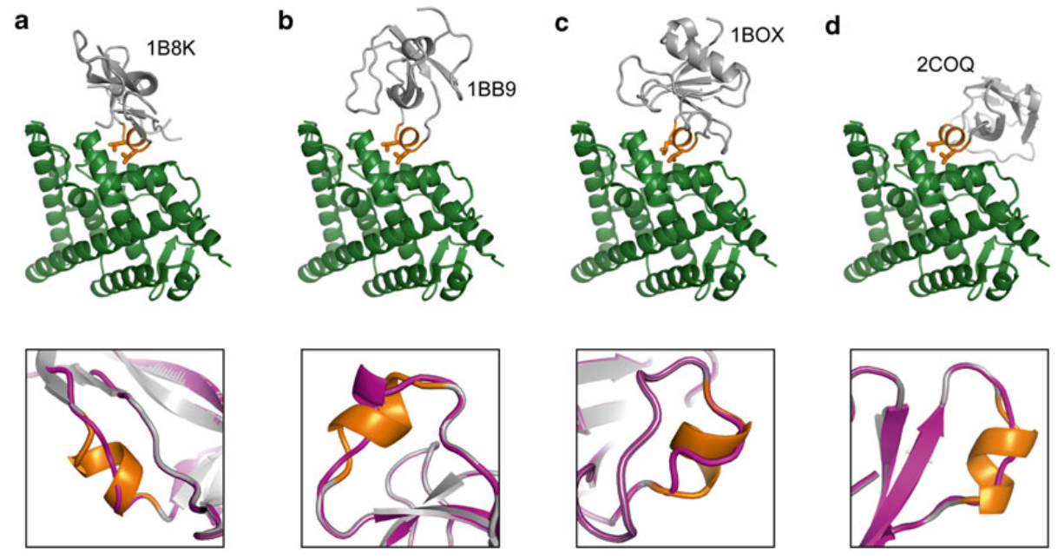
2- Backbone Grafting:
(Silva D, 2016)

Slide 20
2- Backbone Grafting:
XML file:
<ROSETTASCRIPTS>
<TASKOPERATIONS>
<ProteinInterfaceDesign name="pido_far" interface_distance_cutoff="15.0"/>
<ProteinInterfaceDesign name="pido_med" interface_distance_cutoff="12.0"/>
<ProteinInterfaceDesign name="pido_near" interface_distance_cutoff="8.0"/>
<OperateOnCertainResidues name="hotspot_repack">
<ResiduePDBInfoHasLabel property="HOTSPOT"/>
<RestrictToRepackingRLT/>
</OperateOnCertainResidues>
<SelectBySASA name="core" mode="sc" state="bound" probe_radius="2.2" core_asa="0"
surface_asa="30" core="1" boundary="0" surface="0"/>
<SelectBySASA name="core_and_boundary" mode="sc" state="bound" probe_radius="2.2"
core_asa="0" surface_asa="30" core="1" boundary="1" surface="0"/>
</TASKOPERATIONS>
<SCOREFXNS>
</SCOREFXNS>
<FILTERS>
<Ddg name="ddg" confidence="0"/>
<BuriedUnsatHbonds name="unsat" confidence="0"/>
<ShapeComplementarity name="Sc" confidence="0"/>
</FILTERS>
<MOVERS>
<MotifGraft name="motif_grafting" context_structure="context.pdb" motif_structure="motif.pdb" RMSD_tolerance="1.0"
NC_points_RMSD_tolerance="1.0" clash_score_cutoff="5" clash_test_residue="GLY" hotspots="3:7"
combinatory_fragment_size_delta="2:2" max_fragment_replacement_size_delta="-8:8"
full_motif_bb_alignment="0" graft_only_hotspots_by_replacement="0"/>
<build_Ala_pose name="ala_pose" partner1="0" partner2="1" interface_cutoff_distance="8.0" task_operations="hotspot_repack"/>
<Prepack name="ppk" jump_number="0"/>
<PackRotamersMover name="design_core" task_operations="hotspot_repack,pido_far,core"/>
<PackRotamersMover name="design_boundary" task_operations="hotspot_repack,pido_med,core_and_boundary"/>
<PackRotamersMover name="design_interface" task_operations="hotspot_repack,pido_near"/>
<MinMover name="sc_min" bb="0" chi="1" jump="1"/>
</MOVERS>
<PROTOCOLS>
<Add mover_name="motif_grafting"/>
<Add mover_name="ala_pose"/>
<Add mover_name="ppk"/>
<Add mover_name="design_core"/>
<Add mover_name="design_boundary"/>
<Add mover_name="design_interface"/>
<Add mover_name="sc_min"/>
<Add filter_name="unsat"/>
<Add filter_name="ddg"/>
<Add filter_name="Sc"/>
</PROTOCOLS>
</ROSETTASCRIPTS>

Slide 21
Rosetta Motif Graft:
1- Side-Chain Grafting:
WHEN:
- RMSD < 0.5 Å
PRO:
- Minimal number of changes to the scaffold
- Higher chance of correctly folded designs
CONS:
- Limited availability of scaffolds (i.e. weird dihedral angles in the motif can not be fitted in the existing scaffolds
2- Backbone Grafting:
WHEN:
- RMSD > 0.5 Å
- Similar distance for N- and C- terms
PRO:
- Extremely versatile (different SS and lengths)
- Discontinuous epitopes
CONS:
- Might disrupt overall fold
- Unfavorable mutation in scaffold core
(Silva D, 2016)

Slide 22
Rosetta FunFolDes
(Tutorial 3)

Slide 23
3- FunFolDes:
(derived from Fold From Loops (FFL))
- intended for scaffold with low structural similarity
- accepts multiple discontinuous backbone segments
- can swap them if necessary!
- accepts binding partners (including small ligand!)
- allows flexibility across the overall structure
- couple folding and design:
1- Motif is inserted in the scaffold and kept fixed (static)
2- Scaffold is folded through fragment picking
3- Model is accepted if RMSD < threshold (defined by user)
4- Sequence design and relax

Slide 24
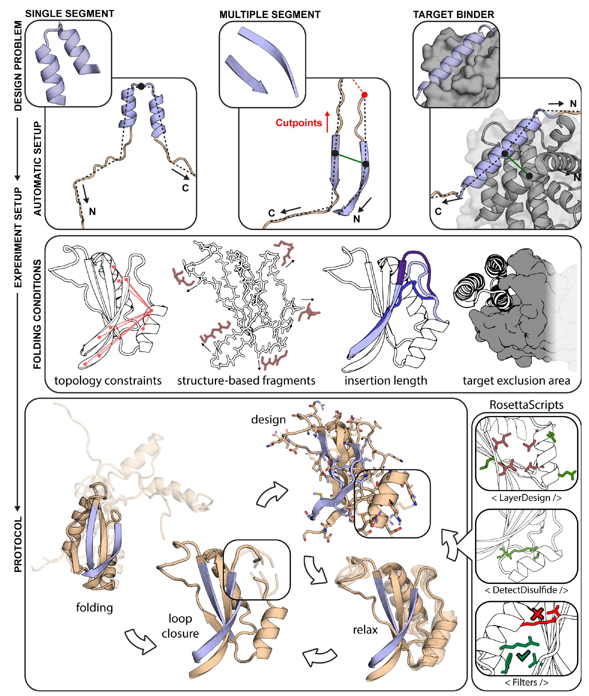
3- FunFolDes:
(Bonet, 2018)

Slide 25
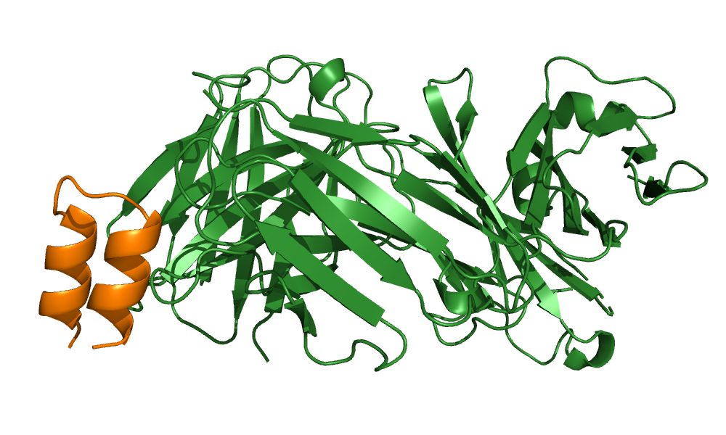
The Motif:
Respiratory Syncytial Virus protein F (RSVF) site II epitope
K_{D} = 20 nM
Antibody motavizumab
(mota)

Slide 26
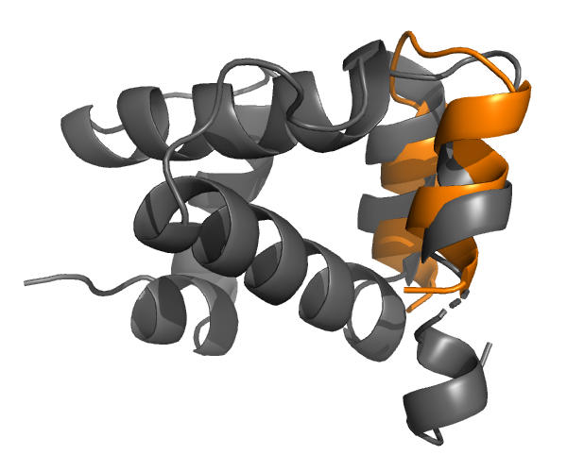
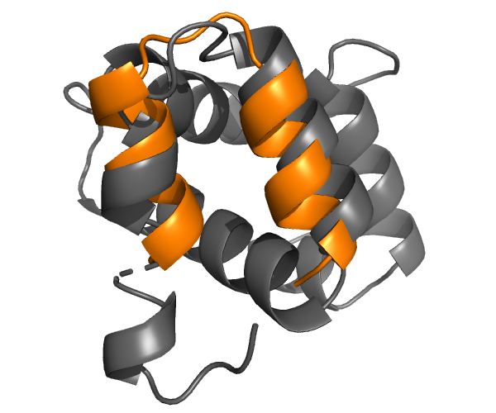
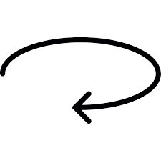
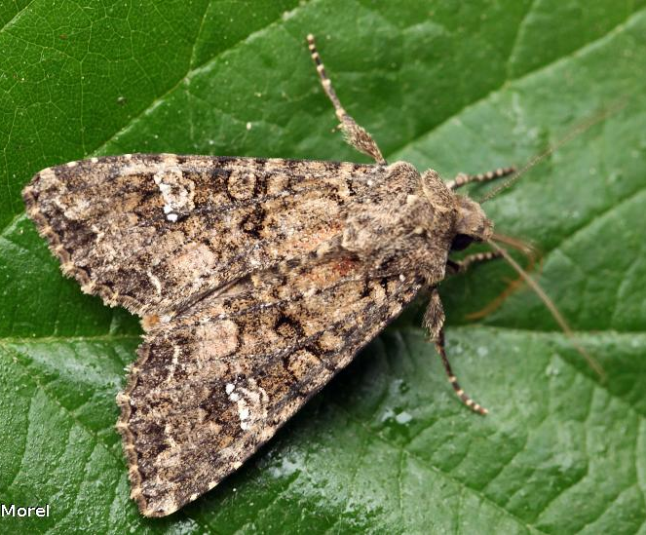
The Scaffold:
90°
Side View
Front View
A6 protein - Antennal Chemosensory system (Mamestra brassicae)
RMSD = 2.37 Å

Slide 27
3- FunFolDes:
Protocol (xml file):
1- Generate fragment database for scaffold
2- Folding of the scaffold
3- Re-design surrounding residues
4- Select best models
- RMSD & Total score
- Binding energy
- buried unsatisfied H-bonds
- Holes score / Core packing

Slide 28
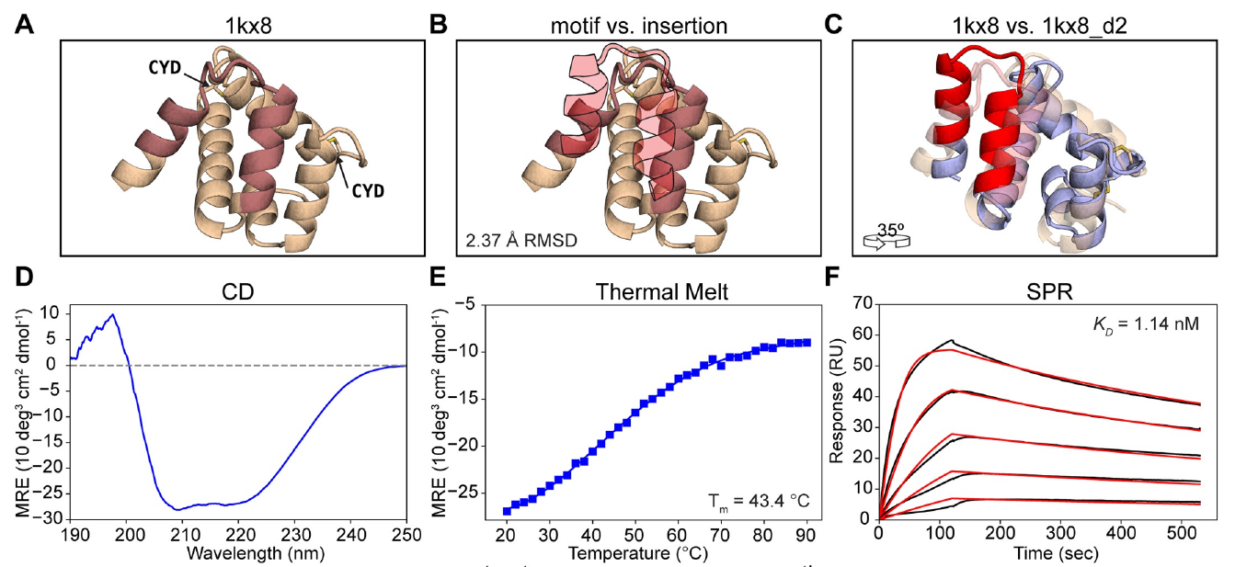
3- FunFolDes:

Slide 29
3- FunFolDes:
1- Side-Chain Grafting:
WHEN:
- RMSD < 0.5 Å
PRO:
- Minimal number of changes to the scaffold
- Higher chance of correctly folded designs
CONS:
- Limited availability of scaffolds (i.e. weird dihedral angles in the motif can not be fitted in the existing scaffolds
2- Backbone Grafting:
WHEN:
- RMSD > 0.5 Å
- Similar distance for N- and C- terms
PRO:
- Extremely versatile (different SS and lengths)
- Discontinuous epitopes
CONS:
- Might disrupt overall fold
- Unfavorable mutation in scaffold core
3- FunFolDes
(ex FFL):
WHEN:
- High RMSD
PRO:
- Extremely versatile (different SS and lengths)
- Discontinuous epitopes
- Allows ligands/DNA/RNA
- Higher rate of folded proteins in experiments
CONS:
- Computationally more expensive in time and CPU

Slide 30
RosettaRemodel
(optional)

Slide 31
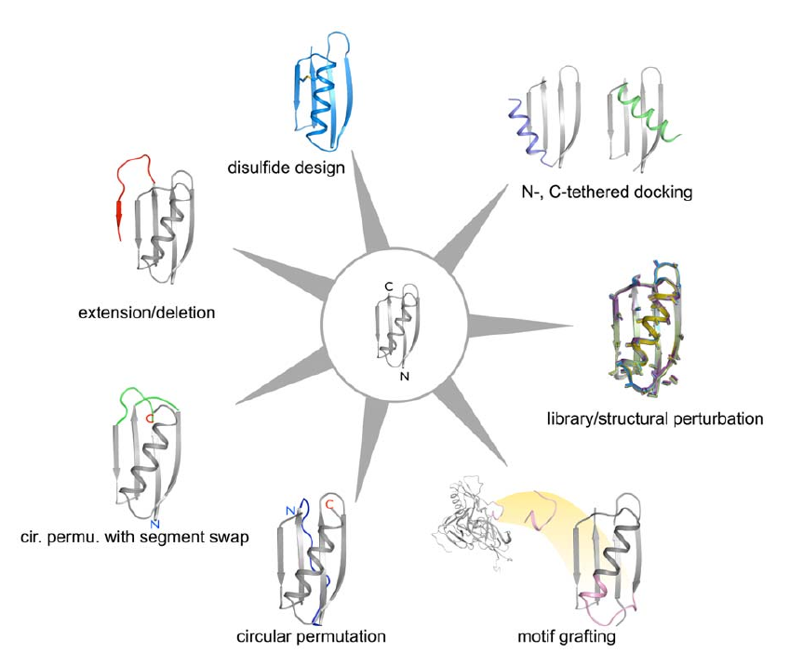
3 - RosettaRemodel:
Blueprint file:
4 I . ALLAA
5 L H
0 x H
6 N H
7 G .
9 F . PIKAA R
(Huang PS, 2011)

Slide 32
References:
Rosetta Motif Graft:
Silva, D. et al. (2016) Motif-driven Design of Protein-Protein Interactions. Methods Mol. Biol. DOI: 10.1007/978-1-4939-3569-7_17
Azoitei, M.L. et al. (2012) Computational Design of High-Affinity Epitope Scaffolds by Backbone Grafting of a Linear Epitope. J. Mol. Biol. DOI: 10.1016/j.jmb.2011.10.003
Azoitei, M.L. et al. (2011) Computation-guided backbone grafting of a discontinuous motif onto a protein scaffold. Science. DOI: 10.1126/science.1209368
Rosetta FunFolDes:
Bonet, J. et al. (2018) Rosetta FunFolDes - A general framework for the computational design of functional proteins. PLOS Computational Biology. DOI: 10.1371/journal.pcbi.1006623
Correia, B.E. et al. (2014) Proof of principle for epitope-focused vaccine design. Nature. DOI: 10.1038/nature12966
RosettaRemodel:
Huang, P.H. et al. (2011) RosettaRemodel: A generalized framework for flexible backbone protein design. PLoS One. DOI: 10.1371/journal.pone.0024109.g001

